Slide 1
B.Sc. PHYSICS · CUEA · DISSERTATION DEFENCE
Measuring the
External Field
Can we measure how hard a news article pushes on what people think?
Brian Mwai 1050555
Supervisor: Dr. Songa Mutambi
25 September 2026
each arrow is one person's opinion

Slide 2

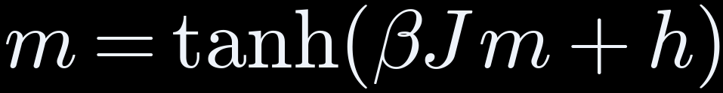
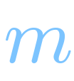



THE IDEA
Physics treats media as a push, h, on opinion. Nobody measures h
magnetisation
= average opinion, −1 to +1
coupling
= pull toward neighbours
inverse temperature
= how firmly people follow
external field
= media's push on everyone
Question: can h be measured from the content itself?
Next: what testing the tools changed →
THE IDEA
02

Slide 3



THE IDEA
Testing the tools changed five assumptions
WE PLANNED
WE FOUND
Measure the amygdala
Model predicts the brain surface only, so we used surface areas
Score as a ratio
Ratio undefined for 69 of 400, so we used a difference
Outrage stands out most
Fear stands out; outrage lifts both areas equally
Measure α, media's strength
Data can't pin α, so we derived its minimum
A manipulation detector
Word counting 0.98 vs our 0.63, so it's a measurement
All five are in the approved amendment.
Next: how the measurement works →
THE IDEA
03

Slide 4




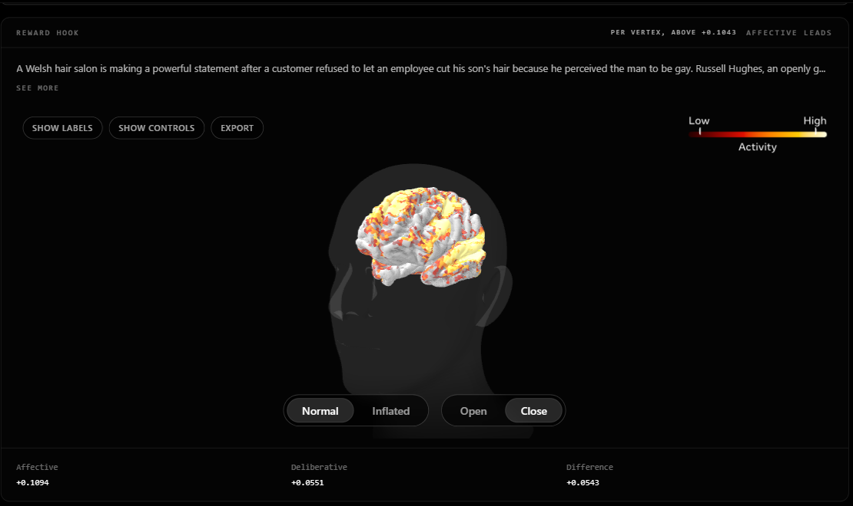

THE METHOD
How one article becomes one number
Article
400 news texts
Read aloud
text-to-speech
Word timings
timing tool
TRIBE v2
20,484 surface points
Brain map
1,030 + 851 points
THE SCORE, X
X < 0: reasoning leads
X > 0: emotion leads
Ā = average predicted activity; standardised, no unit · nobody scanned
TRY THE INSTRUMENT LIVE
monarch-4iy.pages.dev
code and data: github.com/brn-mwai/monarch
One article: emotional +0.109 − deliberate +0.055 = score +0.054, highest of 400
Next: the 400 articles →
THE METHOD
04

Slide 5
THE METHOD
400 articles, four groups, matched in length
100
Fear-activating
fake news (ISOT)
100
High outrage
partisan news (SemEval)
100
Reward hook
clickbait (Webis)
100
Neutral
medical + real news
162–167
average words per article,
lowest to highest group
0.027
smallest η² 400 articles can
detect, set before scanning
× 2
every article
scanned twice
All 400, with scores: monarch-4iy.pages.dev/corpus
Next: reading the corpus page →
THE METHOD
05

Slide 6
THE METHOD
Reading the corpus page: what each number means
COLUMN → MEANING
AVERAGE SCORE X PER GROUP
Emotional
average predicted activity, 1,030 emotional points
Fear-activating
-0.002
Deliberate
average predicted activity, 851 reasoning points
Reward hook
-0.013
Score
Emotional − Deliberate = X
High outrage
Pre-scan label
label from its source, given before any scan
-0.018
Neutral
Words
article length
-0.019
0
All 400 scores: −0.070 to +0.054, spread ΔX = 0.124
Units: standardised activity, no physical unit
All four below 0: the deliberate areas respond more in every group.
Live: monarch-4iy.pages.dev/corpus
Next: are these differences real? →
THE METHOD
06

Slide 7

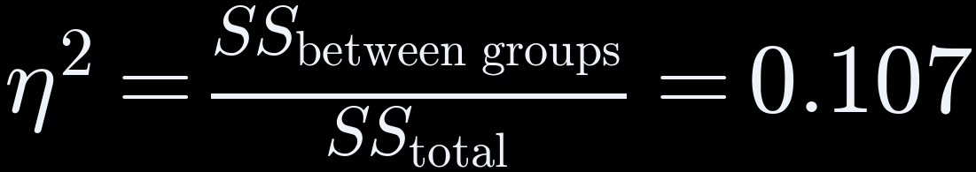
THE RESULTS
Result 1: the four groups differ, η² = 0.107
η² ON EACH RUN (one-way ANOVA), AGAINST THE SMALLEST WE COULD DETECT
10.7%
first run
0.107
second run
0.089
detectable
0.027
F = 15.779
between-group spread ÷ within-group spread
p = 1.0 × 10⁻⁹
probability of F this large if all 4 groups were equal
10.7% of the variation in the score is due to the group
SS = sum of squares. The other 89.3% is article to article.
Next: which group drives it? →
THE RESULTS
07

Slide 8
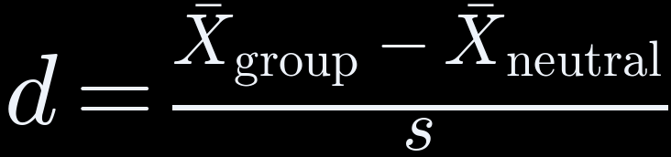
THE RESULTS
Result 2: fear drives it, d = 0.94; outrage lifts both sides equally
d = distance from neutral in standard deviations (s). Reference marks 0.2, 0.5, 0.8.
0.2
0.5
0.8
fear-activating
0.94
reward hook
0.32
high outrage
0.03
+0.61
FEAR, d per region
OUTRAGE, d per region
+0.51
+0.49
score moves:
d = 0.94
score flat:
d = 0.03
-0.10
emotional
deliberate
emotional
deliberate
Next: can we trust the scores? →
THE RESULTS
08

Slide 9

THE RESULTS
Result 3: scores repeat for groups, not single articles
0.8725
ICC: agreement between two runs
51 of 400
changed sign between runs (12.8%)
0 = none
1 = identical
● observed 51 ▌noise predicts 55 (95%: 44 to 67)
Meaning: flipped articles average |X| = 0.003 against 0.022 for the rest, so we report group averages only.
Next: does the score detect manipulation? →
THE RESULTS
09

Slide 10

THE RESULTS
Honest check: word counting beats our score, 0.98 vs 0.63
AUC = chance a random manipulative article scores above a random neutral one
our score 0.63
word counting 0.98
0.5 = coin toss
1.0 = perfect
sentiment 0.54
WHY: EACH GROUP CAME FROM ONE SOURCE
66%
of articles: words identify
the source (chance 25%)
So our score is a measurement for the physics, not a detector.
fear
ISOT fake
outrage
SemEval
reward hook
Webis
neutral
PubMed + ISOT
Next: does the brain model match real brains? →
THE RESULTS
10

Slide 11
THE RESULTS
Does the brain model match real brains? r = +0.028, p = 0.048
Public brain scans of 4 people watching Friends (Algonauts 2025). r = correlation: 0 = no match, 1 = perfect.
people vs each other,
full episode
0.152
ceiling,
2-minute clip
0.096
our model,
2-minute clip
0.028
30%
of the clip ceiling
(0.028 ÷ 0.096)
p = 0.048
against 61 time-shifted copies;
cut-off 0.05
3 bugs
found and fixed along the way
Meaning: the sign is positive (+0.028). The full-episode run is next, in Paper 3.
Next: the physics →
THE RESULTS
11

Slide 12

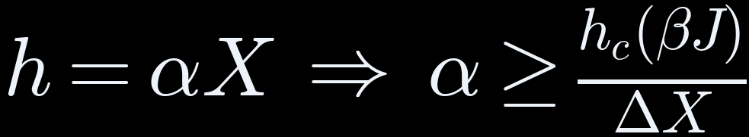




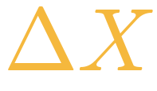
THE PHYSICS
The minimum push media would need: α ≥ 4.29
minimum α
external field = media's push on everyone
observable = our score for an article
coupling constant = push per unit of score
critical field = smallest push that flips the majority
reduced coupling = how strongly people copy each other
reduced coupling βJ →
α ≥ 0.533 ÷ 0.124 = 4.29
at βJ = 2, where the critical field is 0.533
spread = highest − lowest score = 0.124
Next: what it could be used for →
THE PHYSICS
12

Slide 13

WHAT'S NEXT
Can it analyse any content, even what children watch?
CAN DO
NOT YET
WOULD TAKE
Score video, audio and text
Model learned from adult brains
Child brain data, with ethics approval
Compare groups of content
Only news text was tested
A children's video test set
Rate content, never the viewer
1 in 8 single scores flip
Safeguards against targeting children
Short answer: technically possible, but not yet valid for children.
Next: the limits, and what fixes each →
WHAT'S NEXT
13

Slide 14
WHAT'S NEXT
Each limit points to the next study
LIMIT
NEXT STUDY
Predictions, not brain scans
Check against more real brain data
Group mixed up with source
New set: every source has every type
Brain surface only
A model that predicts deep areas
α not measured
Link scores to real opinion data (polls)
Brain check is 2 minutes
The full episode
Next: where the work goes →
WHAT'S NEXT
14

Slide 15


WHAT'S NEXT
Taking it further: where this research can go
PUBLISH
EXTEND THE SCIENCE
OPPORTUNITIES
Paper 1 → Physica A
Kenya: 2024 Finance Bill (funding)
Postgraduate research topic
Paper 2 → Physica A
Video and audio content
Neuroscience + media collaborations
Paper 3 → Imaging Neuroscience
Measure α with opinion data
Open tool, already online
Preprints first (arXiv)
Children's media, ethically
Group-level media audits
Next: conclusions →
WHAT'S NEXT
15

Slide 16
WHAT'S NEXT
Conclusions
1
0.8725
A field observable can be measured
ICC: agreement between two runs
2
0.107
It separates the four groups
η²: 10.7% of variation due to group; source mixed in
3
α ≥ 4.29
Media strength has a minimum
at βJ = 2, within the mean-field model
4
r = 0.028
The brain model matches real brains
positive; 30% of the 0.096 ceiling
Three papers follow. Paper 1 and Paper 2 → Physica A, Paper 3 → Imaging Neuroscience.
Thank you. Questions welcome.
WHAT'S NEXT
16

