Slide 1
B.Sc. PHYSICS · CUEA · DISSERTATION DEFENCE
Measuring the
External Field
Can we measure how hard a news article pushes on what people think?
Brian Mwai 1050555
Supervisor: Dr. Songa Mutambi
25 September 2026
each arrow is one person's opinion
Notes:
KEY POINT: An article pushes on what people think. Physics guesses that push; this work measures it and finds its minimum size.
SCRIPT (about 0.5 min)
Good morning. My name is Brian Mwai, and my dissertation is called Measuring the External Field. In simple words: when you read a news article, it pushes a little on what you think. My question is, can we measure how hard that push is, using only the article itself? Let me start with the idea behind it.
DEFINITIONS (if asked)
- Sociophysics: using the tools of statistical physics to model how groups of people behave.
IF ASKED "SO WHAT?"
Opinion models treat media as a push, but everyone guesses how big it is. I built a way to measure a candidate for that push from the content itself. It separates the four groups at 10.7%, with source mixed in, so I don't claim it detects manipulation. And even without knowing the exact strength, the measured spread gives a floor: media would need a coupling of at least 4.29 to flip a group with beta J = 2. That turns a guessed number into a testable one.

Slide 2
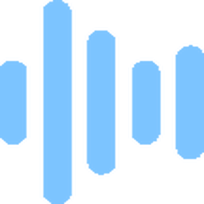
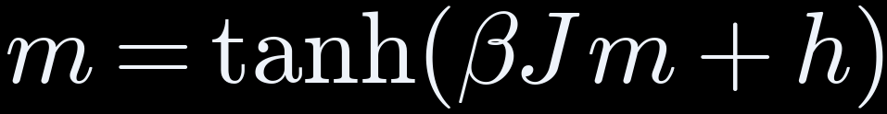
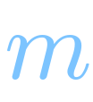



THE IDEA
Physics treats media as a push, h, on opinion. Nobody measures h
magnetisation
= average opinion, −1 to +1
coupling
= pull toward neighbours
inverse temperature
= how firmly people follow
external field
= media's push on everyone
Question: can h be measured from the content itself?
Next: what testing the tools changed →
THE IDEA
02
Notes:
KEY POINT: Physics models opinion like magnets. The media's push, h, is always guessed. Can we measure it?
SCRIPT (about 1 min)
Picture a room full of people, each for or against something. Physics has a model for this. It was built for magnets, where tiny arrows line up with their neighbours; here each arrow is a person. m is the mood of the room: minus one means everyone is against, plus one means everyone is for, zero means evenly split. J is how much people copy those around them. Beta is how seriously they take that pressure instead of deciding at random. And h is the outside push, the media, pushing everyone the same way at once. In every study I found, researchers guess h. Nobody measures it. So I asked: can we measure h from the article itself? When I tested my tools, five parts of my plan had to change.
WHAT THE NUMBERS MEAN
- m = the mood of the room: -1 all against, 0 split, +1 all for
- h = the media's push; 'field' here is general, not magnetic or electric
DEFINITIONS (if asked)
- Ising model: a model of magnets where each spin points up or down and prefers to match its neighbours; used here for two-sided opinions.
- Mean field: each person feels the average of the whole group, not particular neighbours; it makes the maths solvable.
- tanh: a smooth S-shaped function that keeps m between -1 and +1.
IF ASKED
Q: What does beta J mean, and why must a be negative?
A: Beta J is how strongly people copy each other. When it's above 1, the room settles into two stable opinions, for or against; in the maths that shows up as a negative coefficient, a. Then a push is needed to flip from one to the other. Alpha itself is positive.

Slide 3



THE IDEA
Testing the tools changed five assumptions
WE PLANNED
WE FOUND
Measure the amygdala
Model predicts the brain surface only, so we used surface areas
Score as a ratio
Ratio undefined for 69 of 400, so we used a difference
Outrage stands out most
Fear stands out; outrage lifts both areas equally
Measure α, media's strength
Data can't pin α, so we derived its minimum
A manipulation detector
Word counting 0.98 vs our 0.63, so it's a measurement
All five are in the approved amendment.
Next: how the measurement works →
THE IDEA
03
Notes:
KEY POINT: Testing the tools changed five parts of the plan, all approved.
SCRIPT (about 1 min)
One: I planned to look at the amygdala, a fear centre deep in the brain, but the model only sees the brain's outer surface. Two: I planned to divide one brain area by another, but that broke on 69 of the 400 articles, a bit like dividing by zero, so I subtracted instead, which works on all 400. Three: I expected outrage to stand out, and fear did instead. Four: I planned to measure how strong the media's push is; the data couldn't, so I worked out the smallest it could be. Five: plain word counting sorted the articles better than my score, 98 against 63 out of 100, so my score is a measuring tool, not a fake-news detector. My supervisor approved all five. Now, how the measuring works.
WHAT THE NUMBERS MEAN
- 69 of 400: articles where dividing failed (say 69, not 49)
- 98 vs 63 out of 100: how often word counting vs my score ranks a manipulative article above a neutral one; 50 = coin toss
DEFINITIONS (if asked)
- Amygdala: a small structure deep in the brain linked to fear.
- Cortex: the brain's outer surface, where the model predicts.
- Amendment: the approved change to the proposal's scope and title.
IF ASKED
Q: Why no amygdala?
A: The model only predicts the brain's outer surface. The amygdala is deep inside, so I make no claim about it.
Q: Why a difference, not a ratio?
A: The model's numbers are often near zero or negative, so dividing by them breaks, like dividing by zero. It failed on 69 of 400 articles. Subtracting works for all 400.

Slide 4




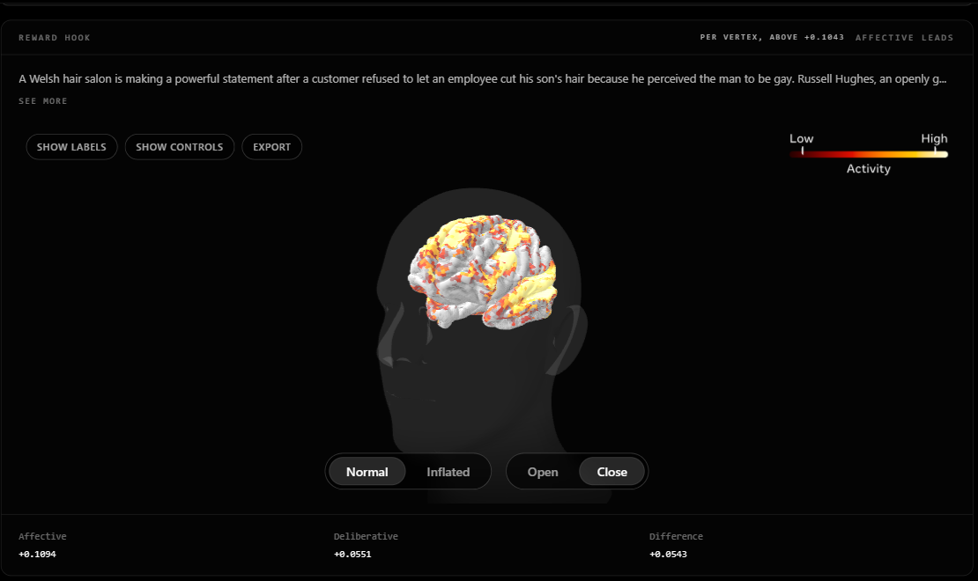
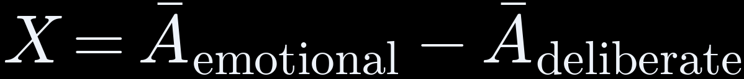
THE METHOD
How one article becomes one number
Article
400 news texts
Read aloud
text-to-speech
Word timings
timing tool
TRIBE v2
20,484 surface points
Brain map
1,030 + 851 points
THE SCORE, X
X < 0: reasoning leads
X > 0: emotion leads
Ā = average predicted activity; standardised, no unit · nobody scanned
TRY THE INSTRUMENT LIVE
monarch-4iy.pages.dev
code and data: github.com/brn-mwai/monarch
One article: emotional +0.109 − deliberate +0.055 = score +0.054, highest of 400
Next: the 400 articles →
THE METHOD
04
Notes:
KEY POINT: Score = emotion reaction minus thinking reaction, predicted by a brain model. Nobody was scanned.
SCRIPT (about 1.5 min)
Here is how one article becomes one number. A computer voice reads it aloud, because the brain model learned from people watching and listening. A tool notes when each word is spoken. Then a brain model from Meta, called TRIBE, predicts how a typical adult brain would react at 20,484 spots on the brain's surface. From a standard brain map I take 1,030 spots linked to emotion and 851 linked to careful thinking. My score is simple: the emotion reaction minus the thinking reaction. Above zero, emotion reacts more. Below zero, thinking reacts more. Nobody was put in a scanner; these are predictions. This article gets 0.109 for emotion and 0.055 for thinking, so its score is plus 0.054, the highest of all 400. So which 400 articles?
WHAT THE NUMBERS MEAN
- 20,484 = spots on the brain's surface the model predicts
- 1,030 emotion spots, 851 thinking spots
- 0.109 - 0.055 = +0.054: emotion reacts a bit more than thinking
- No unit: like marks on a ruler without cm; only comparisons matter
DEFINITIONS (if asked)
- TRIBE v2: Meta's published brain model: it predicts fMRI responses from text, audio and video.
- fMRI: brain scanning that tracks blood flow as a stand-in for activity.
- fsaverage5: a standard brain surface with 20,484 points.
- Glasser 2016 atlas: a standard map dividing the cortex into named areas.
- Standardised activity: the model's output, scaled so it has no physical unit.
IF ASKED
Q: Was anyone scanned? Is it reading minds?
A: No. Nobody was scanned. The scores are predictions of how a typical adult brain reacts. It rates the content, never a person.
Q: Why read the articles aloud?
A: The brain model learned from people watching and listening, so it needs speech and the timing of each word.
Q: Is it okay to use Meta's model?
A: Yes, for research. Its licence allows non-commercial use, I cite it throughout, and this project makes no money.

Slide 5
THE METHOD
400 articles, four groups, matched in length
100
Fear-activating
fake news (ISOT)
100
High outrage
partisan news (SemEval)
100
Reward hook
clickbait (Webis)
100
Neutral
medical + real news
162–167
average words per article,
lowest to highest group
0.027
smallest η² 400 articles can
detect, set before scanning
× 2
every article
scanned twice
All 400, with scores: monarch-4iy.pages.dev/corpus
Next: reading the corpus page →
THE METHOD
05
Notes:
KEY POINT: 400 articles, 4 groups of 100, same length, each run twice.
SCRIPT (about 1 min)
I took 400 articles from four public collections, 100 each: fake news written to scare, angry political news, clickbait like 'you won't believe what happened next', and calm neutral writing, medical summaries and real news. All four groups average between 162 and 167 words, so no group wins just by being longer. Before starting, I worked out that 400 articles is enough to spot a difference as small as 0.027. And I ran every article twice, to check the results repeat. All 400 are online, so here is how to read that page.
WHAT THE NUMBERS MEAN
- 162 to 167 = average words per group: same length
- 0.027 = the smallest difference 400 articles can reliably spot (2.7% explained by group)
- x 2 = every article run twice
DEFINITIONS (if asked)
- Power analysis: working out in advance how big a study must be to detect an effect of a given size.
IF ASKED
Q: Why only 400 articles?
A: I worked out beforehand that 400 is enough to spot a difference as small as 2.7 percent. Each article takes about 70 seconds on the computer, and I ran them all twice.
Q: Why didn't you use Kenyan media?
A: Cost. The 400 articles, run twice, used about 16 hours of free computer time. Kenyan articles would also have to be labelled by hand, by paid people, because no labelled set exists. It is the first extension once there is funding.

Slide 6
THE METHOD
Reading the corpus page: what each number means
COLUMN → MEANING
AVERAGE SCORE X PER GROUP
Emotional
average predicted activity, 1,030 emotional points
Fear-activating
-0.002
Deliberate
average predicted activity, 851 reasoning points
Reward hook
-0.013
Score
Emotional − Deliberate = X
High outrage
Pre-scan label
label from its source, given before any scan
-0.018
Neutral
Words
article length
-0.019
0
All 400 scores: −0.070 to +0.054, spread ΔX = 0.124
Units: standardised activity, no physical unit
All four below 0: the deliberate areas respond more in every group.
Live: monarch-4iy.pages.dev/corpus
Next: are these differences real? →
THE METHOD
06
Notes:
KEY POINT: Every column explained. All four groups sit below zero: thinking reacts more than emotion.
SCRIPT (about 1.5 min)
On the corpus page, every article is a row. Emotional is how strongly the emotion areas react. Deliberate is how strongly the thinking areas react. Score is emotional minus deliberate. Pre-scan label is what the original collection already called the article, before I touched it. Scores run from minus 0.070 to plus 0.054, so the gap from lowest to highest is 0.124. Remember that number; it comes back in the physics. On the right are the group averages. All four are below zero, so for every kind of article the thinking areas react more than the emotion areas. What differs is how far below zero. Fear is closest to zero, and neutral is furthest. Let me show you the live page. [SHOW CORPUS] So, are these differences real, or just chance?
WHAT THE NUMBERS MEAN
- -0.070 to +0.054 = lowest and highest score of the 400
- 0.124 = gap from lowest to highest; used in the physics
- Group averages: fear -0.002, clickbait -0.013, outrage -0.018, neutral -0.019
- Below zero = thinking areas react more than emotion areas
DEFINITIONS (if asked)
- Pre-scan label: the label an article carried in its source collection before anything was scanned.
IF ASKED
Q: Is the difference between groups just writing style?
A: It can't be put down to style alone, because each group came from one source, and the words reveal the source 66 times out of 100. A new set where every source has every type would separate the two.

Slide 7

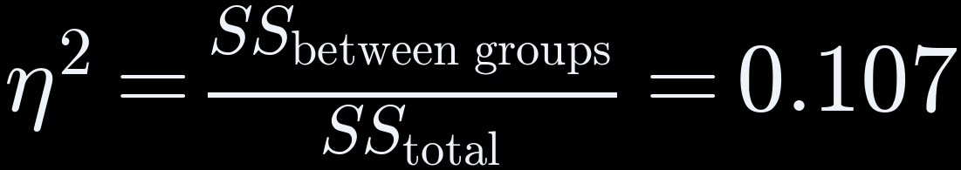
THE RESULTS
Result 1: the four groups differ, η² = 0.107
η² ON EACH RUN (one-way ANOVA), AGAINST THE SMALLEST WE COULD DETECT
10.7%
first run
0.107
second run
0.089
detectable
0.027
F = 15.779
between-group spread ÷ within-group spread
p = 1.0 × 10⁻⁹
probability of F this large if all 4 groups were equal
10.7% of the variation in the score is due to the group
SS = sum of squares. The other 89.3% is article to article.
Next: which group drives it? →
THE RESULTS
07
Notes:
KEY POINT: The groups really differ: group explains 10.7%, and chance is about 1 in a billion.
SCRIPT (about 1 min)
To check, I used a standard test that compares groups, called a one-way ANOVA. It answers two plain questions. First: how much of the difference between articles comes from which group they are in? 10.7 percent. So the group matters, but about 89 percent comes from each individual article. Second: could this be pure chance? If the four groups were really the same, a result this strong would turn up about once in a billion tries. So chance is very unlikely. And running everything a second time gave 8.9 percent, close to the first. So the groups really differ. Which group makes the difference?
WHAT THE NUMBERS MEAN
- 0.107 = 10.7% of the differences between articles come from their group; 89.3% from the article itself
- p = 1.0 x 10^-9 = if the groups were the same, this result would happen about once in a billion tries
- 0.089 = the second run: 8.9%
- F = 15.779 = gap between groups is about 16 times the gap you'd expect from chance
DEFINITIONS (if asked)
- One-way ANOVA: compares the averages of several groups defined by one factor.
- F: spread between group averages divided by spread within groups.
- eta squared: between-group sum of squares over total sum of squares; a share from 0 to 1.
- p-value: the probability of a result at least this large if there were no real difference.
IF ASKED
Q: What is eta squared, physically?
A: It isn't a physical quantity. It's a share between 0 and 1: how much of the total difference between articles is explained by their group. 0.107 means 10.7 percent.
Q: Why a one-way ANOVA?
A: Because there is one thing sorting the articles, the group, and one number per article, the score. That's exactly what a one-way ANOVA tests. I also compared each group with neutral separately.

Slide 8
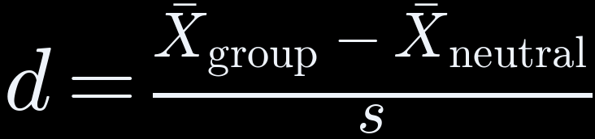
THE RESULTS
Result 2: fear drives it, d = 0.94; outrage lifts both sides equally
d = distance from neutral in standard deviations (s). Reference marks 0.2, 0.5, 0.8.
0.2
0.5
0.8
fear-activating
0.94
reward hook
0.32
high outrage
0.03
+0.61
FEAR, d per region
OUTRAGE, d per region
+0.51
+0.49
score moves:
d = 0.94
score flat:
d = 0.03
-0.10
emotional
deliberate
emotional
deliberate
Next: can we trust the scores? →
THE RESULTS
08
Notes:
KEY POINT: Fear moves the score (0.94). Outrage raises emotion and thinking equally, so its score stays flat (0.03).
SCRIPT (about 1 min)
Fear does. Here I measure how far each group sits from the neutral articles, counted in typical spreads. The usual guide marks are 0.2, 0.5 and 0.8. Fear sits 0.94 away, past the highest mark. Clickbait sits 0.32 away. Outrage only 0.03, almost on top of neutral. Why is outrage so close? Look at the two small charts. Fear switches on the emotion areas, plus 0.61, and not the thinking areas, minus 0.10, so the gap grows and the score moves. Outrage switches on both, plus 0.51 and plus 0.49. Both rise together, so the gap, and the score, stay flat. Outrage does affect the brain, just on both sides equally. Next: can we trust these scores?
WHAT THE NUMBERS MEAN
- d = distance from neutral, in typical spreads (standard deviations)
- Fear 0.94, clickbait 0.32, outrage 0.03; guide marks 0.2, 0.5, 0.8
- Fear: emotion +0.61, thinking -0.10, so the gap grows
- Outrage: emotion +0.51, thinking +0.49, so the gap stays near 0
DEFINITIONS (if asked)
- Cohen's d: difference between two group averages divided by the typical spread (standard deviation).

Slide 9

THE RESULTS
Result 3: scores repeat for groups, not single articles
0.8725
ICC: agreement between two runs
51 of 400
changed sign between runs (12.8%)
0 = none
1 = identical
● observed 51 ▌noise predicts 55 (95%: 44 to 67)
Meaning: flipped articles average |X| = 0.003 against 0.022 for the rest, so we report group averages only.
Next: does the score detect manipulation? →
THE RESULTS
09
Notes:
KEY POINT: Two runs agree at 0.87 out of 1. The 51 flips are what noise predicts, so judge groups, never one article.
SCRIPT (about 1 min)
I ran all 400 articles twice. The two runs agree at 0.87, on a scale where 1 means identical and 0 means no agreement at all. But 51 articles flipped: positive one time, negative the other. Is that a problem? If only small random noise were at work, we'd expect about 55 flips, anywhere from 44 to 67. We saw 51, inside that range. And the flipped articles all sit very close to zero, like a coin balanced on its edge, where a tiny wobble tips it. So I trust group averages, and I never judge a single article. Now the most important honest check.
WHAT THE NUMBERS MEAN
- 0.8725 = agreement between the two runs; 1 = identical, 0 = none
- 51 of 400 = 1 in 8 articles flipped sign
- 55 (44 to 67) = flips that random noise alone would cause
- Flipped articles average 0.003 from zero; the rest 0.022
DEFINITIONS (if asked)
- ICC: intraclass correlation: agreement between repeated measurements of the same items; 1 is identical.
- Sign reversal: a score positive on one run and negative on the other.

Slide 10

THE RESULTS
Honest check: word counting beats our score, 0.98 vs 0.63
AUC = chance a random manipulative article scores above a random neutral one
our score 0.63
word counting 0.98
0.5 = coin toss
1.0 = perfect
sentiment 0.54
WHY: EACH GROUP CAME FROM ONE SOURCE
66%
of articles: words identify
the source (chance 25%)
So our score is a measurement for the physics, not a detector.
fear
ISOT fake
outrage
SemEval
reward hook
Webis
neutral
PubMed + ISOT
Next: does the brain model match real brains? →
THE RESULTS
10
Notes:
KEY POINT: Word counting wins, 98 vs 63 out of 100, because source is mixed in. The score measures, it doesn't detect.
SCRIPT (about 1 min)
Can my score tell manipulative articles from neutral ones? The test is simple: pick one manipulative and one neutral article at random. How often does the method rank the manipulative one higher? 50 out of 100 is a coin toss, and 100 is perfect. A standard sentiment tool gets 54. My score gets 63. Plain word counting gets 98. Why is word counting so good? Each group came from a different source, and the words give the source away: from the words alone you can tell the source 66 times out of 100, where guessing gets 25. So the difference between groups can't be put down to writing style alone, because the source is mixed in. That's why my score is a measurement for the physics, not a fake-news detector. Next: does the brain model match real brains?
WHAT THE NUMBERS MEAN
- AUC = out of 100 random pairs, how often the manipulative article ranks higher
- 54 sentiment tool, 63 my score, 98 word counting; 50 = coin toss
- 66% = words reveal the source; guessing = 25%
DEFINITIONS (if asked)
- AUC: area under the ROC curve: chance a random manipulative article outscores a random neutral one.
- TF-IDF: word counting that weights words by how distinctive they are.
- VADER: a standard sentiment tool.
- Confound: a second factor, here source, that moves with the one studied.
IF ASKED
Q: If word counting does better, why not use that?
A: Word counting mostly learns where an article came from: it names the source 66 times out of 100. My score is meant to be the media push in the physics model, not a detector. I include the comparison to be honest.

Slide 11
THE RESULTS
Does the brain model match real brains? r = +0.028, p = 0.048
Public brain scans of 4 people watching Friends (Algonauts 2025). r = correlation: 0 = no match, 1 = perfect.
people vs each other,
full episode
0.152
ceiling,
2-minute clip
0.096
our model,
2-minute clip
0.028
30%
of the clip ceiling
(0.028 ÷ 0.096)
p = 0.048
against 61 time-shifted copies;
cut-off 0.05
3 bugs
found and fixed along the way
Meaning: the sign is positive (+0.028). The full-episode run is next, in Paper 3.
Next: the physics →
THE RESULTS
11
Notes:
KEY POINT: The brain model moves with real brains: 30% of the best possible.
SCRIPT (about 1 min)
I tested the model on real brain scans of four people watching the TV show Friends. r measures how closely two signals move together: 0 is no match, 1 is perfect. Even real people don't match each other perfectly: over the full episode they match at 0.152, so that's the best any model could hope for. On the 2-minute clip I tested, the best possible is 0.096, and the model reaches 0.028, about 30 percent of the best possible. The p-value is 0.048, just under the usual 5 percent line. And it's positive: the model moves in the same direction as real brains, not the opposite, as an outside audit had claimed. I also found and fixed three bugs along the way. The full-episode test is next. Now the physics.
WHAT THE NUMBERS MEAN
- r = how closely two signals move together; 0 none, 1 perfect
- 0.152 = real people vs each other: the best possible
- 0.096 best possible on the clip; the model 0.028 = 30% of it
- p = 0.048 = about 5 in 100 chance of a match this good by luck alone
DEFINITIONS (if asked)
- Noise ceiling: how well real brains predict each other; the best any model can do.
- r: Pearson correlation: how closely two signals rise and fall together.
- Circular-shift test: shift one signal in time 61 times to see how often chance gives a match this good.

Slide 12

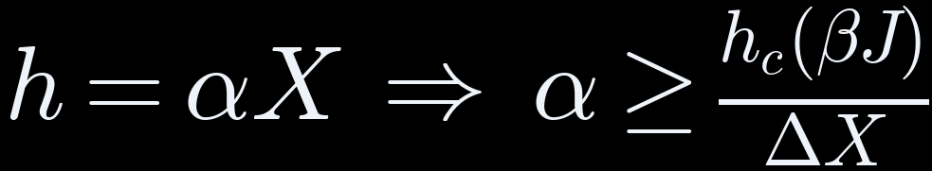




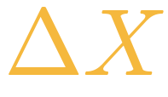
THE PHYSICS
The minimum push media would need: α ≥ 4.29
minimum α
external field = media's push on everyone
observable = our score for an article
coupling constant = push per unit of score
critical field = smallest push that flips the majority
reduced coupling = how strongly people copy each other
reduced coupling βJ →
α ≥ 0.533 ÷ 0.124 = 4.29
at βJ = 2, where the critical field is 0.533
spread = highest − lowest score = 0.124
Next: what it could be used for →
THE PHYSICS
12
Notes:
KEY POINT: Media would need a strength of at least 4.29 to flip the room.
SCRIPT (about 1.5 min)
Back to the room of people. The media's push, h, equals my score times a number called alpha: how much push you get per unit of score. I can't measure alpha, so I asked a different question: how big would alpha have to be for the media to flip the majority of the room? That depends on how much people copy each other, beta J. The more they copy each other, the more stubborn the room, and the bigger the push needed. At beta J of 2, the push needed is 0.533. My scores only span 0.124. So alpha must be at least 0.533 divided by 0.124, which is 4.29. In plain words: anyone claiming these articles flip opinion must assume a media strength of at least 4.29, or the model says it can't happen. It's a minimum bar, not a claim that media does flip opinion. So what could this be used for?
WHAT THE NUMBERS MEAN
- alpha = how much push per unit of score
- beta J = 2: how much people copy each other; say 'beta J', not 'beta'
- 0.533 = push needed to flip the room at beta J = 2
- 0.533 / 0.124 = 4.29 = the minimum alpha
DEFINITIONS (if asked)
- Critical field: the smallest field that flips the majority.
- Lower bound: a minimum: alpha can't be smaller than this.
IF ASKED "SO WHAT?"
Opinion models treat media as a push, but everyone guesses how big it is. I built a way to measure a candidate for that push from the content itself. It separates the four groups at 10.7%, with source mixed in, so I don't claim it detects manipulation. And even without knowing the exact strength, the measured spread gives a floor: media would need a coupling of at least 4.29 to flip a group with beta J = 2. That turns a guessed number into a testable one.
IF ASKED
Q: Why is this physics?
A: The opinion model is the same maths physics uses for magnets lining up. My part is measuring the push and working out its minimum size.
Q: What does alpha >= 4.29 mean in practice?
A: It's a minimum bar. Anyone who claims these articles flip a group's opinion, where people copy each other at strength 2, must use a media strength of at least 4.29, or the model says it can't happen.
Q: What does beta J mean, and why must a be negative?
A: Beta J is how strongly people copy each other. When it's above 1, the room settles into two stable opinions, for or against; in the maths that shows up as a negative coefficient, a. Then a push is needed to flip from one to the other. Alpha itself is positive.

Slide 13

WHAT'S NEXT
Can it analyse any content, even what children watch?
CAN DO
NOT YET
WOULD TAKE
Score video, audio and text
Model learned from adult brains
Child brain data, with ethics approval
Compare groups of content
Only news text was tested
A children's video test set
Rate content, never the viewer
1 in 8 single scores flip
Safeguards against targeting children
Short answer: technically possible, but not yet valid for children.
Next: the limits, and what fixes each →
WHAT'S NEXT
13
Notes:
KEY POINT: It could score children's TV, but it isn't valid for children yet.
SCRIPT (about 1 min)
When I presented my proposal, I was asked: could this analyse anything, even children's TV? The tool takes video and audio, so it could score a cartoon. But the brain model learned from adults, so it can't tell us how a child reacts. I only tested news text. And about 1 in 8 single scores flip between runs, so one show on its own isn't reliable. For children we'd first need children's brain data, with ethics approval. Each limit like this points to a next study.
WHAT THE NUMBERS MEAN
- 1 in 8 = 51 of 400 single scores flip between runs
DEFINITIONS (if asked)
- Ethics approval: formal permission from a review board, required for research with children.
IF ASKED
Q: Can this analyse any content, even what children watch?
A: It can score video and audio. But the model learned from adult brains, so it can't say how a child reacts, and I only tested news. It would need children's brain data and ethics approval first.
Q: Could a parent or a regulator use it to rate one show?
A: Not yet. About 1 in 8 single scores flip between runs, so one score isn't reliable. It is for comparing groups of content.
Q: What would it take for children's media?
A: Children's brain scans with ethics approval and parental consent, a set of children's videos, and content where source and type are mixed.
Q: What about ethics?
A: I collected no data from any person. The brain model was built by Meta from public scans of volunteers who consented, and I used only public articles and public scans. The tool rates content, never a viewer.

Slide 14
WHAT'S NEXT
Each limit points to the next study
LIMIT
NEXT STUDY
Predictions, not brain scans
Check against more real brain data
Group mixed up with source
New set: every source has every type
Brain surface only
A model that predicts deep areas
α not measured
Link scores to real opinion data (polls)
Brain check is 2 minutes
The full episode
Next: where the work goes →
WHAT'S NEXT
14
Notes:
KEY POINT: Every limit has a fix.
SCRIPT (about 0.5 min)
Five limits, each with its fix. These are predictions, so check them against more real brain scans. Group and source are mixed, so build a new set where every source has every type. The model misses deep brain areas, so use a model that sees them. Alpha isn't measured, so compare scores with real opinion polls. And the brain test was 2 minutes, so run the full episode. That leads to where the work goes next.
WHAT THE NUMBERS MEAN
- 5 limits, each stated in the thesis
DEFINITIONS (if asked)
- Crossed design: every source contributes every type of article.

Slide 15


WHAT'S NEXT
Taking it further: where this research can go
PUBLISH
EXTEND THE SCIENCE
OPPORTUNITIES
Paper 1 → Physica A
Kenya: 2024 Finance Bill (funding)
Postgraduate research topic
Paper 2 → Physica A
Video and audio content
Neuroscience + media collaborations
Paper 3 → Imaging Neuroscience
Measure α with opinion data
Open tool, already online
Preprints first (arXiv)
Children's media, ethically
Group-level media audits
Next: conclusions →
WHAT'S NEXT
15
Notes:
KEY POINT: Publish, extend to Kenya and video, and further study.
SCRIPT (about 0.75 min)
Three directions. Publish: three papers, shared publicly first. Extend: a Kenyan case, news coverage of the 2024 Finance Bill, plus video and audio, and measuring alpha against opinion polls. And opportunities: further study, work with brain and media researchers, and a tool that is already online. To close, four conclusions.
WHAT THE NUMBERS MEAN
- Kenya case needs GPU funding
DEFINITIONS (if asked)
- Preprint: a paper shared publicly before peer review, e.g. on arXiv.
IF ASKED
Q: Could someone use it to make content more manipulative?
A: That's a real risk for any measure like this. That's why it only reports group results, for research, and the model's licence forbids commercial use.
Q: Why didn't you use Kenyan media?
A: Cost. The 400 articles, run twice, used about 16 hours of free computer time. Kenyan articles would also have to be labelled by hand, by paid people, because no labelled set exists. It is the first extension once there is funding.

Slide 16
WHAT'S NEXT
Conclusions
1
0.8725
A field observable can be measured
ICC: agreement between two runs
2
0.107
It separates the four groups
η²: 10.7% of variation due to group; source mixed in
3
α ≥ 4.29
Media strength has a minimum
at βJ = 2, within the mean-field model
4
r = 0.028
The brain model matches real brains
positive; 30% of the 0.096 ceiling
Three papers follow. Paper 1 and Paper 2 → Physica A, Paper 3 → Imaging Neuroscience.
Thank you. Questions welcome.
WHAT'S NEXT
16
Notes:
KEY POINT: Four take-aways, then questions.
SCRIPT (about 1 min)
Four things to take away. One: you can measure a push from an article's content, and it repeats: the two runs agree at 0.87 out of 1. Two: it tells the four kinds of articles apart; the group explains 10.7 percent of the differences, with the source mixed in. Three: we can't yet measure media's strength, but we know its minimum: 4.29 when people copy each other at strength 2. Four: the brain model moves with real brains, at 30 percent of the best possible. Three papers come from this work. Thank you, and I'm happy to take questions.
WHAT THE NUMBERS MEAN
- 0.87 = the two runs agree
- 10.7% = explained by group
- 4.29 = minimum media strength at beta J = 2
- 30% = the model's match vs the best possible
IF ASKED "SO WHAT?"
Opinion models treat media as a push, but everyone guesses how big it is. I built a way to measure a candidate for that push from the content itself. It separates the four groups at 10.7%, with source mixed in, so I don't claim it detects manipulation. And even without knowing the exact strength, the measured spread gives a floor: media would need a coupling of at least 4.29 to flip a group with beta J = 2. That turns a guessed number into a testable one.
IF ASKED
Q: Was anyone scanned? Is it reading minds?
A: No. Nobody was scanned. The scores are predictions of how a typical adult brain reacts. It rates the content, never a person.
Q: If word counting does better, why not use that?
A: Word counting mostly learns where an article came from: it names the source 66 times out of 100. My score is meant to be the media push in the physics model, not a detector. I include the comparison to be honest.
Q: What about ethics?
A: I collected no data from any person. The brain model was built by Meta from public scans of volunteers who consented, and I used only public articles and public scans. The tool rates content, never a viewer.

