Slide 1
B.Sc. PHYSICS · DEPARTMENT OF NATURAL SCIENCES · CUEA
Measuring the External Field
A cortical-proxy content observable and the mean-field bound on media-driven opinion change
Brian Mwai 1050555
3 September 2026
Supervisor: Dr. Songa Mutambi

Slide 2

Statistical physics has always modelled media as a field pushing on a population of coupled opinions.
That field is assumed. It is not measured.
This project measures one from content itself, applies it to 400 articles, and derives how strong the coupling would have to be for a spread that size to move a population at all.

Slide 3

01
The problem
What is missing from the way media is modelled.

Slide 4
Two articles can report one event and leave readers in different states
WIRE REPORT
Federal Reserve holds interest rates steady, citing a stable inflation outlook.
THE SAME EVENT
FED DESTROYS AMERICA. Your savings are GONE. The collapse they hid from you!
informs
provokes
Readers notice the difference and cannot quantify it. The platforms distributing both have no objective measure of which they are amplifying.
The problem
4

Slide 5

Existing tools measure the words; none measures the predicted response
SENTIMENT, READABILITY, STANCE
characterise the words
THIS PROJECT
estimate the response
A released neural encoder predicts cortical activity from the content, and the measurement is taken on that prediction.
The instrument is a thermometer for one property of media. The thesis is an account of building it, running it, and stating what its readings support.
The problem
5

Slide 6

02
The instrument
From a passage of text to a single number.

Slide 7
A five-stage cascade turns one article into one number
Text
one article
Speech
synthesised
Timings
per word
Embeddings
text + audio
TRIBE v2
encoder
20,484
vertices
Affective
1,030 vertices
Deliberative
851 vertices
One number
per article
−
=
Encoder: TRIBE v2, d'Ascoli et al., Meta FAIR (2025), arXiv:2507.22229. Regions from HCP MMP1.0, Glasser et al. (2016). Instrument at monarch-4iy.pages.dev
The instrument
7

Slide 8
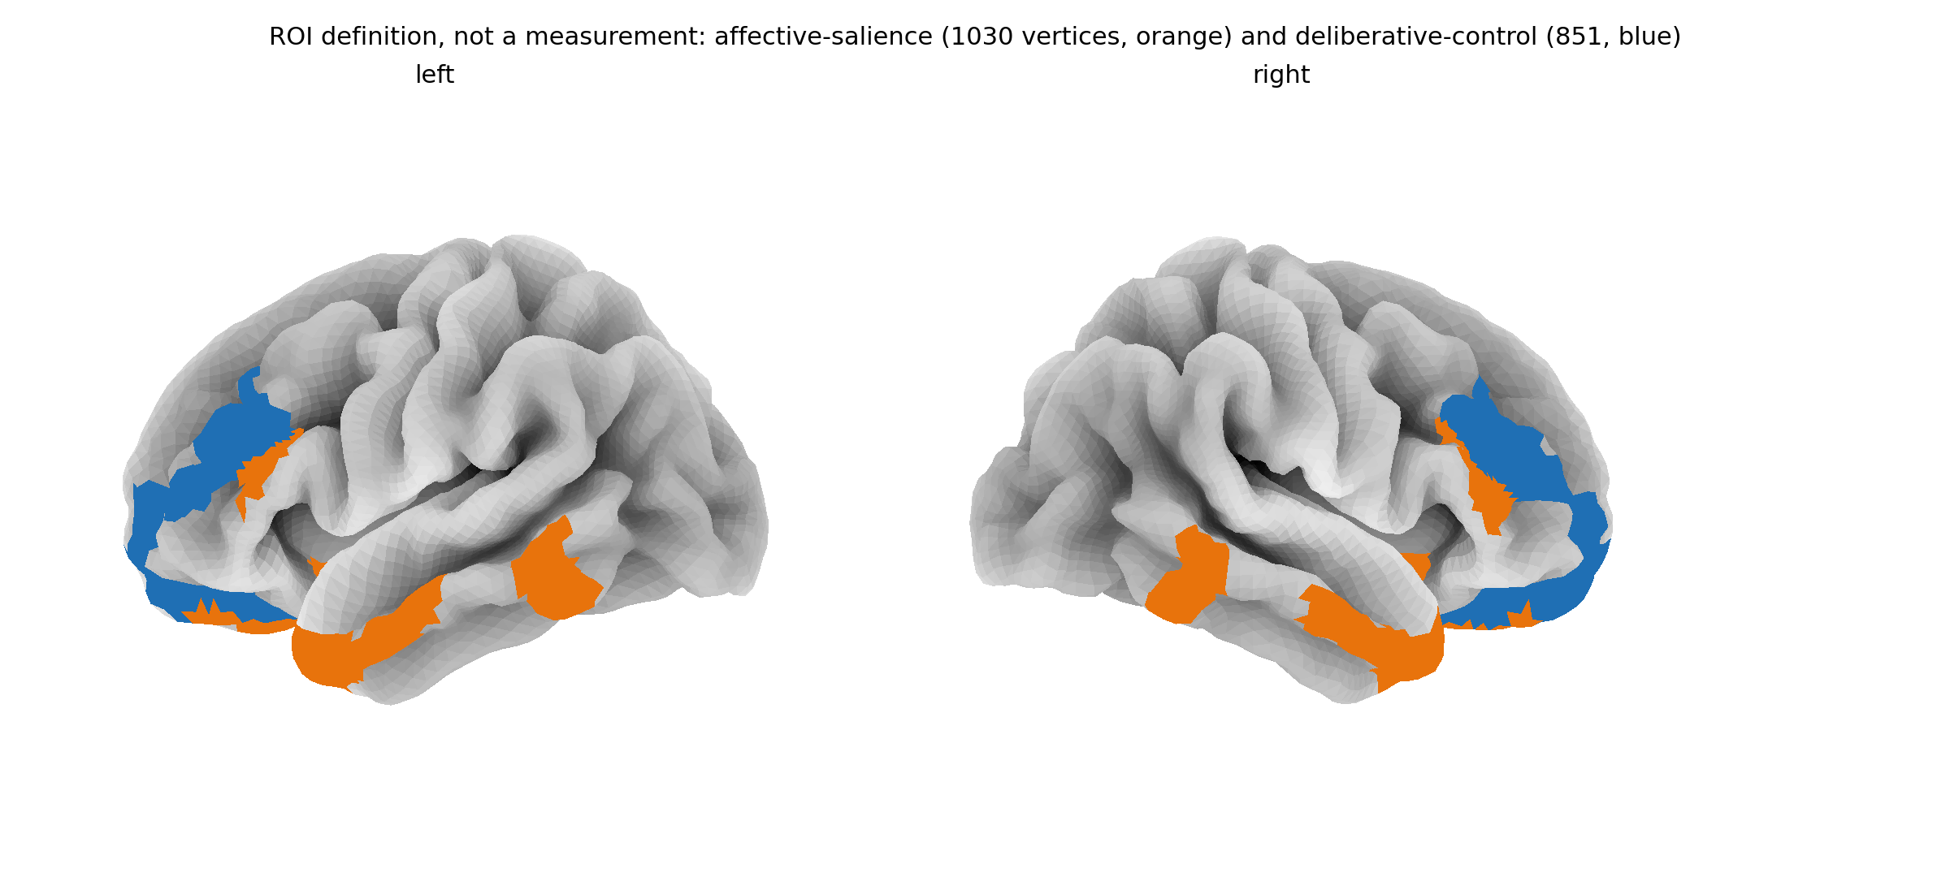
The index contrasts two cortical networks, 1,030 vertices against 851
Affective salience in orange, deliberative control in blue. Resolved once into vertex index sets and cached, so all 400 items are averaged over identical regions.
Regions defined on HCP MMP1.0 (Glasser et al., 2016); surfaces are fsaverage5.
The instrument
8

Slide 9

The observable is a signed difference, defined for every item
NAA_{signed} = A_{affective} − A_{deliberative}
reasoning leads
emotion leads
0
A cortical proxy: it rates content, never a person, and is never called the amygdala.
The instrument
9

Slide 10

Inspecting the checkpoint changed what the project could claim
01
Cortical only
Output is (T, 20484). There is no subcortical head.
The amygdala is not predicted, so the proposal's central equation cannot be computed.
02
Averaged over subjects
The loader forces average_subjects.
It predicts a typical viewer. Whether that carries signal is the third paper's question.
03
Standardised output
Region means sit near zero, so a ratio sign-flips or explodes.
Undefined for 69 of 400 items. Replaced by the difference.
Each was found by testing the artifact, and each is stated in the abstract rather than the limitations.
The instrument
10

Slide 11

03
The measurement
400 articles, scanned twice.

Slide 12

The corpus is length-matched and was powered before the scan
100
fear-activating
ISOT-fake
100
high outrage
SemEval-2019 T4
100
reward hook
Webis-Clickbait-17
100
neutral informational
PubMed + ISOT-true
Length-matched. Mean word counts 167.4, 163.5, 163.7, 162.2; standard deviations near 11.
Powered first. Smallest detectable η² = 0.0268, smallest detectable AUC = 0.5916, both fixed before a single item was scanned.
Corpora: Ahmed et al. (ISOT, 2017); Kiesel et al. (SemEval-2019 Task 4); Potthast et al. (Webis-Clickbait-17); PubMed open abstracts.
The measurement
12

Slide 13
THE FOUR CATEGORIES SEPARATE AT
η² = 0.1068
F = 15.779 p = 1.03 × 10⁻⁹ n = 400
against a design powered to detect 0.0268; AUC against the pre-scan label is 0.6274

Slide 14
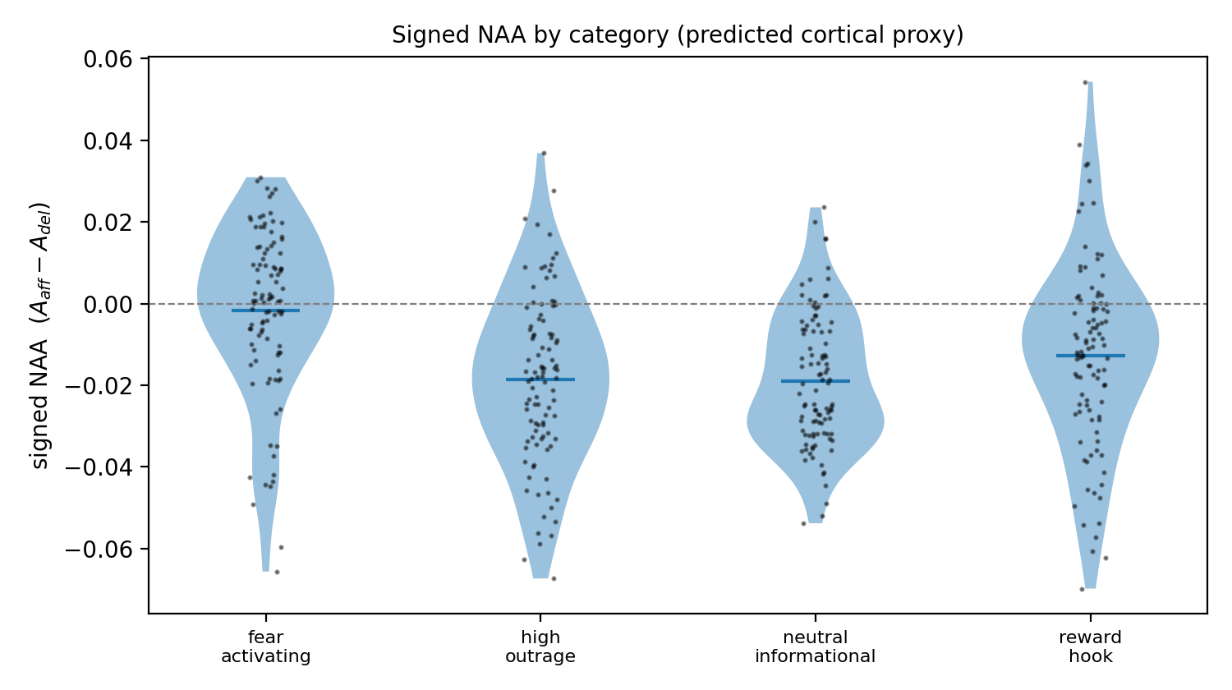
Categories shift against each other, but the distributions overlap
Every category mean is negative: the deliberative network leads throughout, and the categories differ in how far below zero they sit.
The measurement
14

Slide 15
Fear-activating content carries the effect; outrage does not separate
fear-activating
d = 0.939
reward hook
d = 0.319
high outrage
d = 0.030 p = 0.832
Cohen's d against the neutral baseline.
Outrage is the category the proposal expected to separate most, and it does not separate at all.
The measurement
15

Slide 16

Category cannot be told apart from source dataset
CATEGORY
SOURCE DATASET
fear-activating
ISOT-fake
high outrage
SemEval-2019 Task 4
reward hook
Webis-Clickbait-17
neutral informational
PubMed + ISOT-true
One source per category, so the separation is between corpora and cannot be attributed to framing. Length is controlled; provenance is not.
The measurement
16

Slide 17

Group-level claims hold at this precision; per-item claims do not
0.8725
12.8%
ICC between two GPU sessions
of items reverse direction
The separation replicates: 0.0888 on the second session against 0.1068 on the first. Both clear the detectable floor.
51 of 400 items flip sign between sessions, so no verdict on one article appears anywhere in the analysis, the figures or the public site.
A second session scanned all 400 items with identical text, code and regions. Neither run is corrected toward the other, and they are not averaged.
The measurement
17

Slide 18
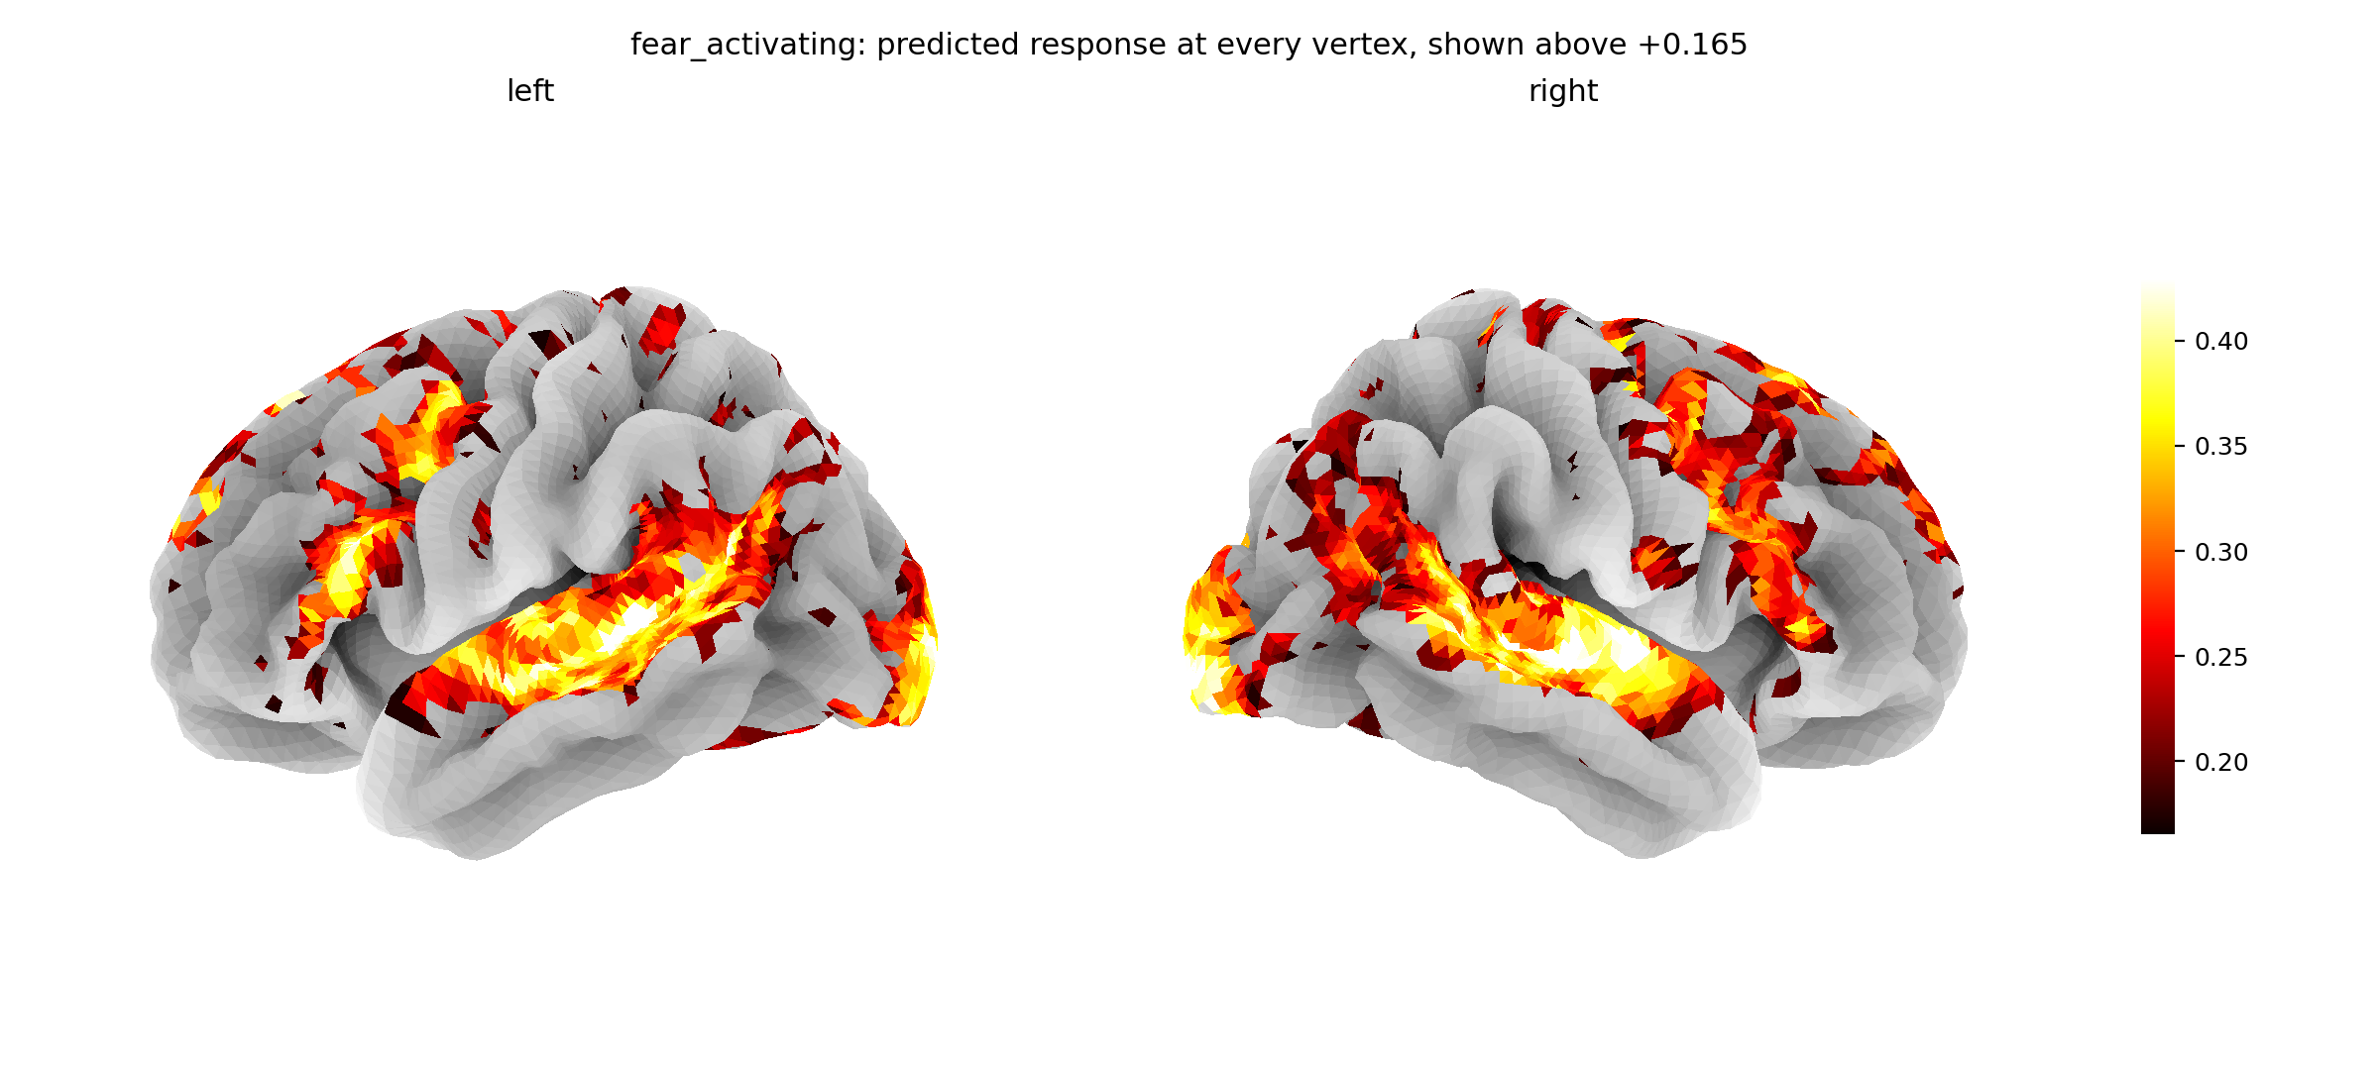
The encoder returns a full cortical map, not a summary statistic
One fear-activating item at all 20,484 vertices, painted above the map's 70th percentile. Nothing is smoothed, interpolated or simulated.
The measurement
18

Slide 19

04
The physics
What a measured field is worth.

Slide 20
Media enters the mean-field model as a field on the measured observable
Each person holds an opinion ±1, is pulled toward their neighbours with strength J, and is pushed by media with field h:
m = tanh( βJ m + h ), h = α X
where X is the measured observable and α the unknown coupling. Expanding artanh(m) ≈ m + m³/3:
F(m) = a m² + b m⁴ − h m, a = (1 − βJ)/2, b = 1/12
Coefficients derived from the self-consistency condition. The proposal carried a = 1 − βJ, b = (βJ)³/3, which do not follow from it. The solver reproduces the exact exponents 1/2, 1 and 3.
The physics
20

Slide 21

The corpus does not identify the coupling, so no value is quoted
What was tried. Regress the outcome on the measured index and read off α.
What happened. The fit performs worse than the sample mean out of sample, and the estimate scales inversely with a coupling βJ that no measurement here fixes.
So no value of α-hat appears anywhere — not in a table, a caption, or “for illustration”.
Reporting an unidentified coupling as though it were measured would be the failure here. Declining to quote it is not.
What replaces it is a statement that does not need the fit at all.
The physics
21

Slide 22

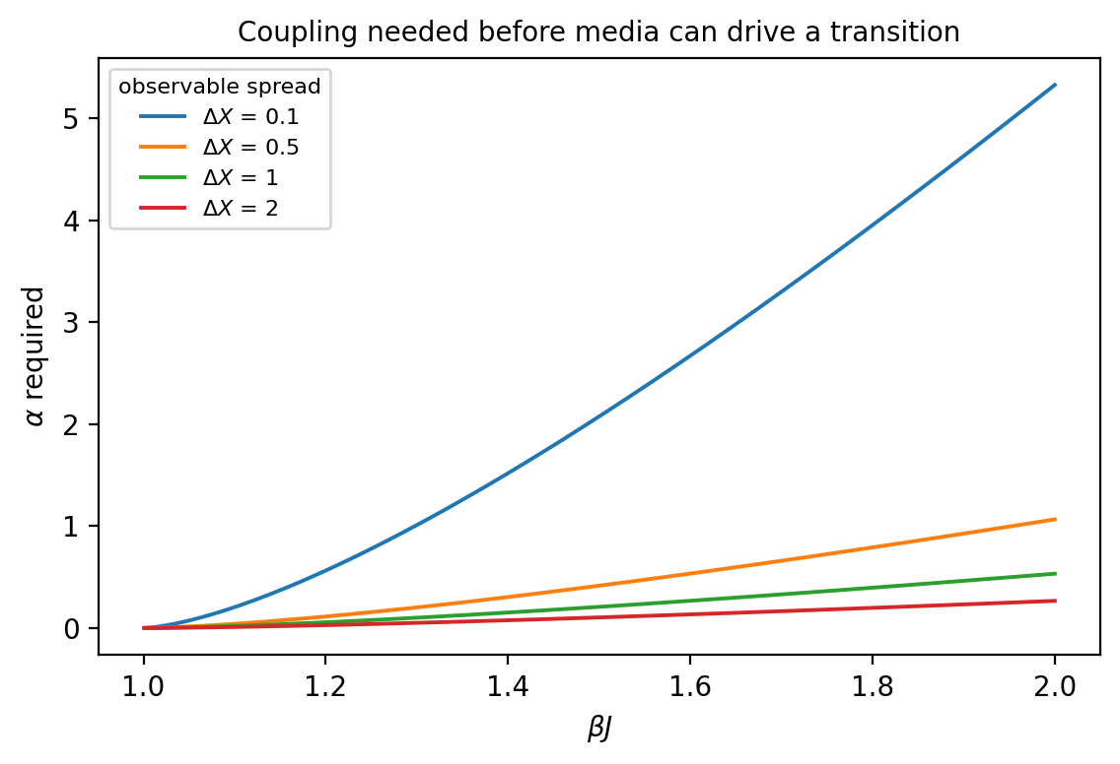
Any content observable must clear a bound to drive a transition
α ≥ h_{c}(βJ) / ΔX
Rather than fitting α and hoping it clears zero, this states what α would have to be for the mechanism to work at all — for any candidate observable, before a corpus exists.
Measured spread ΔX = 0.1241 ⇒ α ≥ 0.169 at βJ = 1.10, 1.655 at 1.50, 4.294 at 2.00
The physics
22

Slide 23

05
Standing
What holds, and what is still open.

Slide 24

Whether the encoder tracks real cortex is measurable, and one pass remains
A commercial lab reports the released checkpoint, in the averaged configuration this project runs, is anti-correlated with real cortex. Four subjects, one stimulus, not independently replicated.
0.1517
measured noise ceiling
CI [0.1484, 0.1551], 4 subjects, 1000 parcels
0.2247
withdrawn
an episode picked by position, and a guard that could not fire
Replaying the old code path reproduces the wrong number exactly, which proved the cause. Both defects were silent: nothing crashed.
Schaefer et al. (2018); Algonauts 2025 (CC0); audit self-published, Sapient (2026).
Standing
24

Slide 25

Four claims the work supports, and four it does not
SUPPORTED
NOT SUPPORTED
• A content observable that can be measured, with its reliability stated.
• That it separates these four corpora at 0.1068, power attached.
• A bound any candidate observable must satisfy, usable before data exists.
• A measured noise ceiling for the checkpoint on public data.
• That the index detects manipulation. Category is confounded with source.
• Anything about the amygdala. The checkpoint does not predict it.
• Any value of the coupling α. The corpus does not identify it.
• Any verdict on one article. 12.8% reverse between sessions.
Standing
25

Slide 26
The work yields a dissertation and three papers
72 pp
Dissertation
Complete draft.
12 pp
Paper 1
The bound and the screening criterion. Physica A. Independent of the scan.
12 pp
Paper 2
The instrument, the corpus, the field bound. Physica A.
6 pp
Paper 3
The measured ceiling and the replication. Imaging Neuroscience. One computation on its final run.
Every number in all four comes from a re-runnable script. Nothing is transcribed by hand.
Standing
26

Slide 27
Conclusions
1. A field observable can be measured from content. The instrument runs, the corpus is complete, and reliability is measured rather than assumed: ICC = 0.8725.
2. It separates four corpora at 0.1068, and the separation is confounded with source. Both halves are reported, the confound first.
3. The coupling is unidentified, so the thesis reports a bound instead. With ΔX = 0.1241, α ≥ 4.294 at βJ = 2 — a constraint on any future proposal of this mechanism.
4. The instrument's own validity is now a measurable question. The noise ceiling is 0.1517; one prediction pass remains.
Brian Mwai · 1050555 · monarch-4iy.pages.dev · github.com/brn-mwai/monarch
Standing
27

Slide 28
References
Ahmed, H., Traore, I., Saad, S. (2017). Detection of online fake news using n-gram analysis and machine learning. ISDDC.
d'Ascoli, S. et al. (2025). TRIBE: a trimodal brain encoder for whole-brain fMRI response prediction. Meta FAIR. arXiv:2507.22229.
Glasser, M. F. et al. (2016). A multi-modal parcellation of human cerebral cortex. Nature 536, 171–178.
Kiesel, J. et al. (2019). SemEval-2019 Task 4: hyperpartisan news detection. SemEval.
Korbel, J., Dahdoul, R., Thurner, S. (2026). Critical campaign spending in a double-random field Ising model of elections. Phys. Rev. Lett. 136, 127402.
Potthast, M. et al. (2018). The Webis clickbait challenge 2017. ECIR.
Schaefer, A. et al. (2018). Local-global parcellation of the human cerebral cortex. Cereb. Cortex 28, 3095–3114.
The Algonauts Project 2025 Challenge. arXiv:2501.00504.
Standing
28

