Slide 1
B.Sc. PHYSICS · DEPARTMENT OF NATURAL SCIENCES · CUEA
Measuring the External Field
A cortical-proxy content observable and the mean-field bound on media-driven opinion change
Brian Mwai 1050555
September 2026
Supervisor: Dr. Songa Mutambi

Slide 2

Statistical physics has always modelled media as a field pushing on a population of coupled opinions.
That field is assumed. It is not measured.
This project measures one from content itself, applies it to 400 articles, and derives how strong the coupling would have to be for a spread that size to move a population at all.

Slide 3

01
The problem
What is missing from the way media is modelled.

Slide 4
Two articles can report one event and leave readers in different states
WIRE REPORT
Federal Reserve holds interest rates steady, citing a stable inflation outlook.
THE SAME EVENT
FED DESTROYS AMERICA. Your savings are GONE. The collapse they hid from you!
informs
provokes
Readers notice the difference and cannot quantify it. The platforms distributing both have no objective measure of which they are amplifying.
The problem
4

Slide 5

Existing tools measure the words; none measures the predicted response
SENTIMENT, READABILITY, STANCE
characterise the words
THIS PROJECT
estimate the response
A released neural encoder predicts cortical activity from the content, and the measurement is taken on that prediction.
The instrument is a thermometer for one property of media. The thesis is an account of building it, running it, and stating what its readings support.
The problem
5

Slide 6

02
The instrument
From a passage of text to a single number.

Slide 7
A five-stage cascade turns one article into one number
Text
one article
Speech
synthesised
Timings
per word
Embeddings
text + audio
TRIBE v2
encoder
20,484
vertices
Affective
1,030 vertices
Deliberative
851 vertices
One number
per article
−
=
Encoder: TRIBE v2, d'Ascoli et al., Meta FAIR (2025), arXiv:2507.22229. Regions from HCP MMP1.0, Glasser et al. (2016). Instrument at monarch-4iy.pages.dev
The instrument
7

Slide 8
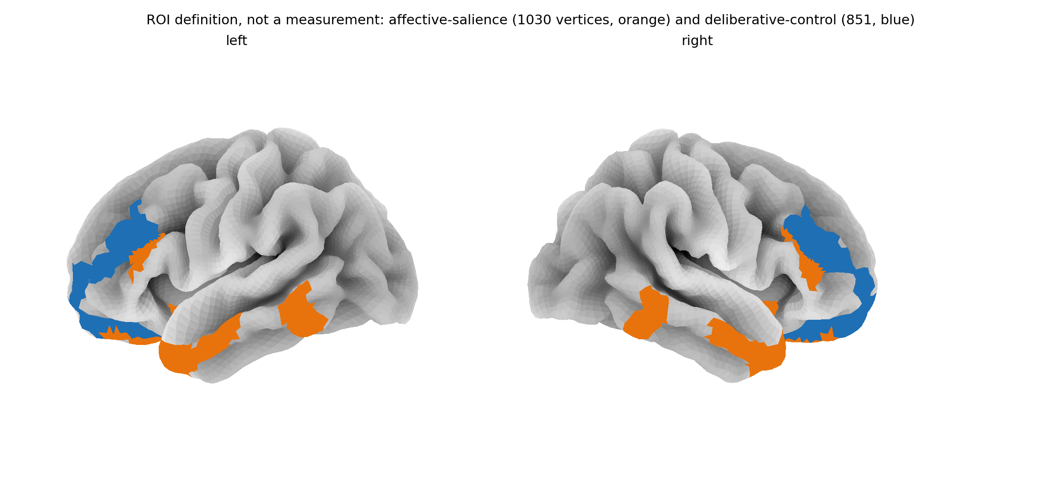
The index contrasts two cortical networks, 1,030 vertices against 851
Affective salience in orange, deliberative control in blue. Resolved once into vertex index sets and cached, so all 400 items are averaged over identical regions.
Regions defined on HCP MMP1.0 (Glasser et al., 2016); surfaces are fsaverage5.
The instrument
8

Slide 9

The observable is a signed difference, defined for every item
NAA_{signed} = A_{affective} − A_{deliberative}
reasoning leads
emotion leads
0
A cortical proxy: it rates content, never a person, and is never called the amygdala.
The instrument
9

Slide 10

Inspecting the checkpoint changed what the project could claim
01
Cortical only
No subcortical output.
No amygdala, so the proposal's equation cannot be computed.
02
Averaged over subjects
The loader forces it.
It predicts a typical viewer, which Paper 3 tests.
03
Standardised output
Means sit near zero, so a ratio breaks.
Undefined for 69 of 400 items; the difference replaces it.
All three were found by testing the checkpoint, before any result.
The instrument
10

Slide 11

03
The measurement
400 articles, scanned twice.

Slide 12

The corpus is length-matched and was powered before the scan
100
fear-activating
ISOT-fake
100
high outrage
SemEval-2019 T4
100
reward hook
Webis-Clickbait-17
100
neutral informational
PubMed + ISOT-true
Length-matched. Mean word counts 167.4, 163.5, 163.7, 162.2; standard deviations near 11.
Powered first. Smallest detectable η² = 0.0268, smallest detectable AUC = 0.5916, both fixed before a single item was scanned.
Corpora: Ahmed et al. (ISOT, 2017); Kiesel et al. (SemEval-2019 Task 4); Potthast et al. (Webis-Clickbait-17); PubMed open abstracts.
The measurement
12

Slide 13
THE FOUR CATEGORIES SEPARATE AT
η² = 0.1068
F = 15.779 p = 1.03 × 10⁻⁹ n = 400
against a design powered to detect 0.0268

Slide 14
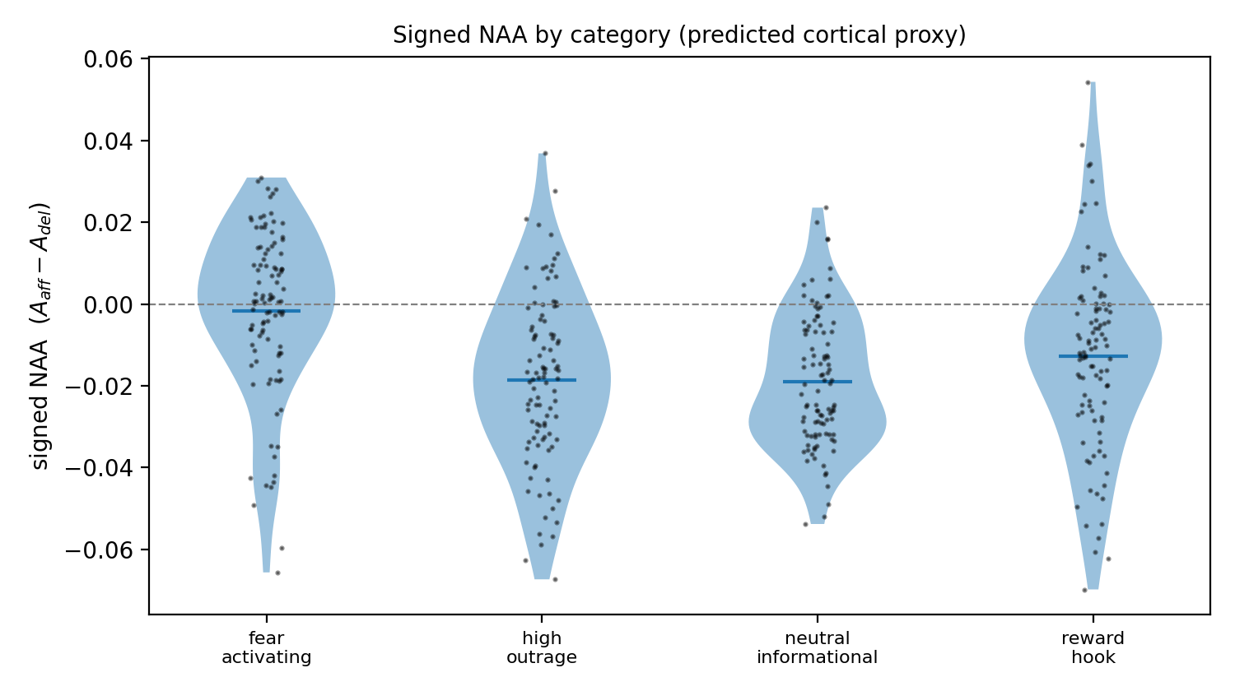
Categories shift against each other, but the distributions overlap
Every category mean is negative: the deliberative network leads throughout, and the categories differ in how far below zero they sit.
The measurement
14

Slide 15
Fear-activating content carries the effect; outrage moves both networks equally
fear-activating
d = 0.939
reward hook
d = 0.319
high outrage
d = 0.030 p = 0.832
Cohen's d against the neutral baseline.
Outrage is the category the proposal expected to separate most. Taken apart, it raises both networks: affective d = +0.507, deliberative d = +0.491. Fear raises one only.
The measurement
15

Slide 16

Category cannot be told apart from source dataset
CATEGORY
SOURCE DATASET
fear-activating
ISOT-fake
high outrage
SemEval-2019 Task 4
reward hook
Webis-Clickbait-17
neutral informational
PubMed + ISOT-true
One source per category, so the separation is between corpora and cannot be attributed to framing. Length is controlled; provenance is not.
The measurement
16

Slide 17
A bag of words beats the index on the label, so the index is not a classifier
0.6274
0.9758
AUC, the index, nothing fitted
AUC, TF-IDF + logistic, 5-fold
Same 400 rows, same label. Sentiment (VADER) sits at chance, 0.5392. The same words guess the source 66% of the time against 25% chance, so much of the lexical win is provenance.
The index is a field observable for the physics, not a detector.
Hutto & Gilbert (2014), VADER.
The measurement
17

Slide 18

Group-level claims hold at this precision; per-item claims do not
0.8725
12.8%
ICC between two GPU sessions
of items reverse direction
The separation replicates: η² = 0.0888 against 0.1068.
51 of 400. Noise alone predicts 55, so no verdict on one article is ever made.
The measurement
18

Slide 19
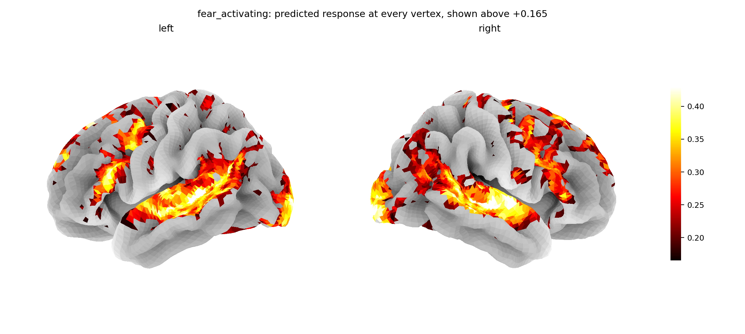
The encoder returns a full cortical map, not a summary statistic
One fear-activating item at all 20,484 vertices, painted above the map's 70th percentile. Nothing is smoothed, interpolated or simulated.
The measurement
19

Slide 20

04
The physics
What a measured field is worth.

Slide 21
Media enters the mean-field model as a field on the measured observable
Each person holds an opinion ±1, is pulled toward neighbours by J, and pushed by media with field h = αX, where X is the measured observable:
m = tanh( βJ m + h )
F(m) = a m² + b m⁴ − h m, a = (1 − βJ)/2, b = 1/12
Coefficients derived, not assumed; this corrects the proposal's a and b. The solver recovers the mean-field exponents.
The physics
21

Slide 22

The corpus does not identify the coupling, so no value is quoted
Tried. Fit the outcome to the measured index and read off α.
Result. Out of sample the fit does worse than the average, and the estimate depends on βJ, which nothing here measures.
So no value of α is quoted anywhere.
What replaces it needs no fit at all: the bound on the next slide.
The physics
22

Slide 23

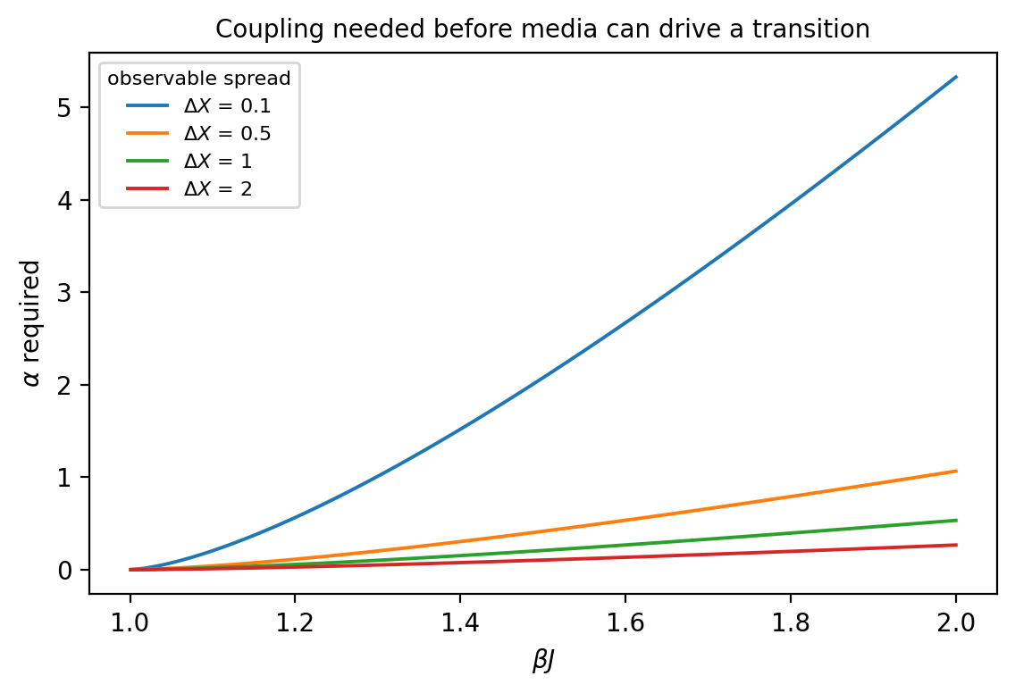
Any content observable must clear a bound to drive a transition
α ≥ h_{c}(βJ) / ΔX
What α would have to be for media to tip opinion, for any observable, before any data. Within the mean-field model.
Measured ΔX = 0.1241 gives α ≥ 4.29 at βJ = 2.
The physics
23

Slide 24

05
Standing
What holds, and what is still open.

Slide 25

Against real brains the encoder is weakly positive, not anti-correlated
A company audit says the checkpoint this project runs is anti-correlated with real cortex. Tested here on public fMRI:
0.1517
noise ceiling
full episode, 4 subjects
+0.028
encoder vs brains
ceiling 0.096 on the same 80 scans, p = 0.048
3 bugs
silent, found, fixed
wrong episode, flipped array, two clocks
Positive, weak, and not yet decisive on two minutes of film.
Algonauts 2025; Schaefer et al. (2018); audit: The Sapient Company (2026).
Standing
25

Slide 26

Four claims the work supports, and four it does not
SUPPORTED
NOT SUPPORTED
• A content observable that can be measured, with its reliability stated.
• That it separates these four corpora at 0.1068, power attached.
• A bound any candidate observable must satisfy, usable before data exists.
• A noise ceiling on public fMRI, and a first check of the encoder against it.
• That the index detects manipulation. Source is confounded; TF-IDF scores 0.9758.
• Anything about the amygdala. The checkpoint does not predict it.
• Any value of the coupling α. The corpus does not identify it.
• Any verdict on one article. 12.8% reverse between sessions.
Standing
26

Slide 27
The work yields a dissertation and three papers
81 pp
Dissertation
Complete, review answered.
12 pp
Paper 1
The bound and the screening criterion. Physica A. Independent of the scan.
16 pp
Paper 2
The instrument, the corpus, the field bound. Physica A.
8 pp
Paper 3
The noise ceiling and a check of the encoder against real brains. Imaging Neuroscience.
Every number in all four comes from a re-runnable script. Nothing is transcribed by hand.
Standing
27

Slide 28
Conclusions
1. A field observable can be measured from content. The instrument runs, the corpus is complete, and reliability is measured rather than assumed: ICC = 0.8725.
2. It separates four corpora at 0.1068, and the separation is confounded with source. Both halves are reported, the confound first.
3. The coupling is unidentified, so the thesis reports a bound instead. With ΔX = 0.1241, α ≥ 4.294 at βJ = 2 — a constraint on any future proposal of this mechanism.
4. The encoder is weakly positive against real brains, not anti-correlated. r = +0.028 against a ceiling of 0.096 on the same scans; not yet decisive.
Brian Mwai · 1050555 · monarch-4iy.pages.dev · github.com/brn-mwai/monarch
Standing
28

Slide 29
References
Ahmed, H., Traore, I., Saad, S. (2017). Detection of online fake news using n-gram analysis and machine learning. ISDDC.
d'Ascoli, S. et al. (2025). TRIBE: a trimodal brain encoder for whole-brain fMRI response prediction. Meta FAIR. arXiv:2507.22229.
Gifford, A. T. et al. (2025). The Algonauts Project 2025 Challenge. arXiv:2501.00504.
Glasser, M. F. et al. (2016). A multi-modal parcellation of human cerebral cortex. Nature 536, 171–178.
Hutto, C. J., Gilbert, E. (2014). VADER: a parsimonious rule-based model for sentiment analysis of social media text. ICWSM.
Kiesel, J. et al. (2019). SemEval-2019 Task 4: hyperpartisan news detection. SemEval.
Korbel, J., Dahdoul, R., Thurner, S. (2026). Empirical validation of the polarization transition in a double-random field model of elections. Phys. Rev. Lett. 136, 127402.
Potthast, M. et al. (2018). Crowdsourcing a large corpus of clickbait on Twitter. COLING, 1498–1507.
The Sapient Company (2026). The Faceless Brain. Self-published technical report.
Schaefer, A. et al. (2018). Local-global parcellation of the human cerebral cortex. Cereb. Cortex 28, 3095–3114.
Standing
29

