Slide 1
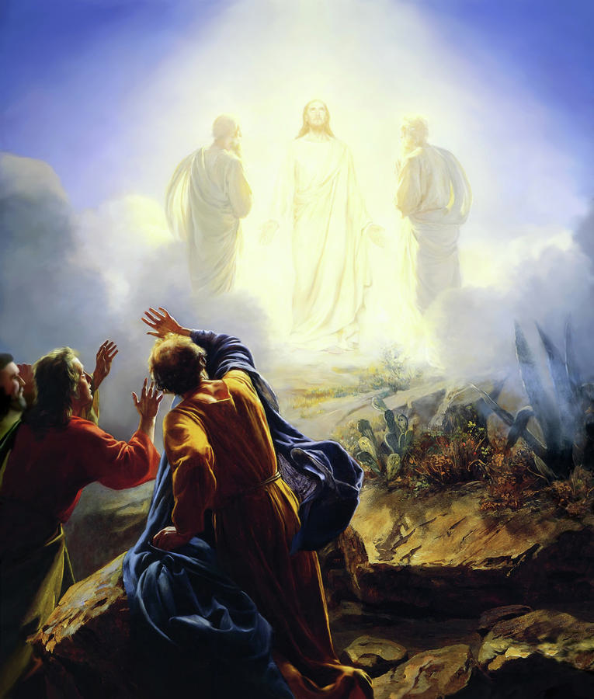
The Glory of the Kingdom

