Slide 1
Design + AI

Slide 2
Native Figma AI

Slide 3
Overview & Business Value
Figma’s emerging AI capabilities—both native features and third-party plugins—dramatically reduce the time spent on repetitive design tasks, speed up prototyping, and enhance collaboration between designers and developers. By automating routine workflows (e.g., generating layouts, renaming layers, writing text, creating images, code export), design teams can focus on high-level creativity and strategic decision-making. This leads to:
Faster time-to-market: Shortened design cycles mean products ship sooner.
Improved ROI on design resources: Designers spend less time on manual tasks, increasing overall productivity.
Greater innovation: Quick AI-driven iterations free teams to experiment with more design variants.

Slide 4
Key AI Features in Figma
Generative Design & Auto Layout: Produces initial UI drafts from text prompts, cutting the “blank canvas” phase drastically.
Automated Text/Image Generation: Fills placeholder content or translations via AI, reducing time spent on copywriting or asset sourcing.
Visual Search & Asset Discovery: Locates UI elements across files by textual or image similarity, promoting asset reuse and preventing duplicated work.
Auto Layer Rename & Auto-Prototyping: Saves hours of file clean-up and wiring; further accelerates design handoff to developers.
Overall, these native AI tools can reduce initial design-phase efforts by an estimated 20–30% and shave off days or weeks from full project timelines.

Slide 5
Leading Third-Party AI Plugins

Slide 6
Magician (by Diagram)
Capabilities: Generates icons, text (“Magic Copy”), and images from prompts within Figma.
Value: Speeds up asset creation, reduces outsourcing for small assets, saves hours in copywriting.
Architecture: Integrates Figma plugin with a cloud-based AI service (LLMs, diffusion models).
Genius (by Diagram)
Capabilities: Contextual design “autocomplete” that suggests UI elements from your design system in real time.
Value: Accelerates iterative design; ensures consistent use of enterprise components.
Architecture: Figma plugin observes user actions, sends partial file data to Diagram’s AI for real-time suggestions.
Uizard
Capabilities: Standalone AI design platform with text-to-design, screenshot scanning, and code export. Integrates with Figma via a plugin.
Value: Non-designers can rapidly produce prototypes in minutes, then refine in Figma. Significant time savings (10x speedup in early-stage mockups).
Architecture: Web-based AI suite (mix of CV for screenshot recognition, LLM for text prompts) synced to Figma.

Slide 7
Workflows

Slide 8
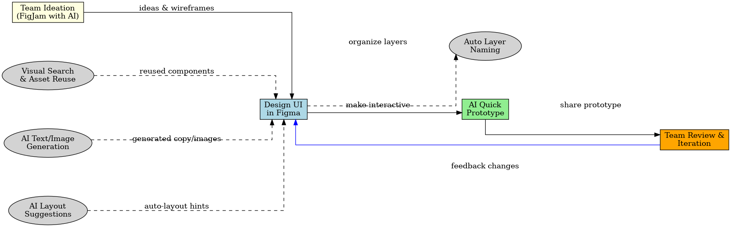
Figure: AI-Enhanced Design Workflow (standalone design process). Tools like Figma’s built-in AI and plugins can automate various steps: from brainstorming ideas in FigJam with AI assistance, to using Visual Search for existing assets, generating realistic text/images for mocks, and auto-organizing layers. Designers can quickly turn static mocks into interactive prototypes with one click. The diagram illustrates how these AI features feed into the design phase, reducing manual work and enabling faster review cycles.

Slide 9
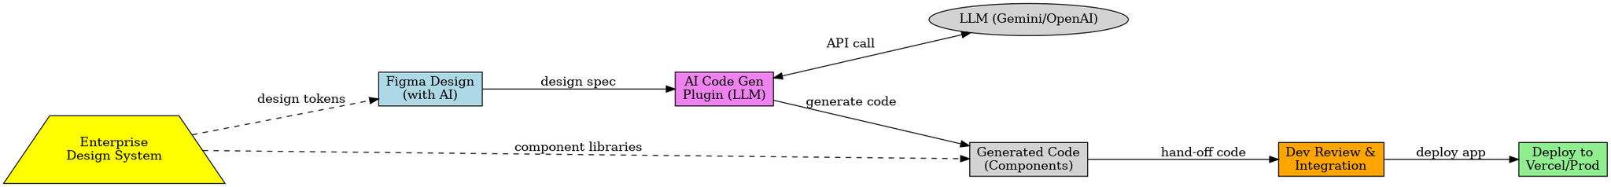
Figure: Integrated Design-to-Development Workflow with AI. After a design is created in Figma (leveraging AI features), an AI code generation plugin (e.g. Visual Copilot) uses an LLM (such as OpenAI GPT-4 or Google Gemini) to convert the design into front-end code. The enterprise’s design system ensures consistency between design and code. Developers then review/integrate the AI-generated code and deploy it (e.g. via Vercel). This architecture shows how AI can bridge the gap between design and development, enabling near-instant handoff and iteration.

Slide 10
Time & Cost Savings

Slide 11
Time & Cost Savings
These efficiencies compound across multiple products or teams, leading to significant cost savings and faster product iterations at scale.
20–30% Reduction in Design Time through quicker ideation, automated cleanup, and faster prototyping.
Up to 50–80% Cut in Front-End Coding with AI-based code export (particularly for marketing pages or straightforward UIs).
Efficiency Gains in Reuse of Assets (Visual Search), automated text generation, and auto-layer naming can each save hours per project.

Slide 12
Security & IP Considerations

Slide 13
Security & IP Considerations
These efficiencies compound across multiple products or teams, leading to significant cost savings and faster product iterations at scale.
Data Exposure: AI features often send prompts or design data to external servers. Enterprises must ensure sensitive data (PII, PHI) is never inadvertently shared.
Plugin Vetting: Third-party plugins should be allow-listed, and data policies clarified (avoid unauthorized training on proprietary designs).
IP Ownership: AI-generated assets are typically owned by the user, but check licensing terms, especially if using brand names or references in prompts.
On-Prem or Private Cloud: For high-security use cases, some AI vendors offer private deployments. Figma’s official features, though, remain cloud-based.

Slide 14
Strategic Recommendations
These efficiencies compound across multiple products or teams, leading to significant cost savings and faster product iterations at scale.
Pilot AI Tools on Non-Sensitive Projects: Validate time savings and integration points before rolling out broadly.
Establish AI Governance: Define policies around usage (e.g., “no confidential data in AI prompts,” plugin allow-lists, and mandatory reviews of AI-generated code).
Train Teams on Best Practices: Encourage creative exploration with AI, but require human oversight for final outputs (to catch errors or IP issues).
Integrate Development Early: Tools like Visual Copilot or Uizard can unify design and development from the start, reducing handoff friction.
AI in Figma (official features + plugins) presents a substantial opportunity to accelerate enterprise design and development workflows.
By automating routine tasks, boosting design ideation, and bridging design-to-code handoff, organizations can achieve faster product releases, better design consistency, and stronger ROI on their design investments.
We should focus on responsible adoption—piloting these tools, establishing governance, and supporting teams with training—to harness the transformative potential of AI-driven design securely and effectively.

Slide 15
Next Steps

Slide 16
Next Steps
Identify pilot projects for Figma AI features or curated third-party plugins.
Involve Security/Compliance early to address data handling concerns.
Collect metrics on time saved (e.g., design cycles shortened, code generation efficiency).
Scale adoption based on successful pilots and refine policies as needed.

