Slide 1
Vercel & Design/Development Scenarios

Slide 2
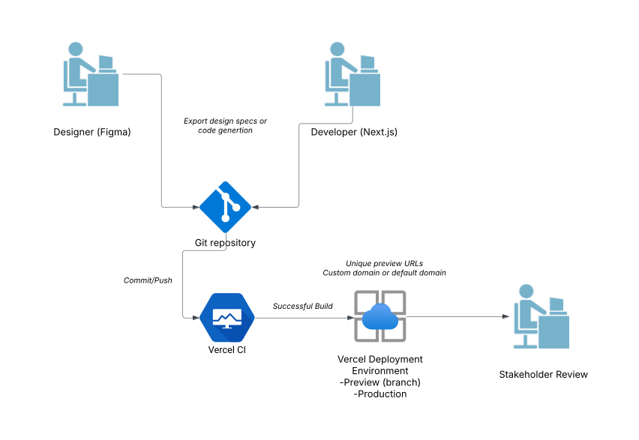
End-to-End Design-to-Deployment Workflow with Vercel
This diagram shows how a design team works in Figma (or another design tool) and hands off artifacts to developers, who push code to a Git repo. Vercel automatically handles builds and previews, allowing rapid iteration. Designers do initial UI in Figma. Devs implement UI in Next.js, referencing design specs. On every commit, Vercel CI triggers an automated build and deploys to a preview environment. The team reviews changes via a shareable preview URL; if approved, merges to main for production release.
Key Points
Automated Previews allow design teams to test real code quickly—no waiting for manual environments.
Production Deploy can go live with a single merge/push, ensuring frictionless rollouts.
This loop drastically shortens feedback cycles between design and implementation.

Slide 3
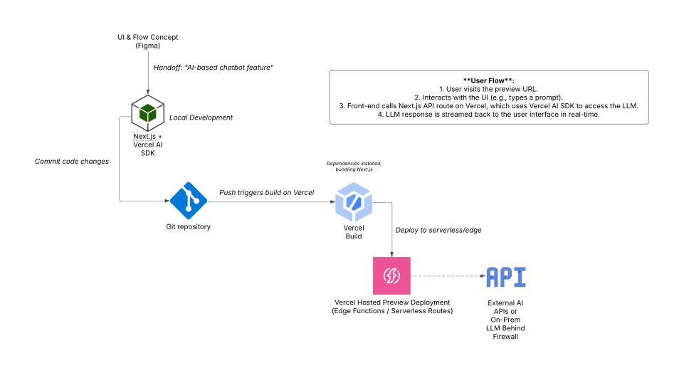
AI-Driven Prototype with Vercel AI SDK
If the team wants to build a generative or AI-powered prototype, Vercel’s AI SDK (or any LLM integration) streamlines hooking up a large language model. This diagram highlights the extra steps where the AI model is called.
Key Points
Minimal AI Integration Overhead: The Vercel AI SDK removes boilerplate for streaming model responses.
Flexible Model Hosting: The LLM can be a public API (like OpenAI) or a privately hosted service (connected via environment variables).
Rapid Iteration: Each commit instantly updates the AI prototype link, letting designers and PMs test new features quickly.

Slide 4
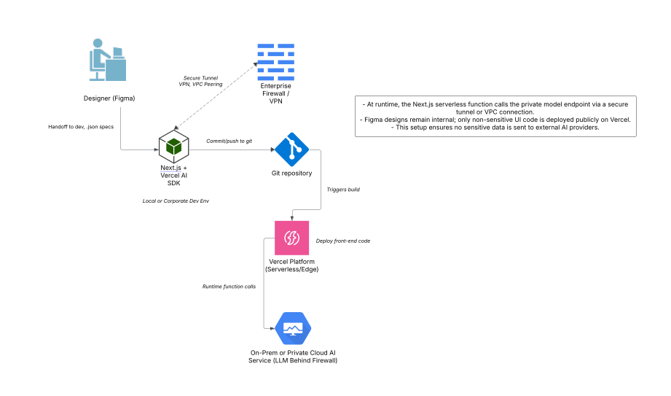
Security-Focused, Private Model Approach
This shows a scenario where the AI model is behind a corporate firewall, yet Vercel still hosts the front-end. A tunnel or secure API allows AI calls without exposing sensitive data to a public cloud provider.
Key Points
Private AI Hosting: Prevents proprietary or PII data from going to a public LLM.
Network Connectivity: Requires configuring Vercel’s serverless environment to connect securely to the enterprise network (e.g., via VPC peering or an API gateway).
End-to-End Security: Combine with enterprise SSO on Git, encrypted environment variables for model access tokens, and restricted build logs.

Slide 5
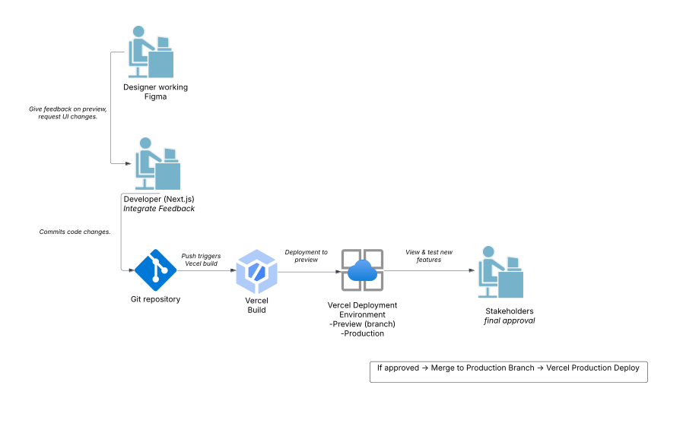
Multi-Team Collaboration & Preview Review Flow
A more people-oriented diagram, showing how different roles (Designer, Developer, Product Manager) interact with Vercel’s previews to keep everyone aligned.
Key Points
Centralized Collaboration: Vercel’s preview links let each stakeholder see the same version of the prototype.
Faster Sign-Off: Automated preview means minimal friction to gather feedback, which shortens iteration cycles.
Separation of Concerns: Designers remain in Figma, devs handle code, but everyone converges around the same preview environment.

