Slide 1
Experimental Results
Intel Core2 Quad Q6600 2.4 GHz (quad core with shared L2 cache), FSB 1066 MHz, DDR2 667 RAM
32 KB L1 cache, 8 MB L2 cache (4MB per core pair)
ICC 10.1 (-oparallel -fast)
Linux 2.6.18 x86-64

Slide 2
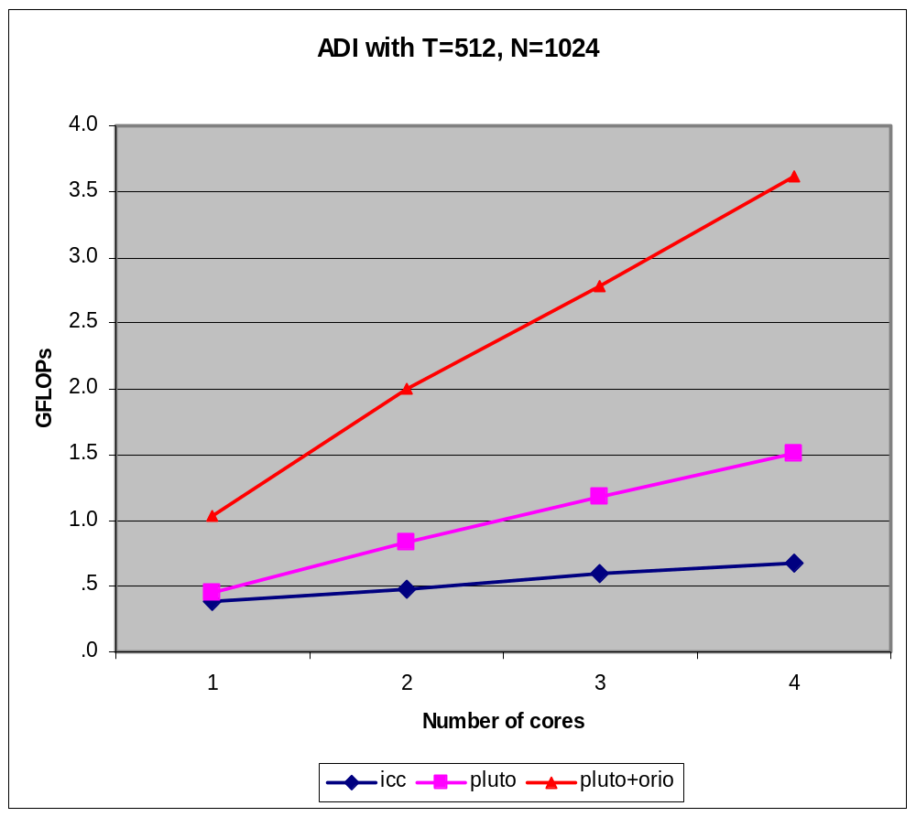
ADI Kernel: Multi-core

Slide 3
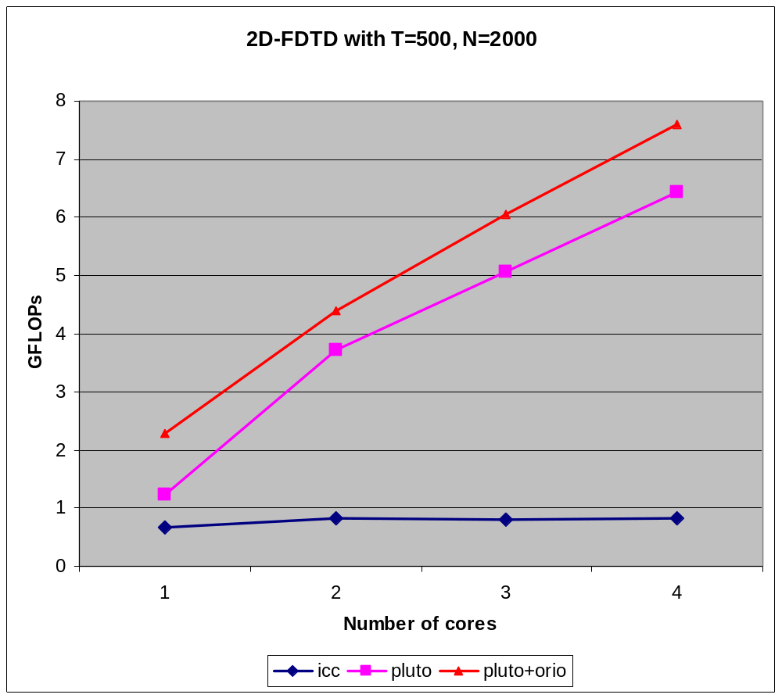
2-D FDTD: Multi-core

Slide 4
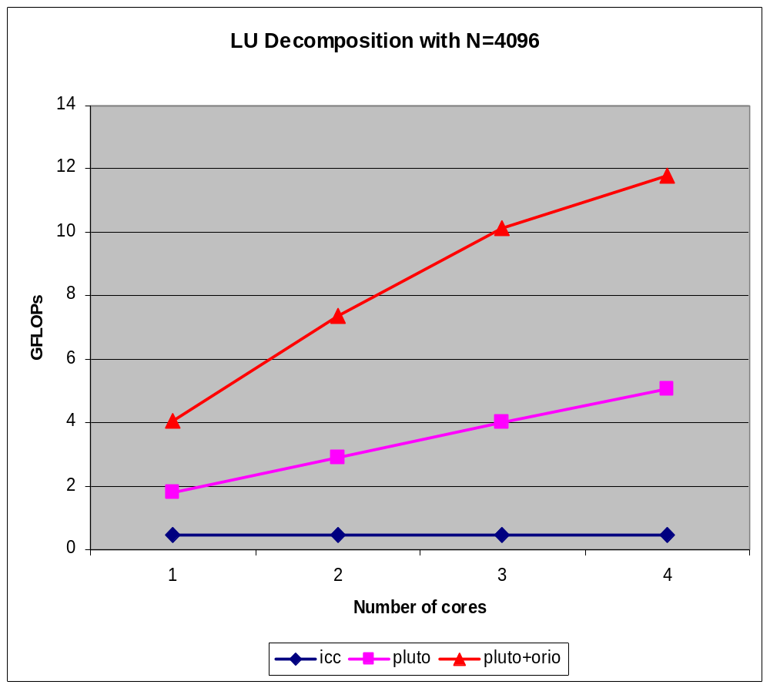
LU Decomposition: Multi-core

Slide 5
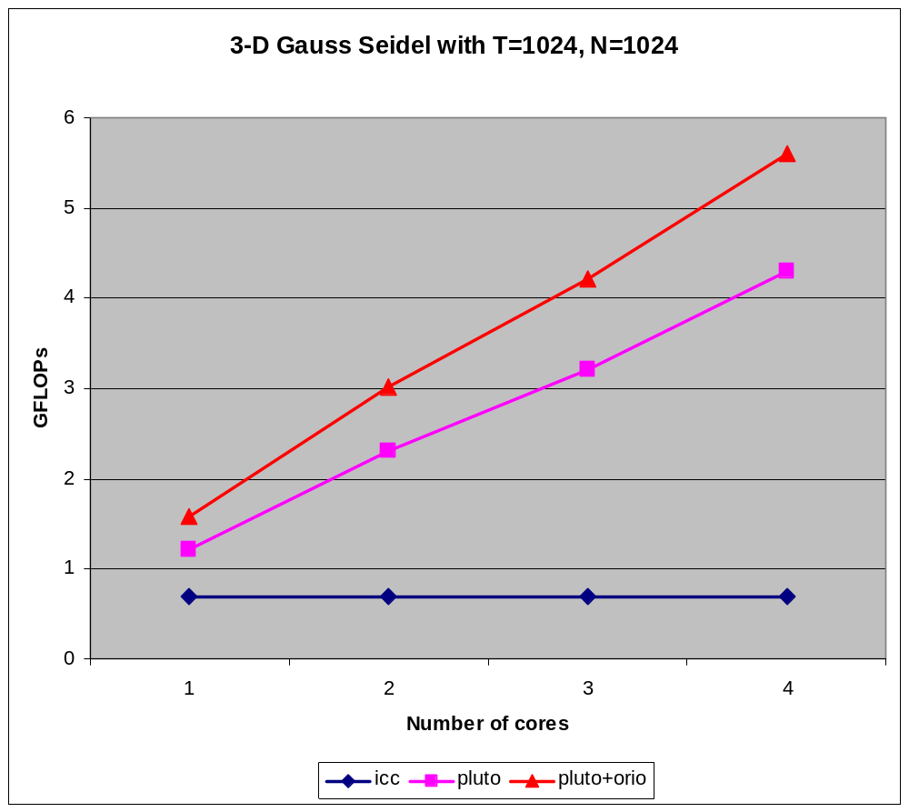
3-D Gauss Seidel: Multi-core

Slide 6
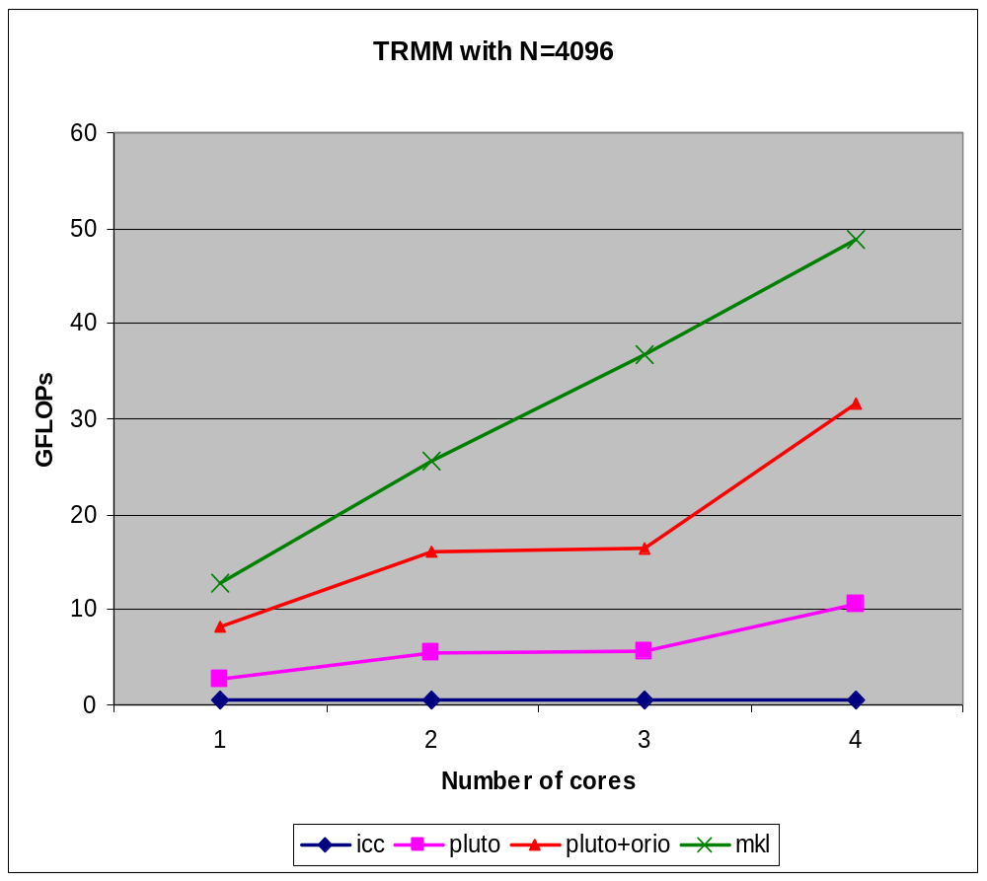
TRMM (Triangular MatMult): Multi-Core

