Slide 1



















二分图
$$s_{1,1}$$
$$s_{1,2}$$
$$s_{1,3}$$
$$s_{1,4}$$
$$s_{i,1}$$
$$s_{i,2}$$
$$s_{i,3}$$
$$s_{i,4}$$
……
……
……
……
$$e_{1,1}$$
$$e_{1,2}$$
$$e_{1,3}$$
$$e_{1,4}$$
$$e_{1,5}$$
$$e_{j,1}$$
$$e_{j,2}$$
$$e_{j,3}$$
$$e_{j,4}$$
$$e_{j,5}$$
$$e_{j,6}$$

Slide 2









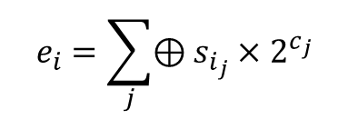











编码示意图
$$U(0,G_{s})$$
$$s_{2}$$
$$s_{3}$$
$$s_{4}$$
$$s_{5}$$
……
source packets :
$$s_{1}$$
$$s_{K}$$
step 1 :
$${\tilde{μ}}^{(k)}′$$
selected source packets :
$$s_{i_{1}}$$
$$s_{i_{2}}$$
$$s_{i_{3}}$$
$$s_{i_{4}}$$
……
step 2 :
$$U(0,G_{s})$$
$$U(0,G_{s})$$
$$U(0,G_{s})$$
$$U(0,G_{s})$$
shifted source packets :
$$s_{i_{1}}×2^{c_{1}}$$
$$s_{i_{2}}×2^{c_{2}}$$
$$s_{i_{3}}×2^{c_{3}}$$
$$s_{i_{4}}×2^{c_{4}}$$
……
step 3 :
$$e_{i}=\sum_{j}{⊕s_{i_{j}}×2^{c_{j}}}$$
encoded packet :

Slide 3

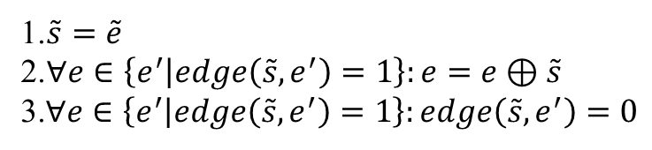

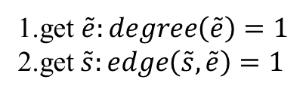




译码示意图
$$N<K$$
yes
step 1:
update $G$
no
$$N≥K$$
no
check if exists $\tilde{e}:degree\left(\tilde{e}\right)=1$
yes
1.get $\tilde{e}:degree\left(\tilde{e}\right)=1$
2.get$\tilde{s}:edge\left(\tilde{s},\tilde{e}\right)=1$
1.$\tilde{s}=\tilde{e}$
2.$∀e∈\left\{e^{′} | edge\left(\tilde{s},e^{′}\right)=1\right\}:e=e⊕\tilde{s}$
3.$∀e∈\left\{e^{′} | edge\left(\tilde{s},e^{′}\right)=1\right\}:edge\left(\tilde{s},e^{′}\right)=0$
step 2:
yes
check if exists $\tilde{e}:degree\left(\tilde{e}\right)=1$
no
no
check if $∀s∈S^{′}:degree\left(s\right)=0$
yes
end

