Slide 1


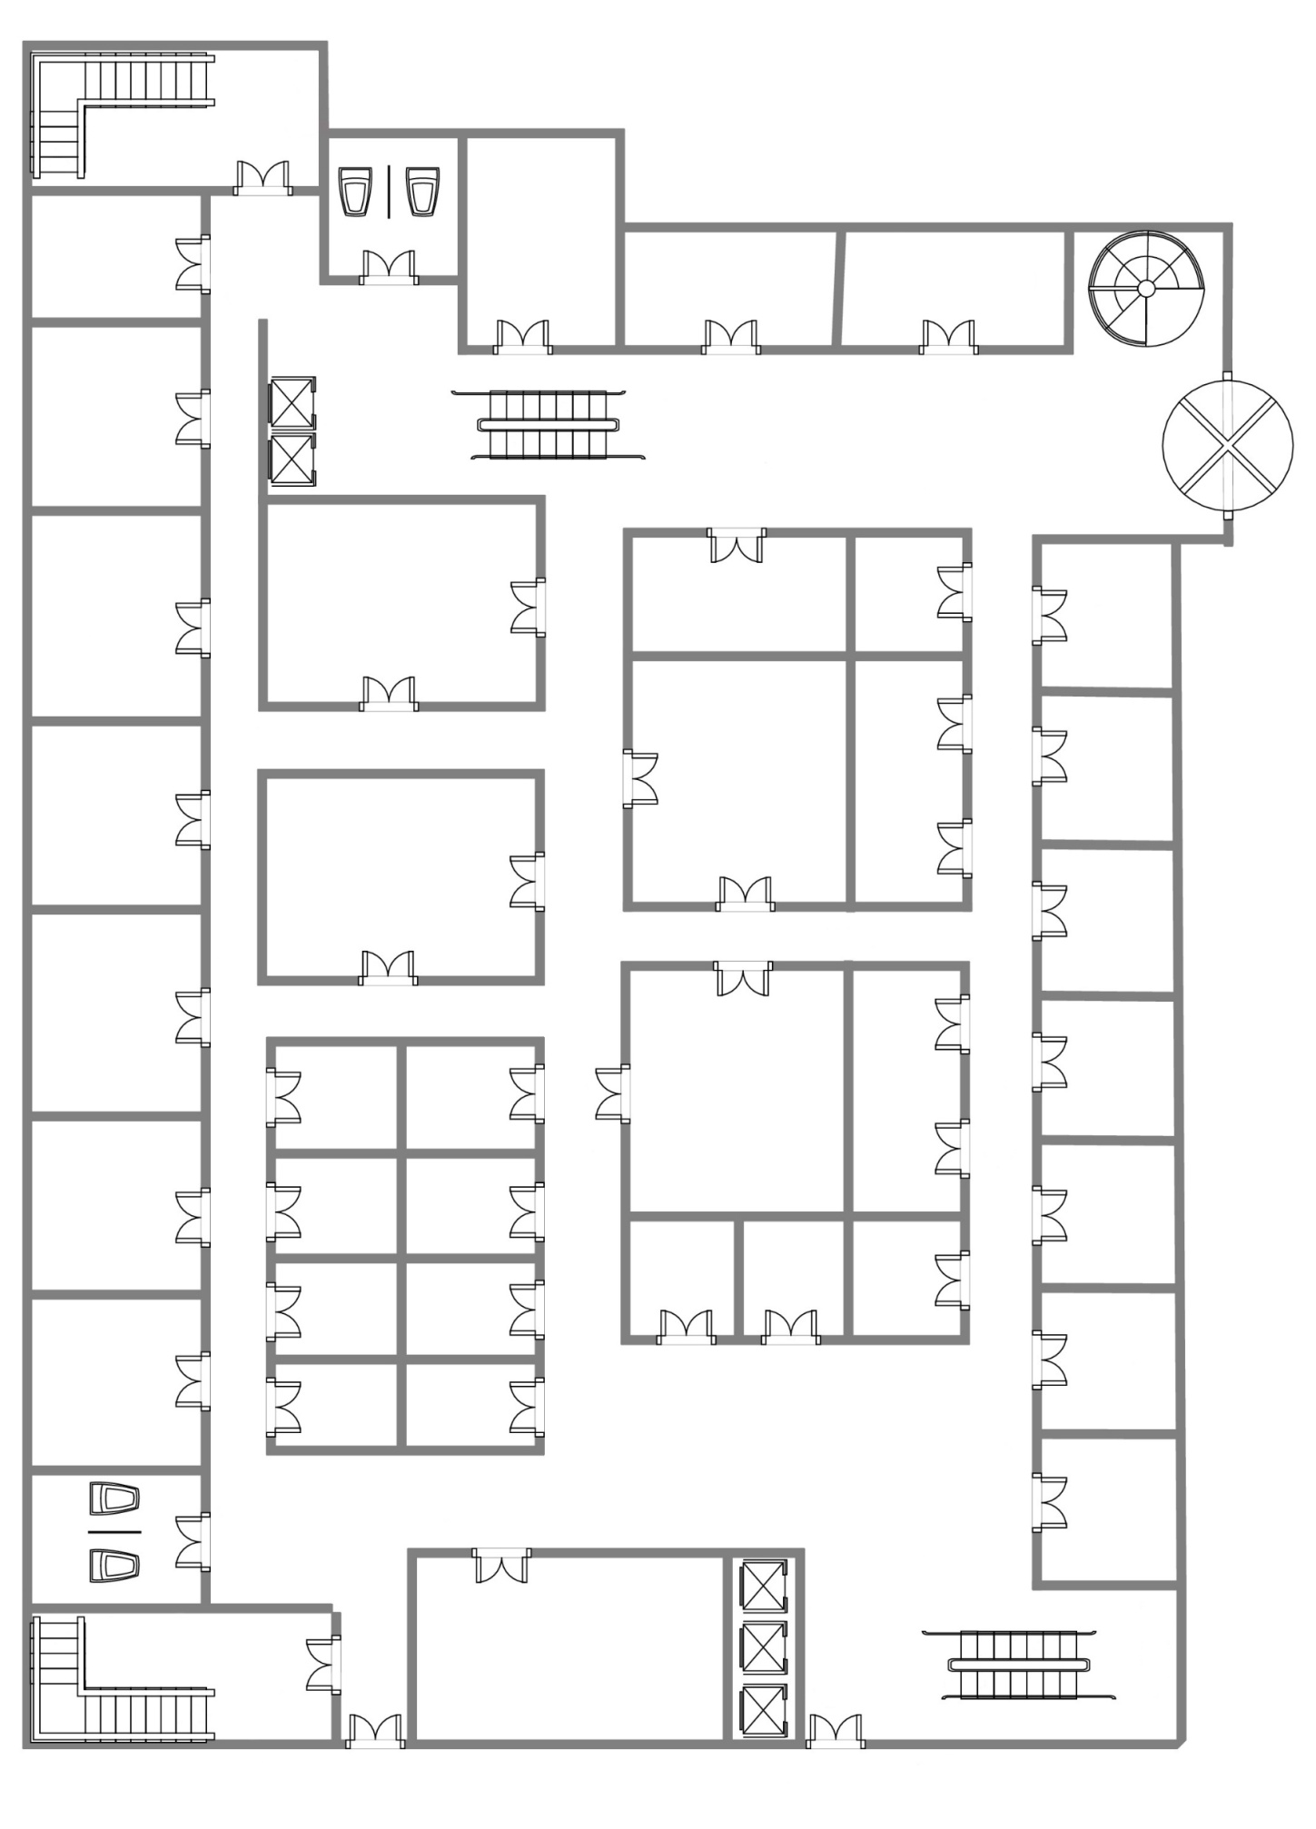
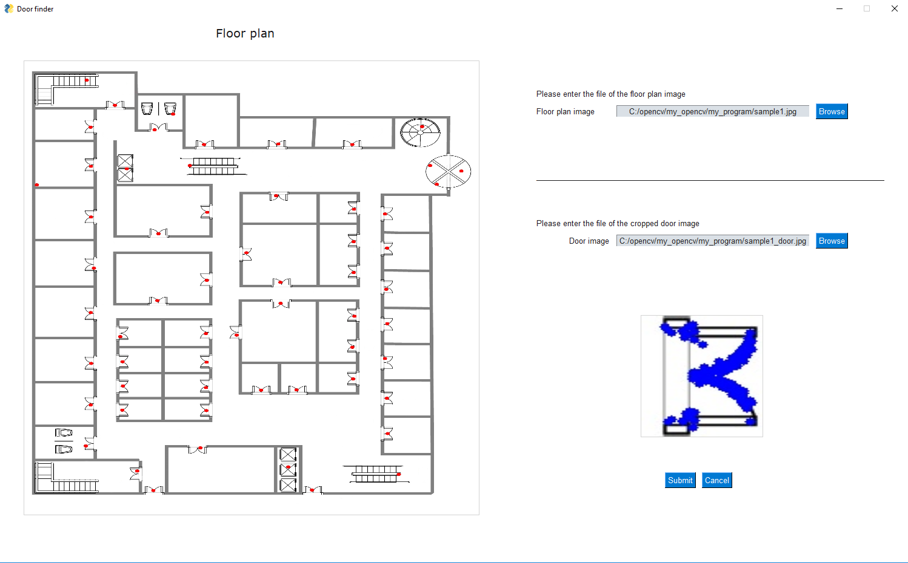
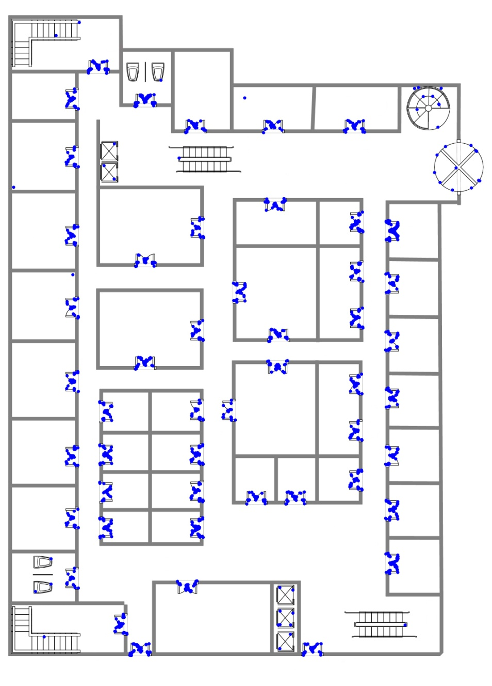
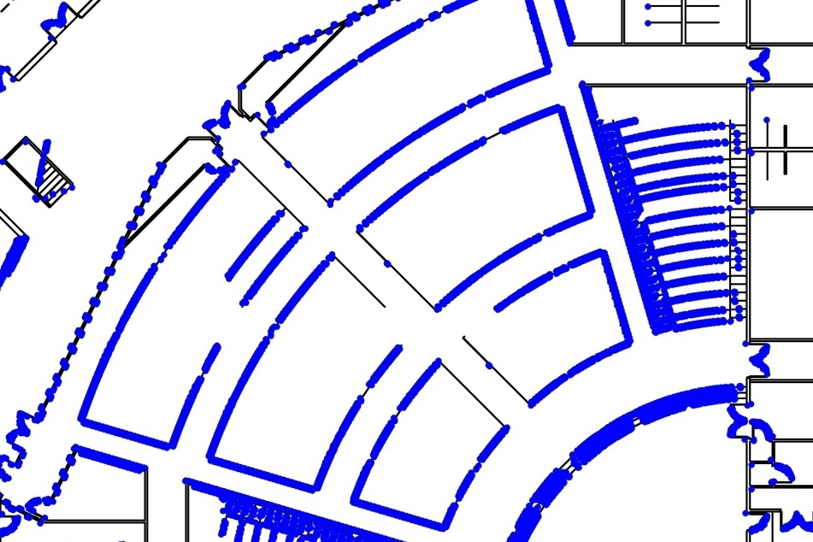
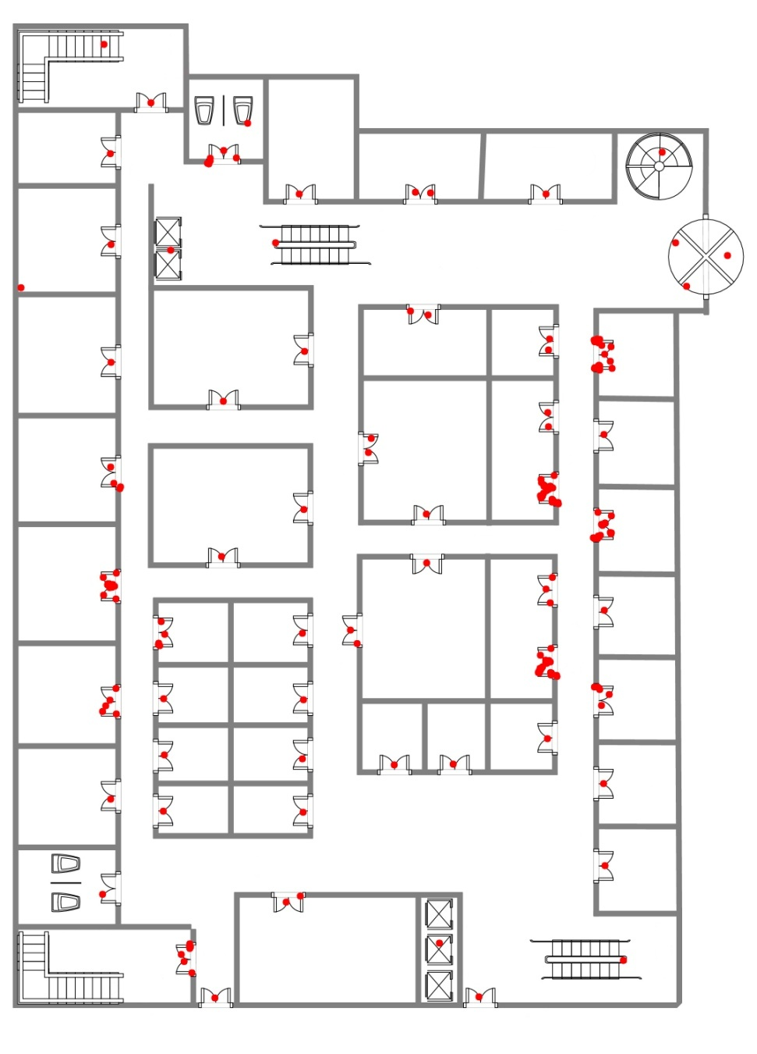

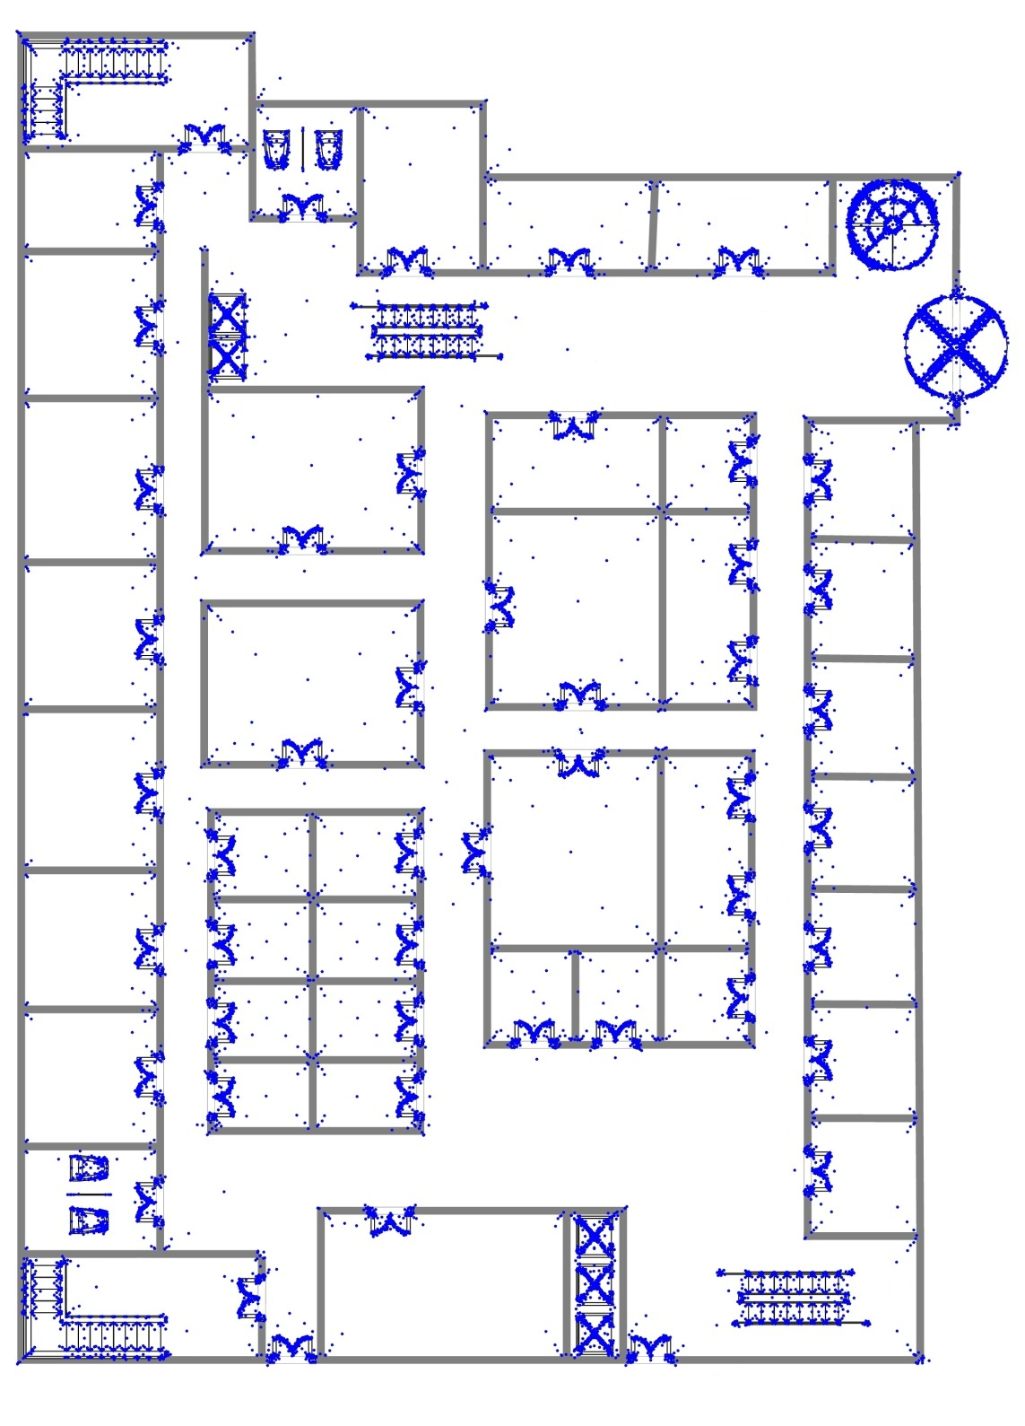
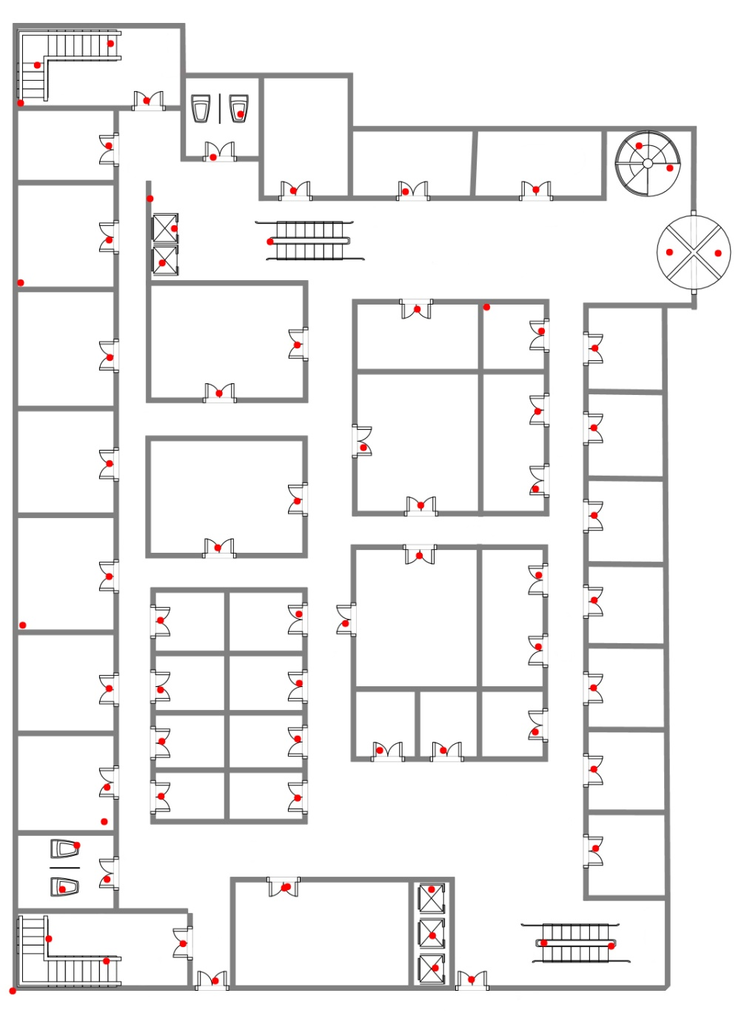


NETCPS REU
August 2, 2019
Indoor Navigation for the Blind:
Processing Digital Floor Plans Using OpenCV-Python for Beacon Placement
The Problem
Charlie Broadbent | Faculty Mentor: Dr. Vinod Namboodiri
When setting up a building for indoor navigation, one of the first steps is deciding on where to place Bluetooth beacons that will be used to transmit navigational information to users.
This gives us a set of keypoints and descriptors. We then match the features from the floor plan to the features of the door. This leaves us with the features in the floor plan that are most likely part of a door.
UI
The UI is barebones, but very simple.
Perhaps the simplest way to do this is to manually have someone look over a floor plan; however, this can be time consuming, and prone to human-error, especially with very large floor plans.
What if there was a tool to allow us to automate this process? Luckily, there is: IBeaconMap. The problem is it that it is written in MATLAB, which means it cannot be distributed without a fee.
OpenCV, a library of programming functions, is an alternative for implementing computer vision.
If the floor plan has a lot of curves, they can be detected to be doors.
Results
How can we automate this?
Matched features
 | Doors found | Missed doors | Redundant points | Processing time (s)
Shopping Mall | 49 | 0 | 27 | 5.38
Sample plan (low res) | 16 | 2 | 16 | 1.33
Research Building | 50 | 7 | 27 | 3.18
Large Area | 208 | 18 | 204 | 2247
Using OpenCV (specifically, the Python libraries), can we create a software similar to IBeaconMap that is just as accurate?
Feature matching does not work perfectly, however. It leaves is with many more points than we need, and we need to somehow reduce these points down to a single point that is on top of a door
k-means clustering
What are the goals of this tool?
Since the base functionality of the program needs to locate the doors on a floor plan, this is what I set out to achieve. Therefore, we want a tool that:
Marks as many doors on a floor plan as possible without missing any.
At the same time, it should make as many least redundant marks as possible (i.e. marks that are not doors).
Is simple to use for a person of any level of computer experience.
We can make a significant reduction using k-means clustering, which will find the centers of some clusters of keypoints, but not all, meaning we must reduce further.
IBeaconMap’s results (lower table). The research building, shopping mall, and large area floor plans used were the same images for both programs. FDM indicates the use of only feature detection and no machine learning.
How does it work?
Brute-force checker
For the most part, it is accurate, though slightly less than IBeaconMap.
Processing time for very large images between the two tools also varies greatly (up to 37 minutes vs. IBeaconMap’s 3 minutes).
First, we run a feature detection algorithm (I chose SIFT) on an image of the floor plan and a cropped image of a door from the same floor plan.
We reduce the rest of the points by checking if other points exist within a certain radius. If there exists such a point, we add a new point at the midpoint. This process continues until all points are sufficiently far away from each other.
What improvements need to be made?
Better UI
SIFT
A more efficient clustering algorithm and/or data structure to store keypoints to improve processing time on large images.
The leftover points are not perfectly placed, and there will exist redundant points—so how accurate is this process?
Improved optimization of OpenCV’s feature detection, feature matching, and clustering algorithms to improve accuracy and reduce redundancy.
Floor plan with all features marked
Final result

