Slide 1

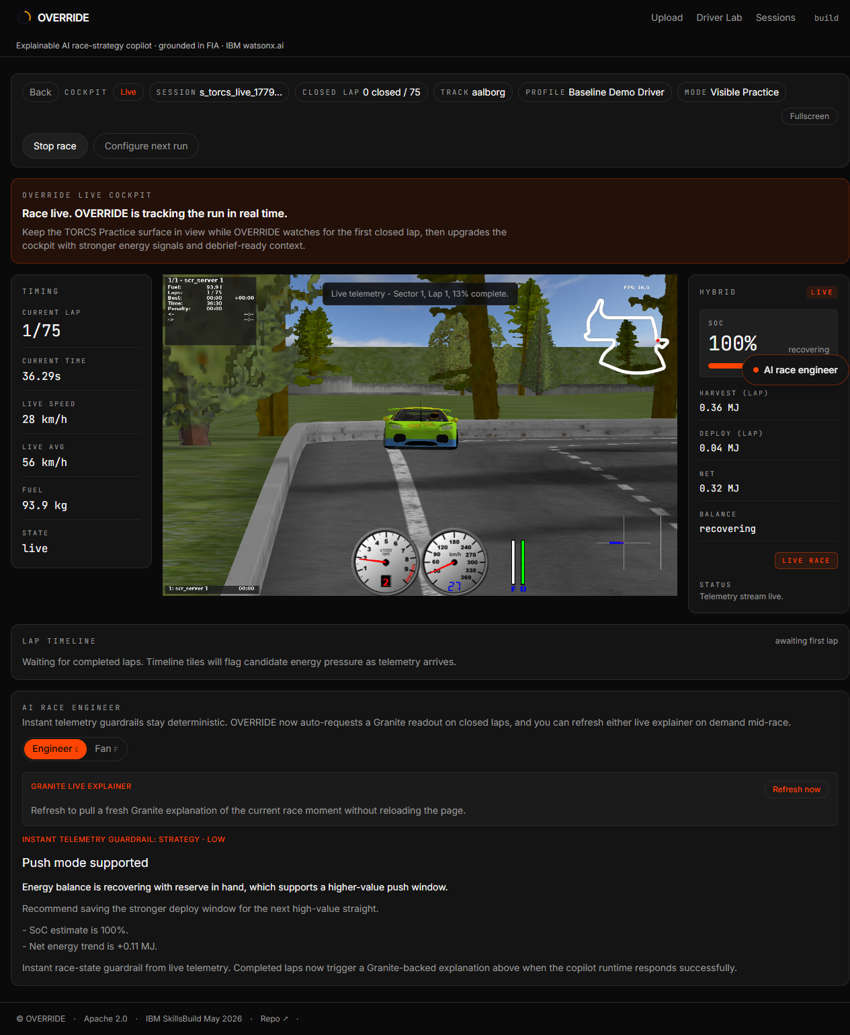
SUBMISSION PITCH
Explainable race-strategy AI
for the 2026 hybrid era
Telemetry reasoning, regulation grounding, what-if exploration, and Fan Mode from one decision-support engine.
Decision support, never replacement
Built on IBM Granite + watsonx.ai
IBM TECHNOLOGIES
TESTS
6
439
IBM SkillsBuild AI Builders Challenge - May 2026 / 01

Slide 2
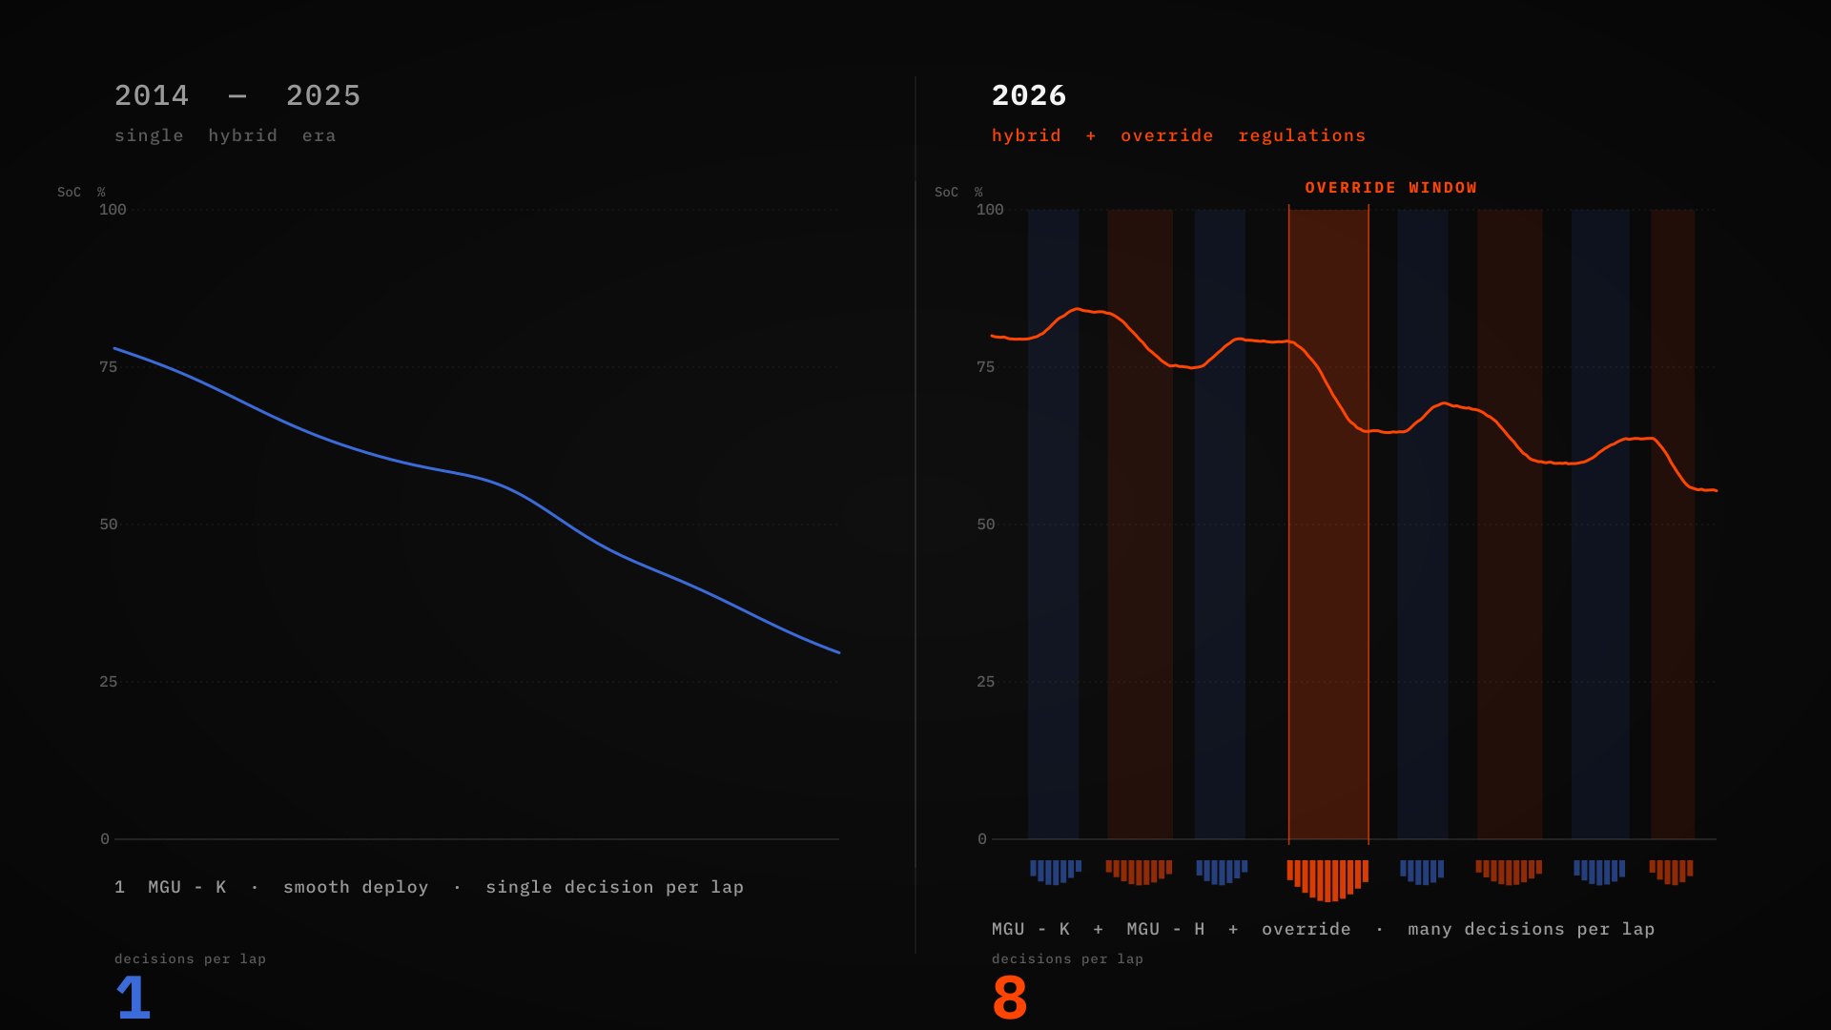
THE PROBLEM
2026 turns every lap into an energy decision
The hybrid system becomes a primary strategic variable, not a background modifier.
MGU-K POWER
ENERGY SPLIT
DRS SUCCESSOR
TOOLING GAP
350 kW
50 / 50
Override
Open gap
Race engineers, drivers, broadcasters, and fans all face the same missing layer: a way to connect telemetry, regulation, and consequence in language a human can audit.
OVERRIDE competes on explainability, not on pretending to replace the strategist.
IBM SkillsBuild AI Builders Challenge - May 2026 / 02

Slide 3
MARKET GAP
Telemetry shows what happened. Strategy needs why.
Existing public racing AI was designed for the previous hybrid era.
Teams
Drivers
Fans and broadcasters
Need auditable support for deploy, harvest, recharge, and Override tradeoffs as regulations move.
Need cause-and-consequence feedback to rebuild instincts around new energy behavior.
Need plain-language translation of an invisible energy chess match.
Missing layer: open, regulation-grounded, explainable decision support that makes the reasoning visible before a human acts.
IBM SkillsBuild AI Builders Challenge - May 2026 / 03

Slide 4
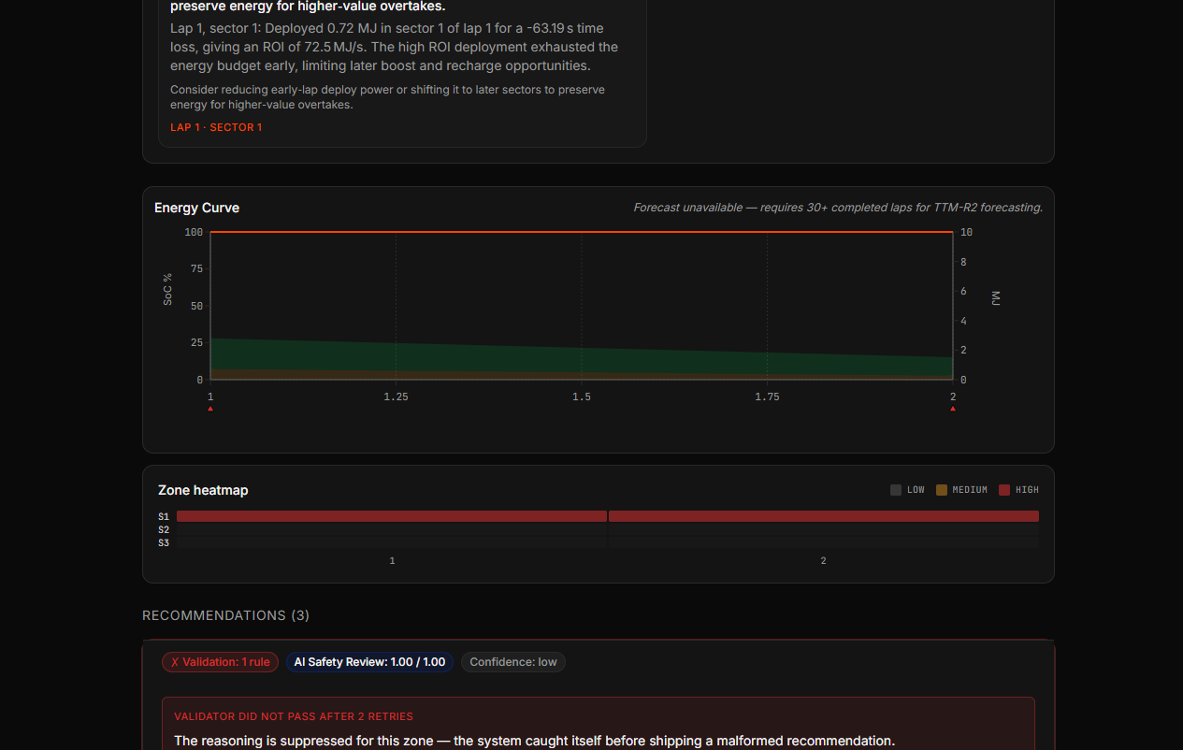
PRODUCT DEMO
From live cockpit to completed debrief
The video should feel like a real racing workflow, not a static analytics dashboard.
1. Live TORCS cockpit
2. Auditable AI debrief
The strongest beat: the thing the judge just watched becomes a grounded explanation with safety badges.
IBM SkillsBuild AI Builders Challenge - May 2026 / 04

Slide 5
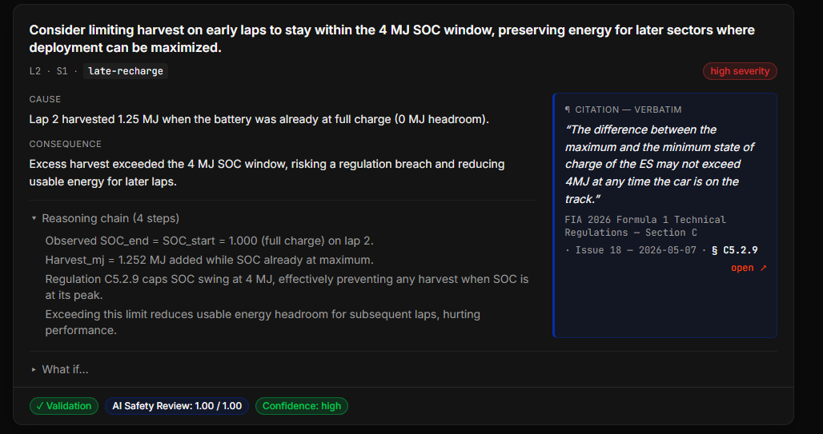
TRUST ARCHITECTURE
Explainability is the product
OVERRIDE shows the reasoning, the rule, and both safety passes.
Docling grounding
Regulation passages are parsed and rendered dynamically. No hardcoded FIA article numbers.
Pass 1 validation
Deterministic checks catch citation existence, energy bounds, source consistency, and unsafe language.
Pass 2 Guardian
Granite Guardian scores custom energy-safety and regulation-consistency criteria.
IBM SkillsBuild AI Builders Challenge - May 2026 / 05

Slide 6
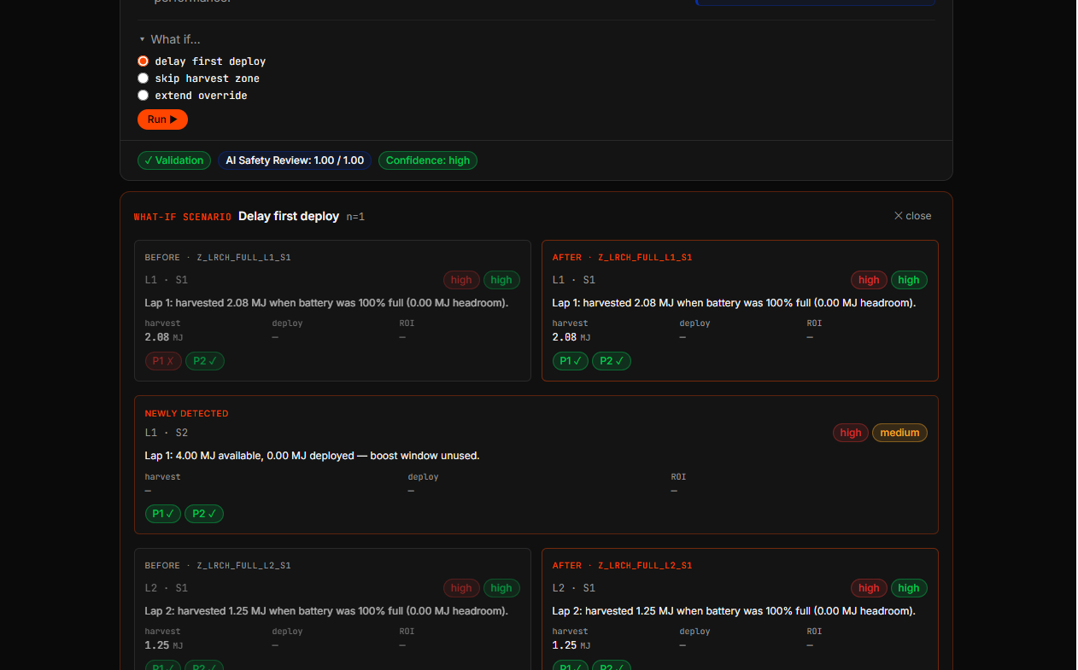
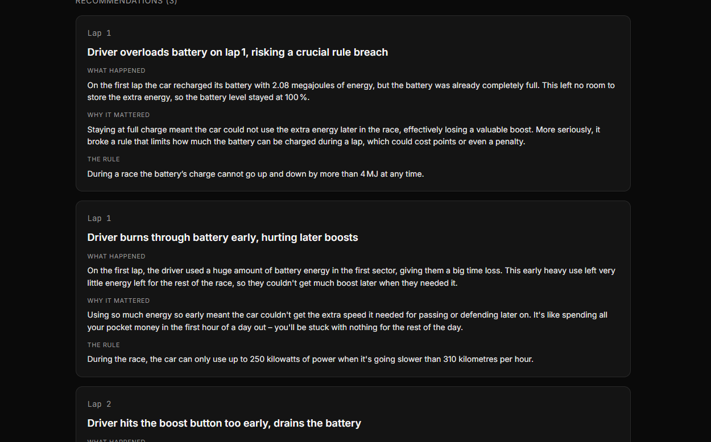
ONE ENGINE
Four audiences, one explanation layer
Engineer Mode keeps the evidence; Fan Mode makes the race legible.
Engineer and driver value: test a counterfactual and review the same validation gates on the alternate strategy.
Broadcaster and fan value: same intelligence translated into plain language without fabricating certainty.
IBM SkillsBuild AI Builders Challenge - May 2026 / 06

Slide 7
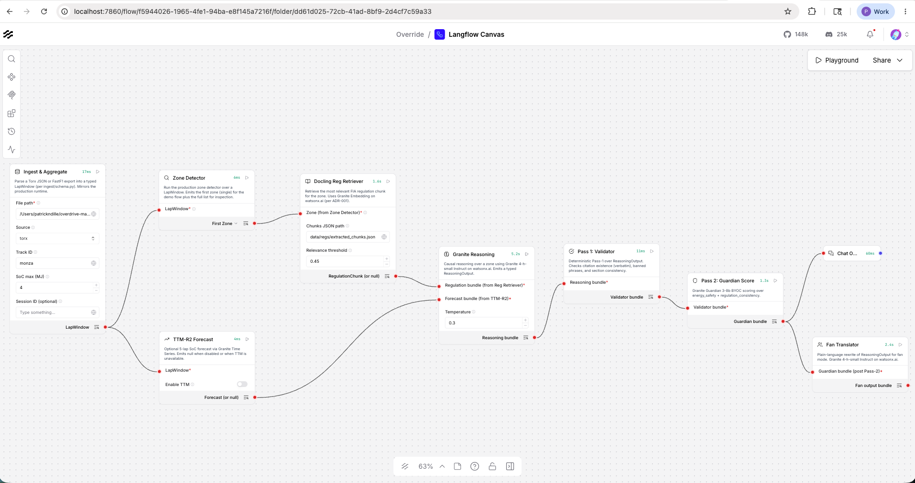
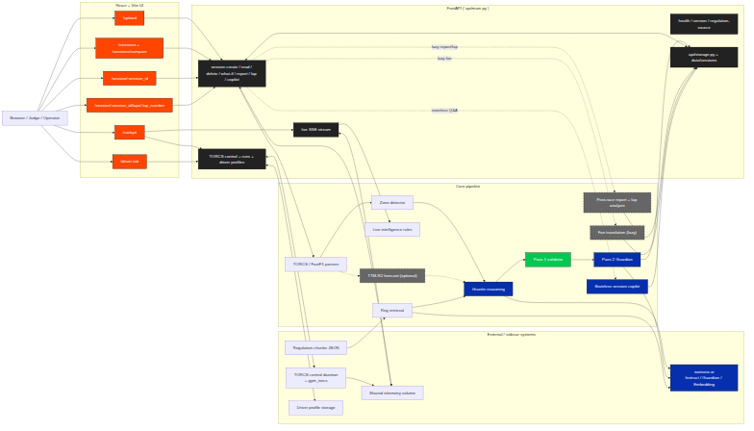
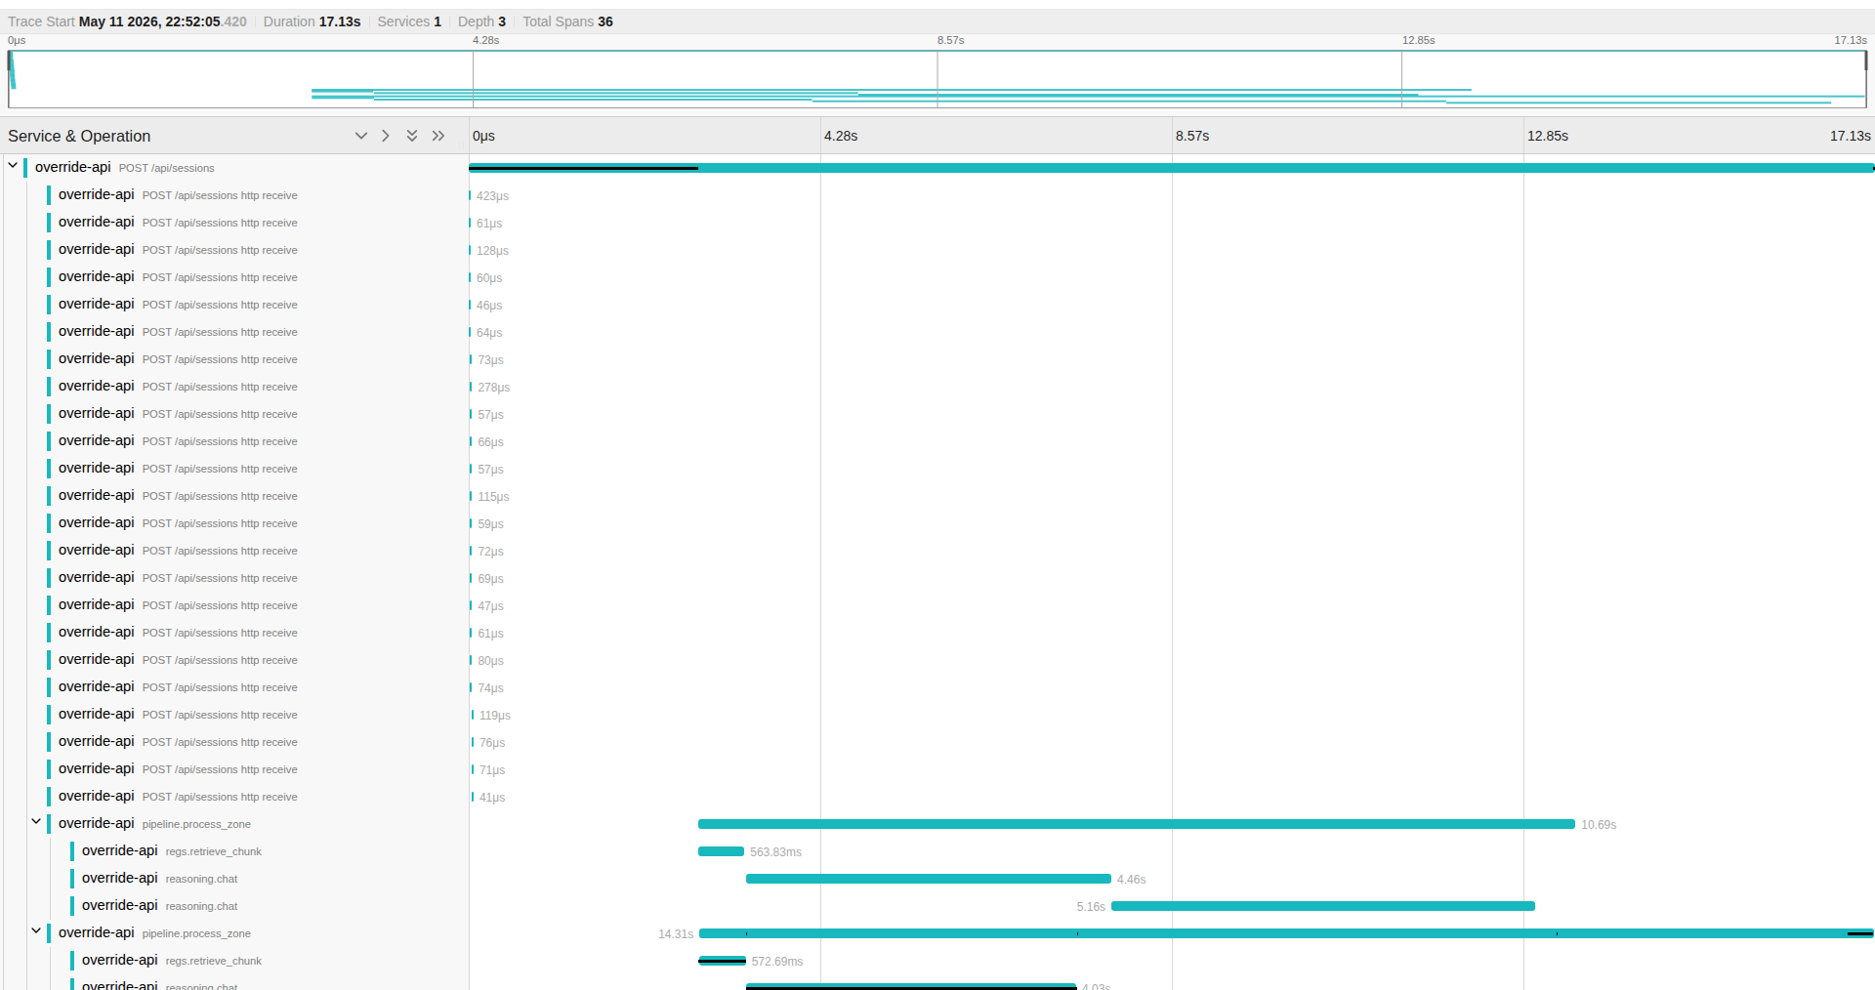
IMPLEMENTATION PROOF
Built as a reproducible AI system
FastAPI runtime, React UI, TORCS sandbox, Langflow design layer, and observable spans.
TESTS COLLECTED
IBM TECHNOLOGIES
RUNTIME
LICENSE
439
6
watsonx.ai
Apache 2.0
IBM SkillsBuild AI Builders Challenge - May 2026 / 07

Slide 8
VIDEO RUN OF SHOW
The 2:55 video should make trust feel immediate
Lead with racing motion, then prove the AI can be audited.
0:00
Hook
2026 hybrid reset: every lap is an energy decision.
0:40
Live cockpit
Start race, show telemetry, hybrid rail, AI Race Engineer.
1:18
Debrief
Ingest capture and show race report plus zones.
1:55
Trust proof
Reasoning chain, Docling citation, validator, Guardian.
2:22
What-if + Fan
Counterfactual strategy and plain-language translation.
2:42
Close
Langflow, architecture, Jaeger, IBM stack.
Closing line: OVERRIDE is explainable race-strategy AI for the 2026 hybrid era - decision support, never replacement.
IBM SkillsBuild AI Builders Challenge - May 2026 / 08

