Slide 1
QCRSCpeakExplorer
QCRSCpeakExplorerPro
QCRSCautomatic
QCRSCreviewer
QCRSCexplorerPro
QCRSCMXPro

Slide 2
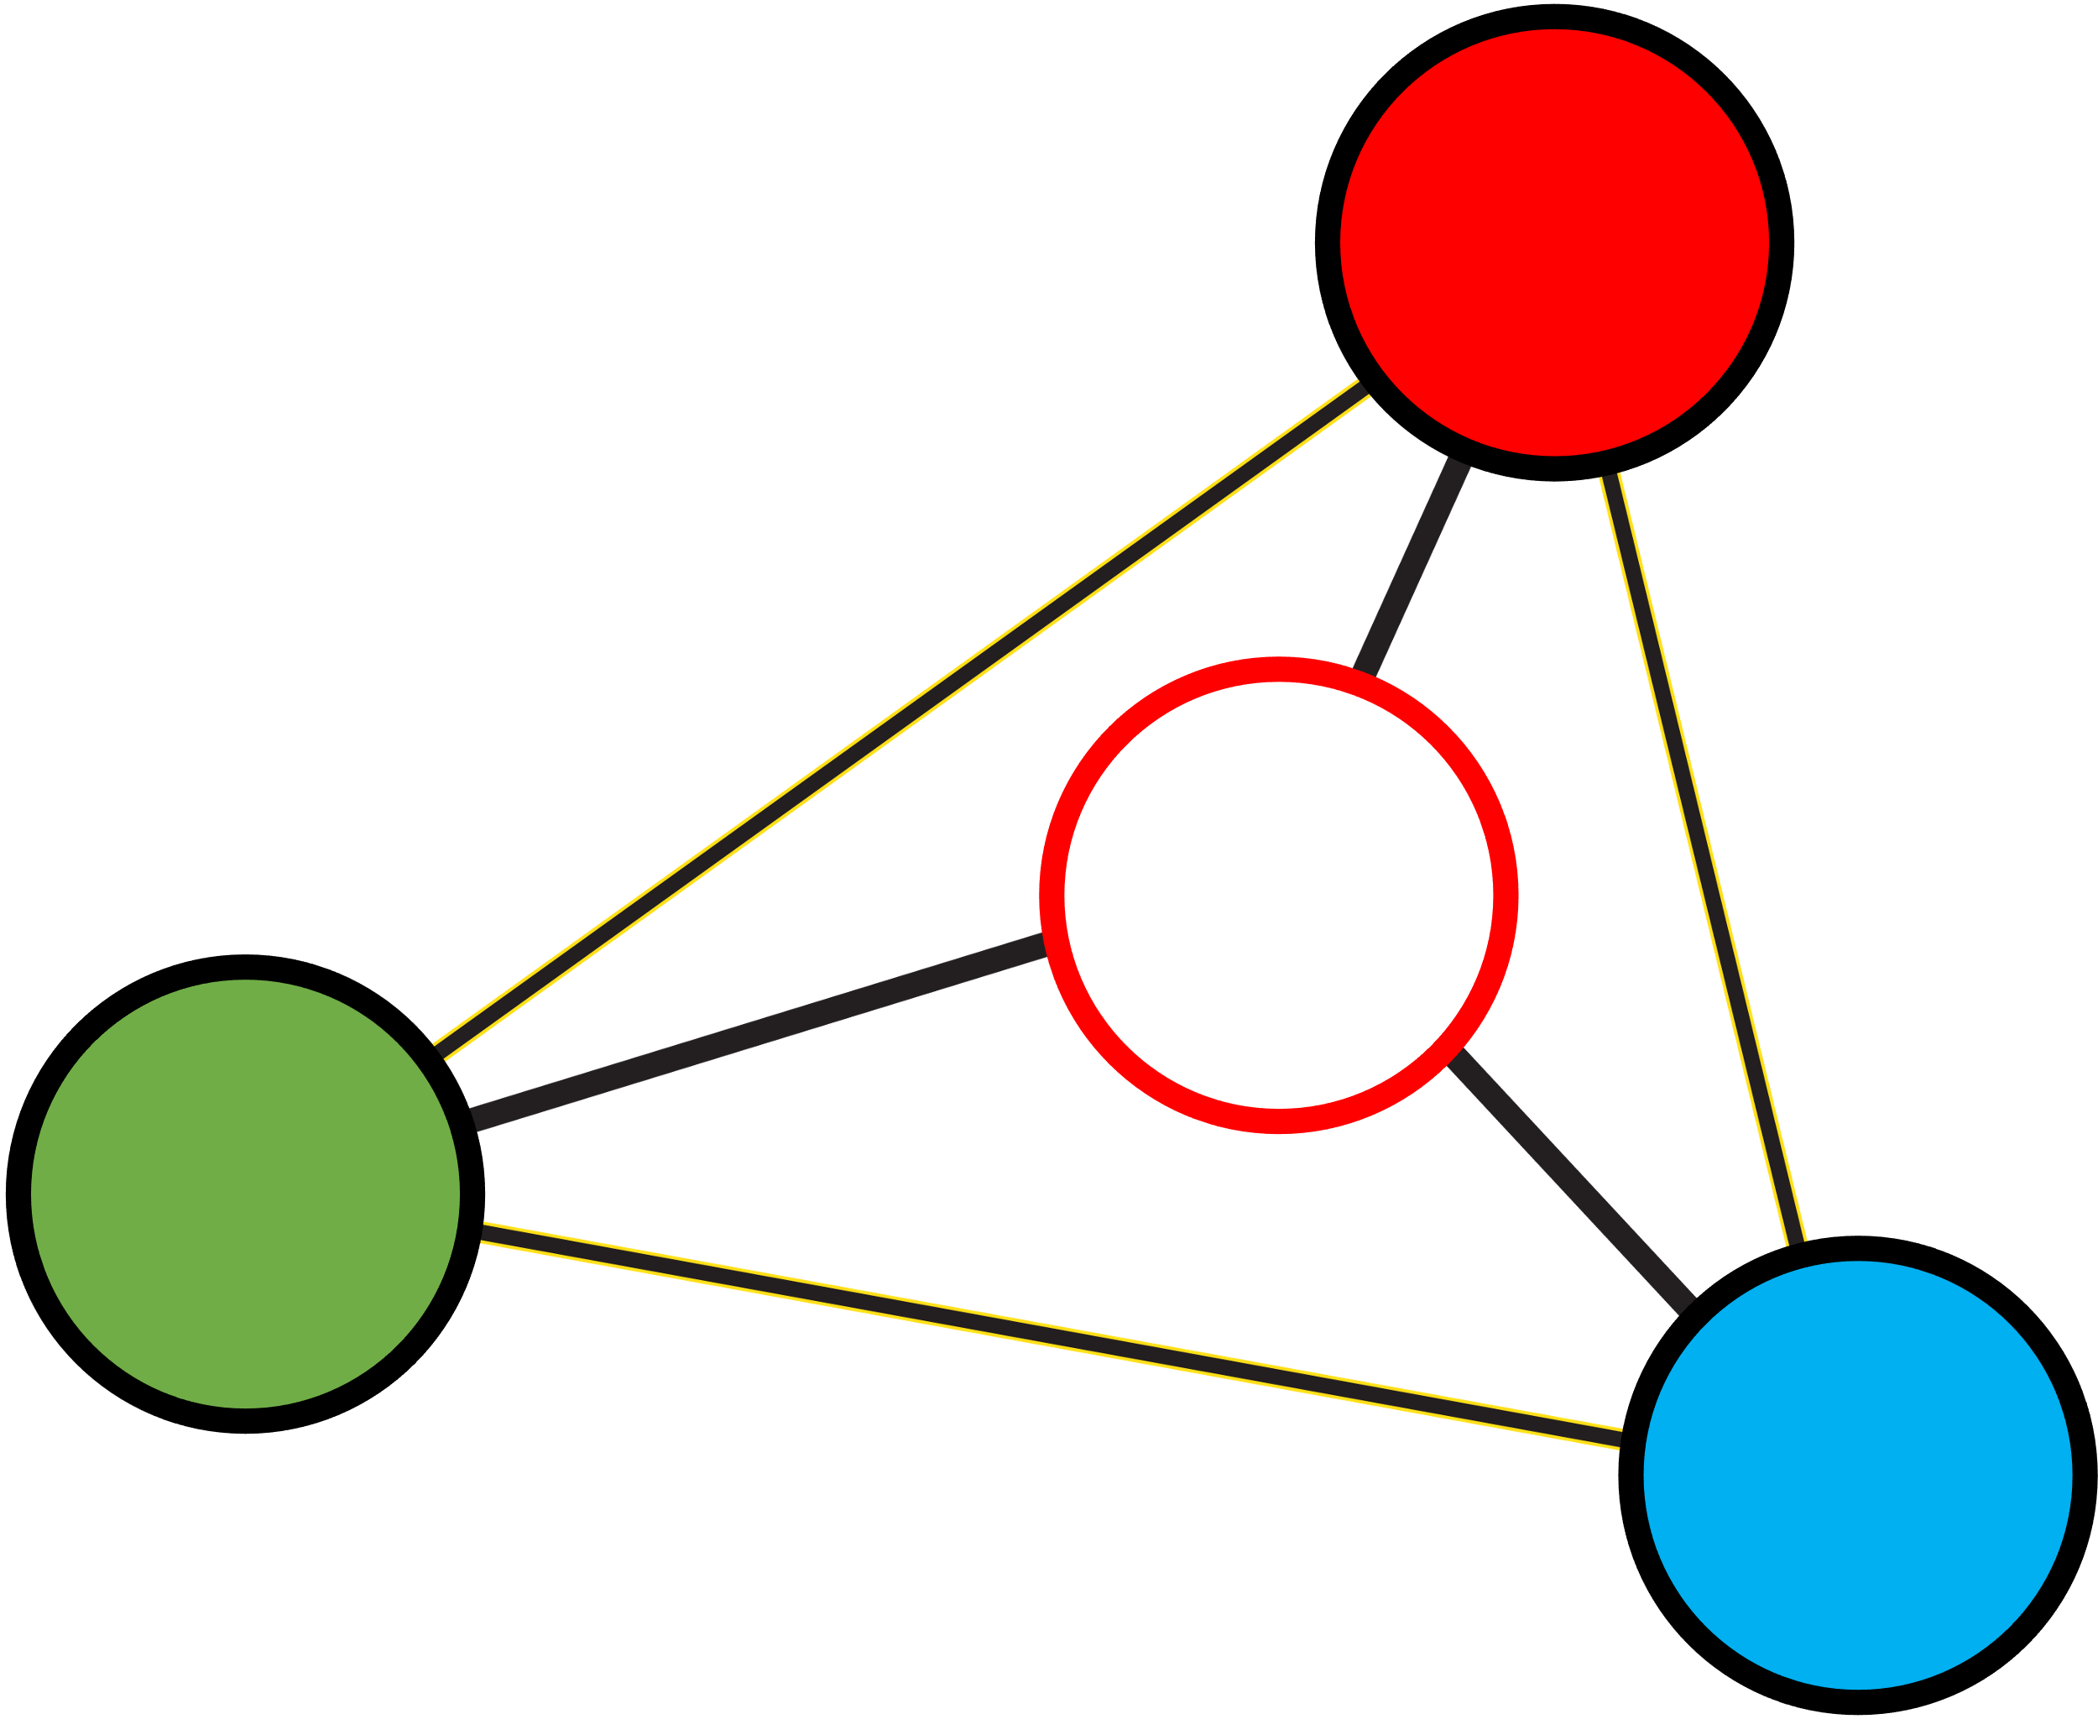
QCfeatureExplorer
QCcorrectionExplorer
QCfeatureExplorer
QCfeatureExplorer
QC
QCMXP
Filter Reset
MXP

Slide 3
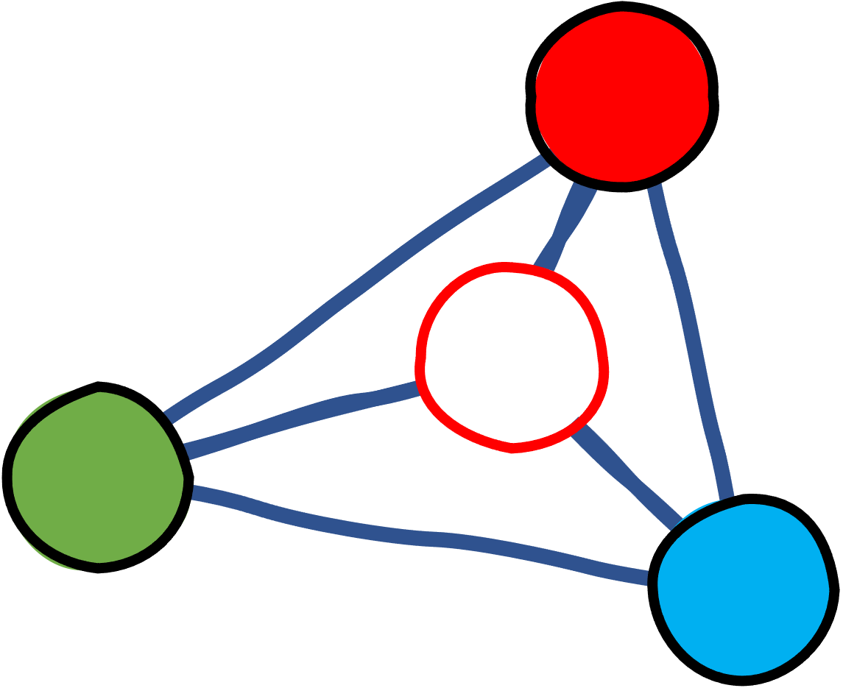

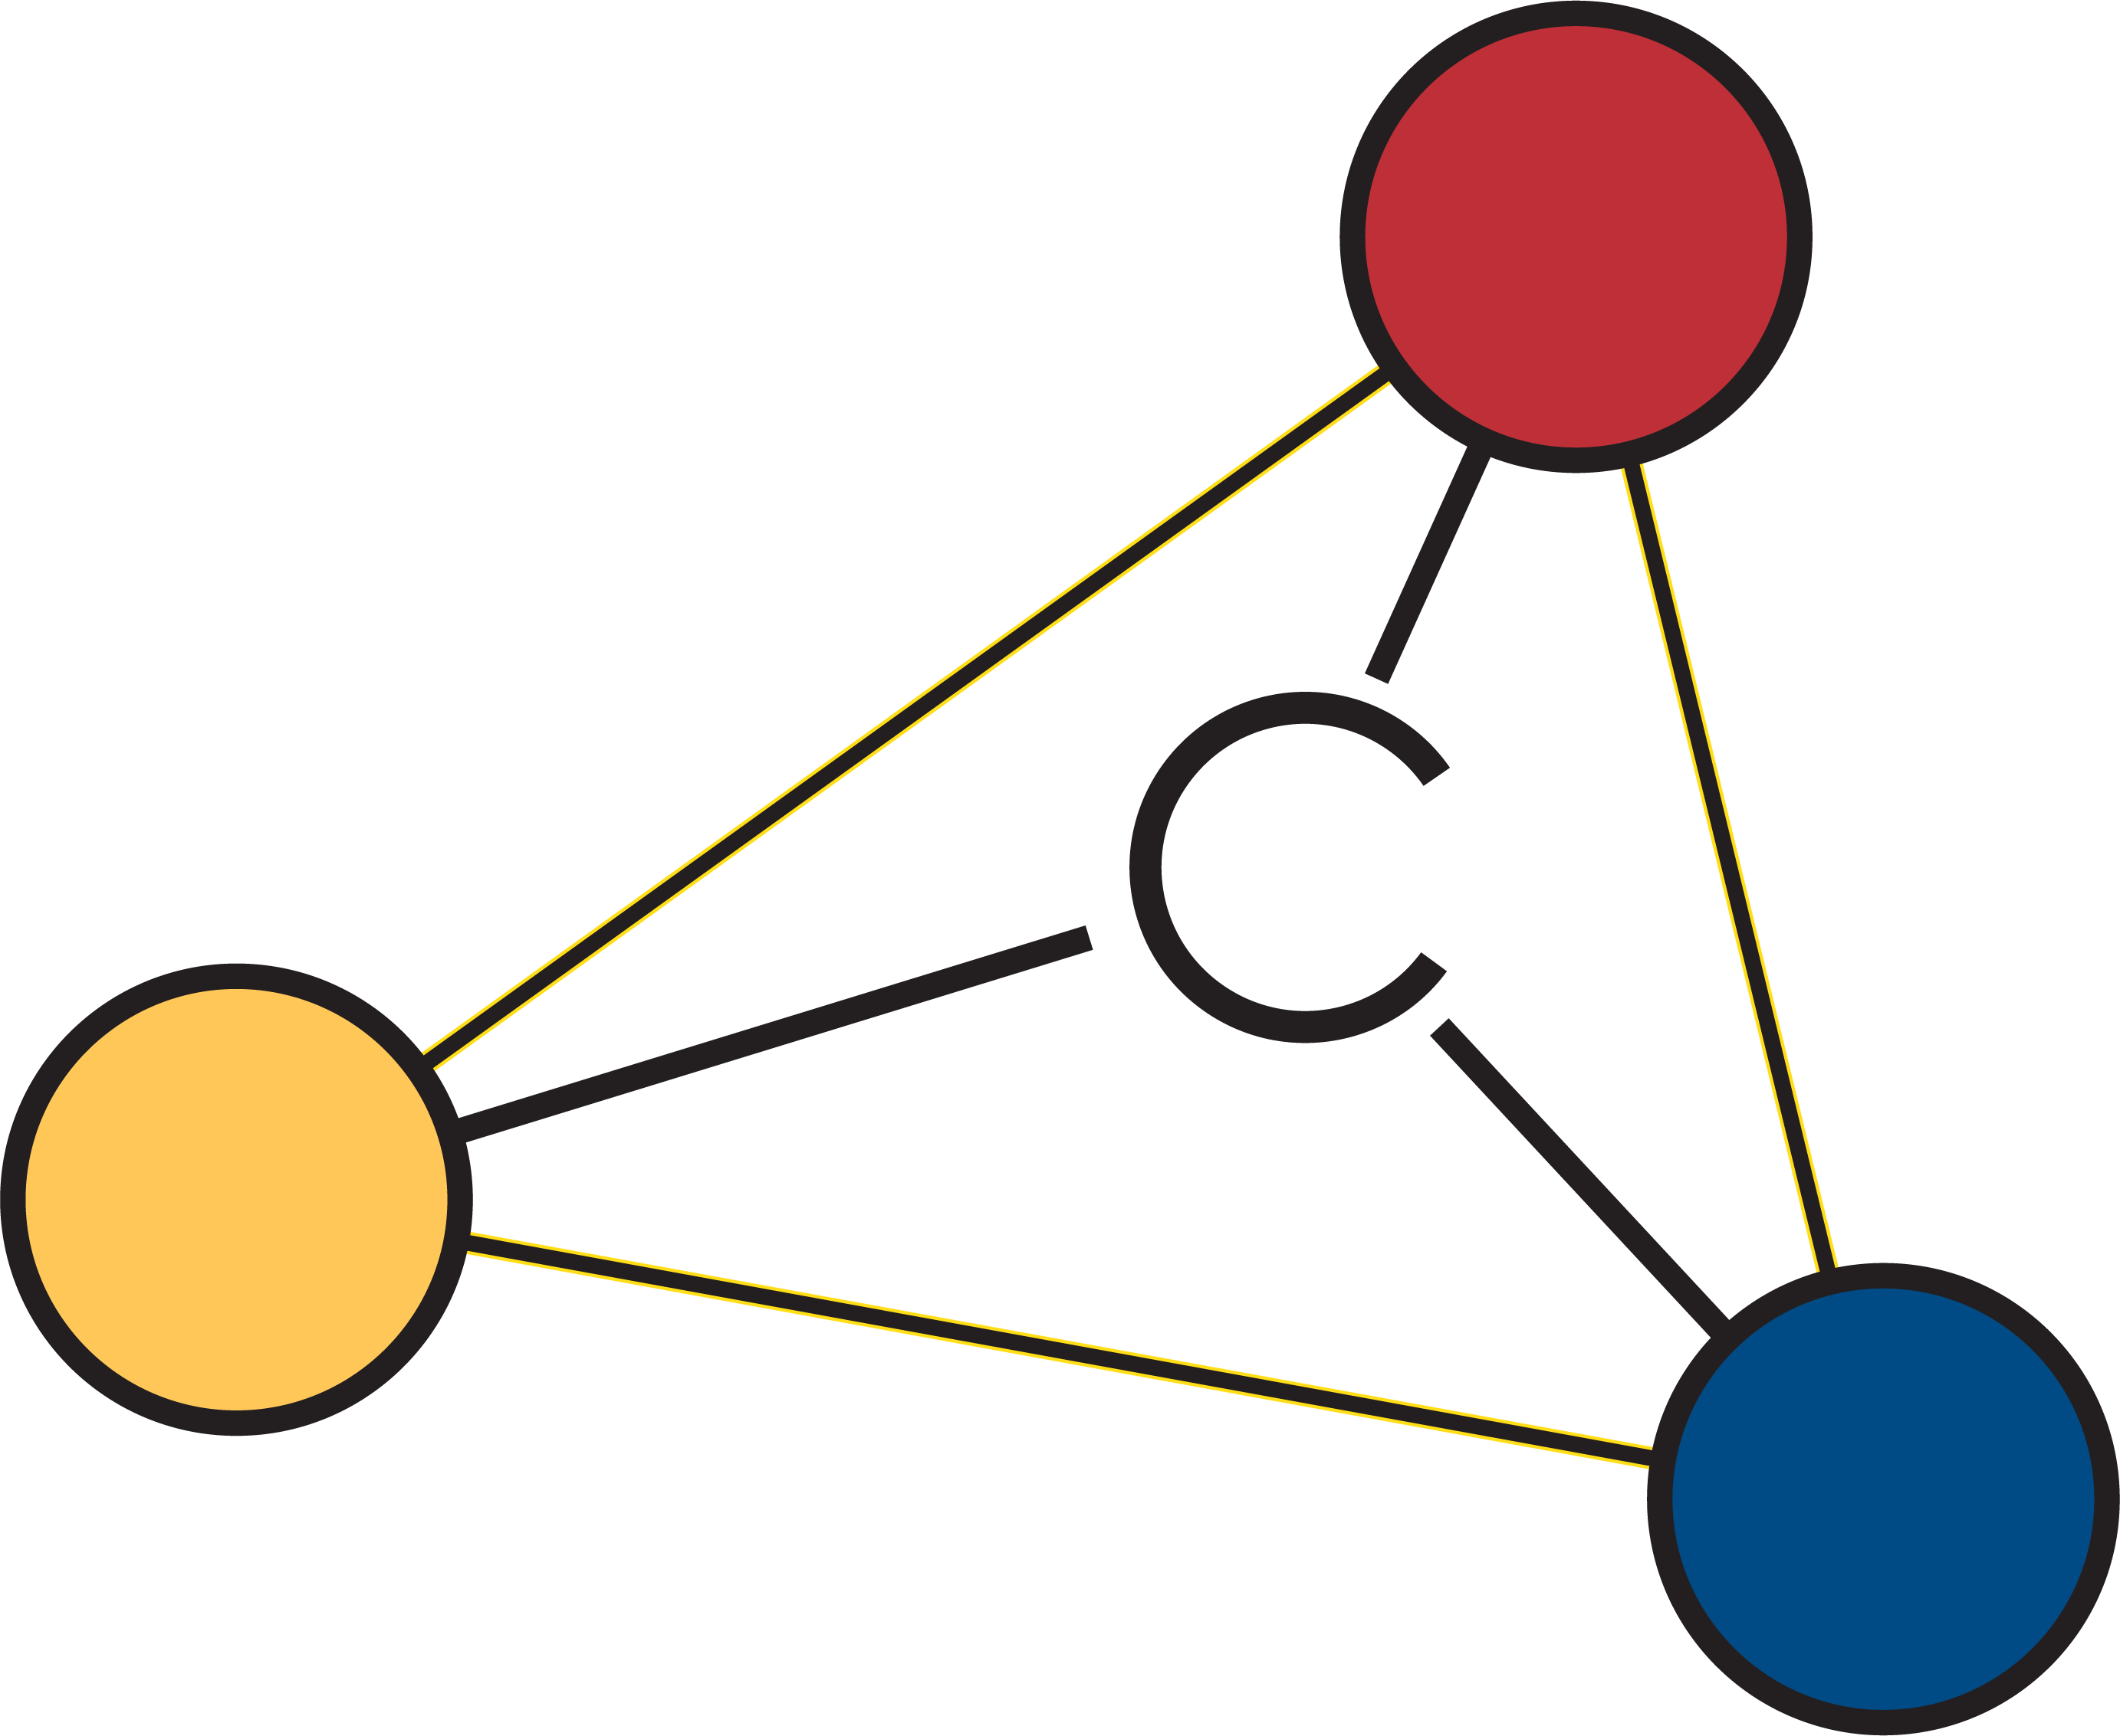

Quality Control
Regularized Spline Correction
QC-RSC Explorer
Batch Explorer
Quality Control
peakExplorer

Slide 4

configExplorer
Repeat-injection-based:
Quality Control,
Batch Correction,
Exploration,
& Data Cleaning

Slide 5
QC-RSC Explorer

Slide 6
Repeat-injection-based:
Quality Control,
Batch Correction,
Exploration,
& Data Cleaning

Slide 7
OC
MXP

Slide 8

Quality Control
engine
MXP
calibrationExplorer

Slide 9
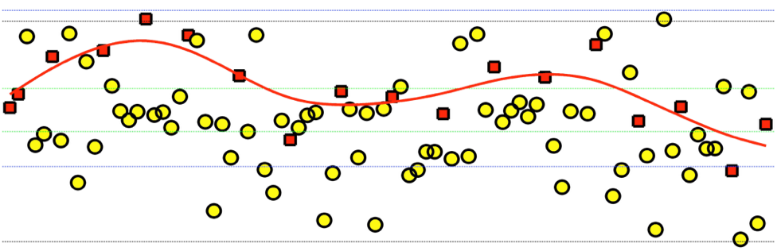

Slide 10
Thermo CD3
Excel Export
2
Liverpool
*
tidyMet
qc

Slide 11
OC
MXP

