Slide 1

Data Table (Tidy)
Peak Table (Tidy)

Slide 2
Load Data
Batch Correct:
Run the batch correction algorithm. Each feature is corrected in turn (or in parallel if the parallel engine is activated).
4
Export Corrected Data
1
5
Prefilter:
Remove features with less that a given % of QC values missing (or below the blank concentration)
Explore & Clean Data:
2
3
Evaluate:
Calculate quality metrics univariately & multivariately.
Filter Features:
Remove features (peaks) based on metrics of quality: RSD, D-Ratio, Blank Ratio
Exploration:
Visualize quality metrics univariately & multivariately.
Configuration:
Set the desired configuration of the: QC outlier detection, the within batch correction method (with or without cross-validation) and other operational settings
6
Export Clean Data

Slide 3
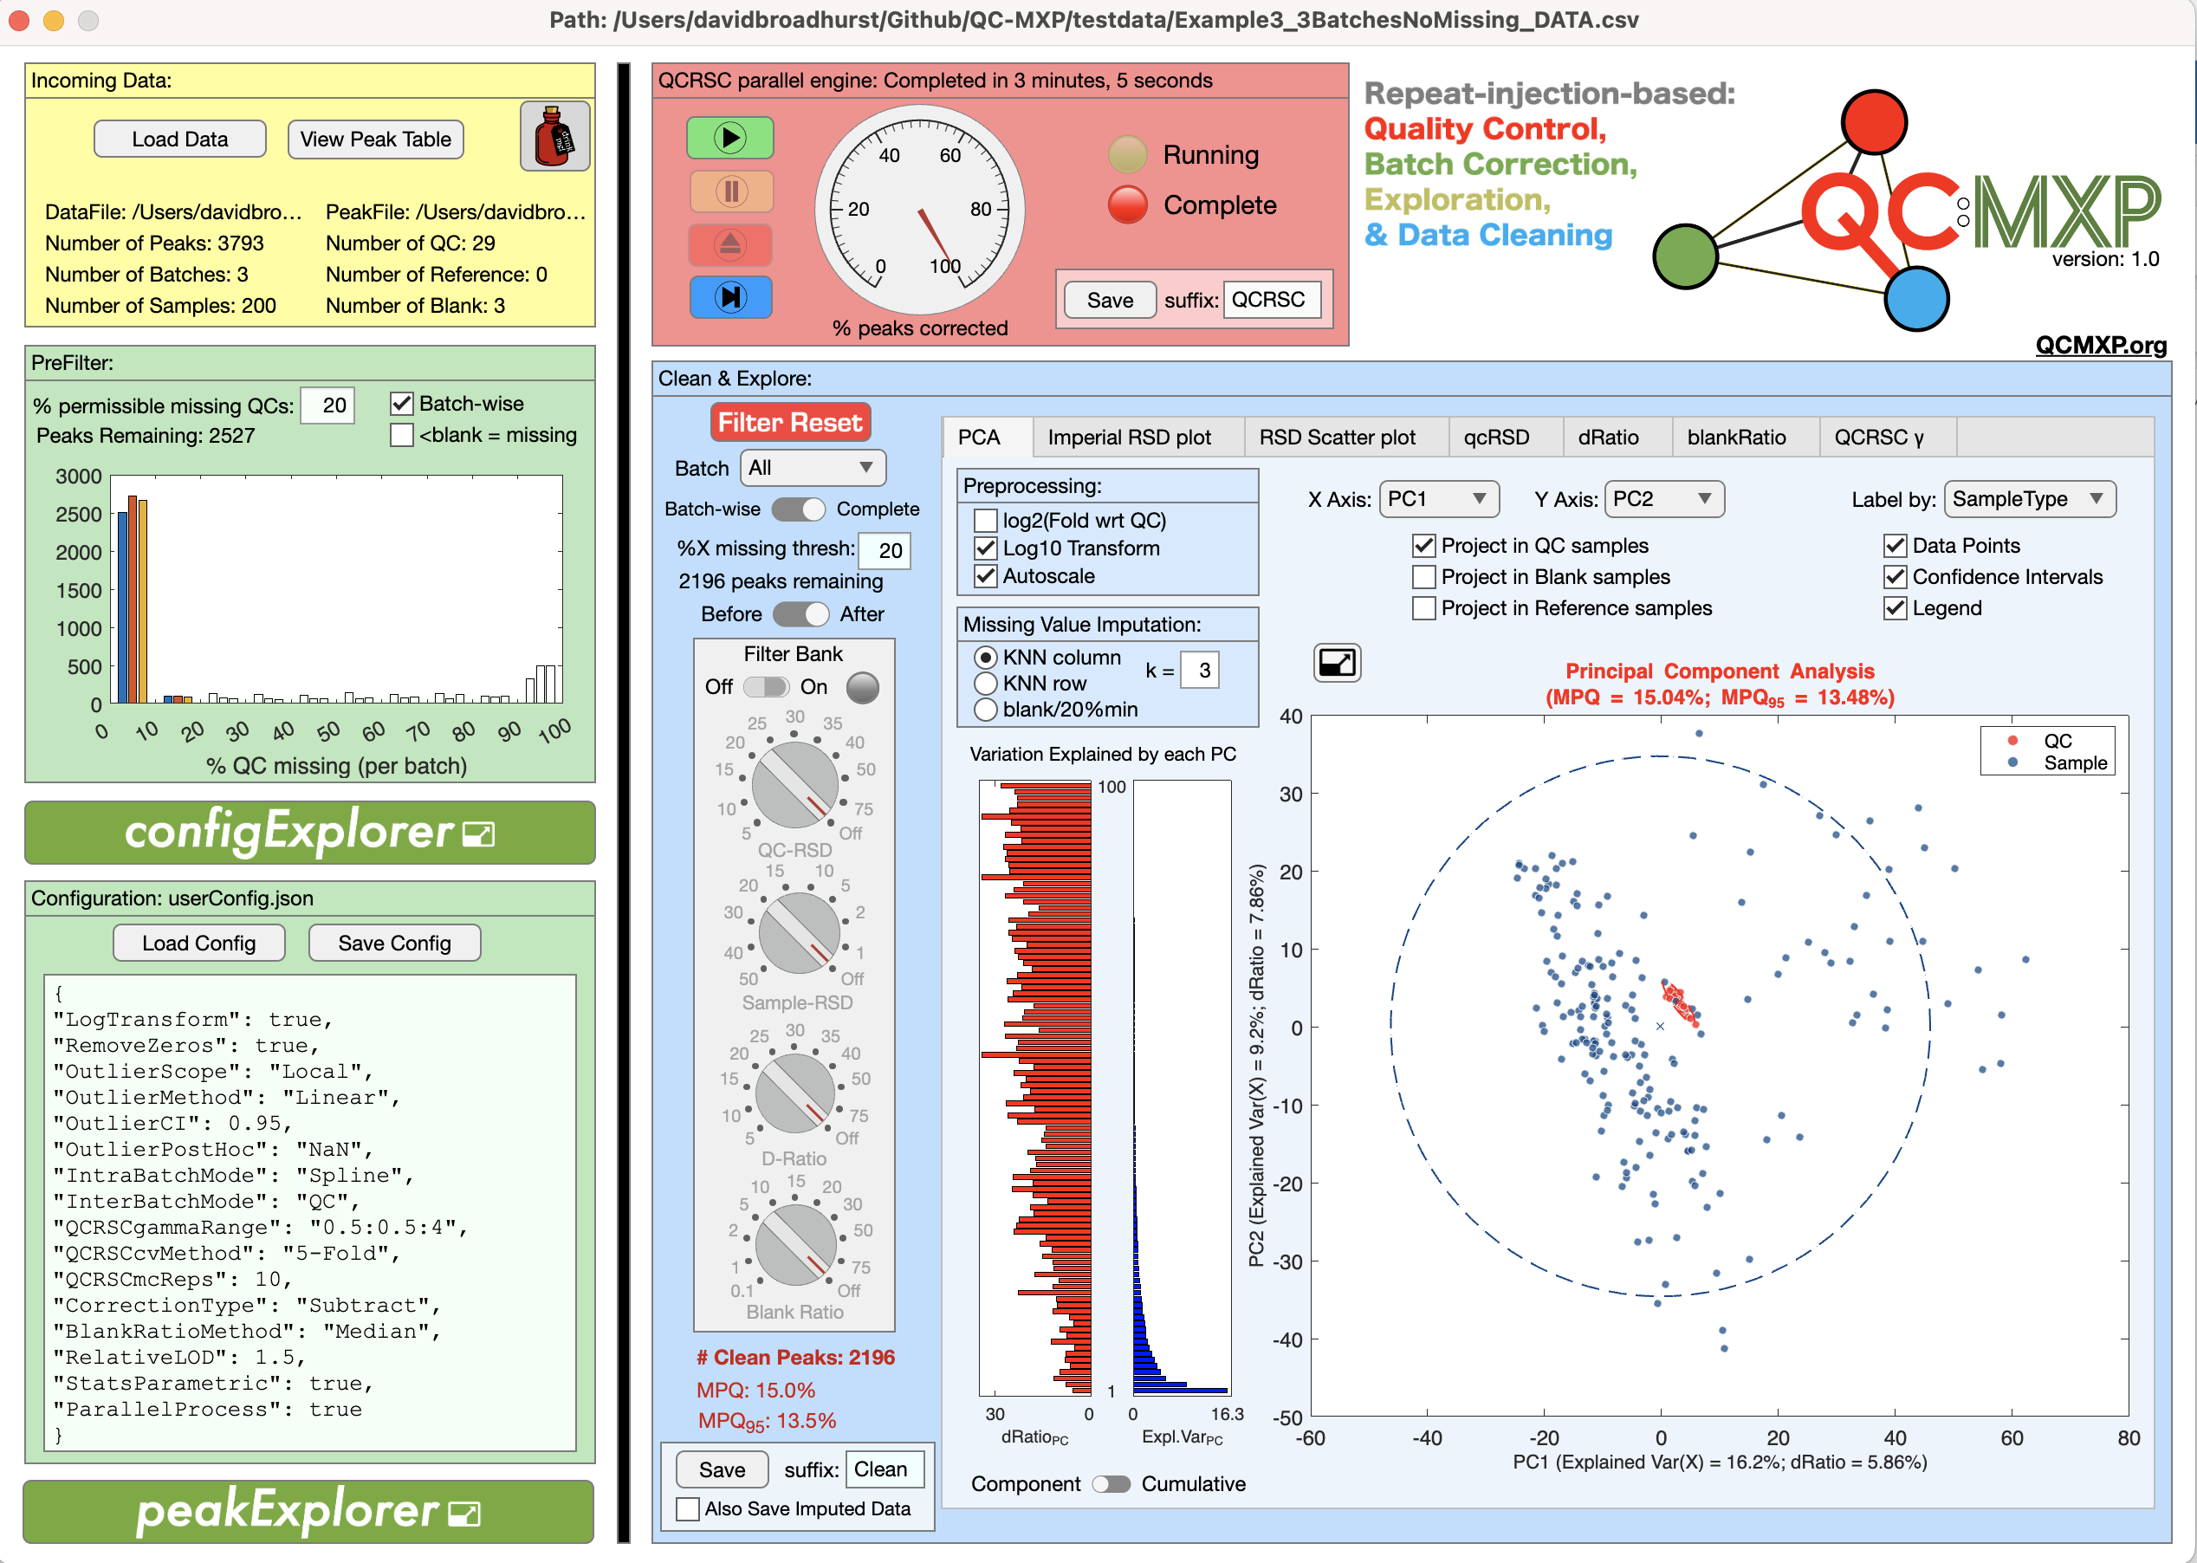

Slide 4
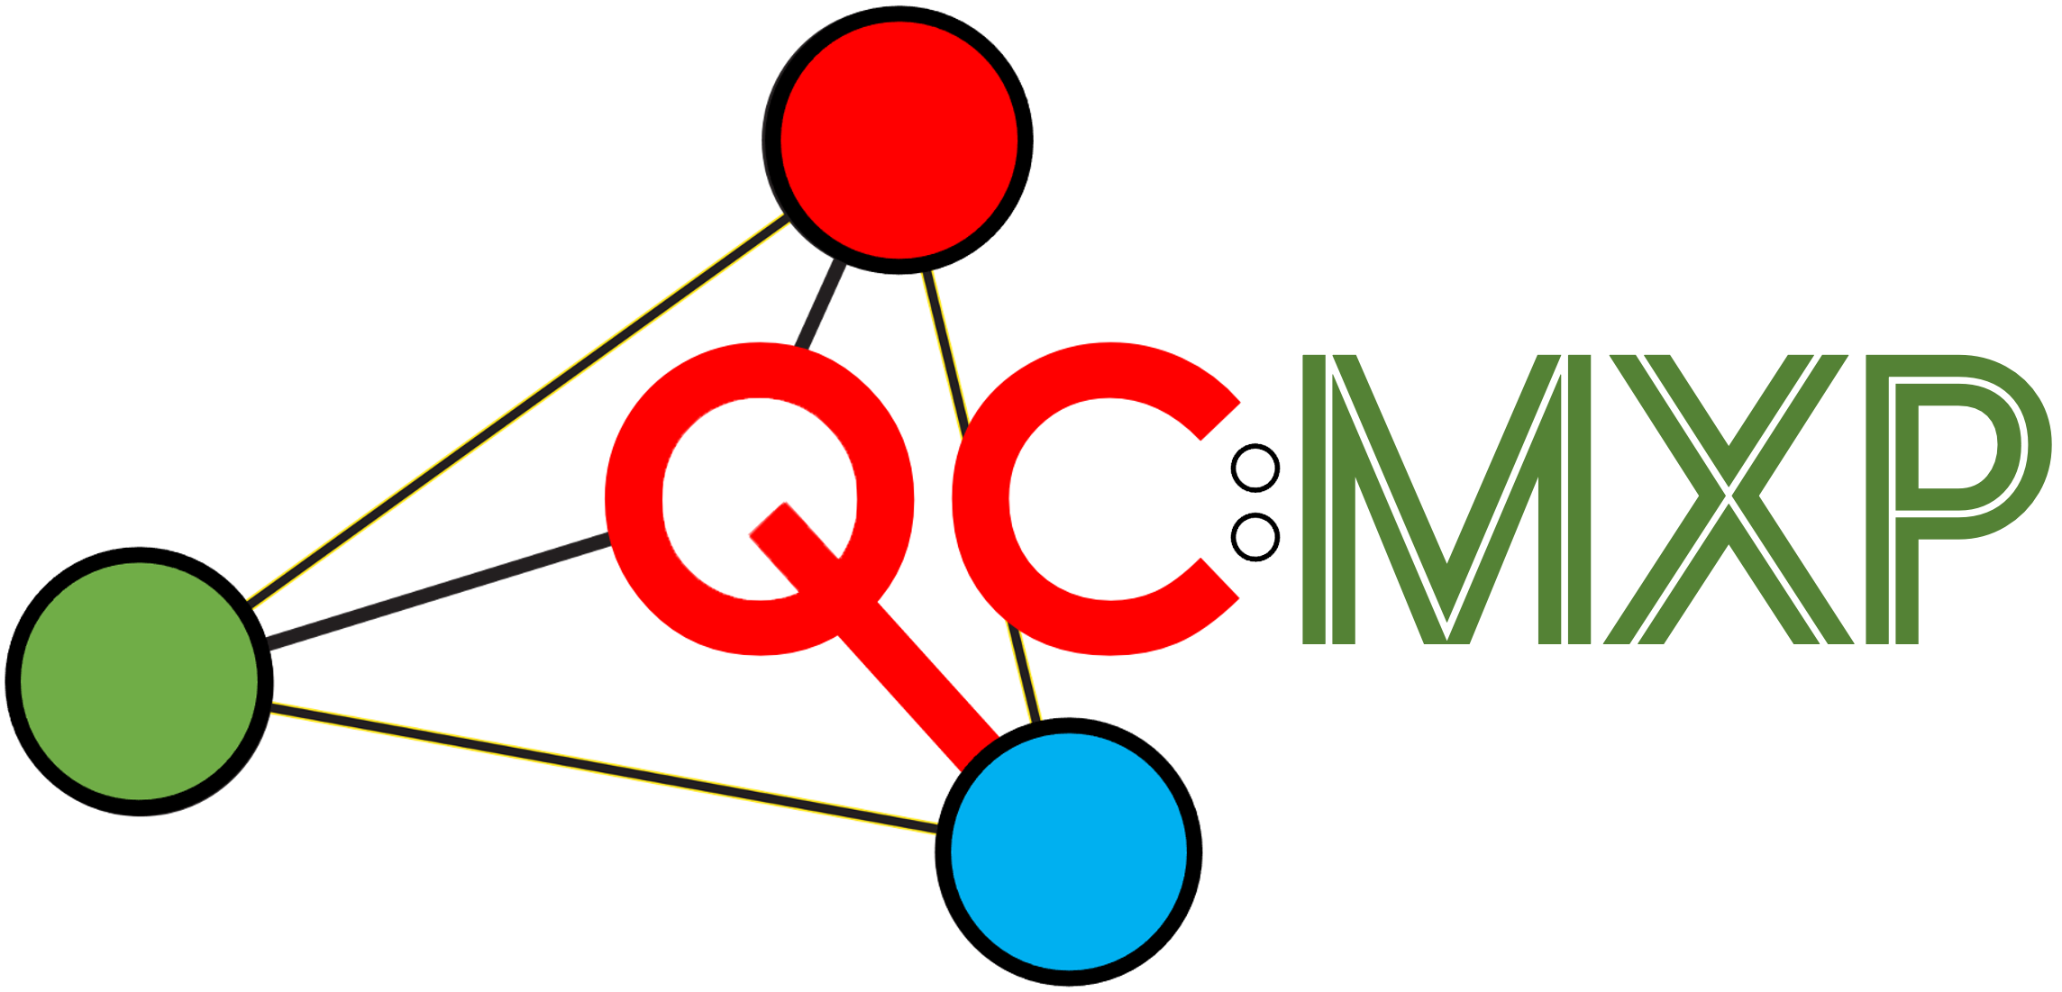

Slide 5
