Slide 1

Tidy Data for Metabolomics
David Broadhurst

Slide 2
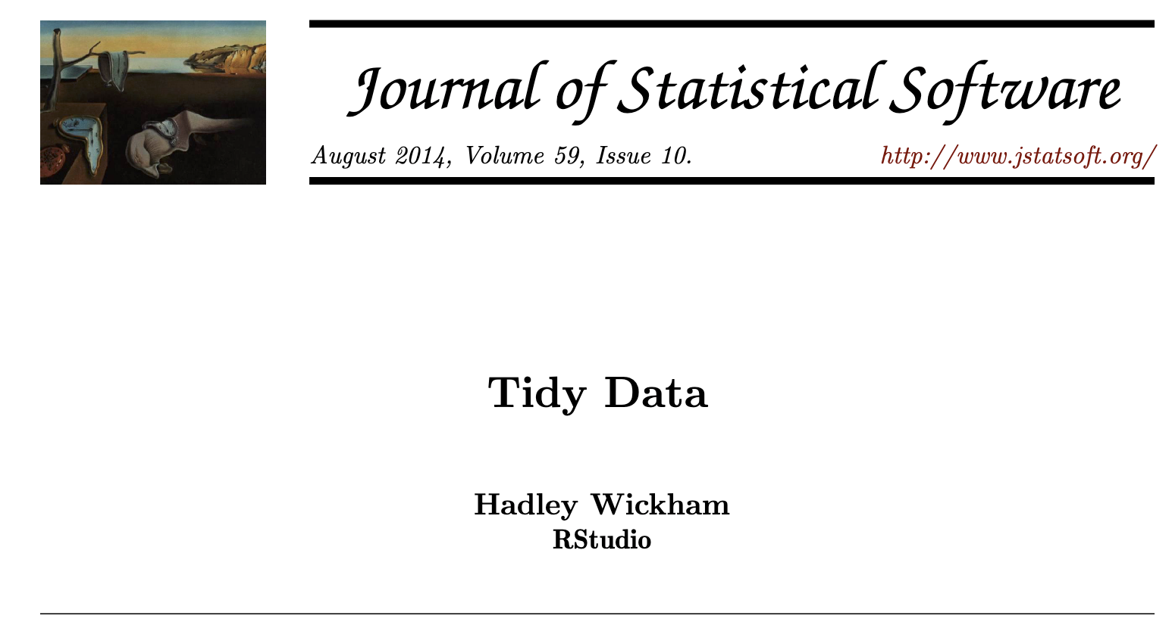
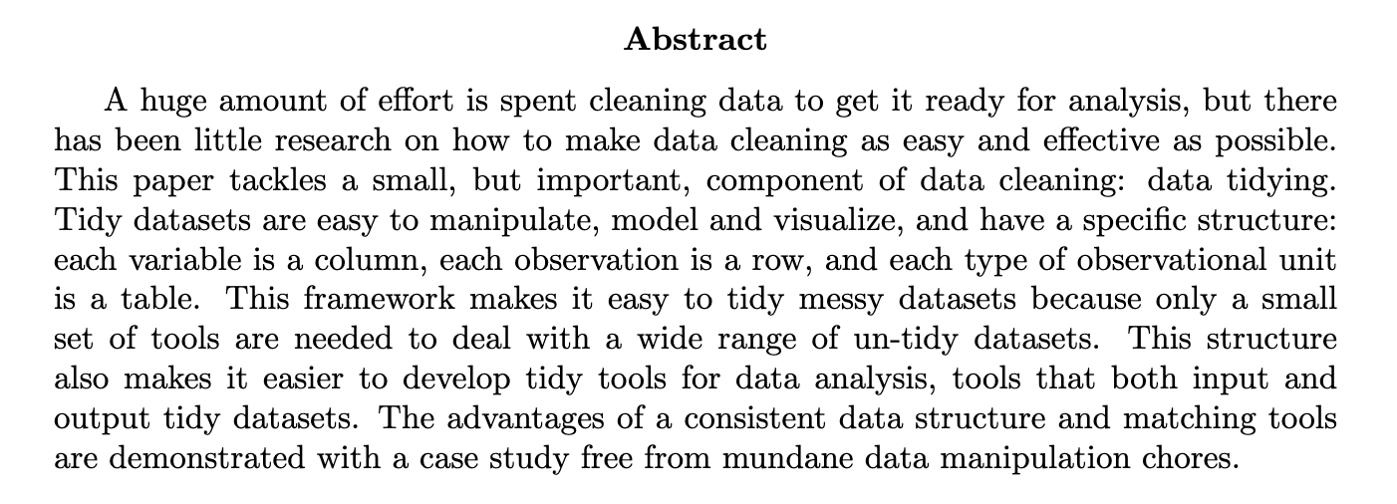

Slide 3

DataTable
SampleID
PeakTable
MetaTable
SampleID

Slide 4
Solution 4
DataTable
PeakTable

Slide 5
variables
observations
values

