Slide 1

Tidy Data for Metabolomics
David Broadhurst

Slide 2
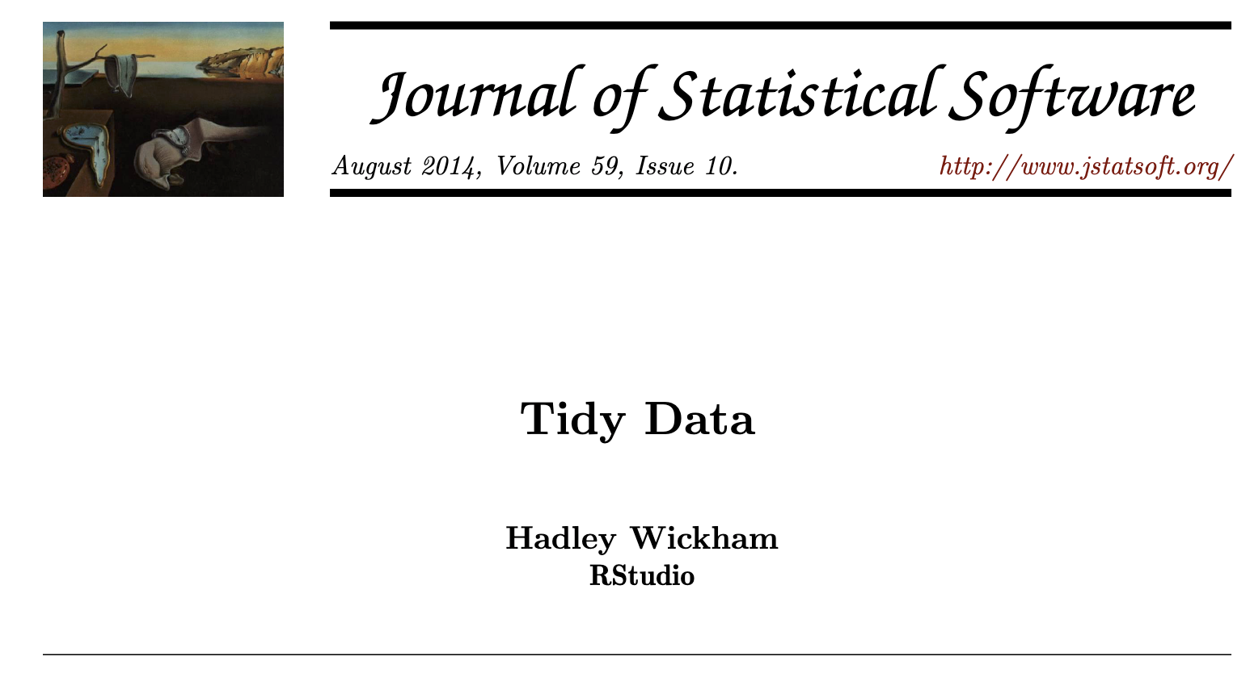
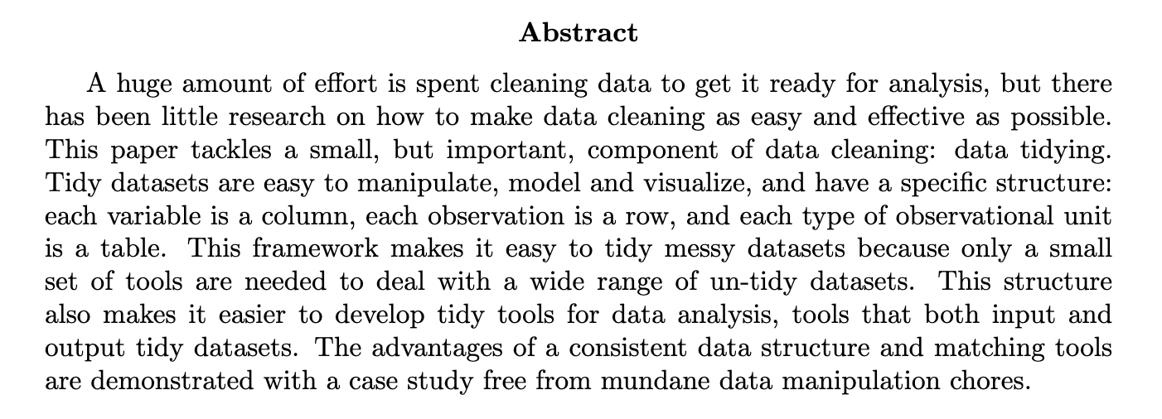

Slide 3

DataTable
SampleID
FeatureTable
MetaTable
SampleID

Slide 4
Solution 4
DataTable
FeatureTable
UID

Slide 5
variables
observations
values

