Slide 1
Evidence of cell state switching in single cell drug response

Slide 2
2015_10_05_DrugRepurposing_AravindSubramanian_GolubLab_Broad
DMSO
No of Plates | No of DMSO Wells | Cell Count
SQ00015142 | 24 | 68708
SQ00015143 |  | 63737
SQ00015144 |  | 63796
SQ00015145 |  | 66987
SQ00015201 |  | 56739

Slide 3
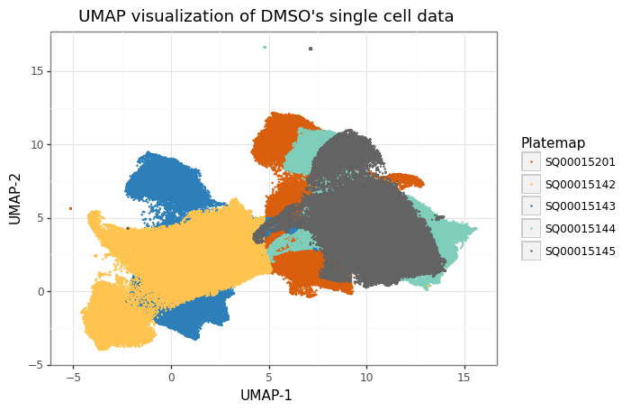
Data preprocessing
Z-normalization
Features [ 471 ]
We can clearly see batch effects are predominant in the data and requires batch correction

Slide 4
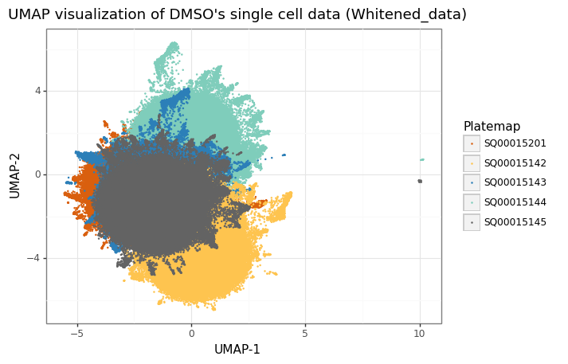
Whitened data
batch effects removed after whitening

