Slide 1
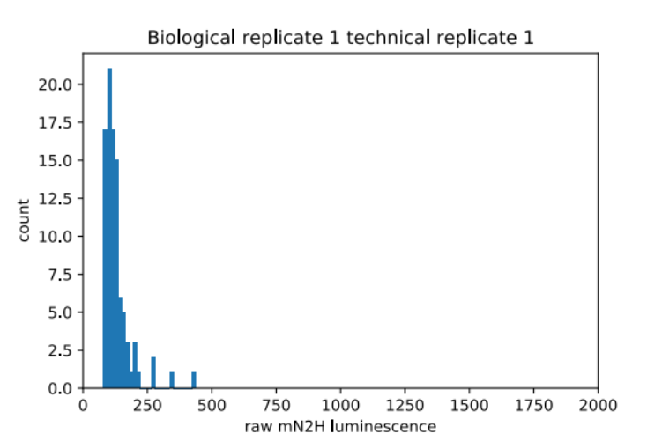
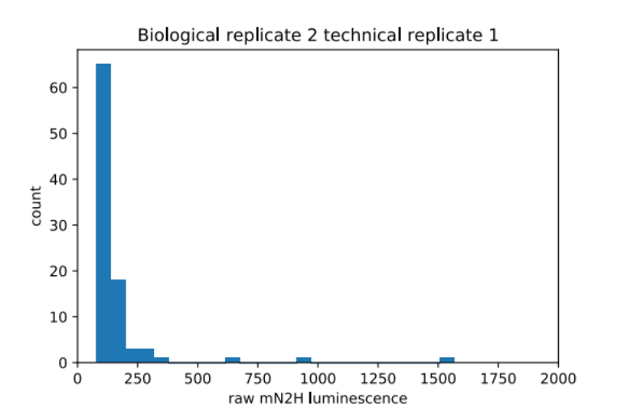
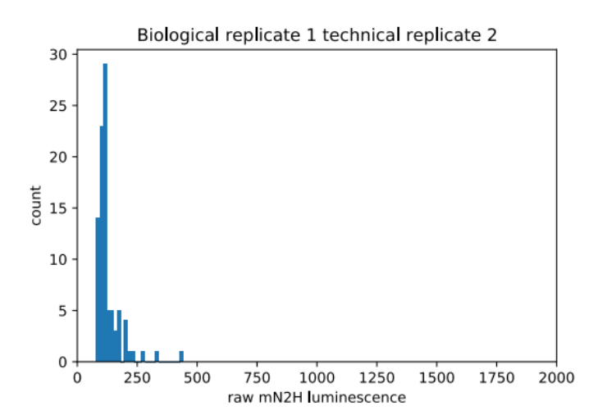
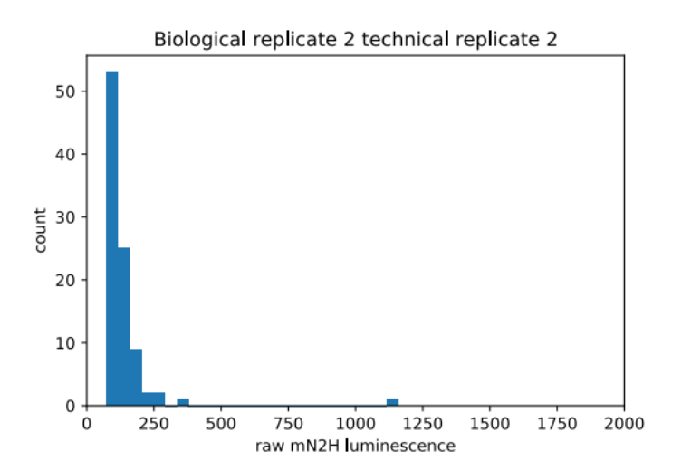
Empty wells background noise
Low mN2H raw signal in expected empty wells

Slide 2
Allele experiment (July)
Pearson r = 0.99
Pearson r = 0.98
B1 = biological replicate 1 (average of B1 technical 1 and B1 technical 2)
B2 = biological replicate 2 (average of B2 technical 1 and B2 technical 2)
B1R1 = Biological replicate 1 technical replicate 1
B1R2 = Biological replicate 1 technical replicate 2
B2R1 = Biological replicate 2 technical replicate 1
B2R2 = Biological replicate 2 technical replicate 2
Pearson r = 0.68

Slide 3
Wild-Type experiment (March)
Pearson r = 0.99
Pearson r = 0.99
Pearson r = 0.92

Slide 4
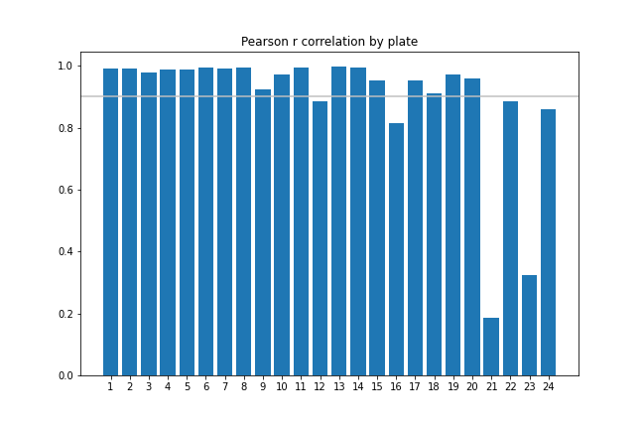
Plates correlation between each biological replicates
High correlation pairs
N1-N2 correlation ≥ 0.9
N1-empty N2 correlation ≥ 0.9
N2-empty N1 correlation ≥ 0.9

Slide 5
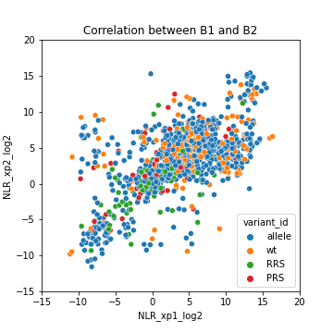
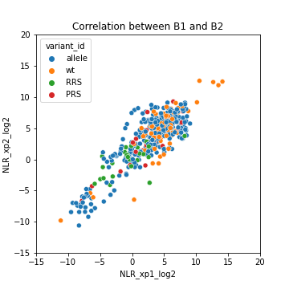
Remaining data after filtering high correlation pairs between biological replicates
All pairs
High correlation pairs
Pearson r = 0.63
Pearson r = 0.86
All High correlation allele-wt pairs
allele 830 317 245
wt 248 93 93
RRS 78 26
PRS 60 23

Slide 6
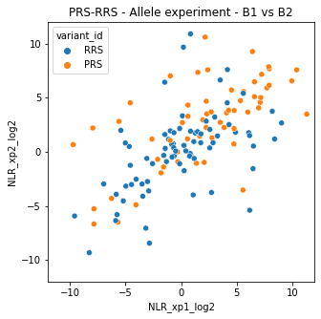
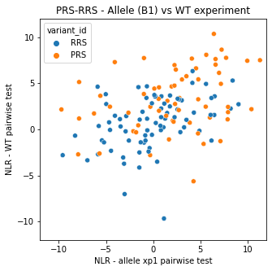
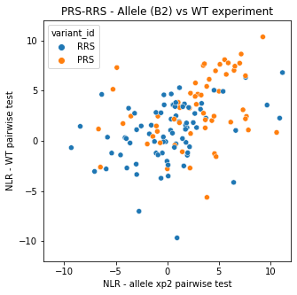
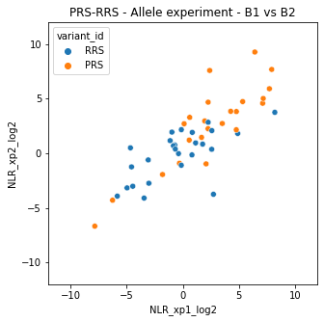
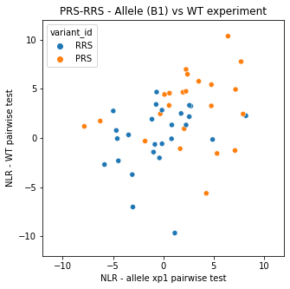
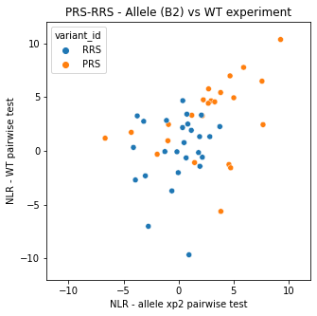
PRS-RRSv2 - correlation between March and July xp
All
PRS-RRS
High correlation
PRS-RRS

Slide 7
Correlation PRS-RRS (March) vs Chooi et al

Slide 8
WT PPIs - correlation between March and July xp

