Slide 1
Using git from Rstudio
CP BootCamp 2024

Slide 2
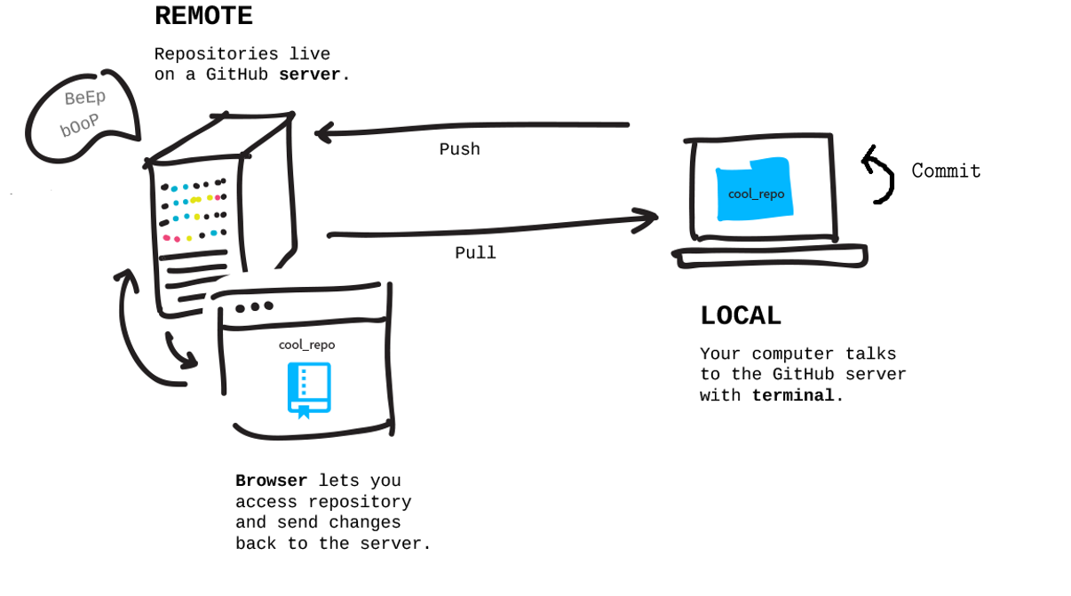
Introduction
What is version control?
What is Git?
What is GitHub?
https://malikaihle.github.io/Introduction-RStudio-Git-GitHub/

Slide 3
Installation
Downloading Git → http://git-scm.com/downloads
Downloading GitHub Desktop → https://desktop.github.com/

Slide 4
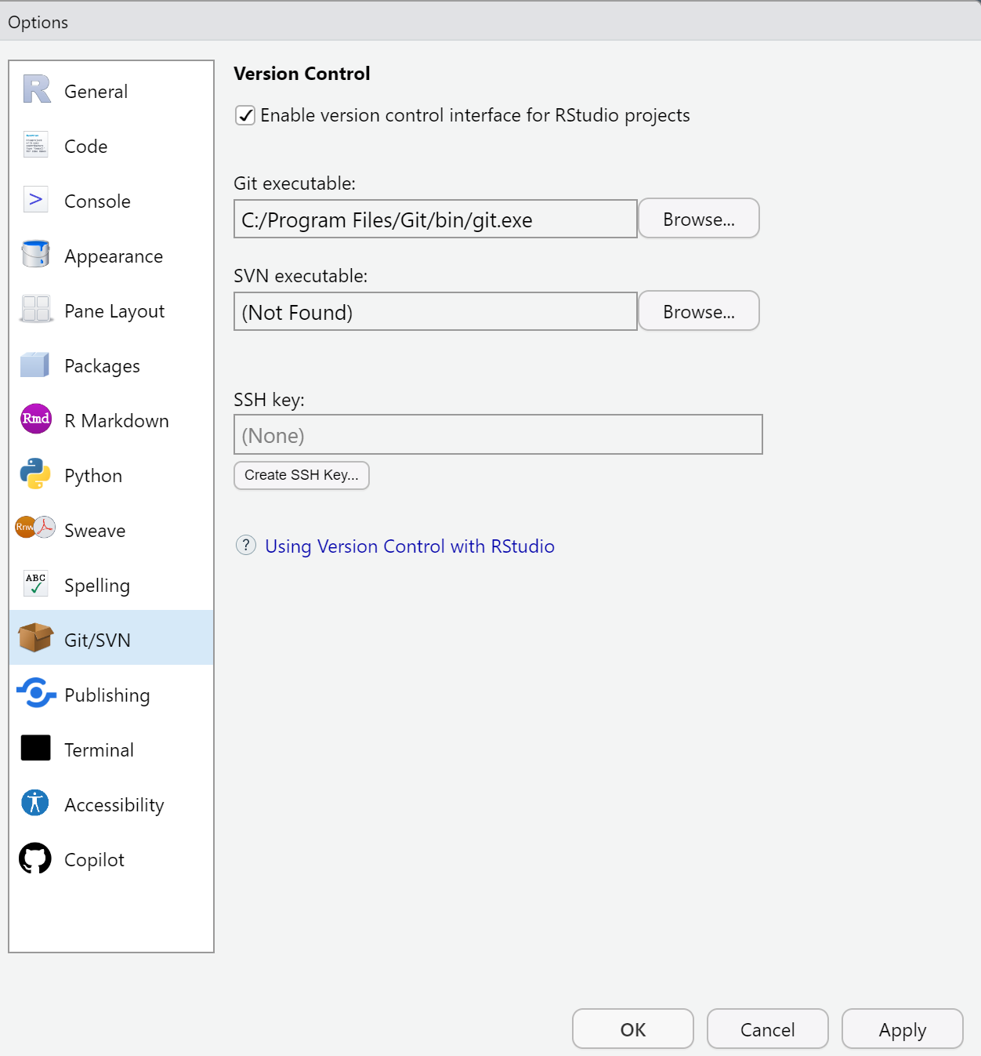
Setting up GitHub in RStudio
Go to Global Options (from the Tools menu)
Click Git/SVN
Click Enable version control interface for RStudio projects
If necessary, enter the path for your Git executable where provided.
Re-start RStudio

Slide 5
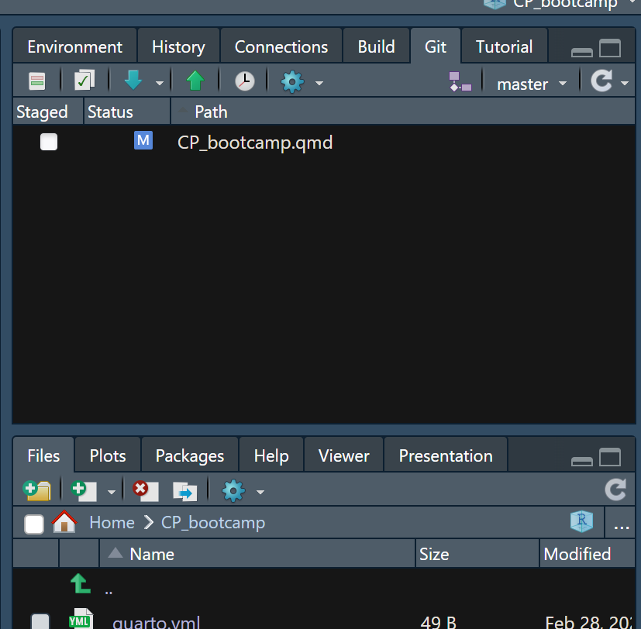
Setting up GitHub in RStudio
Go to Global Options (from the Tools menu)
Click Git/SVN
Click Enable version control interface for RStudio projects
If necessary, enter the path for your Git executable where provided.
Re-start RStudio

Slide 6

Create a GitHub account
Go to the website → https://github.com/

Slide 7
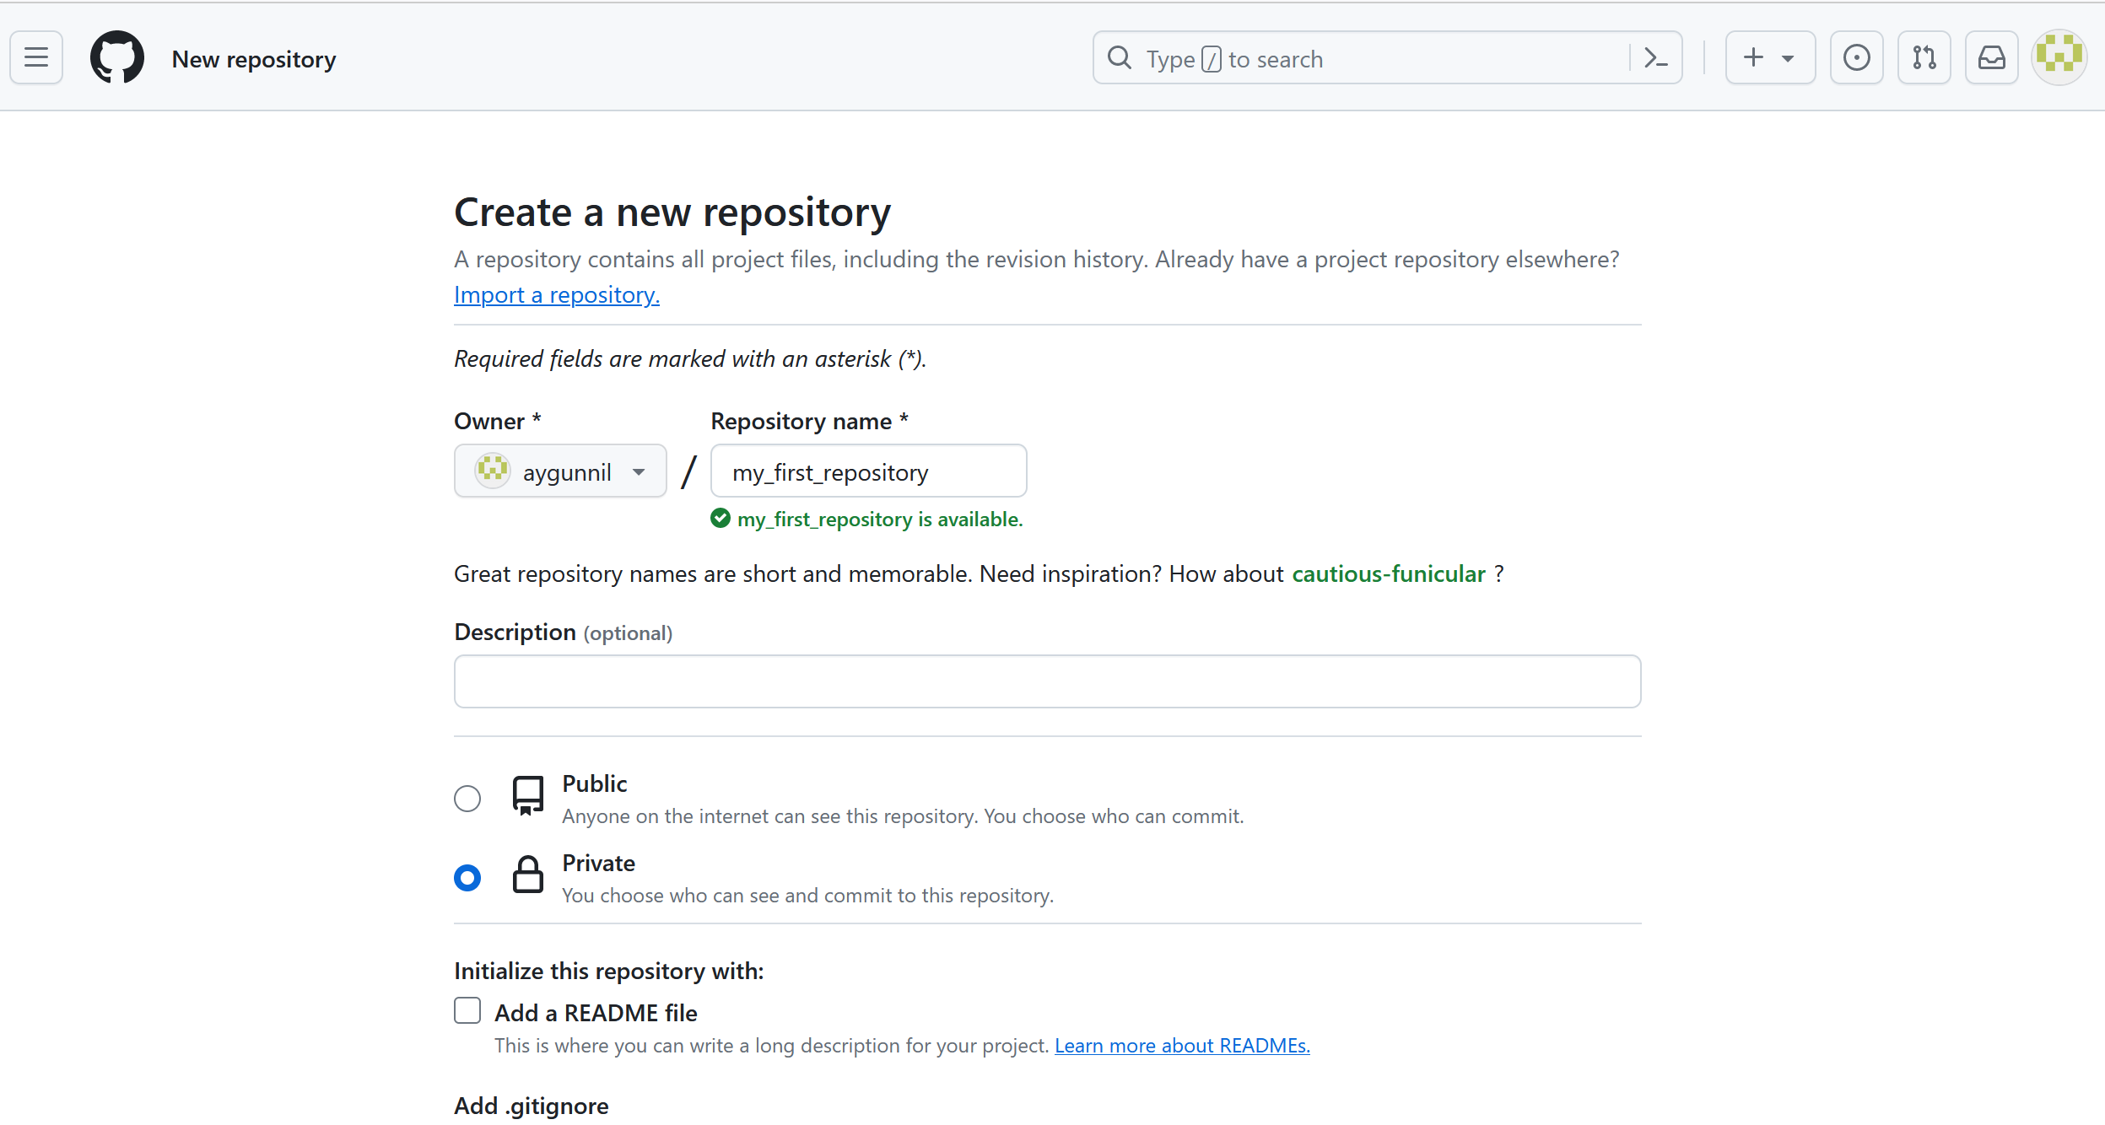
Starting git version control
1. Create a new repository in your Github account

Slide 8
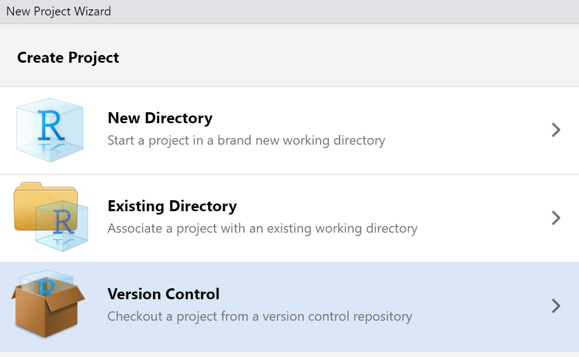
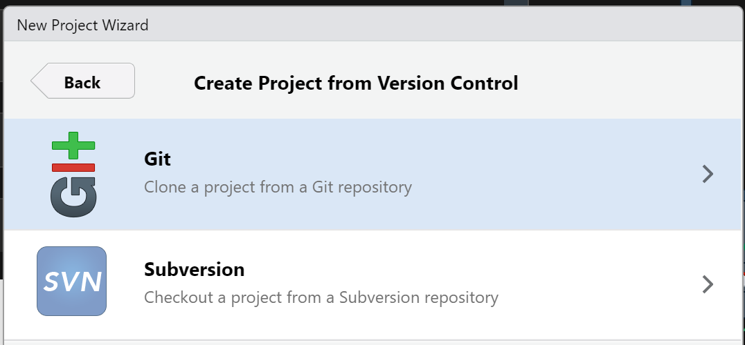
2. Clone a project from a version control repository

Slide 9
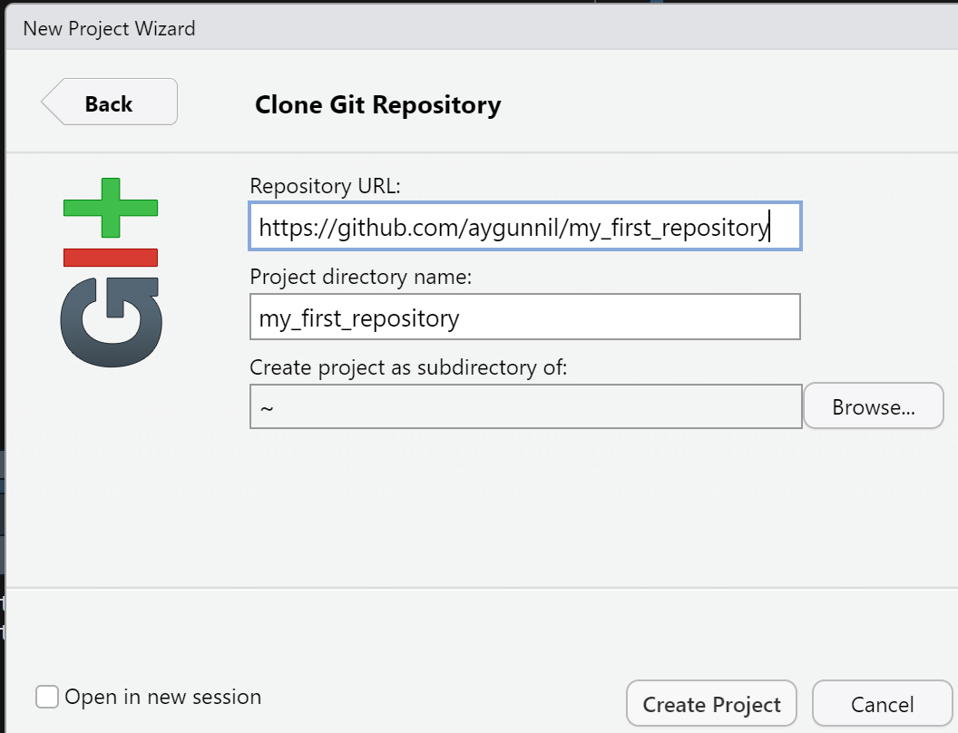
2. Clone a project from a version control repository

Slide 10
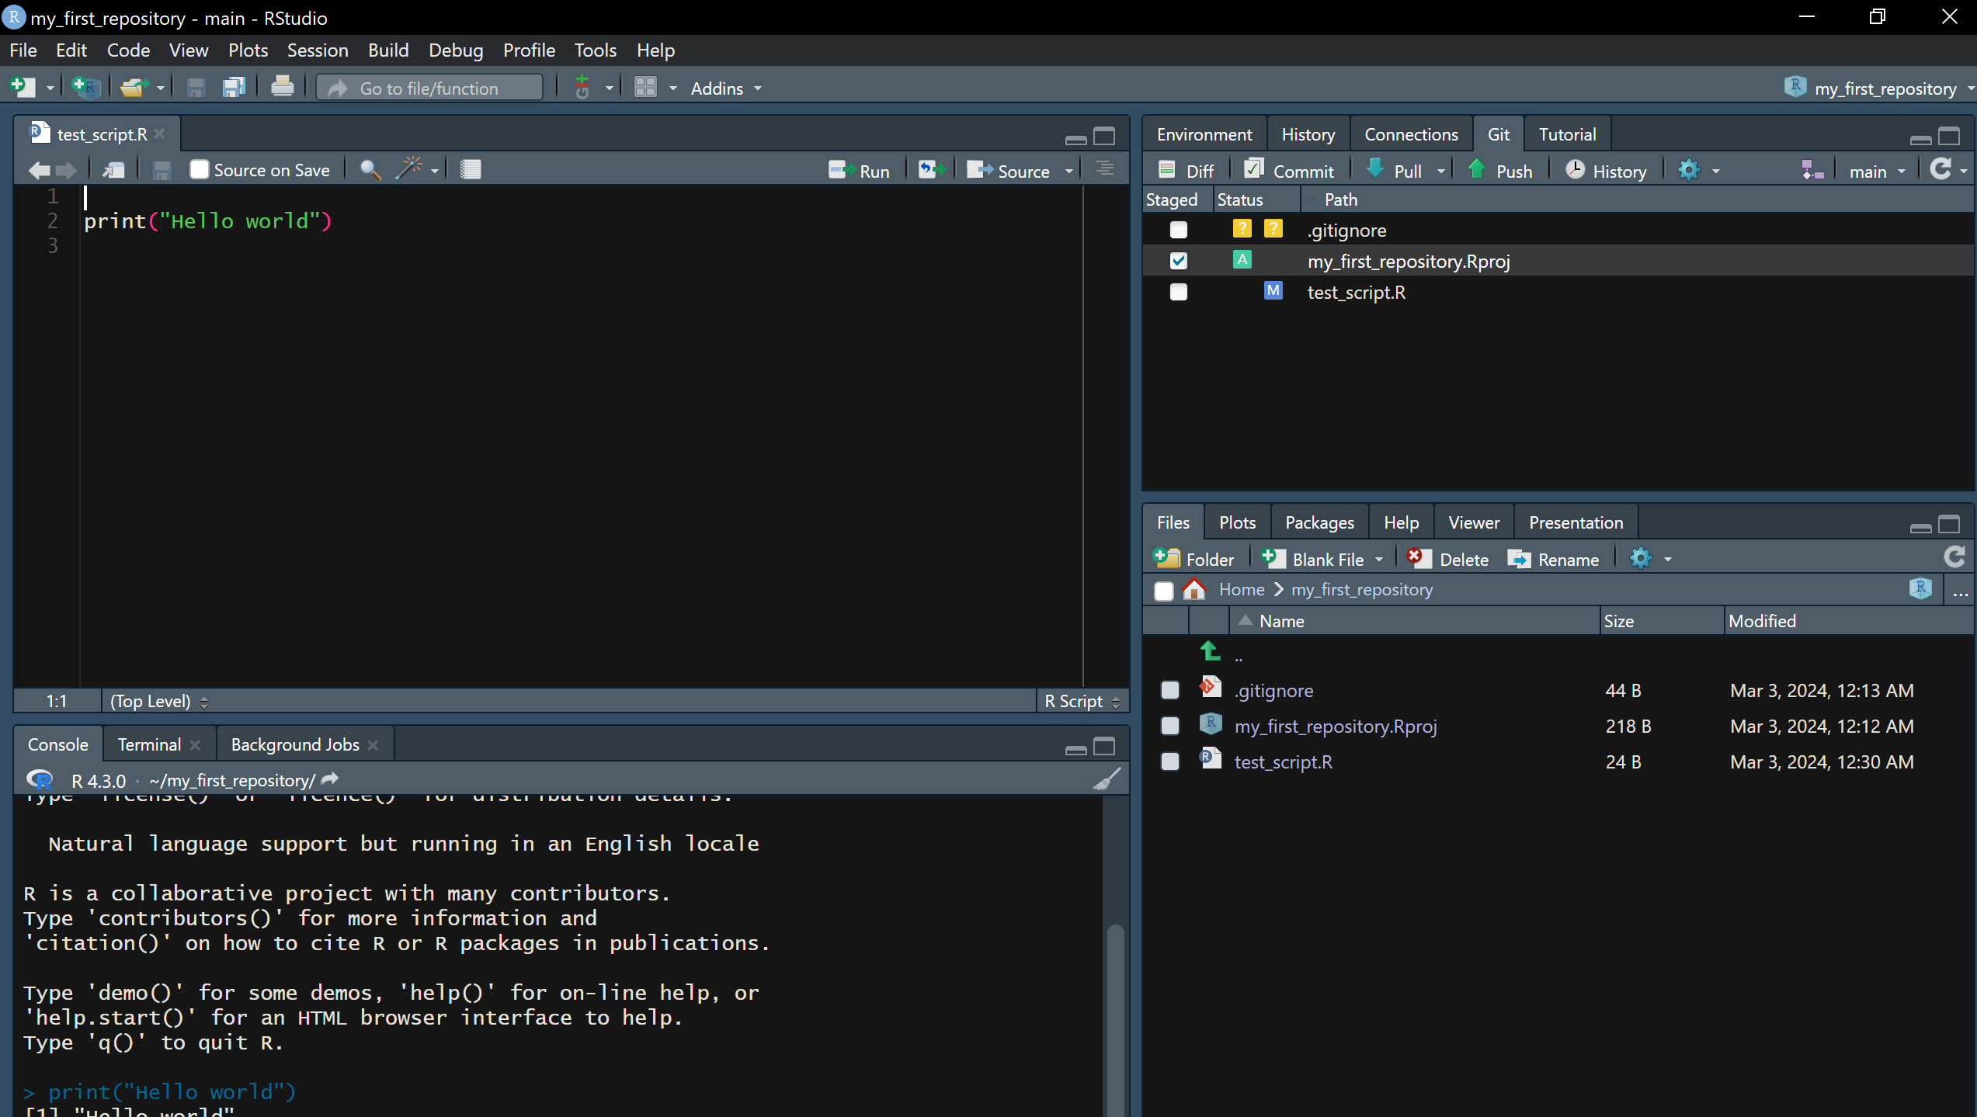
Save new scripts and changes in these scripts in your GitHub directory

Slide 11
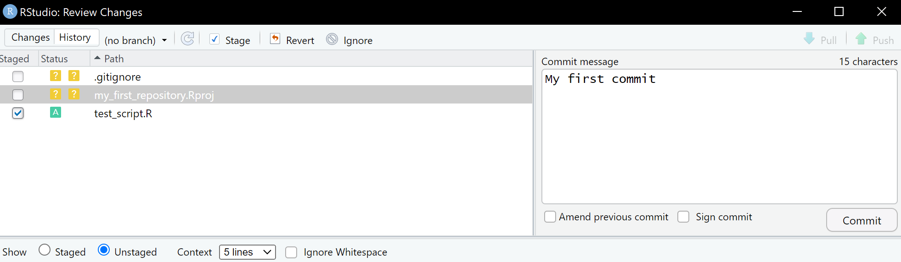
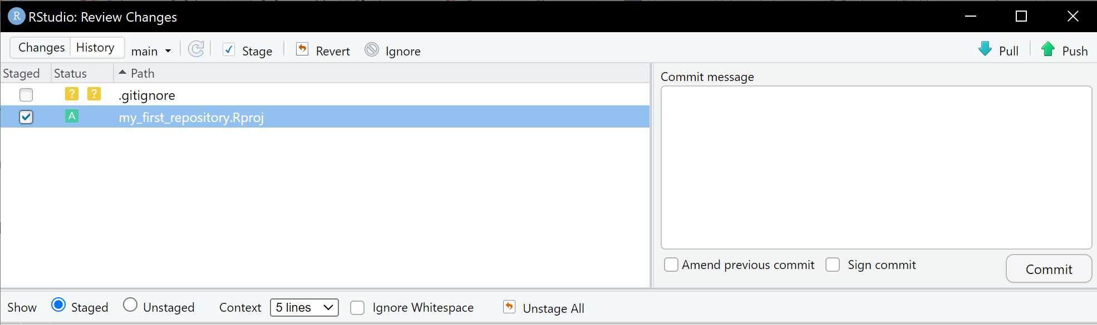
1. Commit the changes you made in the project
2. Push the changes you made in the project

Slide 12
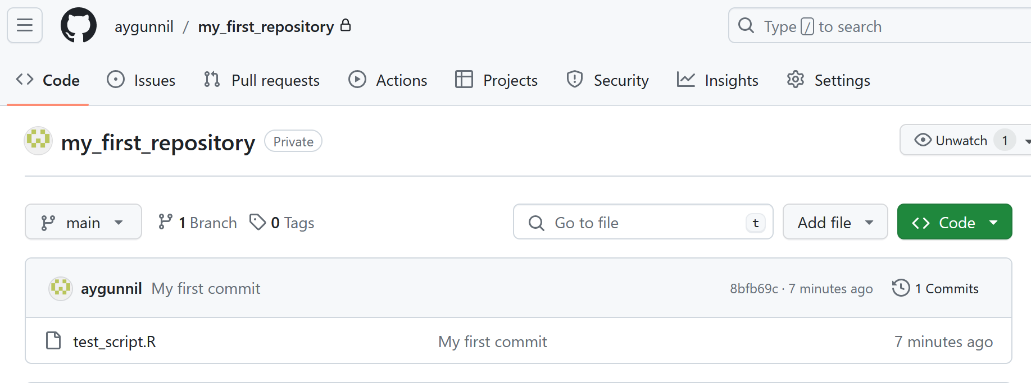
Changes are in the GitHub now

Slide 13
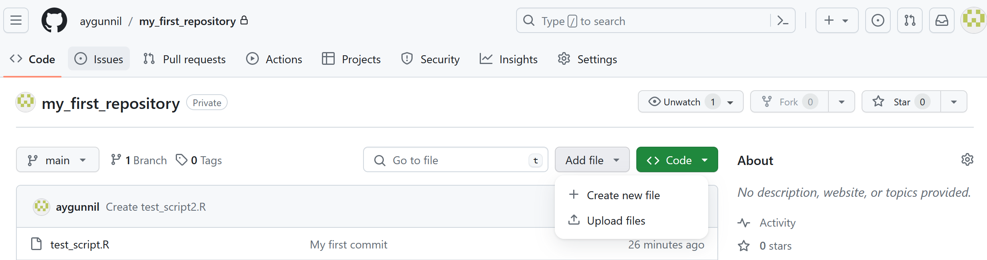
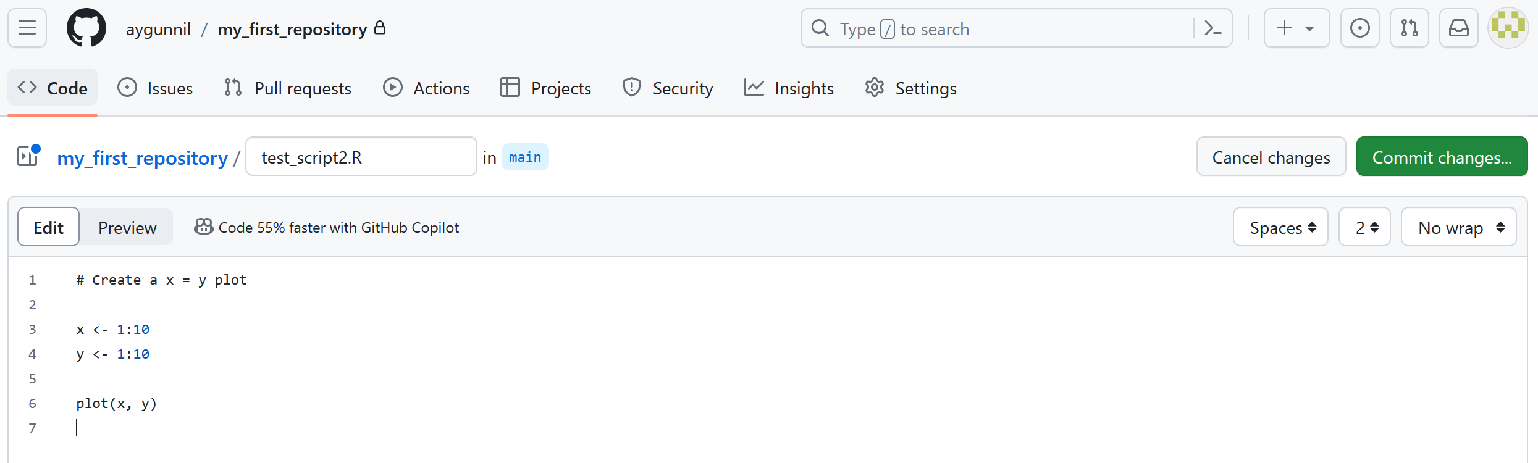
Transfer new files from GitHub to your RStudio
1. Generate new files in your GitHub repository

Slide 14
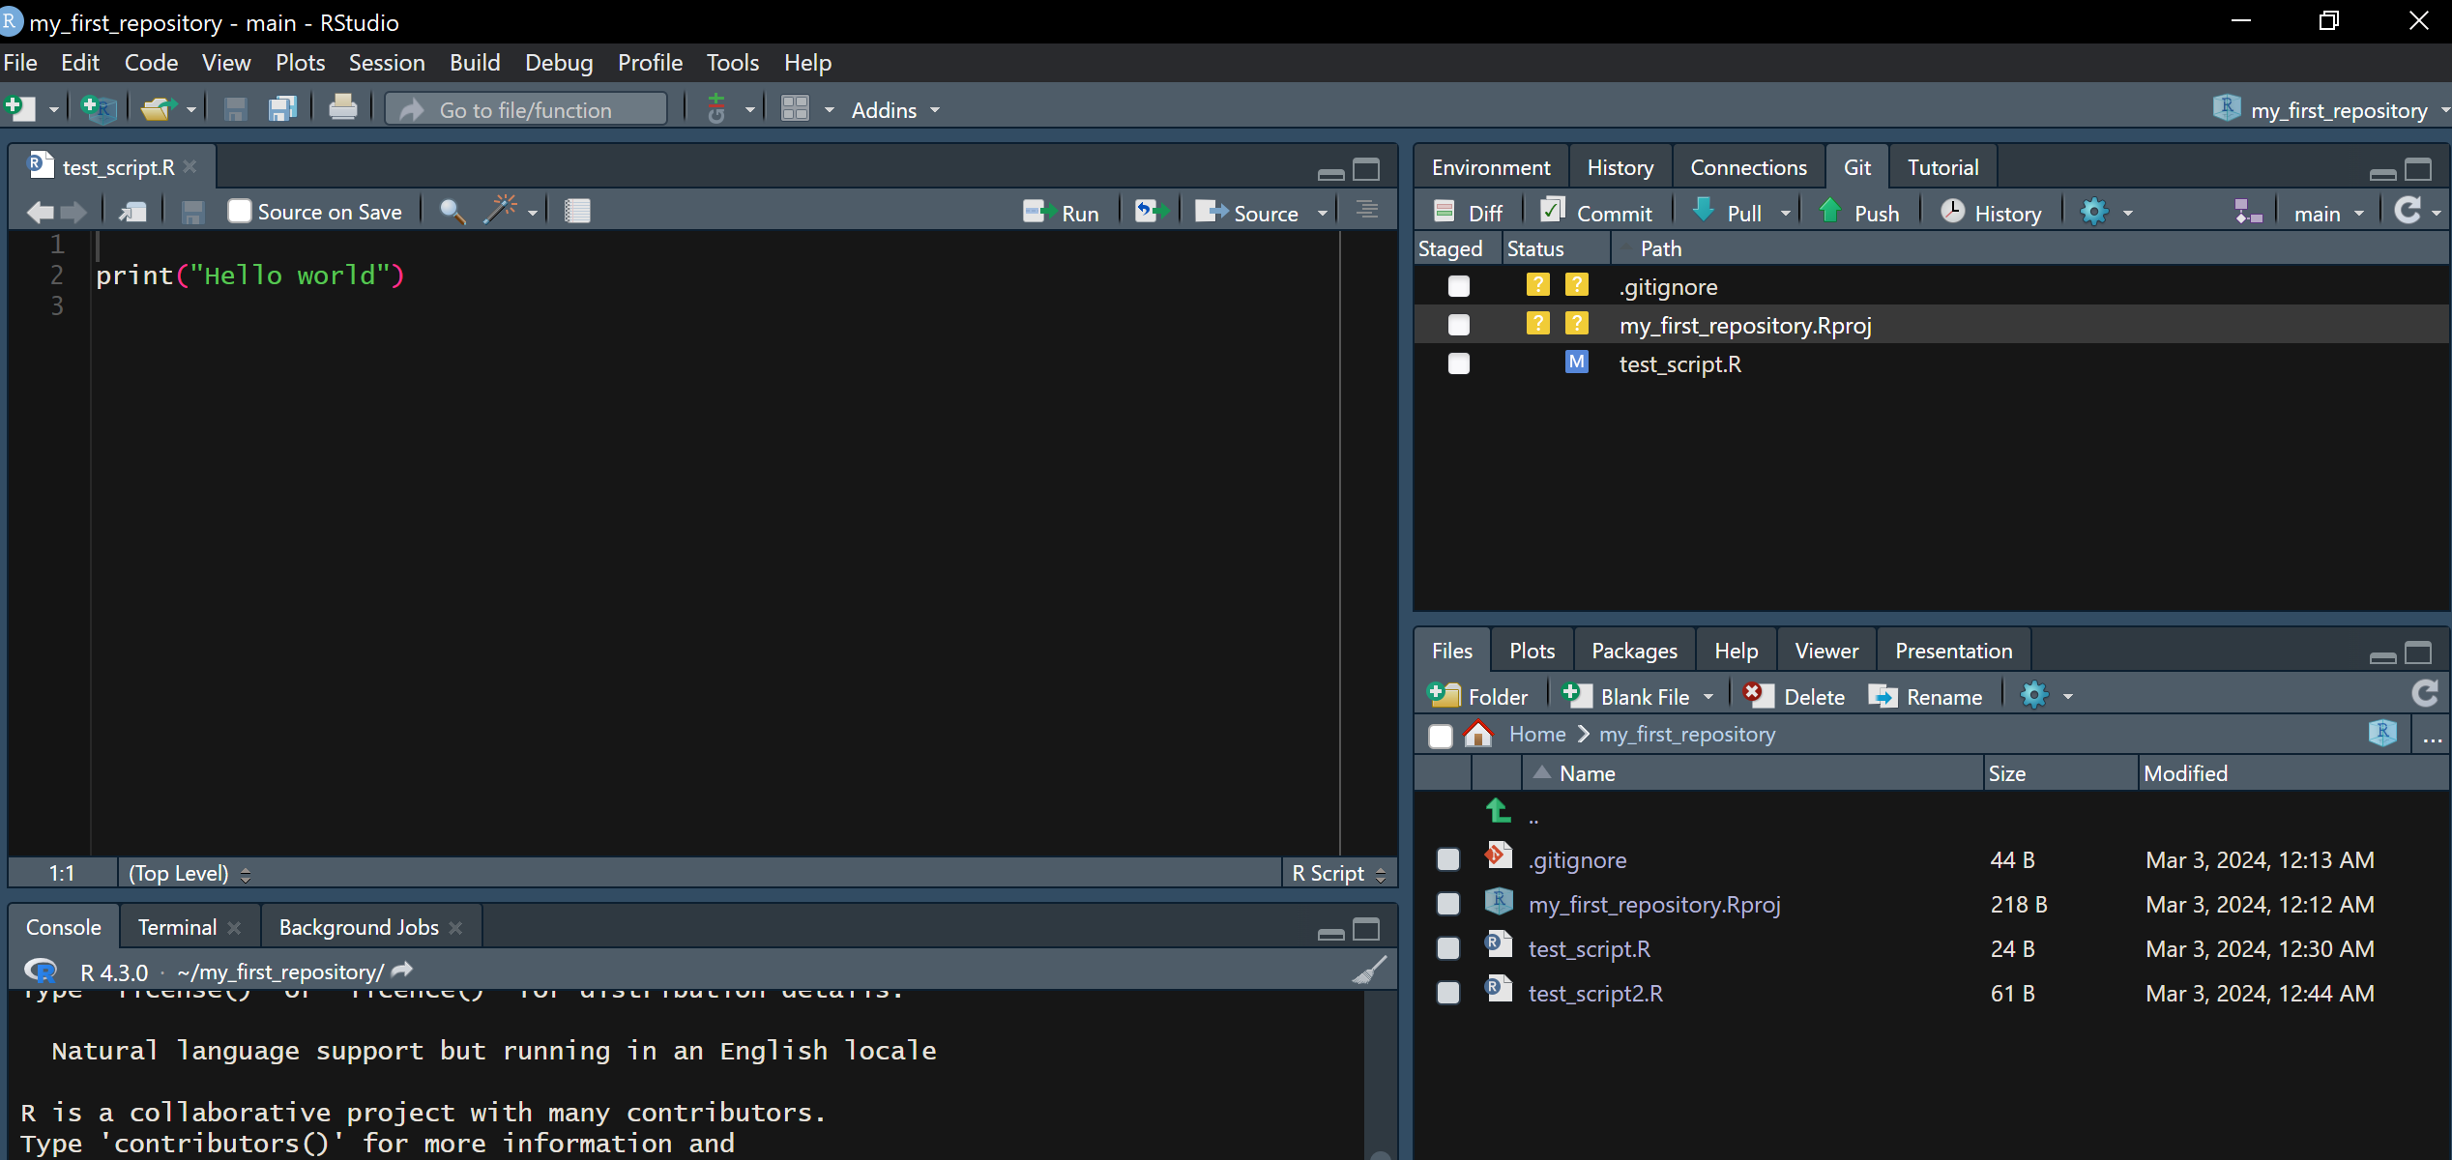
Pull the changes you made in the project

Slide 15
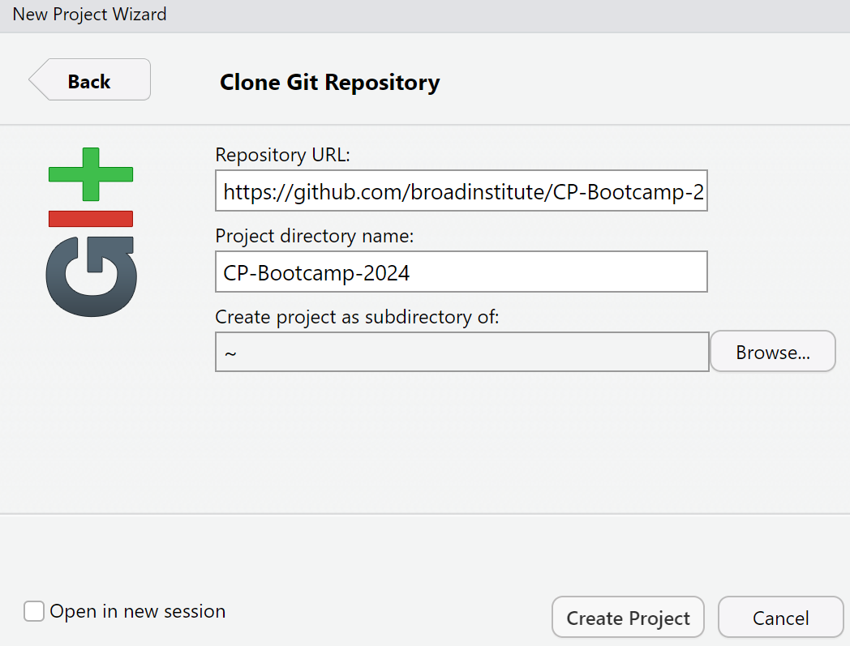
Transfer new files from GitHub to your RStudio
2. From an existing repository, let’s access our lecture notes
https://github.com/broadinstitute/CP-Bootcamp-2024

Slide 16
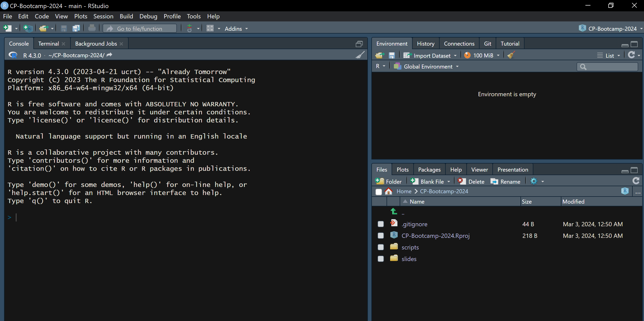
All lecture materials are now in your local machine

