Slide 1
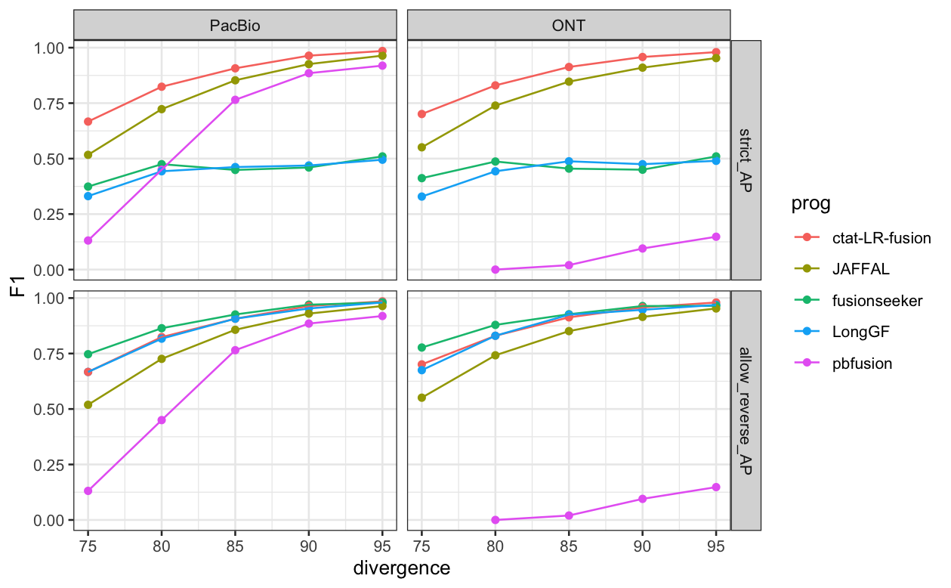
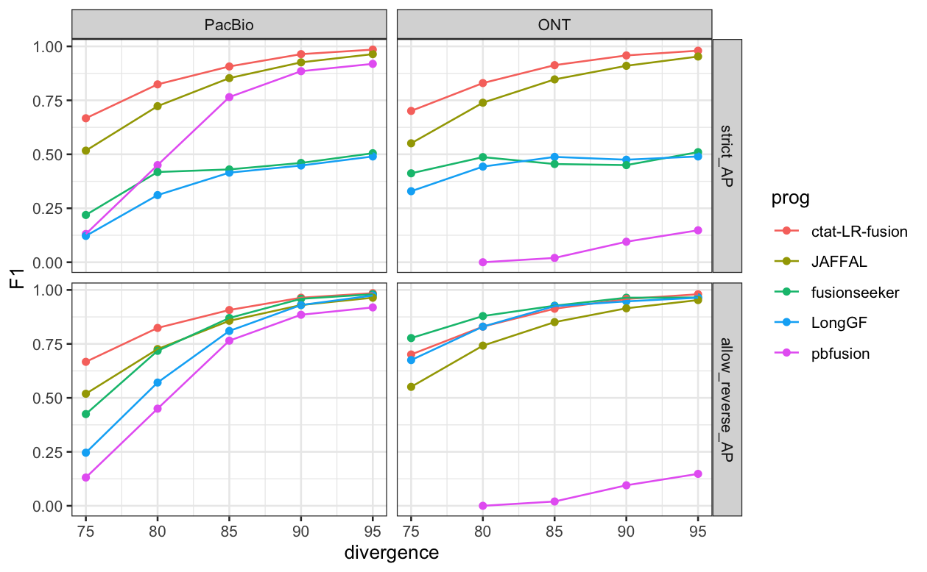
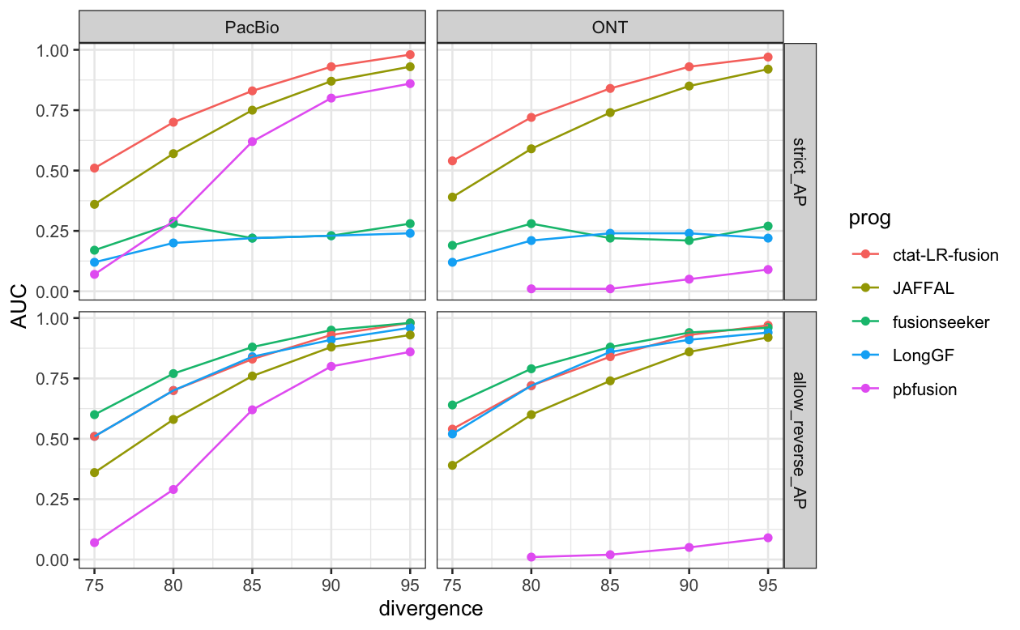
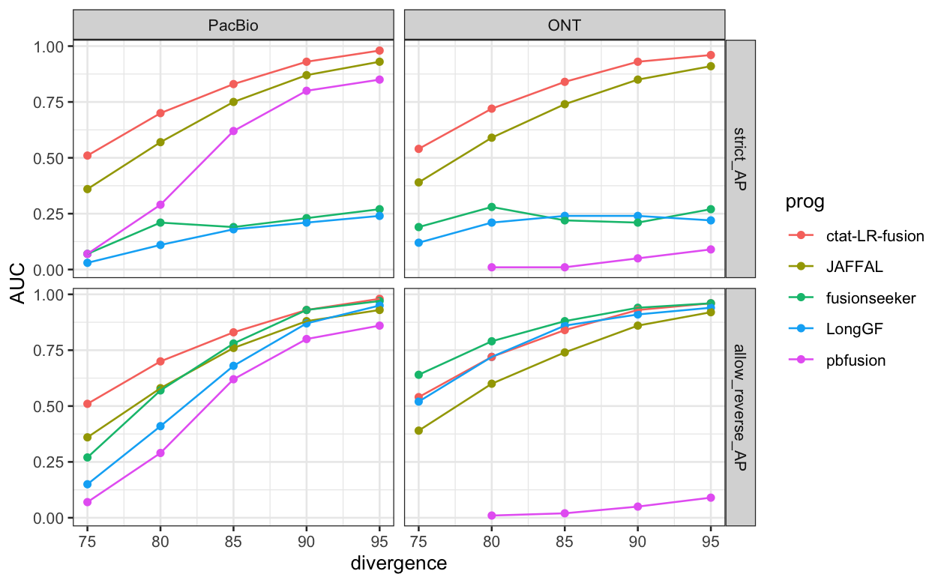
F1 – ax_splice for pbio
F1 – PacBioIsoSeqUb for pbio
PR-AUC – ax_splice for pbio
PR-AUC – PacBioIsoSeqUb for pbio

