Slide 3
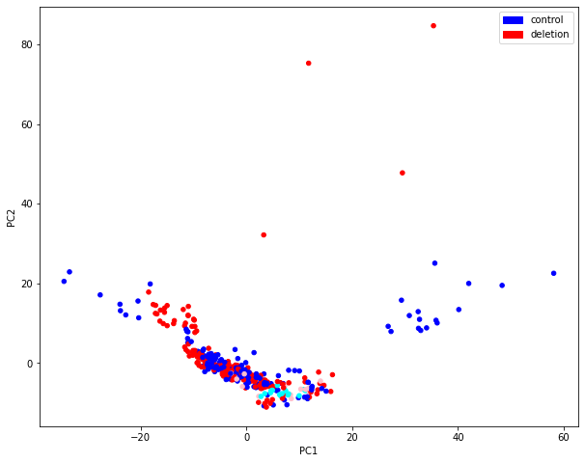
PCA, Progenitors
Human deletion 33
(Other 4 missing)
Human controls 5,6

