Slide 2
Human only | Exclude low cell ct | Swap isogenic |  | Score on data | Score on residuals
T | T | n/a
T | F | n/a
F | T | T
F | T | F
F | F | T
F | F | F

Slide 3
Human only | Exclude low cell ct | Swap isogenic | Split type | Score on residuals, train | Score on residuals, test
T | T | n/a | Random | 0.996 ± 0.002 | 0.924 ± 0.032
T | T | n/a | By cell line | 0.998 ± 0.002 | 0.672 ± 0.112
Human only | Exclude low cell ct | Swap isogenic | Split type | Score on residuals, train | Score on residuals, test
T | n/a | n/a | Random | 1.00 ± 0.00 | 0.967 ± 0.031
T | n/a | n/a | By cell line | 1.00 ± 0.00 | 0.868 ± 0.062

Slide 4
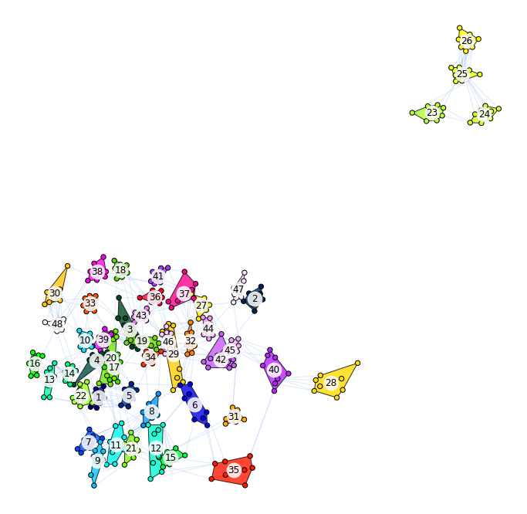

Slide 5
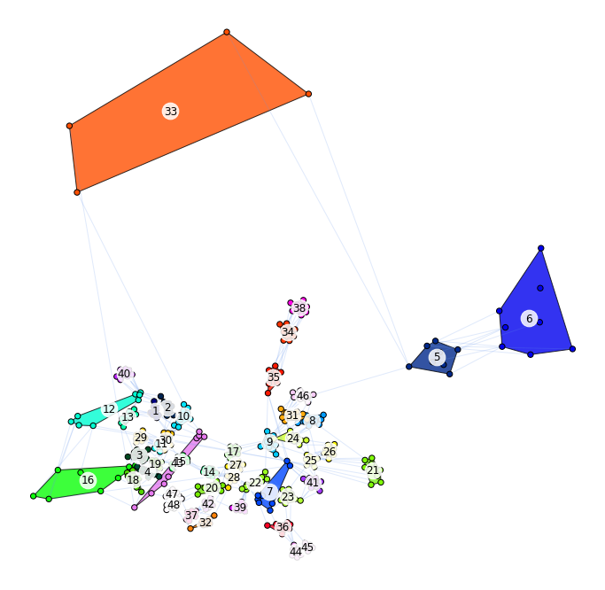
Num removed due to low cell count:
5: 8
6: 8
8: 5
12: 2
16: 3
21: 8
31: 4
33: 8
41: 2
46: 8

