Slide 1
A gentle introduction to D3
Meredith Broadway, Data Analysis Librarian
Owen Graduate School of Management

Slide 2
D3 (Data Driven Documents)
“D3.js is a JavaScript library for manipulating documents based on data. D3 helps you bring data to life using HTML, SVG and CSS. D3’s emphasis on web standards gives you the full capabilities of modern browsers without tying yourself to a proprietary framework, combining powerful visualization components and a data-driven approach to DOM manipulation.”
In plain English (for us mere mortals): you’re taking data, attaching it to SVG and HTML objects, and manipulating those objects according to the type of data you have

Slide 3
D3 is…
Not:
Easy to learn: It’s the K2 of data manipulation libraries
A programming language
For data visualization by itself (instead, think data storytelling)
Only at its most basic level is D3 used for stand-alone visualization
We’ll be using D3 at its most basic for the workshop today
For:
Creating very complex visualizations
Advanced data journalists use D3 in combination with 3D software and tools like CARTO Builder
Utilizing a toolkit -- or library -- of existing standards
Custom-interactive web pages

Slide 4
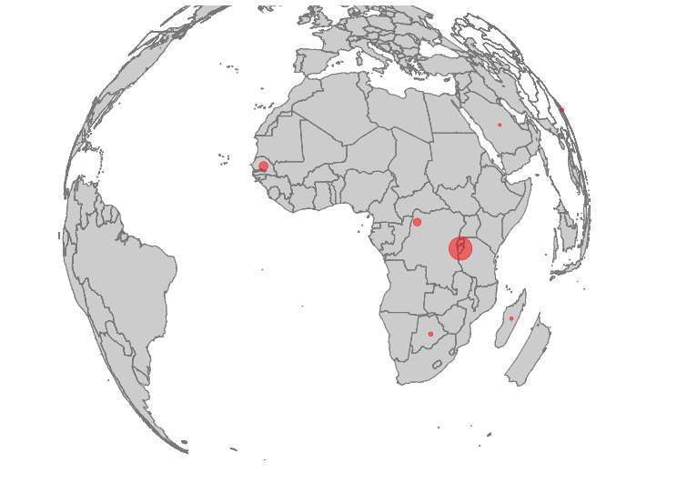

These are the “basic” objects we’ll build today

Slide 5
Once upon a data story: Examples of “real” D3 objects
“Cracking the mystery of egg shape”
“Snow Fall: the Avalanche at Tunnel Creek”
Royal Constellations

Slide 6
How to get started
Blockbuilder.org:
This will allow you to render objects without going to all the trouble of setting up a text file and using the web browser
If you create a unique object (not derived from someone else’s D3 project), you can save your document as a gist
Blockbuilder connects with your Github. It’s comprised of the D3 community who want to share their projects.
The hard way:
The “real” way you should be using D3
Use a text file and browser
Setup here

Slide 7
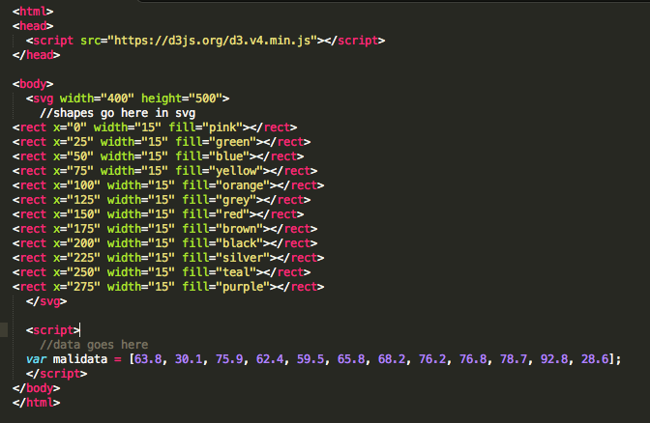
Creating a simple bar chart:
<script src=“https://d3js.org/d3.v4.min.js”></script> is where you call D3. You must do this every time you work with D3. It’s similar to calling your namespace in XML.
SVG is your canvas on which is paint shapes
Within your <script> you must manually attach your data to a named variable of your choice (e.g. var malidata).

Slide 8
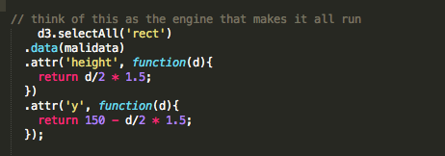
Creating a simple bar chart:
Add the code above right under your var malidata, within the <script>
D3 has select( ) and selectAll( ) methods to find single or multiple DOM elements, respectively.
Since selectAll ('rect') finds multiple elements, everything in the chain following this will be happening to each of those elements.
In plain English: Use selectAll function to call all (multiple) rectangles (called DOM elements) we manually created in the <body>.
Using .data(malidata) will find all elements in your array of numbers (var malidata) and ‘bind’ them to page elements.

Slide 9
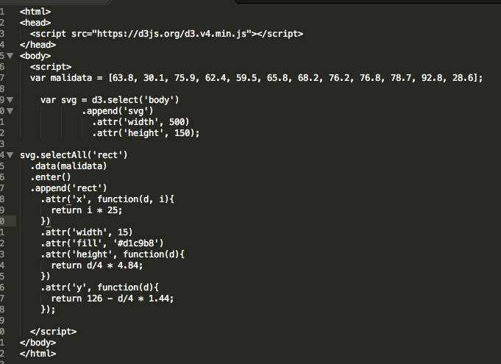
Creating a bar chart 2.0:
MAJOR kudos to anyone who can tell me what’s happening here.
How does our bar chart render when we don’t have a ‘rect’ DOM object to even use selectAll on?

Slide 10
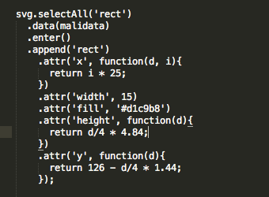
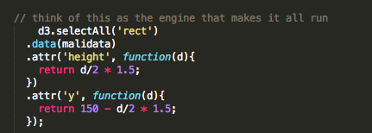
Creating a bar chart 2.0:
In order to call ‘rect’ that doesn’t exist, you have to use .enter(), which tells your document you have incoming data. We then .append each incoming data value with a ’rect’

