Slide 1



Slide 2
Taking Control of WCF
Patrick Roeper (github.com/broccliman)
Jay Hill (codequota.com)

Slide 3
Defining a WCF Service
[ServiceContract]
public interface IAuthenticationService
{
[OperationContract]
bool Authenticate(string username, string password);
[OperationContract]
...
}

Slide 4
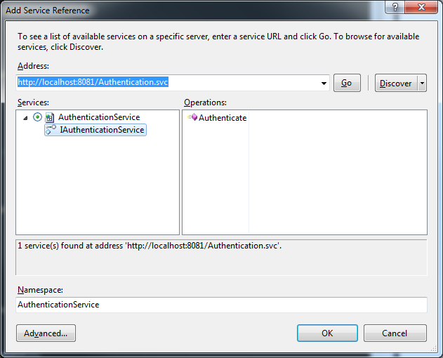
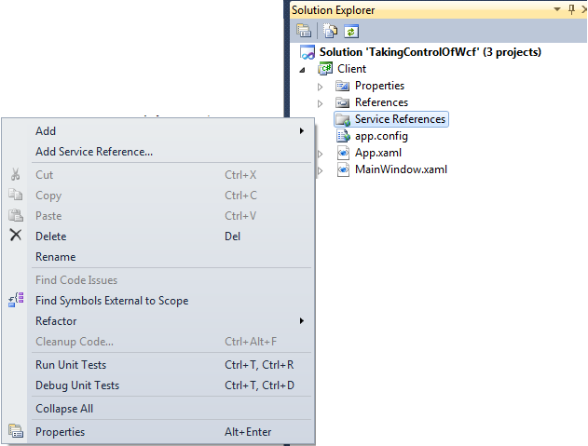
Consuming the WCF Service
private void AuthenticateUserButtonClick(sender, args)
{
using (var client = new AuthenticationServiceClient())
{
bool result = client.Authenticate(“user", “pass");
}
}

Slide 5
Refactoring the WCF Service
[ServiceContract]
public interface IAuthenticationService
{
[OperationContract]
bool Authenticate(string username, string password);
[OperationContract]
...
}
[OperationContract]
bool Authenticate(string username, string password,
out List<string> roles);

Slide 6
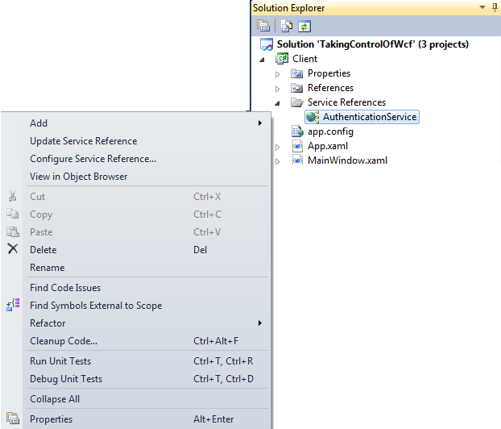
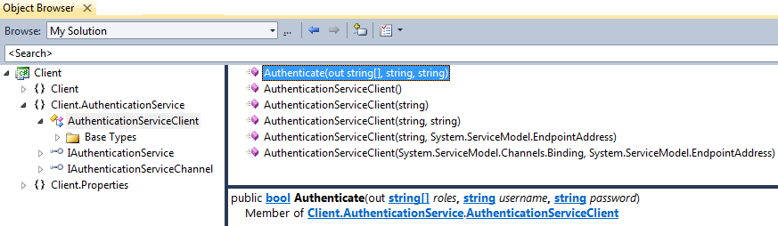
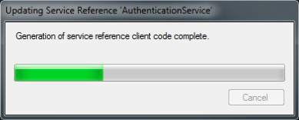
Updating the Service Reference

Slide 7
Refactoring to Request/Response
[OperationContract]
AuthenticateResponse Authenticate(AuthenticateRequest request);
[OperationContract]
Authenticate(AuthenticateRequest request,
out List<string> roles
);
[OperationContract]
bool Authenticate(
string username,
string password,
out List<string> roles
);
bool
[DataContract]
public class AuthenticateRequest
{
[DataMember]
public string Username { get; set; }
[DataMember]
public string Password { get; set; }
}
[DataContract]
public class AuthenticateResponse
{
[DataMember]
public bool IsAuthenticated { get; set; }
[DataMember]
public List<string> Roles { get; set; }
}

Slide 8
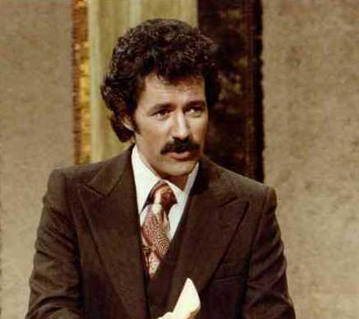
Trivia Round – What’s Wrong?
[OperationContract]
AuthenticateResponse Authenticate(AuthenticateRequest request);
An exception was thrown in a call to a WSDL export extension: System.ServiceModel.Description.
DataContractSerializerOperationBehavior
contract: IAuthenticationService ----> System.Xml.Schema.XmlSchemaException: The global element 'AuthenticateResponse' has already been declared.

Slide 9


Slide 10
Replacing “Add Service Reference”
Contracts.dll
Build Server
Service Definition
New Changeset
Service Definition
Request/Response
Request/Response
Client-side Logic
Server-side Logic
Client.exe
Service.svc

Slide 11
Invoking the Service
private void AuthenticateUserButtonClick(sender, args)
{
using (var client = new AuthenticationServiceClient())
{
var response = client.Authenticate(request);
}
}
private void AuthenticateUserButtonClick(sender, args)
{
var response = ServiceAdapter<IAuthenticationService>
.Execute(x => x.Authenticate(request));
}
private void AuthenticateUserButtonClick(sender, args)
{
var response = AuthenticationClient
.Execute(x => x.Authenticate(request));
}
private void AuthenticateUserButtonClick(sender, args)
{
using (var factory = new
ChannelFactory<IAuthenticationService>())
{
var service = factory.CreateChannel();
var response = client.Authenticate(request);
}
}

Slide 12
Replacing “Add Service Reference”
Service Definition
Request/Response
Contracts.dll
Service Client
Client-side Logic
Server-side Logic
Client.exe
Service.svc

Slide 13
Demo
Switched from “Add Service Reference” to a “Contracts” assembly where service definition and request/response objects reside
Intended to be shared with internal consumers
Added a simple API for invoking a service
Hides IDisposable details
Leverages expressions for intellisense
Enabled build integration scenarios that ensure publishers and consumers have same API

Slide 14


Slide 15
Service API
MethodA(ReqA req)
{
Logger.Log(“Handling ReqA”);
try
{
var result = new ResultA();
result.Name = GetName(req.Id);
result.Email = GetEmail(req.Id);
return result;
}
catch (Exception ex)
{
Logger.LogError(ex);
throw;
}
}
var result = new ResultA();
result.Name = GetName(req.Id);
result.Email = GetEmail(req.Id);
return result;
return req.Role == GetRole(req.Id)
? new ResponseB(true)
: new ResponseB(false);
using(var db = new Ctx())
{
return db.Contacts;
}
MethodB(ReqB req)
{
Logger.Log(“Handling ReqB”);
try
{
return req.Role == GetRole(req.Id)
? new ResponseB(true)
: new ResponseB(false);
}
catch (Exception ex)
{
Logger.LogError(ex);
throw;
}
}
MethodC(ReqC req)
{
Logger.Log(“Handling ReqC”);
try
{
using(var db = new Ctx())
{
return db.Contacts;
}
}
catch (Exception ex)
{
Logger.LogError(ex);
throw;
}
}

Slide 16
Service API
var result = new ResultA();
result.Name = GetName(req.Id);
result.Email = GetEmail(req.Id);
return result;
return req.Role == GetRole(req.Id)
? new ResponseB(true)
: new ResponseB(false);
using(var db = new Ctx())
{
return db.Contacts;
}
Logging/Auditing
Transactional
Exception Handling

Slide 17
Reimagined Business Layer
RequestHandler<Req,Resp>
RequestHandler<Req,Resp>
Response
Request
Response
Request
WCF Service
(Method 1)
Business Logic
Business Logic
(Method 2)
Method 1
Method 2
Method 1
Method 2
WCF Service

Slide 18
Hooking into WCF
IOperationInvoker
IOperationBehavior
IServiceBehavior
class ServiceExtensionsAttribute : ,
{
IServiceBehavior: foreach (operation op) { ApplyOperationBehavior (op); }
IOperationBehavior: (operation op) => op.Invoker = new CustomInvoker();
}
IServiceBehavior Interface (MSDN)
Provides a mechanism to modify or insert custom extensions
across an entire service, including the ServiceHostBase.
IOperationBehavior Interface (MSDN)
Implements methods that can be used to extend run-time
behavior for an operation in either a service or client application.
IOperationInvoker Interface (MSDN-ish)
… takes a service and an array of parameters the request
extracted from a message, invokes a method on that service with those
parameters the request, and returns the method's return value and
output parameters response.

Slide 19
Custom Invoker Implementation
IOperationInvoker
Transactional (inputs, out outputs, invoker)
{
using (var tx = new TransactionScope())
{
invoker.Execute(inputs, out outputs);
tx.Complete();
}
}
WCF_Impl (inputs, out outputs)
{
// reflection maybe?
not_interesting();
}
Default WCF
Audit (inputs, out outputs, invoker)
{
var request = inputs[0];
audit(request);
invoker.Execute(inputs, out outputs);
var response = outputs[0];
audit(response);
}
ELMAH (inputs, out outputs, invoker)
{
try
{
invoker.Execute(inputs, out outputs);
}
catch (Exception ex)
{
ELMAH.Log(ex);
throw;
}
}
RequestHandler (inputs, out outputs)
{
var request = inputs[0];
var handler = find_handler(request.GetType());
var response = handler.Execute(request);
outputs[0] = response;
}
ELMAH (inputs, out outputs, invoker)
{
try
{
invoker.Execute(inputs, out outputs);
}
catch (Exception ex)
{
// job security
}
}
Request Handler
Transactional
Audit/Logging
Try/Catch

Slide 20

Hooking into WCF (w/ Patterns)
class ServiceExtensionsAttribute : IOperationBehavior, IServiceBehavior
{
IServiceBehavior: foreach (operation op) { ApplyOperationBehavior (op); }
IOperationBehavior: (operation op) => op.Invoker = new CustomInvoker();
}
Try/Catch + ELMAH
Audit/Logging
=
Transactional
Request Handler
WCF

Slide 21



How It Works
Response Authenticate (Request)
Thanks ‘brah!
‘Sup brah -
I’m trying to login…
User: jersey_admin
Pass: gym_tan_laundry
Service Consumer
Authentication.svc
Request Handlers

Slide 22
Demo
Moved from a monolithic API to a collection of small, single responsibility objects
New features added by creating components, not changing existing ones
Decoupled infrastructure from business logic
Behavior of operations can be extended without modifying the operation (“open-closed”)
Overrode operation invocation system
Services only change to expose new operations

Slide 23

Authentication Service
Authentication Client
Financial Service
Financial Client
Search Service
Search Client
Administration Service
Administration Client

Slide 24

Portal

Slide 25



Portal Concepts
1. Service for all requests
[ServiceContract]
IPortalService
{
[OperationContract]
byte[] Execute(byte[] payload);
}
PortalClient
{
TResp Execute(TReq request);
}
Try/Catch + ELMAH
010001010100101010
101010111010010101
110101001111100101
000100101101010010
Request
Digital Signature
User Claims
Portal
2. Client for all requests
Audit/Logging
3. Enveloping/Packaging
Transactional
Request Handler
4. Facilities
- Compression
- Encryption
WCF
Portal (inputs, out outputs, invoker)
{
var request = Payload.FromByteArray(inputs[0]);
invoker.Execute(new [] {request}, out outputs);
var response = outputs[0];
outputs[0] = Payload.ToByteArray(response);
}
5. IOperationInvoker

Slide 26


How It Works
byte[] Execute(byte[] payload)
10010101
Thanks ‘brah!
‘Sup brah -
I’m trying to login…
User: jersey_admin
Pass: gym_tan_laundry
10010101
Service Consumer
Portal.svc
Request Handlers

Slide 27
Demo
Hosted a WCF service capable of processing any request – Portal.svc
One service, one operation; byte[] in, byte[] out
Consumer changed to use PortalClient, instead of service-specific client
Shortened API; operation name doesn’t matter
Enabled support for “facilities”
Compression, encryption, digital signature, …

Slide 28
Rocky Lhotka (CSLA)
“I favor option 3. I don’t like to accept the cost and performance ramifications of SOA when building an application, so I’d prefer to use a faster and cheaper n-tier architecture. At the same time, many applications do need to interact with each other, and the requirement to create ‘application mashups’ through edge applications happens from time to time.”
Three service architecture models:
Option 1: N-Tier (Portal)
Option 2: Edge Services (SOA)
Option 3: Hybrid (Portal + SOA)
“The direct users of my application get n-tier performance and maintainability. And the broader organization can access my slower-moving, standards-based, contractual service interface. It is the best of both worlds.”

Slide 29
Hybrid Service Architecture
Business Logic
Request Handlers, Data Access, …
Input / Output
Request/Response
Portal Service
Customer Service
Service / API
Contracts Assembly
Order Service
Internal (N-Tier)
External (SOA)
N-Tier

Slide 30

Nitpicker Corner
I <3 “Add Service Ref.”
Async
Auditing vs. Tracing
Decorator vs. IErrorHandler
Svc Exception-Smell
Byte[] vs. Stream

Slide 31
References
http://stackoverflow.com/questions/3051326/request-response-pattern-in-soa-implementation
http://geekswithblogs.net/LeonidGaneline/archive/2008/06/02/wcf-data-contract-names-dont-use-names-with-response-suffix.aspx
http://msdn.microsoft.com/en-us/library/system.servicemodel.channelfactory.aspx
http://en.wikipedia.org/wiki/SOLID_(object-oriented_design)
http://msdn.microsoft.com/en-us/library/system.servicemodel.dispatcher.ioperationinvoker.aspx
http://msdn.microsoft.com/en-us/library/system.servicemodel.description.ioperationbehavior.aspx
http://msdn.microsoft.com/en-us/library/system.servicemodel.description.iservicebehavior.aspx
http://en.wikipedia.org/wiki/Decorator_pattern
http://stackoverflow.com/questions/895901/exception-logging-for-wcf-services-using-elmah
http://www.lhotka.net/weblog/Silverlight6DoesnrsquotMatter.aspx

