Slide 1
LEGO EV3 PROGRAMMING
16级计科基地班
刘安
pacer97@qq.com
2018/10

Slide 2
Content
Intro
Examples
Videos

Slide 3
Intro to EV3
LEGO MINDSTORMS EV3 is based on a brick
includes an ARM®9-based processor, micro SD card reader, and USB port for Wi-Fi connectivity.
It connects to a variety of sensors, such as ultrasound, color/light, gyroscope, and touch.
It also connects to up to four servo motors, so you can use it to build mobile robots.

Slide 4
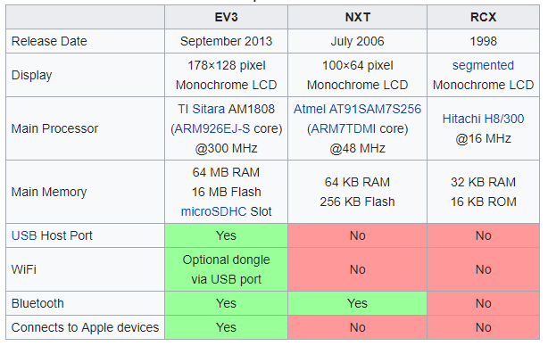
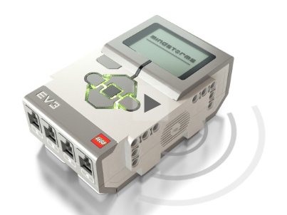
Brick

Slide 5
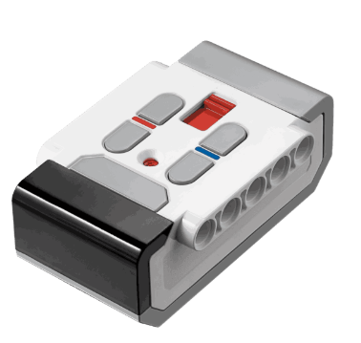
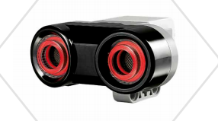
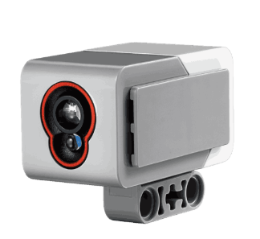
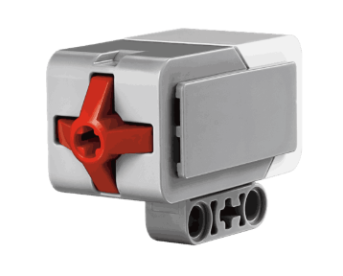
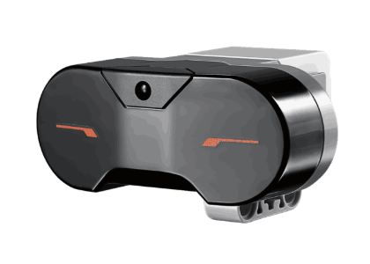
Sensors
触动传感器
颜色传感器
远程红外信标
红外/超声波传感器

Slide 6
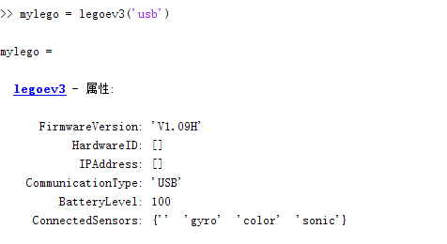
Program with Matlab
% LEGOEV3 - The class to represent the LEGO EV3 brick
% You can use LEGOEV3 to interact with EV3 brick.
%
% myev3 = legoev3('usb')
% set up USB connection between host and EV3 brick.
%
% myev3 = legoev3('wifi', ip_address, hardware_id)
% set up WiFi connection between host and EV3 brick
% For example:
% myev3 = legoev3('wifi', '192.168.1.7', '00165340e49b')
%
% myev3 = legoev3('bluetooth', com_port)
% set up Bluetooth connection between host and EV3 brick
% For example:
% myev3 = legoev3('bluetooth', 'COM19')
%

Slide 7
Demo1-Control Sensors
%%%%%%%%%%%%%%%%%%%%%%%%%%%%%%%%%%%%%%%%%%%%%%%%%%%%%%%%%%%%%%%%%%%
% Create a connection to the gyroscopic sensor called mygyrosensor.
% Measure the rotation, in degrees,
% since the creation of the connection to the sensor.
% Reset the measurement to zero.
% Measure the current rate of rotation, in degrees per second.
%%%%%%%%%%%%%%%%%%%%%%%%%%%%%%%%%%%%%%%%%%%%%%%%%%%%%%%%%%%%%%%%%%%
myev3 = legoev3;
mygyrosensor = gyroSensor(myev3);
angle = readRotationAngle(mygyrosensor);
resetRotationAngle(mygyrosensor);
rate = readRotationRate(mygyrosensor);

Slide 8
Demo2-Collision Alarm Template
%------- Change ME -------------------------
mylego = legoev3; % Set up MATLAB and EV3 communication
RANGE = 0.3; % Detection range in meters
%-------------------------------------------
mysensor = sonicSensor(mylego); % Set up ultrasonic sensor
%% Operations %%%%%%%%%%%%%%%%%%%%%%%%%%%%%%
while ~readButton(mylego, 'up') % Exit if UP button is pressed
dis = readDistance(mysensor); % Read ultrasonic sensor value
freq = 5000*(RANGE-dis)/RANGE; % Increase frequency as getting closer
volume = 100*(RANGE-dis)/RANGE; % Increase volume as getting closer
playTone(mylego, freq, 1, volume); % Play tone
end

Slide 9
Demo3-How to Go Straight
mylego = legoev3; % Set up MATLAB and EV3 communication
mymotor1 = motor(mylego, 'B'); % Set up motor
mymotor2 = motor(mylego, 'C');
% Application parameters
EXE_TIME = 10; % Application running time in seconds
SPEED = 30; % Motor speed
mymotor1.Speed = SPEED; % Set motor speed
mymotor2.Speed = SPEED;
start(mymotor1); % Start motor
start(mymotor2);
pause(EXE_TIME); % Wait
stop(mymotor1); % Stop motor
stop(mymotor2);

Slide 10
Demo3-How to Go Straight (closeloop)
%%% setup %%%%%%%%%%%%%%%%%%%%%%%%%%%%%%%%%%%%%%%%%%%%%%
mylego = legoev3; % Set up MATLAB and EV3 communication
% Change based on your motor port numbers
mymotor1 = motor(mylego, 'B'); % Set up motor
mymotor2 = motor(mylego, 'C');
% Application parameters
EXE_TIME = 10; % Application running time in seconds
PERIOD = 0.1; % Sampling period
SPEED = 20; % Motor speed
P = 0.01; % P controller parameter
%-------------------------------------------
mymotor1.Speed = SPEED; % Set motor speed
mymotor2.Speed = SPEED;
resetRotation(mymotor1); % Reset motor rotation counter
resetRotation(mymotor2);
start(mymotor1); % Start motor
start(mymotor2);
t = timer('TimerFcn', 'stat=false;', 'StartDelay',EXE_TIME);
start(t);
%% Operations %%%%%%%%%%%%%%%%%%%%%%%%%%%%%%
stat = true;
lastR1 = 0;
lastR2 = 0;
while stat == true % Quit when times up
r1 = readRotation(mymotor1); % Read rotation counter in degrees
r2 = readRotation(mymotor2);
speed1 = (r1 - lastR1)/PERIOD; % Calculate the real speed in d/s
speed2 = (r2 - lastR2)/PERIOD;
diff = speed1 - speed2; % P controller
mymotor1.Speed = mymotor1.Speed - int8(diff * P);
lastR1 = r1;
lastR2 = r2;
pause(PERIOD); % Wait for next sampling period
end
%% Clean up %%%%%%%%%%%%%%%%%%%%%%%%%%%%%%%%
stop(mymotor1); % Stop motor
stop(mymotor2);

Slide 11
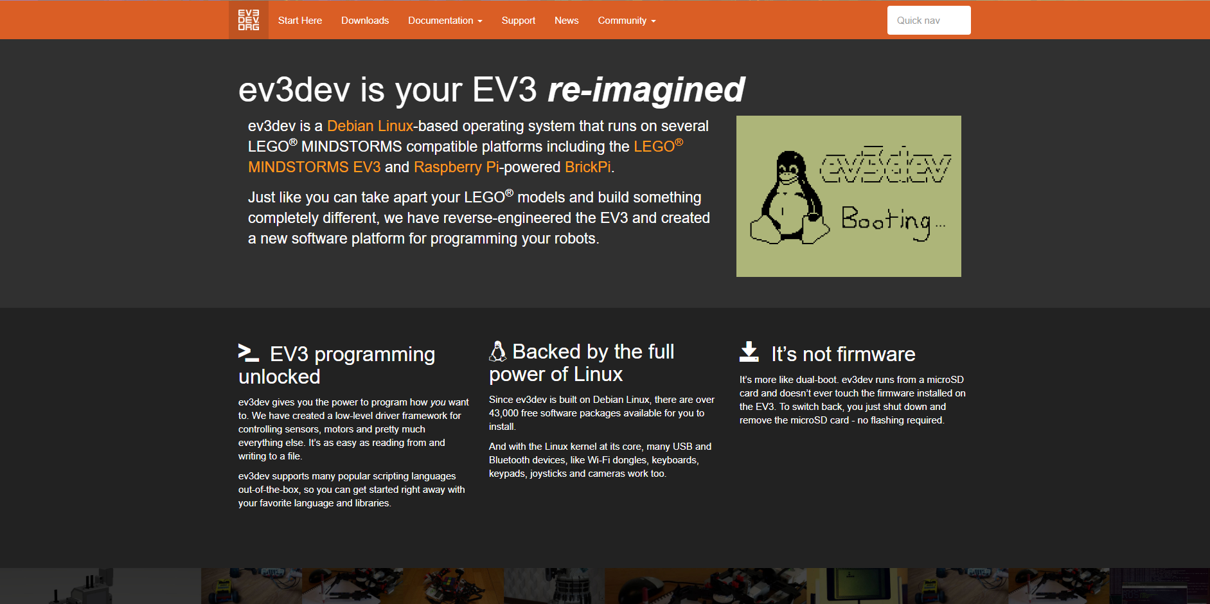

Slide 12
Program in other Languages
Python
JavaScript
C/C++
Go
Ruby
Java
……

Slide 13
Need to Prepare
A LEGO MINDSTORMS EV3 Intelligent Brick or Raspberry Pi (any model).
A microSD or microSDHC card (2GB or larger). microSDXC is not supported on the EV3. All cards larger than 32GB will not work with the EV3!
A computer with an adapter for the SD card. You will need administrator user permissions on this computer.
USB Wi-Fi dongle

Slide 14
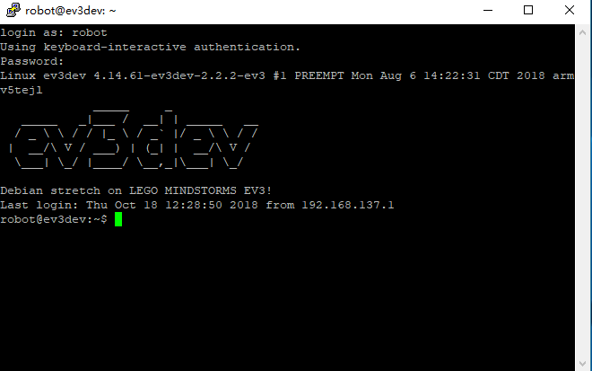
Demo- Connecting to Ev3dev Using SSH

Slide 15
Program in Python
#!/usr/bin/env python3
from ev3dev2.motor import LargeMotor, OUTPUT_A, OUTPUT_B, SpeedPercent, MoveTank
from ev3dev2.sensor import INPUT_1
from ev3dev2.sensor.lego import TouchSensor
from ev3dev2.led import Leds
# TODO: Add code here
sound = Sound()
sound.speak('Welcome to the E V 3 dev project!')
tank_drive = MoveTank(OUTPUT_A, OUTPUT_B)
# drive in a turn for 5 rotations of the outer motor
# the first two parameters can be unit classes or percentages.
tank_drive.on_for_rotations(SpeedPercent(50), SpeedPercent(75), 10)
# drive in a different turn for 3 seconds
tank_drive.on_for_seconds(SpeedPercent(60), SpeedPercent(30), 3)

Slide 16
Demo-Color
#!/usr/bin/env python3
"""Make robot say whatever color it observes with the color sensor."""
from ev3dev2.sensor.lego import ColorSensor
from time import sleep
from ev3dev2.sound import Sound
color_sensor = ColorSensor()
sound = Sound()
while True:
color = color_sensor.color
text = ColorSensor.COLORS[color]
sound.speak(text)
sleep(2)

Slide 17
Demo-Touch
#!/usr/bin/env python3
"""
Reverse robot if bumps into wall.
This script is a simple demonstration of the touch sensor.
"""
from ev3dev2.motor import MoveSteering, OUTPUT_B, OUTPUT_C
from ev3dev2.sensor.lego import TouchSensor
motor_pair = MoveSteering(OUTPUT_B, OUTPUT_C)
touch_sensor = TouchSensor()
# Start robot moving forward
motor_pair.on(steering=0, speed=10)
# Wait until robot touches wall
touch_sensor.wait_for_pressed()
# Stop moving forward
motor_pair.off()
# Reverse away from wall
motor_pair.on_for_seconds(steering=0, speed=-10, seconds=2)

Slide 18
Demo-Ultrasonic
#!/usr/bin/env python3
"""
Use robot to reposition cuboid.
This script is a simple demonstration of the ultrasonic sensor and medium
motor.
"""
from ev3dev2.motor import (
MoveSteering, MediumMotor, OUTPUT_A, OUTPUT_B, OUTPUT_C)
from ev3dev2.sensor.lego import UltrasonicSensor
from time import sleep
motor_pair = MoveSteering(OUTPUT_B, OUTPUT_C)
medium_motor = MediumMotor(OUTPUT_A)
ultrasonic_sensor = UltrasonicSensor()
# Start robot moving forward
motor_pair.on(steering=0, speed=10)
# Wait until robot less than 3.5cm from cuboid
while ultrasonic_sensor.distance_centimeters > 3.5:
sleep(0.01)
# Stop moving forward
motor_pair.off()
# Lower robot arm over cuboid
medium_motor.on_for_degrees(speed=-10, degrees=90)
# Drag cuboid backwards for 2 seconds
motor_pair.on_for_seconds(steering=0, speed=-20, seconds=2)
# Raise robot arm
medium_motor.on_for_degrees(speed=10, degrees=90)
# Move robot away from cuboid
motor_pair.on_for_seconds(steering=0, speed=-20, seconds=2)

Slide 19
Demo-Square
#!/usr/bin/env python3
"""
Move robot in a square path without using the Gyro sensor.
This script is a simple demonstration of moving forward and turning.
"""
from ev3dev2.motor import MoveSteering, OUTPUT_B, OUTPUT_C
motor_pair = MoveSteering(OUTPUT_B, OUTPUT_C)
for i in range(4):
# Move robot forward for 3 seconds
motor_pair.on_for_seconds(steering=0, speed=50, seconds=3)
# Turn robot left 90 degrees (adjust rotations for your particular robot)
motor_pair.on_for_rotations(steering=-100, speed=5, rotations=0.5)

Slide 20
Demo-Square-gyro
#!/usr/bin/env python3
"""
Move robot in a square path using the Gyro sensor.
This script is a simple demonstration of turning using the Gyro sensor.
"""
from ev3dev2.motor import MoveSteering, OUTPUT_B, OUTPUT_C
from ev3dev2.sensor.lego import GyroSensor
motor_pair = MoveSteering(OUTPUT_B, OUTPUT_C)
gyro = GyroSensor()
gyro.mode = GyroSensor.MODE_GYRO_ANG
for i in range(4):
# Move robot forward for 3 seconds
motor_pair.on_for_seconds(steering=0, speed=50, seconds=3)
# Spin robot to the left
motor_pair.on(steering=-100, speed=5)
# Wait until angle changed by 90 degrees
gyro.wait_until_angle_changed_by(90)
# Stop motors
motor_pair.off()

Slide 21
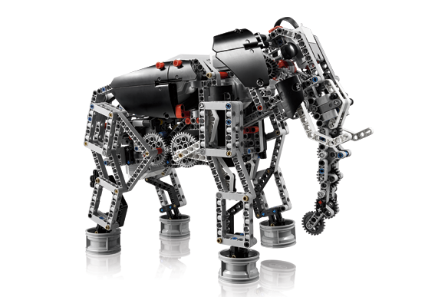
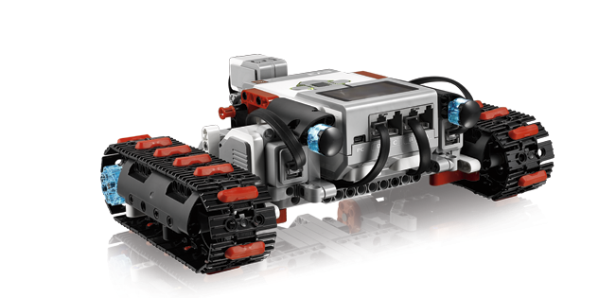
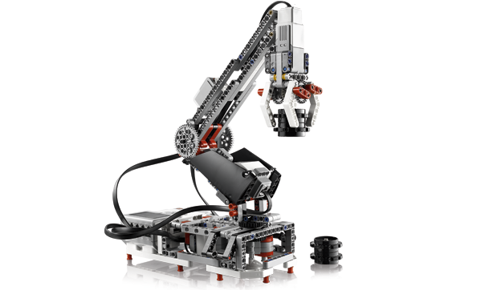
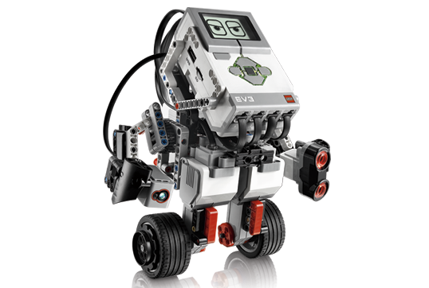
Usage

Slide 22
Vedios
https://www.youtube.com/watch?v=Z4Lz2rYRipQ
https://www.bilibili.com/video/av5740892/

Slide 23
Reference
https://sites.google.com/site/ev3python/learn_ev3_python/going-further/auto-drive
https://www.ev3dev.org/docs/getting-started/
https://github.com/ev3dev/ev3dev-lang-python
https://python-ev3dev.readthedocs.io/en/ev3dev-stretch/motors.html#units
https://github.com/ev3dev/ev3dev-lang-python-demo
https://github.com/sshopov/pyconau2017/blob/master/final.ipynb

Slide 24
THANKS
Q&A

