Slide 1
電路模擬器 MiniPSPICE
B09901034 戴瑋佑 B09901170 黃元顥 B09901175 楊博宇

Slide 2
Table of contents
Introduction
DC Analysis (with multiple voltage sources)
AC Analysis (with one voltage source)

Slide 3
Introduction
B09901170 黃元顥

Slide 4
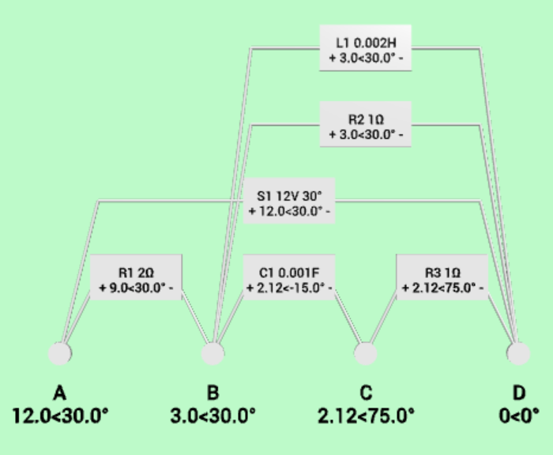
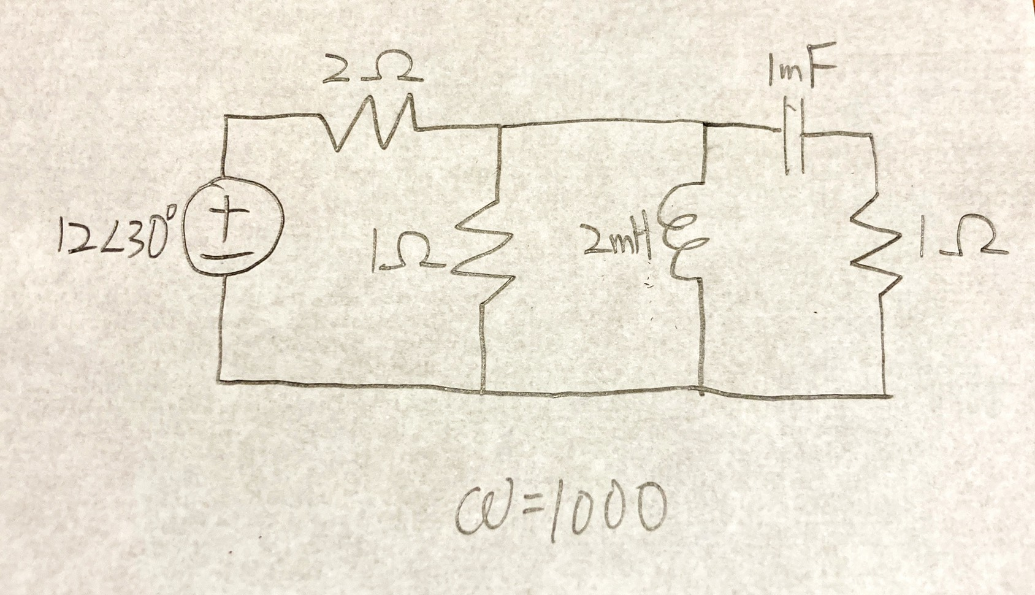
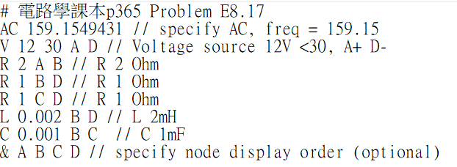
Procedure
Target Circuit
Description
Simulation

Slide 5
Circuit Description
Assign nodes
AC/DC (specify frequency for AC)
Components
Voltage Source: V mag (phase) node+ node-
Resistor: R value node1 node2
Inductor: L value node1 node2
Capacitor: C value node1 node2
Specify node display order: & node1 node2 …
Comments: # (whole line), // (behind)
Units are in Hz, Ohm, H, F
A
B
C
D

Slide 6
Result
Generate circuit diagram
Calculate voltage of each node
Calculate terminal voltage of each component

Slide 7
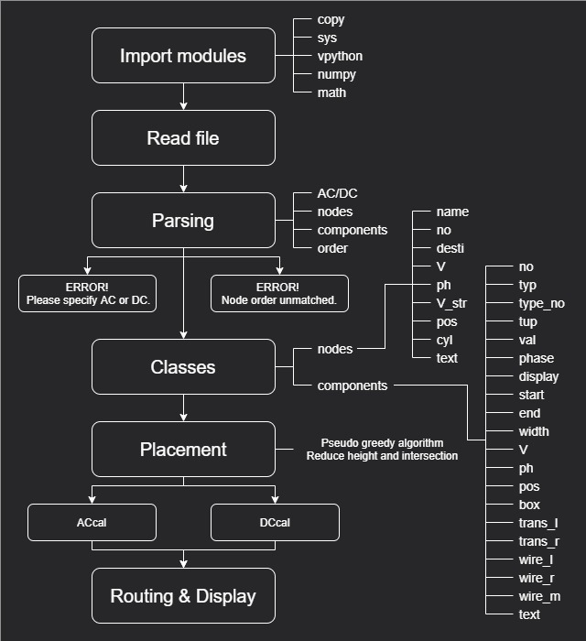
Main Structure

Slide 8
DC Analysis
B09901175 楊博宇

Slide 9
Nodal Analysis
Take one node as the ground node.
Select node voltages (vs. ground) as the variables.
If node voltages are known, all the other branch variables can be calculated.

Slide 10
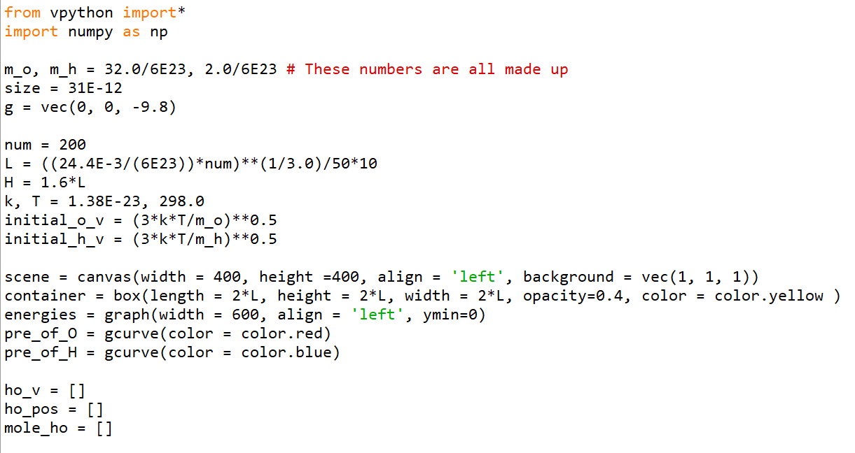
程式說明 (1/5)：設定參數

Slide 11
AC Analysis
B09901134 戴瑋佑

Slide 12
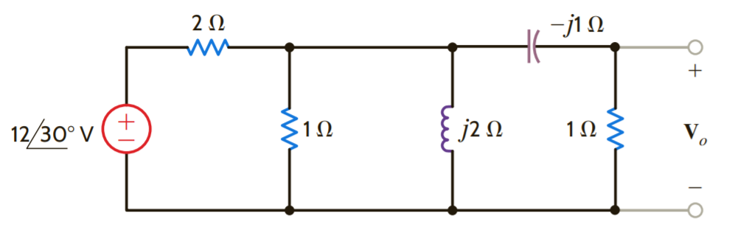
Node analysis
A
B
C
D
Take this circuit for example first. According to node analysis, we can list the formula

Slide 13
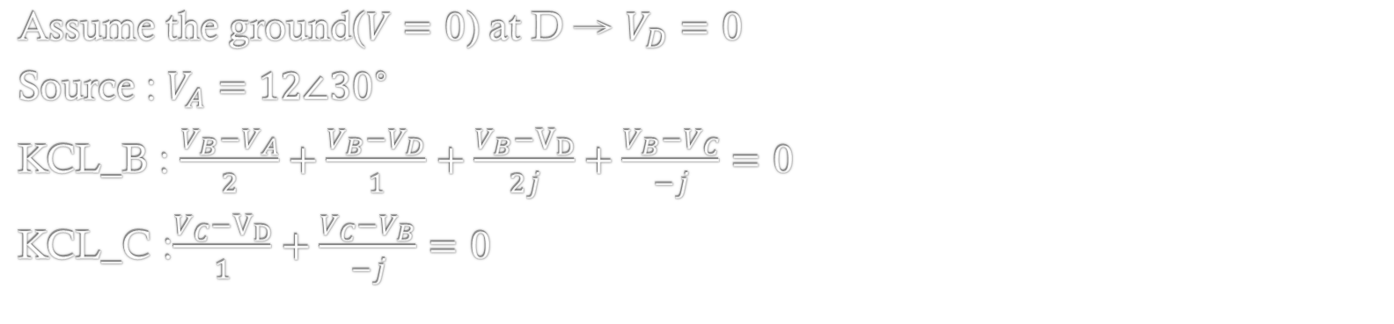
Node analysis
A
B
C
D
Assume the ground($V=0$) at D → $V_{D}=0$
Source : $V_{A}=12∠{30}^{∘}$
KCL_B : $\frac{V_{B}−V_{A}}{2}+\frac{V_{B}−V_{D}}{1}+\frac{V_{B}−V_{D}}{2j}+\frac{V_{B}−V_{C}}{−j}=0$
KCL_C :$\frac{V_{C}−V_{D}}{1}+\frac{V_{C}−V_{B}}{−j}=0$

Slide 14
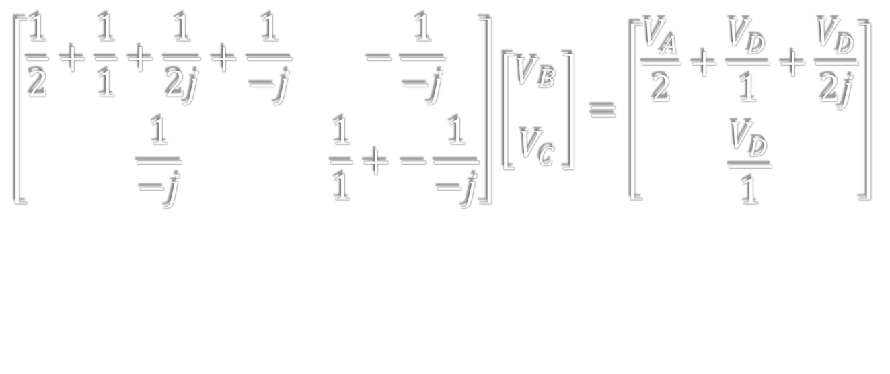
Node analysis
A
B
C
D
$$\left[\begin{matrix}\frac{1}{2}+\frac{1}{1}+\frac{1}{2j}+\frac{1}{−j} & −\frac{1}{−j} \\ \frac{1}{−j} & \frac{1}{1}+−\frac{1}{−j}\end{matrix}\right]\left[\begin{aligned}V_{\begin{aligned}B \\ \end{aligned}} \\ V_{C}\end{aligned}\right]=\left[\begin{aligned}\frac{V_{A}}{2}+\frac{V_{D}}{1}+\frac{V_{D}}{2j} \\ \frac{V_{D}}{1}\end{aligned}\right]$$

Slide 15
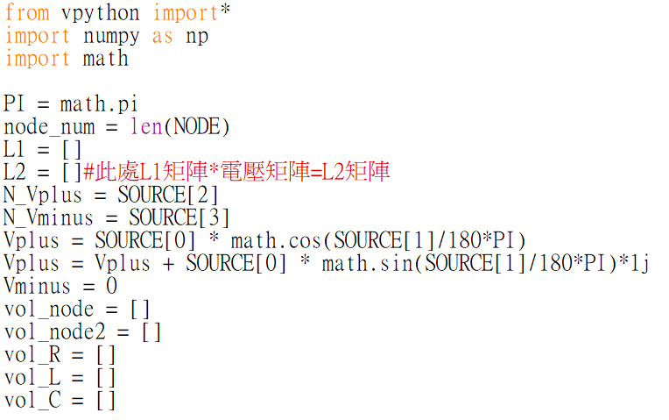
程式說明

Slide 16
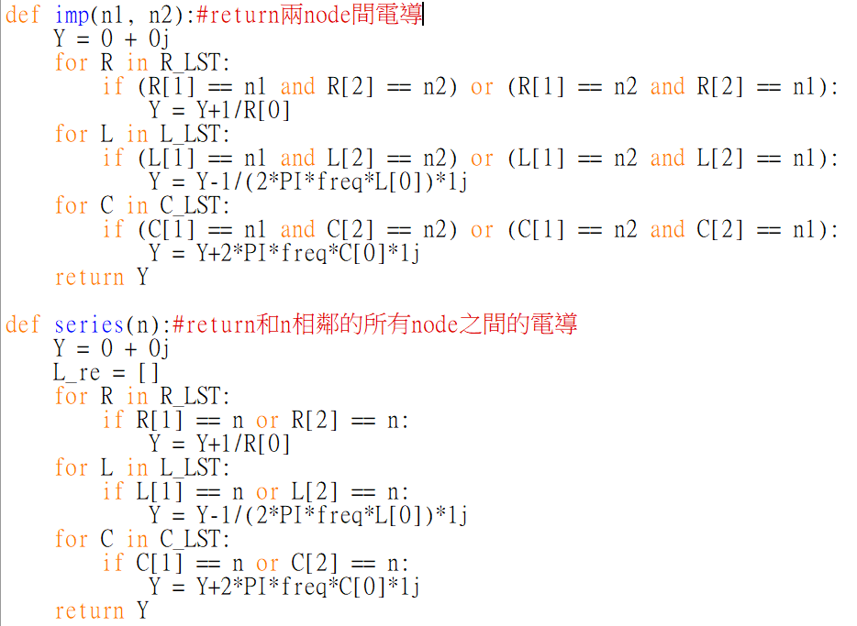
程式說明

Slide 17
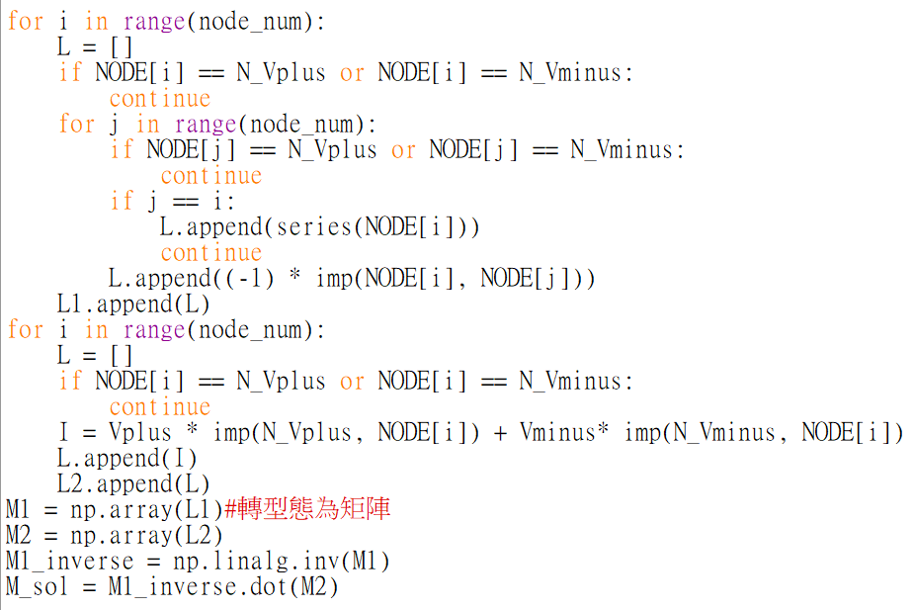

程式說明
$$\left[\begin{matrix}\frac{1}{2}+\frac{1}{1}+\frac{1}{2j}+\frac{1}{−j} & −\frac{1}{−j} \\ \frac{1}{−j} & \frac{1}{1}+−\frac{1}{−j}\end{matrix}\right]\left[\begin{aligned}V_{\begin{aligned}B \\ \end{aligned}} \\ V_{C}\end{aligned}\right]=\left[\begin{aligned}\frac{V_{A}}{2}+\frac{V_{D}}{1}+\frac{V_{D}}{2j} \\ \frac{V_{D}}{1}\end{aligned}\right]$$

Slide 18
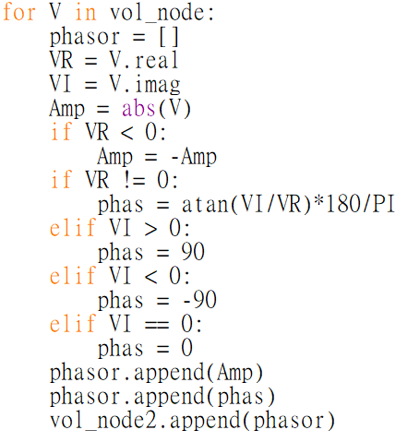
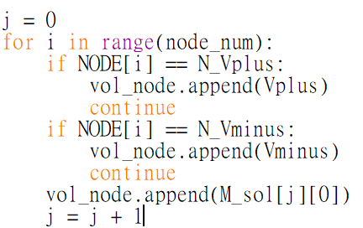
程式說明

Slide 19
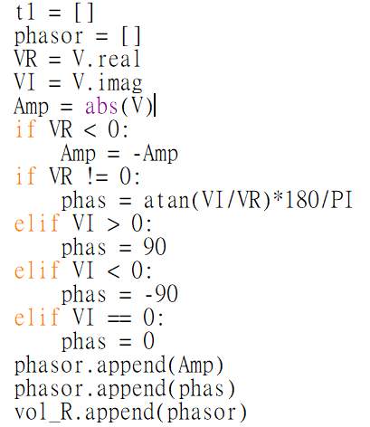
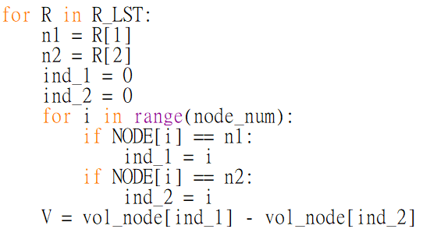
程式說明

Slide 20
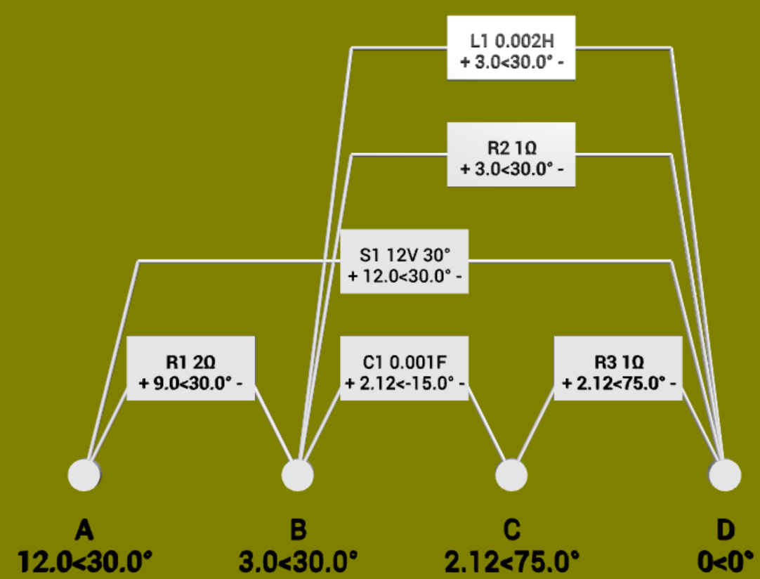
輸出結果
A
B
C
D

Slide 21
Thank you for listening!

