Slide 1
電路模擬器 MiniPSPICE
B09901034 戴瑋佑 B09901170 黃元顥 B09901175 楊博宇

Slide 2
Table of contents
Introduction
DC Analysis (with multiple voltage sources)
AC Analysis (with one voltage source)

Slide 3
Introduction
B09901170 黃元顥

Slide 4
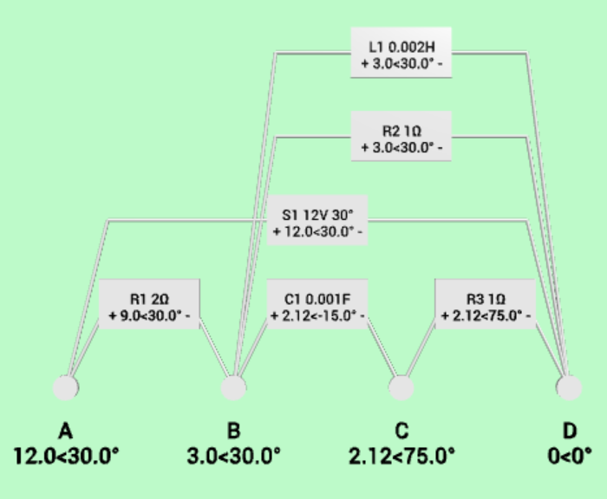
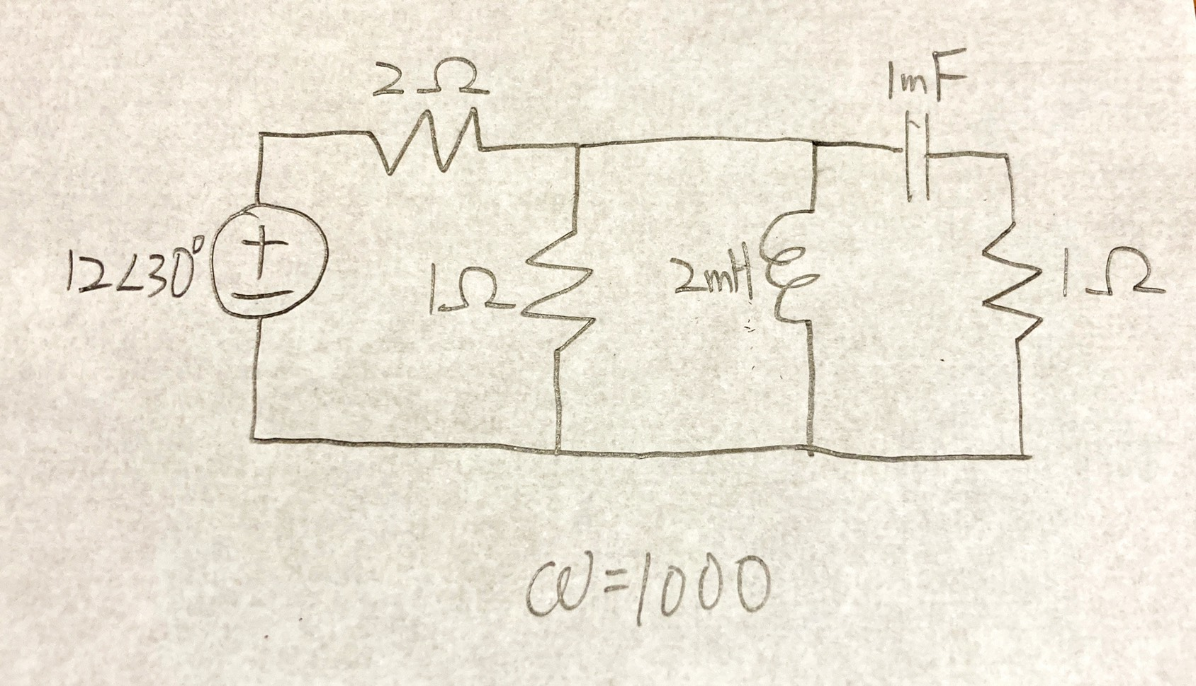
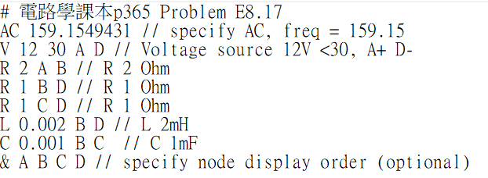
Procedure
Target Circuit
Description
Simulation

Slide 5
Circuit Description
Assign nodes
AC/DC (specify frequency for AC)
Components
Voltage Source: V mag (phase) node+ node-
Resistor: R value node1 node2
Inductor: L value node1 node2
Capacitor: C value node1 node2
Specify node display order: & node1 node2 …
Comments: # (whole line), // (behind)
Units are in Hz, Ohm, H, F
A
B
C
D

Slide 6
Result
Generate circuit diagram
Calculate voltage of each node
Calculate terminal voltage of each component

Slide 7
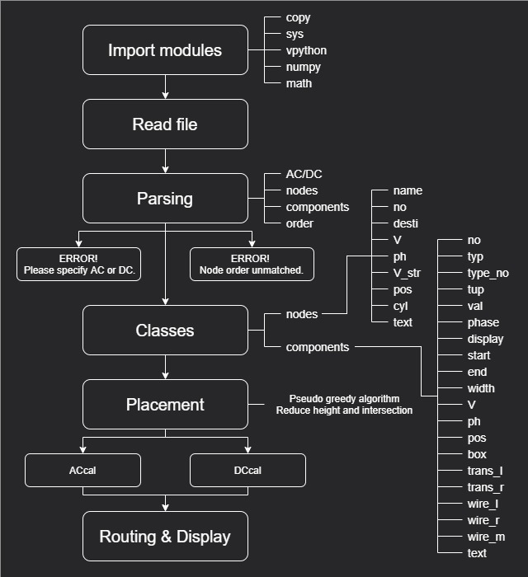
Main Structure

Slide 8
DC Analysis
B09901175 楊博宇

Slide 9
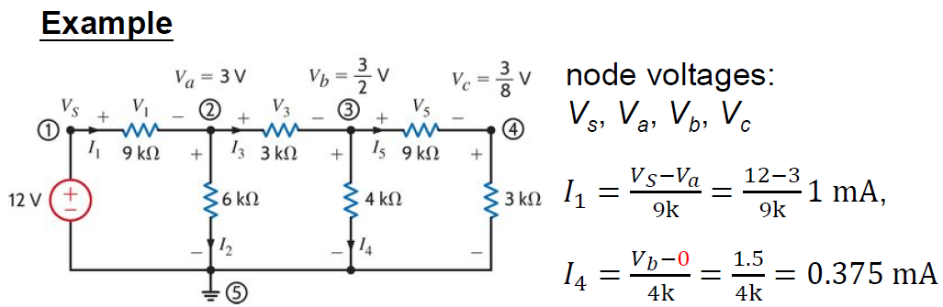
Nodal Analysis
Take one node as the ground node.
Select node voltages (vs. ground) as the variables.
If node voltages are known, all the other branch variables can be calculated.

Slide 10
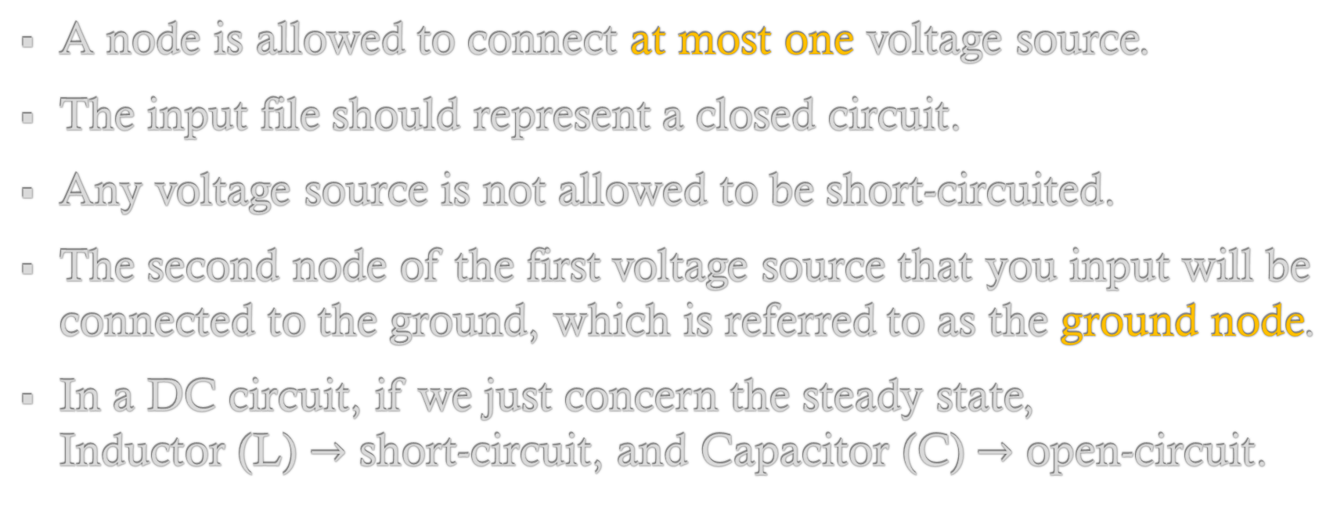
Constraints
A node is allowed to connect at most one voltage source.
The input file should represent a closed circuit.
Any voltage source is not allowed to be short-circuited.
The second node of the first voltage source that you input will be connected to the ground, which is referred to as the ground node.
In a DC circuit, if we just concern the steady state, Inductor (L) $→$ short-circuit, and Capacitor (C) $→$ open-circuit.

Slide 11

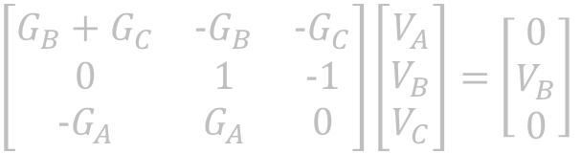

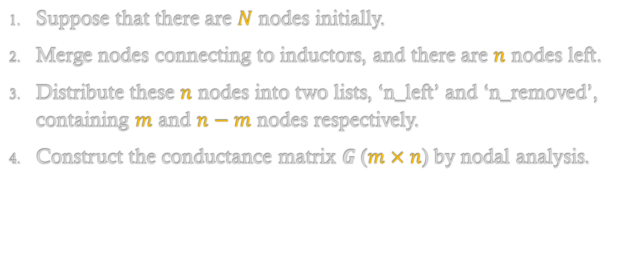



Procedure
$\left[\begin{matrix}G_{B}+G_{C} & -G_{B} & -G_{C} \\ 0 & 1 & -1 \\ -G_{A} & G_{A} & 0\end{matrix}\right]\left[\begin{matrix}V_{A} \\ V_{B} \\ V_{C}\end{matrix}\right]=$ $\left[\begin{matrix}0 \\ V_{B} \\ 0\end{matrix}\right]$
$$\#m$$
$$\#n−m$$
$$G$$
$$V$$
$$I$$
Suppose that there are $N$ nodes initially.
Merge nodes connecting to inductors, and there are $n$ nodes left.
Distribute these $n$ nodes into two lists, ‘n_left’ and ‘n_removed’, containing $m$ and $n−m$ nodes respectively.
Construct the conductance matrix $G$ ($m×n$) by nodal analysis.

Slide 12
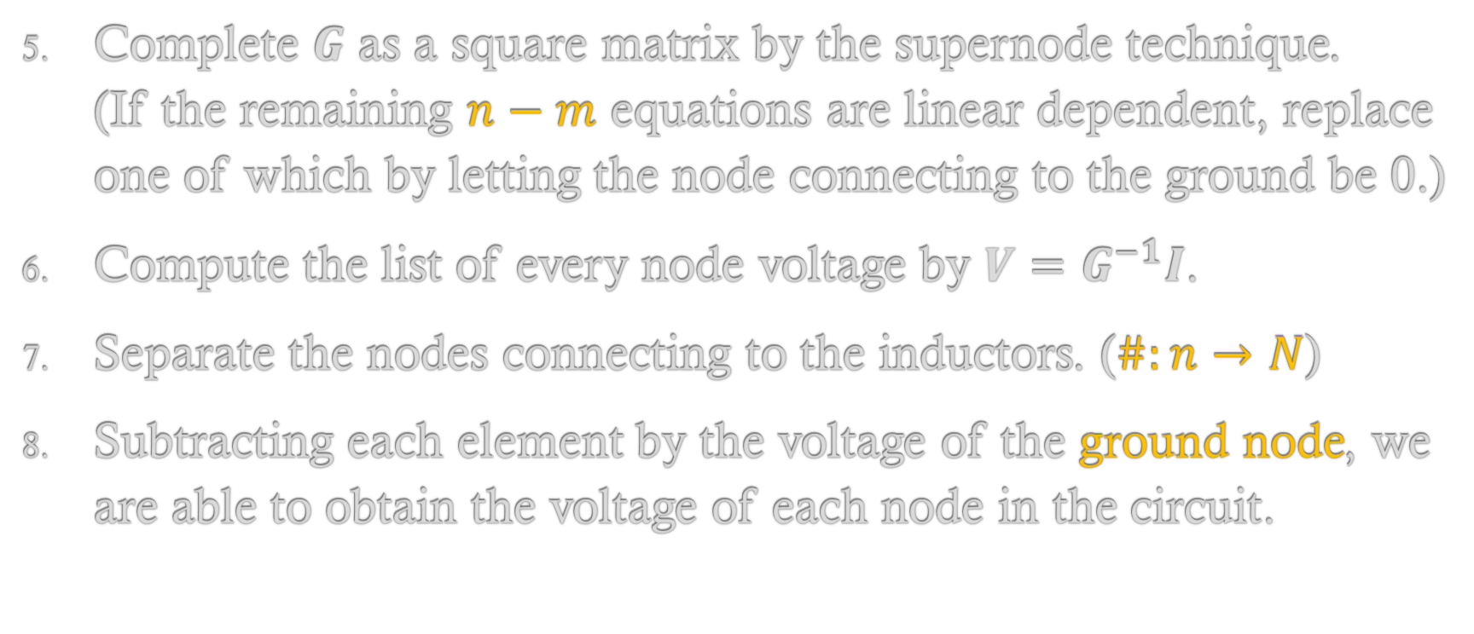



Procedure
$$G(n×n)$$
$$V(n×1)$$
$I$ $(n×1)$
$\left[\begin{matrix}G_{B}+G_{C} & -G_{B} & -G_{C} \\ 0 & 1 & -1 \\ -G_{A} & G_{A} & 0\end{matrix}\right]\left[\begin{matrix}V_{A} \\ V_{B} \\ V_{C}\end{matrix}\right]=$ $\left[\begin{matrix}0 \\ V_{B} \\ 0\end{matrix}\right]$
$$\#m$$
$$\#n−m$$
Complete $G$ as a square matrix by the supernode technique. (If the remaining $n−m$ equations are linear dependent, replace one of which by letting the node connecting to the ground be 0.)
Compute the list of every node voltage by $V=G^{−1}I$.
Separate the nodes connecting to the inductors. ($\#:n→N$)
Subtracting each element by the voltage of the ground node, we are able to obtain the voltage of each node in the circuit.

Slide 13
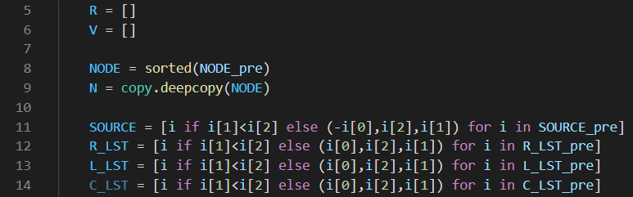

Code Explanation(1/5): Setting variables

Slide 14
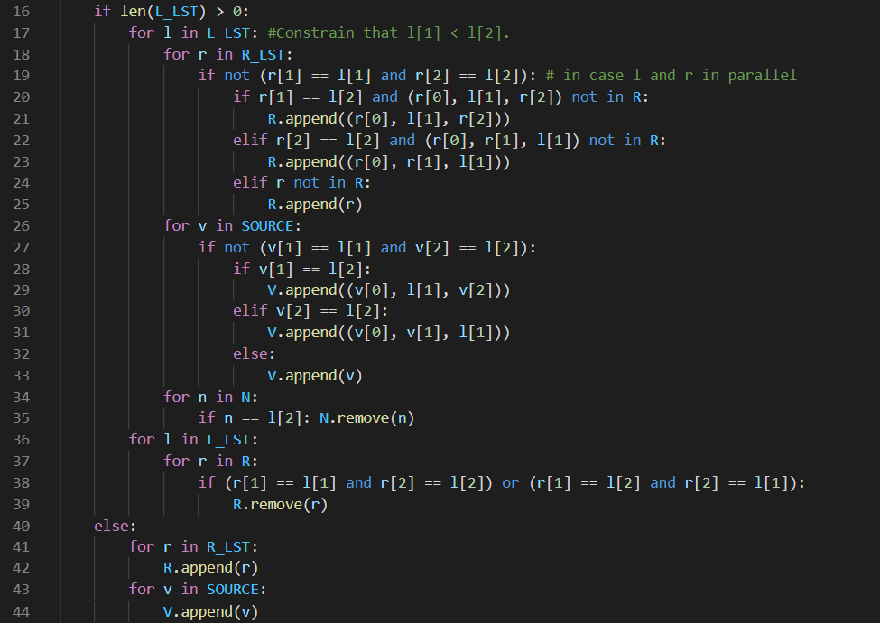
Code Explanation(2/5): Merging nodes connecting to L

Slide 15
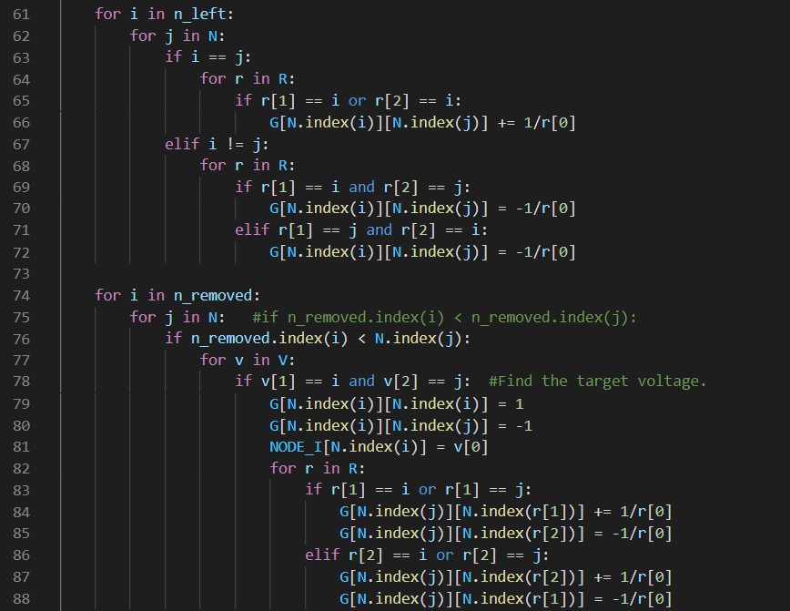
Code Explanation(3/5): Constructing the matrix G

Slide 16
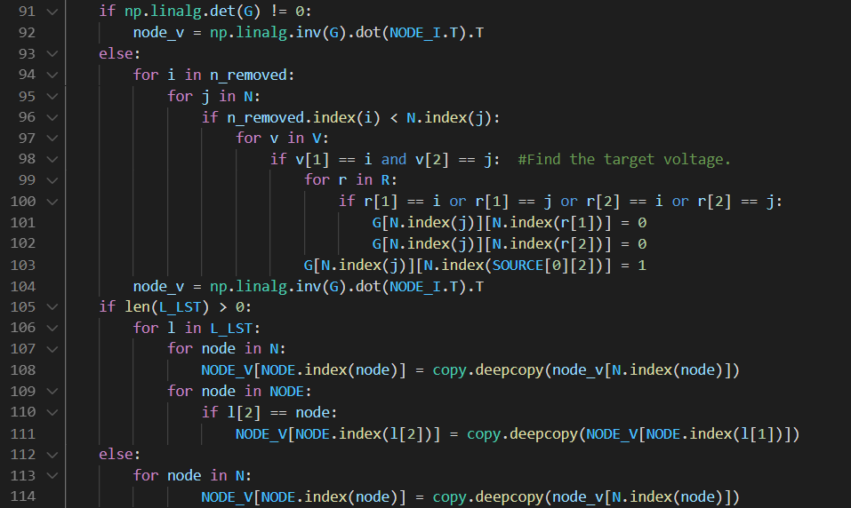
Code Explanation(4/5): Solving the node voltage

Slide 17
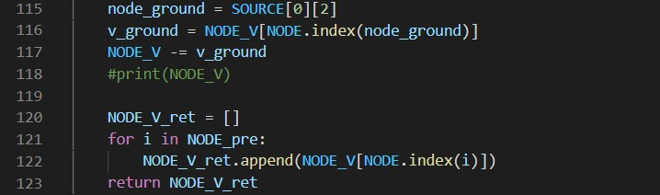
Code Explanation(5/5): Obtaining the answer

Slide 18
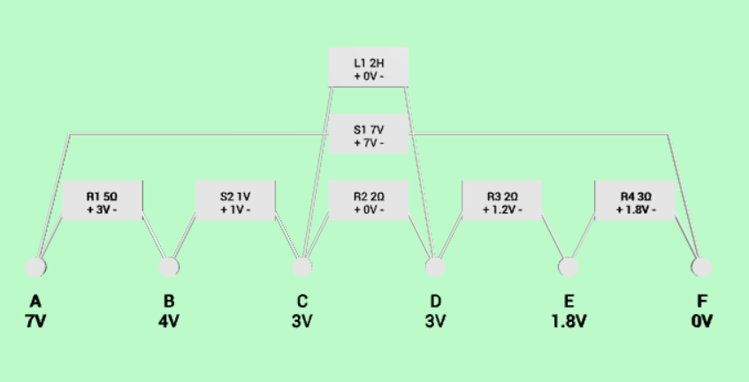
Demonstration
Input
Output
DC
V 7 A F
V 1 B C
R 5 A B
R 2 C D
L 2 C D
R 2 D E
R 3 E F
& A B C D E F

Slide 19
AC Analysis
B09901134 戴瑋佑

Slide 20
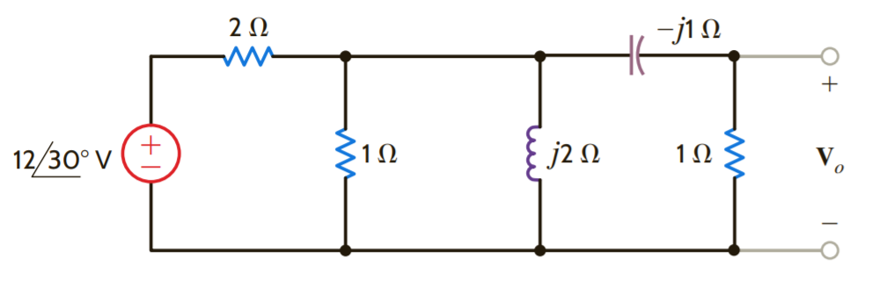
Node analysis
A
B
C
D
Take this circuit for example first. According to node analysis, we can list the formula

Slide 21
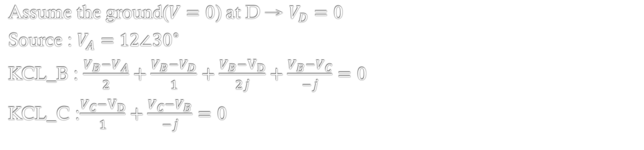
Node analysis
A
B
C
D
Assume the ground($V=0$) at D → $V_{D}=0$
Source : $V_{A}=12∠{30}^{∘}$
KCL_B : $\frac{V_{B}−V_{A}}{2}+\frac{V_{B}−V_{D}}{1}+\frac{V_{B}−V_{D}}{2j}+\frac{V_{B}−V_{C}}{−j}=0$
KCL_C :$\frac{V_{C}−V_{D}}{1}+\frac{V_{C}−V_{B}}{−j}=0$

Slide 22
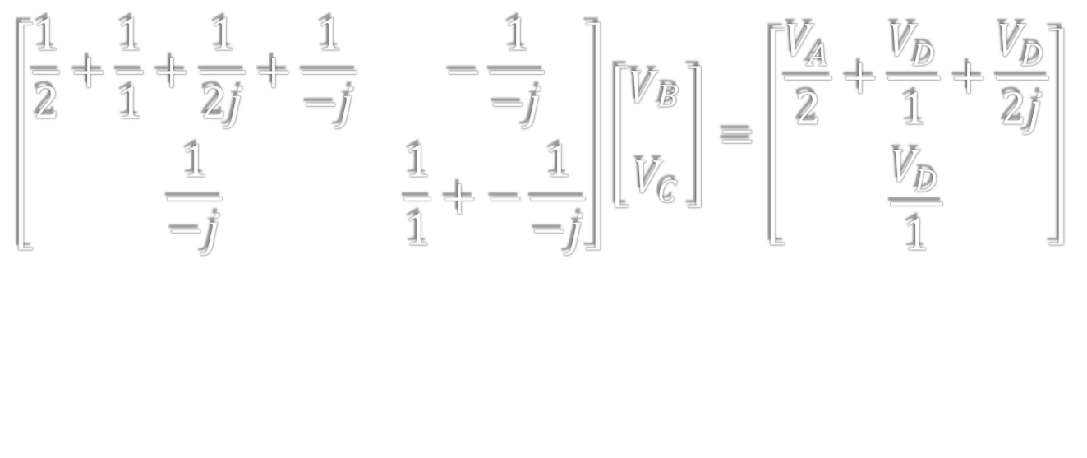
Node analysis
A
B
C
D
$$\left[\begin{matrix}\frac{1}{2}+\frac{1}{1}+\frac{1}{2j}+\frac{1}{−j} & −\frac{1}{−j} \\ \frac{1}{−j} & \frac{1}{1}+−\frac{1}{−j}\end{matrix}\right]\left[\begin{aligned}V_{\begin{aligned}B \\ \end{aligned}} \\ V_{C}\end{aligned}\right]=\left[\begin{aligned}\frac{V_{A}}{2}+\frac{V_{D}}{1}+\frac{V_{D}}{2j} \\ \frac{V_{D}}{1}\end{aligned}\right]$$

Slide 23
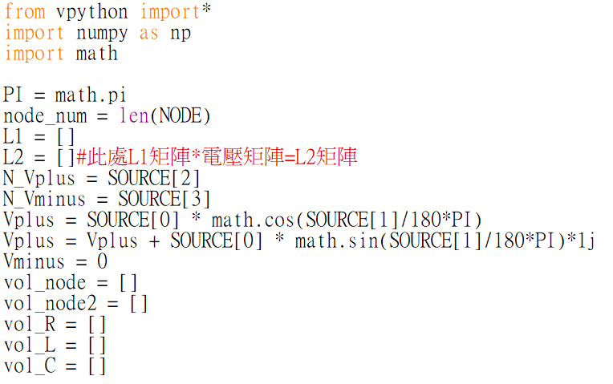
程式說明

Slide 24
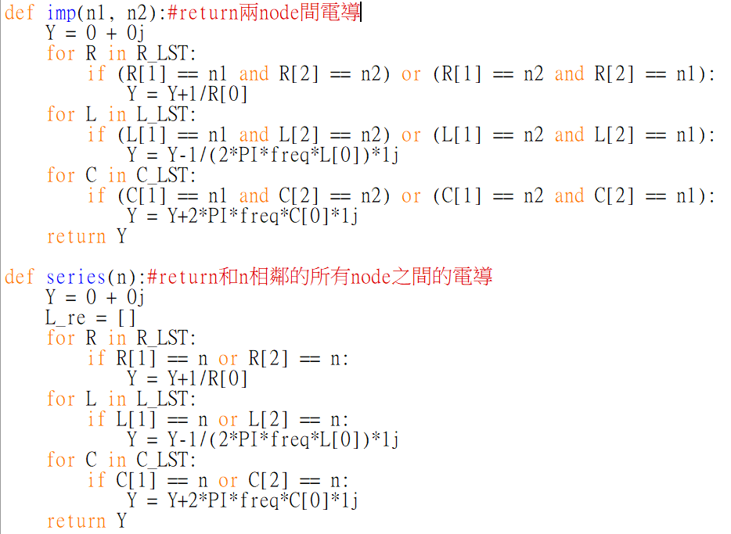
程式說明

Slide 25
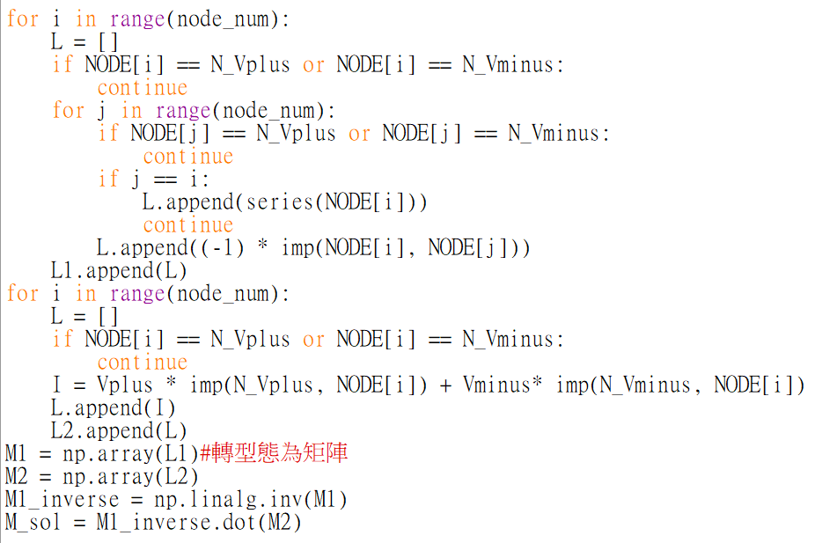

程式說明
$$\left[\begin{matrix}\frac{1}{2}+\frac{1}{1}+\frac{1}{2j}+\frac{1}{−j} & −\frac{1}{−j} \\ \frac{1}{−j} & \frac{1}{1}+−\frac{1}{−j}\end{matrix}\right]\left[\begin{aligned}V_{\begin{aligned}B \\ \end{aligned}} \\ V_{C}\end{aligned}\right]=\left[\begin{aligned}\frac{V_{A}}{2}+\frac{V_{D}}{1}+\frac{V_{D}}{2j} \\ \frac{V_{D}}{1}\end{aligned}\right]$$

Slide 26
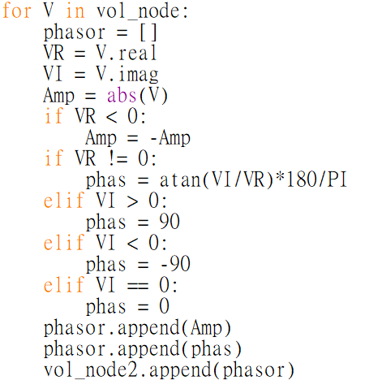
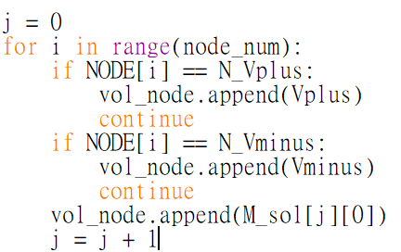
程式說明

Slide 27
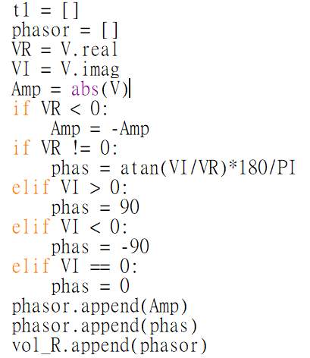
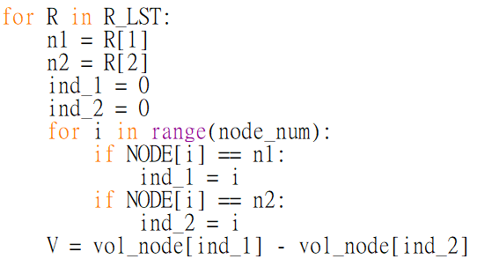
程式說明

Slide 28
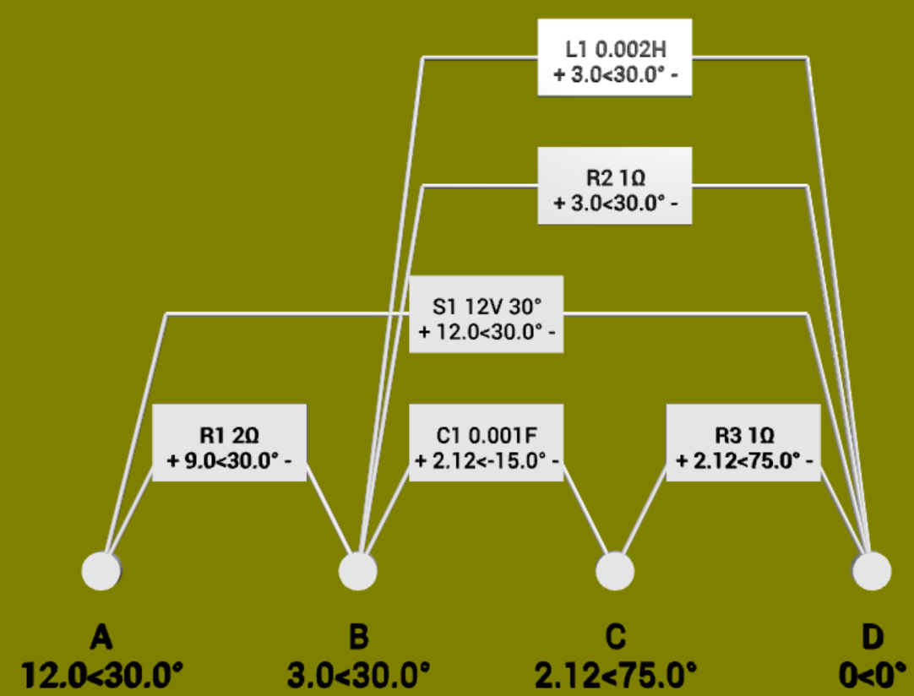
輸出結果
A
B
C
D

Slide 29
Thank you for listening!

