Slide 1

Acknowledgements
A secure document tracking platform

Slide 2


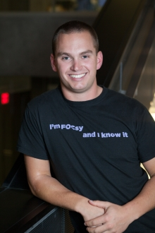
Our Team
Karl Price - Co-founder
Brock Kopp- Co-founder

Slide 3

The Construction Industry
Annual revenue $61 Billion - Statistics Canada
Complex approval processes
Extreme safety concerns

Slide 4
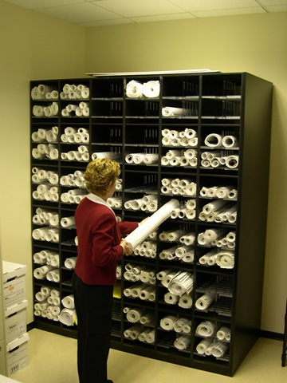
Problem
Distributed approval process
Current process mainly paper/e-mail based
Liability/integrity concerns
All communications archived

Slide 5

Barriers to Entry
Established workflow
Industry resistance to change
Setup cost, including re-training

Slide 6
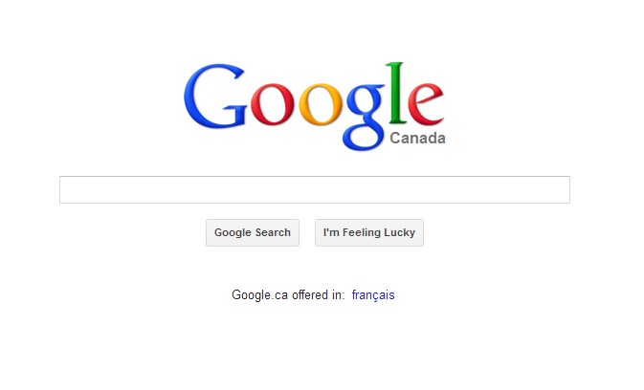
Our Solution
One-stop approval / archiving / revision tracking
Web-based application
Mobile application (increased accessibility)
Clean, simple user interface

Slide 7
Revenue Streams
Setup Fee
Licensing Fee (per project)
Customization Contract

Slide 8

Current Status
Product development (Completed mid-Aug)
First client (end of August)
$6000 seed money
Server space
Client meetings
Future clients

Slide 9
Acknowledgements
A secure document tracking platform

