Slide 1
HIST 2P26 Intro to AGOL
Sharon Janzen, Map, Data & GIS Library
Heather Whipple, Data Librarian
6 November 2019

Slide 2
HIST 2P26 - Introduction
Today’s session will focus on using ArcGIS Online to explore and display data.
The data you’ll use in this activity has already been processed – sometimes called cleaned – so that it can be manipulated effectively by ArcGIS or other software.
Original data can be accurately transcribed but may still need to be cleaned before visualization or other analysis.

Slide 3

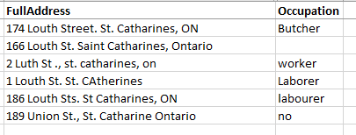
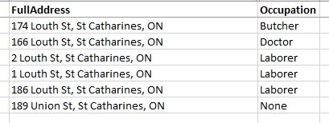
HIST 2P26 - Introduction
When you use ArcGIS Online for your HGIS report, you may need to clean your data first.
Original Data
Copy the original data to a NEW file for editing
Cleaned Data

Slide 4
HIST 2P26 - Introduction
“Messy” data generally means data that is either incomplete, inconsistent, or incorrect in some way:
Missing values (no occupation; no province)
Spelling errors and variants, punctuation inconsistencies
Multiple values for single category (worker, laborer, Laborer)
Be sure to plan for enough time to review and clean the data you’ll use for your HGIS report!

Slide 5
HIST 2P26 - Download the data
https://github.com/brockmdgl/HIST2p26
To download the CSV, R-click RAW and select Save as…
Go to arcgis.com and sign in using the credentials assigned to you.

