Slide 1
Probability of defaulting
Springboard Capstone 1 Final
By: brock nosbisch

Slide 2
Overview
The Problem
Dataset
Exploratory Data Analysis
Machine Learning
Metrics by Subgroups
Conclusions

Slide 3
The problem
My client is any bank, credit union, or other financial institution that gives loans to individuals. Predicting whether someone will default on their loan is key to the company deciding on whether to give that person a loan or not.
The original intent was to predict the probability of each person defaulting but it transformed into finding the best model to produce the highest amount of revenue for the company.

Slide 4
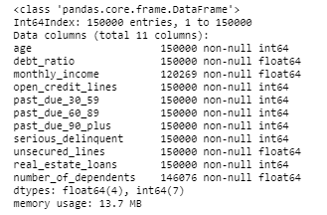
Dataset
The original dataset comes from a Kaggle competition found here.
The dataset includes 11 features for 150,000 individuals. The data contains history for the past 2 years.

Slide 5
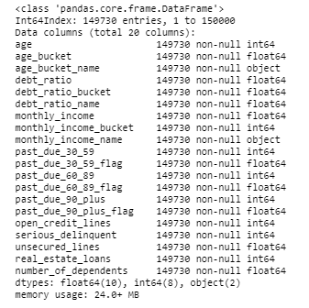
Dataset
Additional features like Age Buckets, Monthly Income Buckets, Past Due Flags, etc. were added to the dataset.
Some data also needed cleaned. Monthly Income and Number of Dependents had NULL values and the Past Due fields values had records with 96 and 98 values.

Slide 6
Dataset (field definitions)
30-59 Days Past Due: Number of times borrower has been 30-59 days past due but no worse in the last 2 years.
60-89 Days Past Due: Number of times borrower has been 60-89 days past due but no worse in the last 2 years.
90+ Days Past Due: Number of times borrower has been 90 days or more past due.
Serious Delinquent: Flag to show if a person experiences 90 days past due delinquency or worse.
Age: Age of borrower in years.
Age Bucket: Age of borrower bucketed in 10 year increments (20-29, 30-39, 40-49, ... 90-99, 100+)
Monthly Income: Monthly income.
Monthly Income Range: Monthly income bucketed (0-499, 500-999, 1000-2499, 2500-4999, 5000-7499, 7500-9999, 10000-24999, 25000-49999, 50000+); NULL means that no monthly income value was provided.
Debt Ratio: Monthly debt payments, alimony, living costs divided by monthly gross income.
Debt Ratio Quantile: 10% increments of the Debt Ratio. Each 10% bucket contains approximately the same amount of people.
Number of Open Credit Lines (and Loans): Number of open loans (installment like car loan or mortgage) and lines of credit (e.g. credit cards)
Unsecured Lines: Total balance on credit cards and personal lines of credit except real estate and no installment debt like car loans divided by the sum of credit limits.
Real Estate Loans: Number of mortgage and real estate loans including home equity lines of credit.
Number of Dependents: Number of dependents in family excluding themselves (spouse, children, etc.)

Slide 7
Exploratory data analysis
Several observations of interest were found during EDA. Here are the high-level results.
The younger in age you are, the higher the probability that you will be 60-89 Days Past Due, 90+ Days Past Due, and/or Serious Delinquent.
The $1000-$2499 and $2500-$4999 Monthly Income Ranges are most likely to be Past Due when compared to other income ranges.
The Debt Ratio quantiles show that the Past Due Bucket averages gradually increase from the 0-10% quantile, dip a little bit after the 11-20% quantile, stay flat until the 41-50% quantile, and then keep rising up to the 71-80% quantile where the average is highest.
The 60-89, 90+, and Serious Delinquent averages are flat after the # of Open Credit Lines reaches ~4 and above. (Do note that any Open Credit Limits with < 500 people are excluded (# > 23))

Slide 8
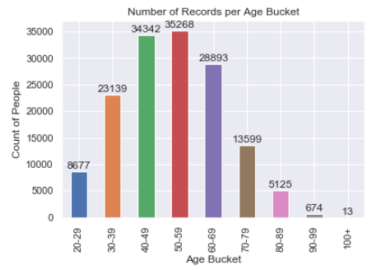
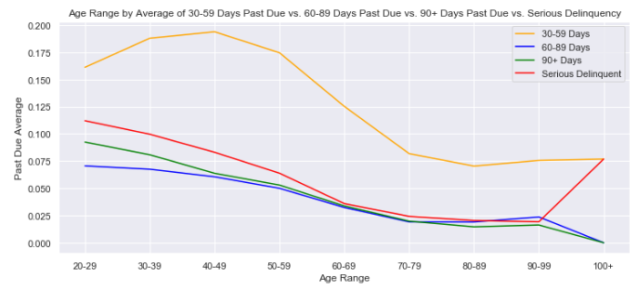
Exploratory data analysis (age)
Averages of each Age Range to be Past Due 30-59 Days, 60-89 Days, 90+ Days, and Serious Delinquent
Count of People per Age Bucket

Slide 9
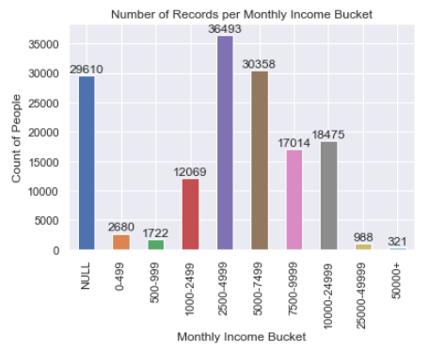
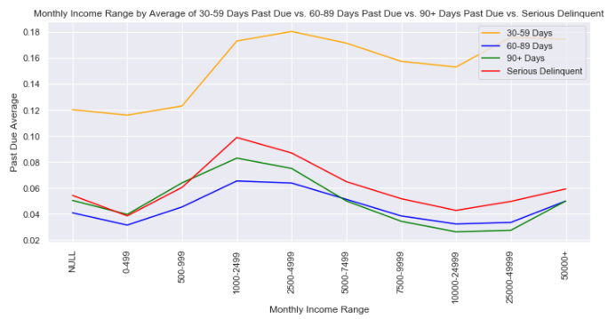
Exploratory data analysis (monthly income)
Count of People per Monthly Income Range
Averages of each Income Range to be Past Due 30-59 Days, 60-89 Days, 90+ Days, and Serious Delinquent

Slide 10
Machine learning (custom scorer)
I created a Custom Scorer that calculates the profit / loss and can be reused for each algorithm.
Cost Factors:
Average Loan Amount (defaulted to $50,000)
Average Interest Rate (defaulted to 4%)
Average Loan Length (defaulted to 2 years)
Calculations:
If the scorer correctly predicts a non-defaulter then the profit is 4,000 (loan amount x rate x length).
If the scorer incorrectly labels a defaulter as a non-defaulter then the loss is 50,000 (loan amount).
For simplicity, I assume the defaulter has never made a payment.
If the scorer incorrectly labels a non-defaulter as a defaulter then the loss is 4,000 (profit we would have taken in).

Slide 11
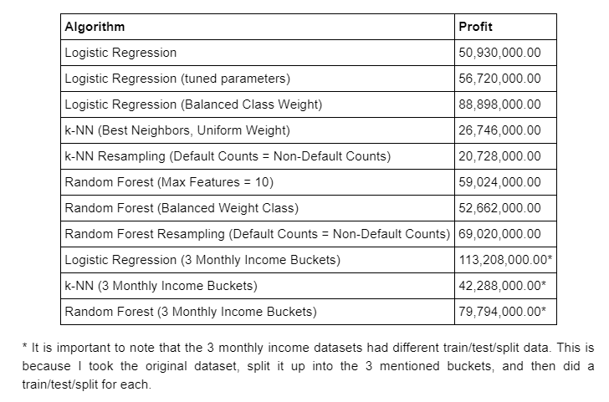
Machine learning (summary)
The results show the Profits taken in for each algorithm. The Logistic Regression (3 Monthly Income Buckets with Balanced Weight Class) had the best Profit predicted with over $110 million followed by Logistic Regression (Balanced Class Weight) and Random Forest Resampling (3 Monthly Income Buckets) both having profits of $79+ millions.
All others resulted in $70 million or less. Do note that SVM was run initially but had to be removed due to computational power.

Slide 12
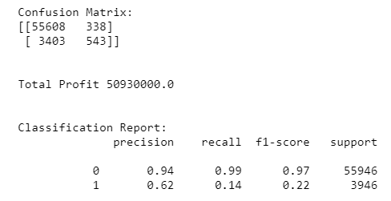
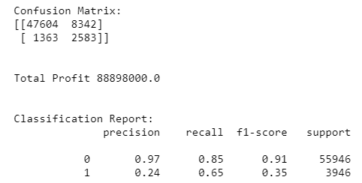
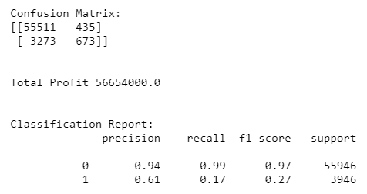
Machine learning (Logistic Regression)
For Logistic Regression, I ran 3 tests.
Default parameters, CV=10
Default parameters, tuned parameters
Balanced Class Weight, Ridge Regression Penalty (L2), CV=10

Slide 13
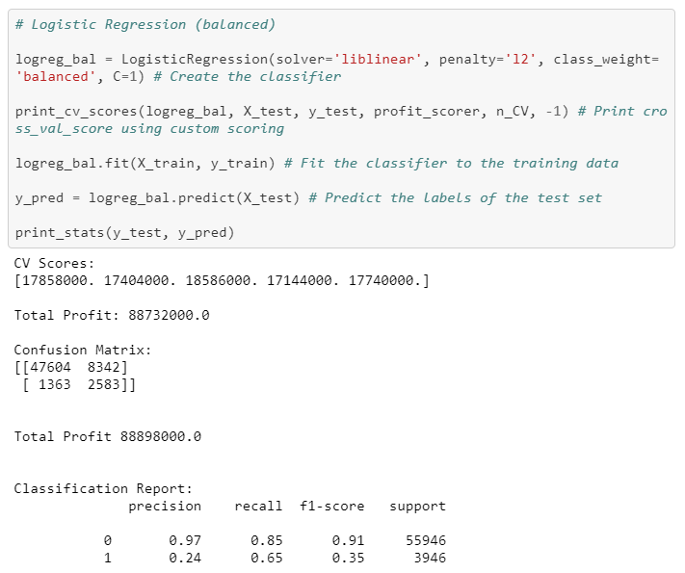
Machine learning (Logistic Regression - Balanced)
As you can see from the previous slide, the best performing model was the Balanced Class Weight, Ridge Regression Penalty (L2), CV=10.
I consider this model to be the best out of all the models (excluding the 3 monthly income bucket models since they had different datasets than the rest).
Total Profit: $88,898,000

Slide 14
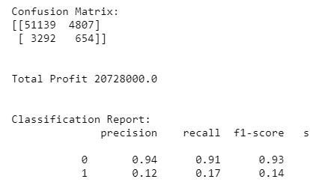
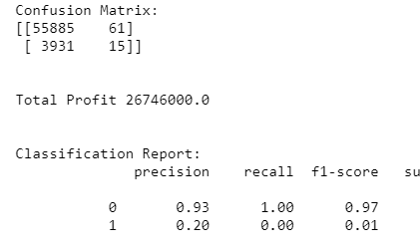
Machine learning (k-nearest neighbors)
For k-NN, I ran 2 tests. The results for each were not subpar.
Find the best k-NN parameters using Grid Search and use it.
Upsample the data so that out of the training set, 50% have been serious delinquent and 50% have not.

Slide 15
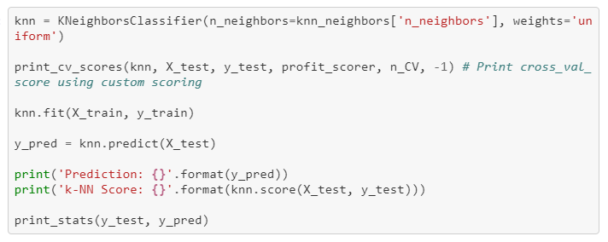
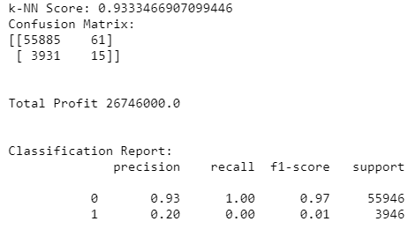
Machine learning (k-nearest neighbors – Best params)
For the k-NN (Best Neighbors, Uniform Weight) run, the Precision was 93% and Recall was ~100% but that is because the model only predicted 61 total defaults. Only 15 of those 61 actually defaulted.
Profit was only ~$26 million because of this.

Slide 16
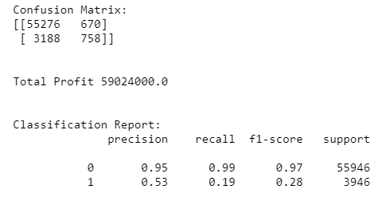
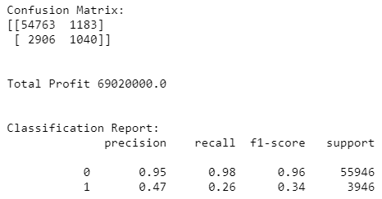
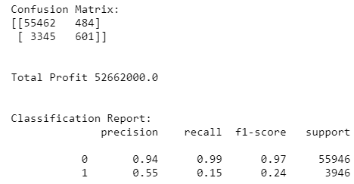
Machine learning (random forest)
For Random Forest, I ran 3 tests. The results were pretty decent with profit in the range of 52 – 69 million dollars.
Max Features = 10
Balanced Weight Class
Upsample

Slide 17
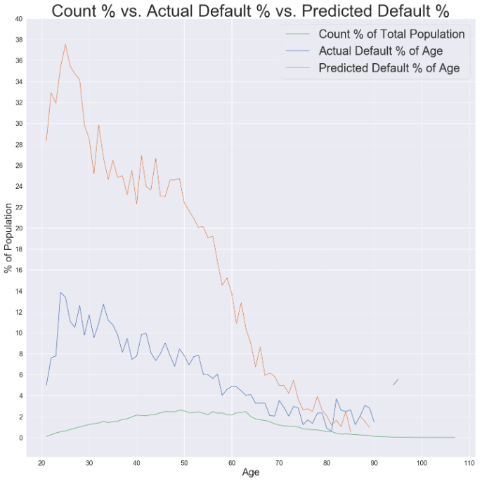
Metrics by subgroups (logistic regression – balanced)
For analysis of metrics by subgroups, I am using the Logistic Regression (Balanced Class Weight) model since it is being defined as the best model.
This graph is showing the Count % of Total Population by Age, Actual Default % by Age, and Predicted Default % by Age.

Slide 18
Metrics by subgroups (logistic regression – balanced)
The model is predicting a good portion of the younger ages to default so it appears the best single model is biased against younger people. For instance, if you are in your mid-20's, you have over a 35% chance of being predicted as a defaulter.
To maximize profits, predicting a portion of people to Default when they would have actually paid leads to more profit. Using our default numbers, it takes 12.5 non-defaulters to make up the losses from 1 defaulter.

Slide 19
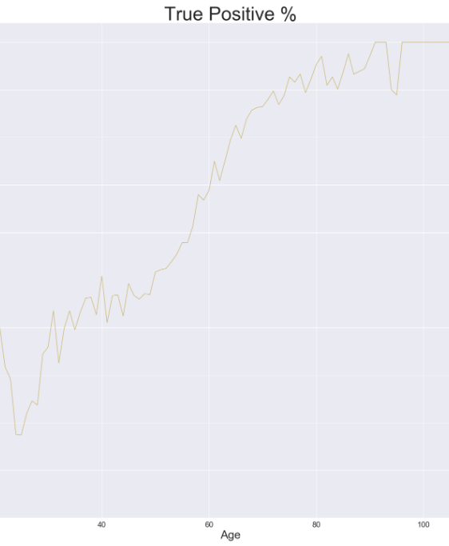
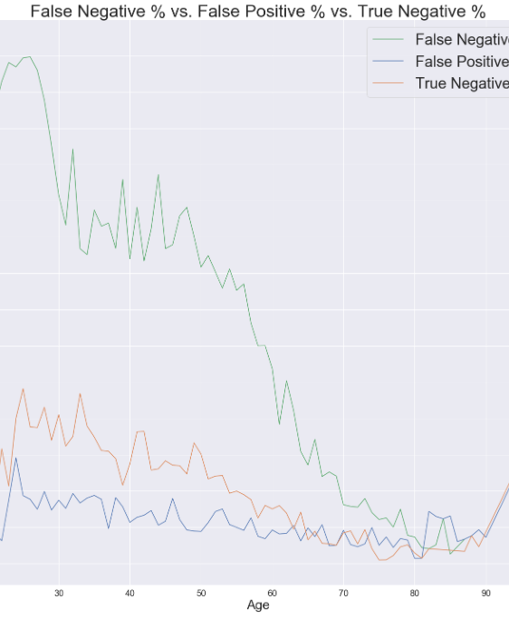
Metrics by subgroups (logistic regression – balanced)
The model had False Negatives for 15% of the total non-Defaulters with the highest % of False Negatives in the mid-20's (up to 29% of total population). This means that by being in your mid-20's, you have over a 25% of being declined a loan even though you would have paid back the loan in full.
So in summary, younger people are higher risk and have more uncertainty among outcomes.

Slide 20
Metrics by subgroups (logistic regression – balanced)
Another analysis of the breakdown of Subgroups of those who were predicted to Default but would have paid, those who we did predict to default and did default, and those who we did not predict to default but did default. One interesting data point I see is that 22% of the people predicted to Default but had not previously gone 90 days past due. For those who predicted to Default and actually did Default, 53% of the people had previously gone 90 days past due. For those who were not predicted to Default but did Default, only 1.5% had previously gone Past Due 90 Days.
Basically the model is good at predicting for those who have been late in the past but not so good for those that have never been past due previously.

Slide 21
Conclusions
Logistic Regression with Balanced Class Weight is the best model Profit-wise.
The model does seem to be biased against younger people.
In the end, the final decision on whether to give someone a loan or not should not be solely based on the model.
Possible Next Steps:
If time permitted, I would add additional algorithms (ex. xgboost).
Find additional data source(s) to combine with the dataset used.

