Slide 1
Customer churn
Springboard Capstone 2 Milestone report 2
By: brock nosbisch

Slide 2
Overview
The Problem
Dataset
Exploratory Data Analysis
Machine Learning
Conclusions

Slide 3
The problem
My client is a natural gas company. Being able to predict when a customer will turn off is crucial to the natural gas business. By knowing when a customer will turn off:
Workload planning and field operations can forecast future turn off work and plan for enough resources to be available to do the required work.
Enables salesreps to reach out to those customers to try to get them to stay on but if the customer does want to turn off still, the salesrep can schedule that customer to turn off during a non-peak time. This will save the company in overtime costs and ensure the workers are working at 100% utilization.

Slide 4
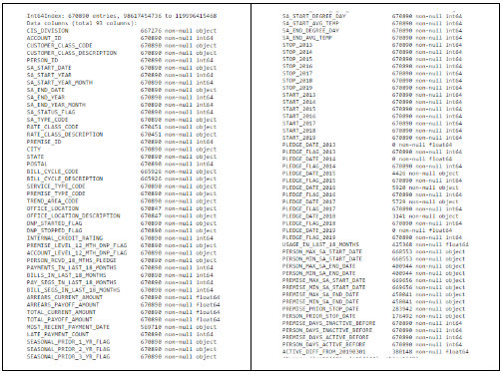
Dataset
This dataset comes from combining multiple internal applications and external data sources.
The dataset includes 93 fields and 670,000 records.

Slide 5
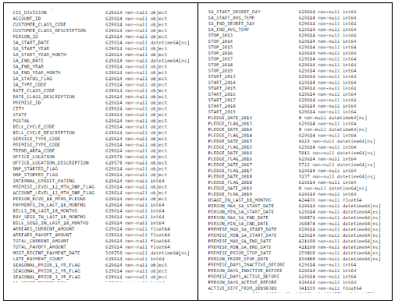
Dataset
Some data needs to be removed for certain SA Statuses.
The data also has some bad data for Rate Class, Company, and Bill Cycle values. The bad records will be removed.

Slide 6
Dataset (field definitions)
CIS Division: Company
Account ID: An account is owned by 1 person but can have multiple Service Agreements.
Customer Class: Account level customer class.
Person ID: A person can have multiple accounts.
SA Start: The Service Agreement's Start Date (when gas started).
SA End: The Service Agreement's End Date (when gas stopped).
SA Status: The current SA status.
SA Type: The Service Agreement's type (example: Gas Residential).
Rate Class: Determines how the SA is billed.
Premise ID: Unique identifier for an address.
City: Premise's City
State: Premise's State
Postal: Premise's Zip Code
Bill Cycle: How we know when to bill an Account.
Service Type: Always Gas.
Premise Type: Premise Type (example: Commercial).
Office Location: Closest office to premise.

Slide 7
Dataset (field definitions)
DNP Started Flag: Was the previous stop a DNP.
DNP Stopped Flag: Did the current SA Stop because of DNP.
Internal Credit Rating: The internal credit rating for an Account.
Premise Level 12 Month DNP Flag: Has the Premise had a DNP in the last 12 months.
Account Level 12 Month DNP Flag: Has the Account had a DNP in the last 12 months.
Person Received 18 Months Pledge: Has the Person received a Pledge in the last 18 months.
Payments in Last 18 Months: How many payments have been made for the SA in the last 18 months.
Bills in Last 18 Months: How many bills were billed for the SA in the last 18 months.
Arrears Current/Payoff Amount: How much money is past due for the SA.
Total Current/Payoff Amount: How much money is owed for the SA.
Most Recent Payment Date: What was the most recent Payment Date.
Late Payment Count: How many late payments were charged to the SA in the past 18 months.
Seasonal Flags (1 year ago, 2 years ago, 3 years ago): Did the premise turn off between 3/1 and 6/30 and then turn on between 8/1 and 12/31.
SA Start/End Degree: What was the Degree Days on the SA Start and SA End dates.
Stop/Start Flags: Flags to show if the SA started/stopped in a given year.
Pledge Date/Flag: The Pledge Date and Flag for each year.
Usage in Last 18 Months: The Usage billed in the past 18 months.

Slide 8
Dataset (field definitions)
Person/Premise Min/Max SA Start/End Dates: What are the minimum and maximum start and end dates at a Person or Premise level.
Person/Premise Days Active/Inactive Before: How many days was the previous SA for the Person or Premise Active or Inactive for.
Stop Days from 20190301: Flags to use for training/testing. This should be dynamic but we are hardcoding the value for now.

Slide 9
Exploratory data analysis
Several observations of interest were found during EDA. Here are the high-level results.
The most frequent Start Date of the SAs that were stopped in March had started gas service in October, November, and December of the previous year.
The Residential Customer Class has the most stops during all 3 of the time windows but less than 1% of all active Residential SAs were stopped. The biggest offenders of stops during the 3 windows are Landlords and Builder/Developers. 14% of Landlord SAs stopped during the 21 day window and 9% of Builder/Developer SAs stopped during the same window.
When looking at stops during the 7 day, 14 day, and 21 day windows by City, Webb City, Joplin, Cameron, and Aurora have the highest % of Active SAs that were stopped. Over 2% of all Active SAs in Aurora are stopped during the 21 day window.
The higher the arrears amount, the more likely you are to stop. For example, if you owe 100 or less then you have less than a 1% chance of stopping between 3/1/19 - 3/21/19. If you owe 700−799 then you have over a 6% chance of stopping in the same timeframe. Residential customers have almost a 10% chance of stopping in the same bucket/timeframe.
The shorter amount of time a customer has had gas service, the more likely the customer will stop gas.
The percentage of stopped SAs that were DNPs previously during the 7 day window was 11%, 14 day window was 15%, and 21 day window was also 15%.
The Bootstrap Estimate of SA Stops Mean shows the 95% confidence interval for SAs stopping between 3/1/2017 and 3/7/2019 is from .34% to .38%.. Similarly, 3/1/2017 to 3/14/2019 is from .67% to .72% and 3/1/2019 to 3/21/2019 is from .98% to 1.04%.

Slide 10
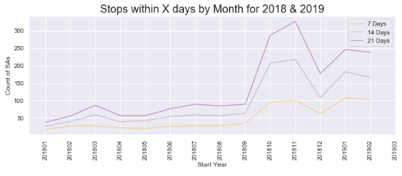
Exploratory data analysis (Start date of stops)

Slide 11
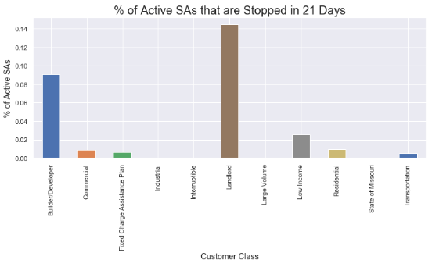
Exploratory data analysis (Stops by Customer class)

Slide 12
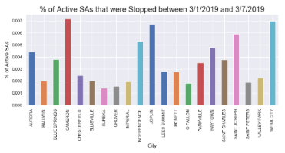
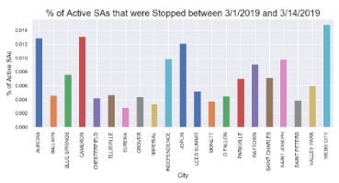
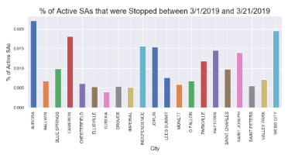
Exploratory data analysis (Stops by City)

Slide 13
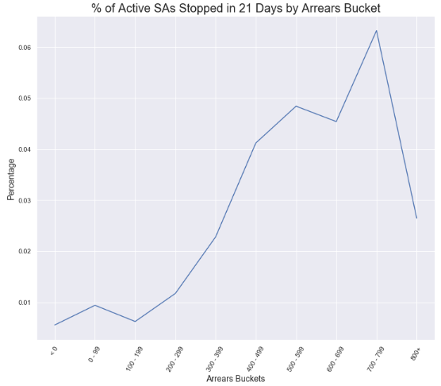
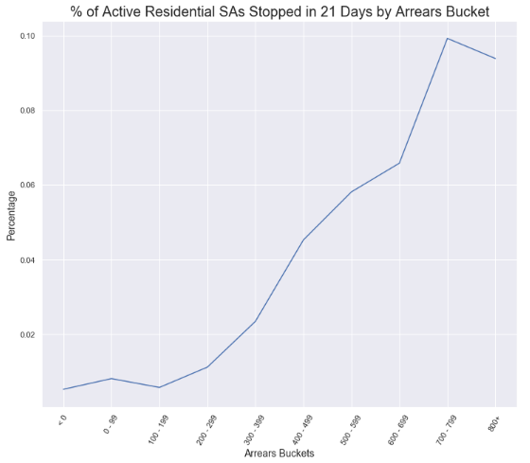
Exploratory data analysis (Arrearage)

Slide 14
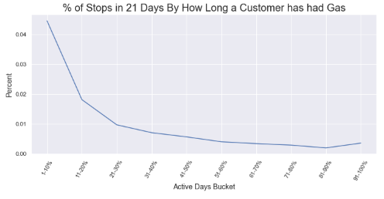
Exploratory data analysis (Active days)

Slide 15
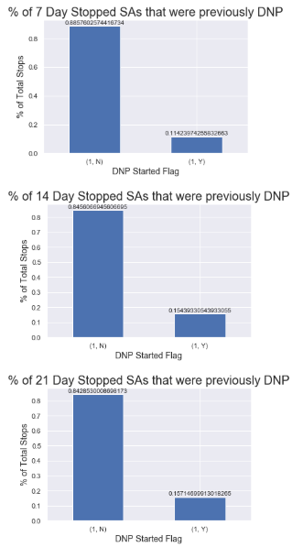
Exploratory data analysis (Stops for previous dnps)

Slide 16
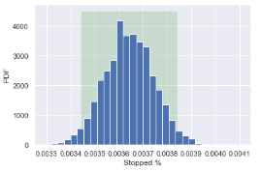
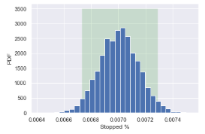
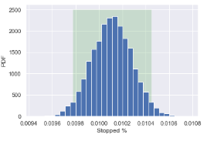
Exploratory data analysis (Bootstrap estimate)
7 Day Stops
14 Day Stops
21 Day Stops

Slide 17
Machine learning (custom scorer)
I created a custom scorer to show the amount of savings. For simplicity, I made the savings for scheduling a turn-off as 100 dollars and the cost of making a non-productive call as -10 dollars. This will account for cases of saving money for scheduling a turn-off (or a customer staying on) and also account for a CSR or salesreps' time they spent calling customers that were never going to turn-off.
Cost Factors:
Scheduling a Turn-Off = $100 savings
Time Spend Calling a non-Stop = -$10
Calculations:
If the scorer correctly predicts a Stop then the savings is $100.
If the scorer incorrectly labels a non-Stop as a Stop then the cost is -$10.

Slide 18
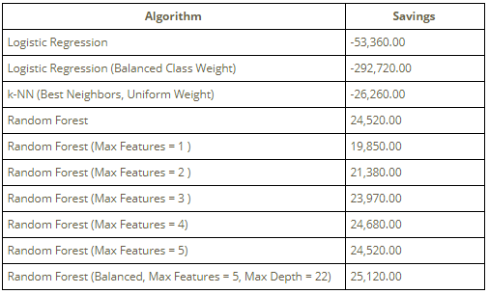
Machine learning (summary)
The original data brought in is for a handful of random cities. This was done to reduce the number of records brought into the original Data Wrangling notebook. From the Active SAs as of 3/1/2019, I upsampled stops to 20,000 and downsampled the Active SAs (non-stops) to 40,000. This was done to reduce training time.
The Random Forest algorithm was the best performing by far. The other algorithms were outputting negative savings.

Slide 19
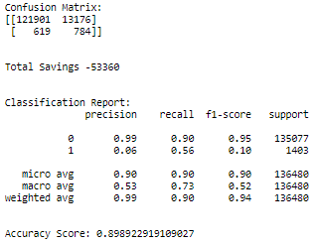
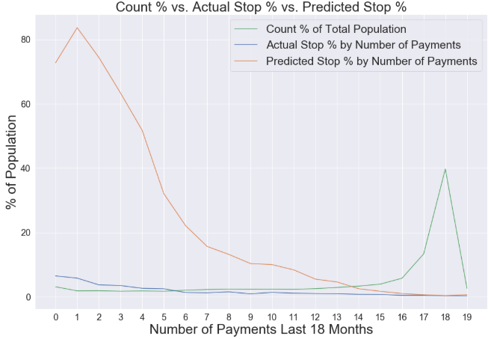
Machine learning (Logistic regression)
The Confusion Matrix is showing:
Accuracy: 90% (122,685 out of 136,480)
Precision: 99% (tp / (tp + fp))
Recall: 90% (tp / (tp + fn))
F1 Score: 95% (2 * ((p * r) / (p + r)))
The confusion matrix is showing decent numbers but looking at the total savings from the custom scorer shows that the company would still lose over 53,000 dollars using this algorithm.
Predicted 784 Stops out of 1,403 (56%)
Out of the 13,960 predicted stops, only 784 were actual stops (6%)
Total Savings: -53,360
Overpredicting stops when there are 13 or less payments made. If someone has made 4 or less payments, that person has over a 50% chance of being predicted as a Stop.

Slide 20
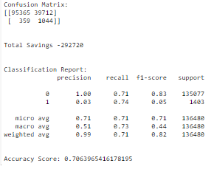
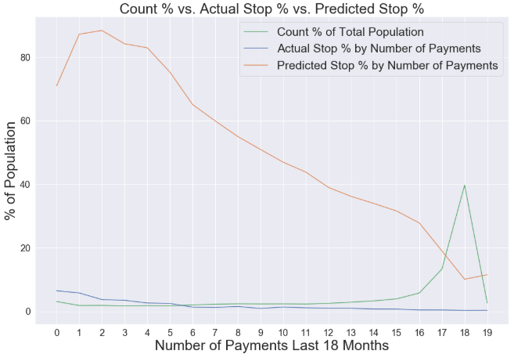
Machine learning (Logistic Regression (Balanced))
The Confusion Matrix is showing:
Accuracy: 71% (96,409 out of 136,480)
Precision: 99% (tp / (tp + fp))
Recall: 71% (tp / (tp + fn))
F1 Score: 83% (2 * ((p * r) / (p + r)))
The confusion matrix is showing bad numbers but looking at the total savings from the custom scorer shows that the company would lose over 292,000 dollars using this algorithm.
Predicted 1,044 Stops out of 1,403 (74%)
Out of the 40,756 predicted stops, only 1,044 were actual stops (3%)
Total Savings: -292,720
Overpredicting all stops where the customer has made 17 or less payments. If someone has made 9 or less payments, that person has over a 50% chance of being predicted as a Stop.

Slide 21
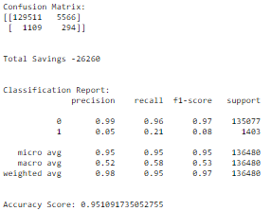
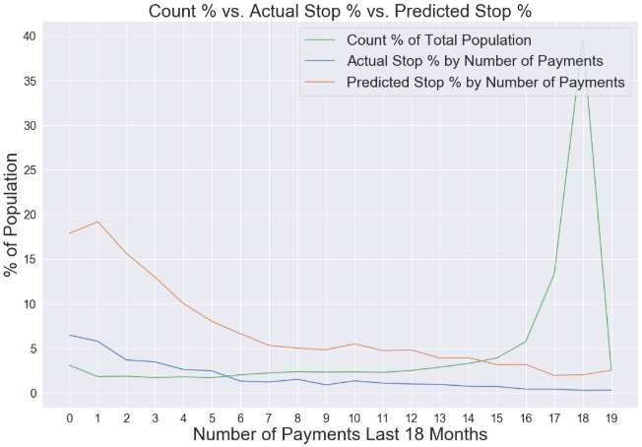
Machine learning (K-NN)
The Confusion Matrix is showing:
Accuracy: 95% (129,805 out of 136,480)
Precision: 99% (tp / (tp + fp))
Recall: 96% (tp / (tp + fn))
F1 Score: 97% (2 * ((p * r) / (p + r)))
The confusion matrix is showing pretty good numbers but looking at the total savings from the custom scorer shows that the company would lose over 26,000 dollars using this algorithm.
Predicted 294 Stops out of 1,403 (21%)
Out of the 5,860 predicted stops, only 294 were actual stops (5%)
Total Savings: -26,260
Overpredicting all stops where the customer has made 14 or less payments. The highest predicted population % predicted to be stops were customers who have made 1 payment. The predicted % is around 18%.

Slide 22
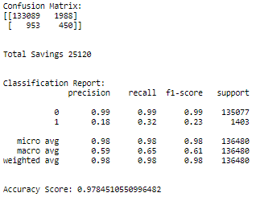
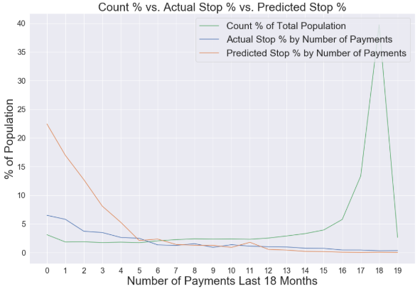
Machine learning (Random forest w/ max 5 features, max depth of 22)
The Confusion Matrix is showing:
Accuracy: 98% (133,539 out of 136,480)
Precision: 99% (tp / (tp + fp))
Recall: 99% (tp / (tp + fn))
F1 Score: 99% (2 * ((p * r) / (p + r)))
The confusion matrix is showing pretty good numbers but looking at the total savings from the custom scorer shows that the company would save over 25,000 dollars using this algorithm.
Predicted 450 Stops out of 1,403 (32%)
Out of the 2,438 predicted stops, 450 were actual stops (18%)
Total Savings: 25,120
These are the best predictions seen. 4 or less payments are overpredicted to stop but not by much. The biggest % overprediction is 0 payments and that is about 15% overpredicted.

Slide 23
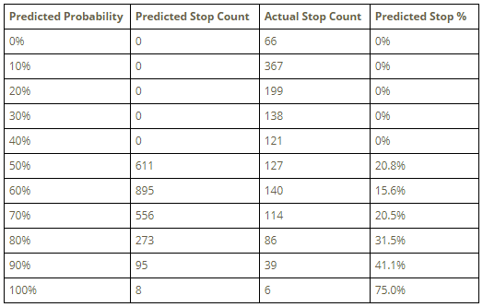
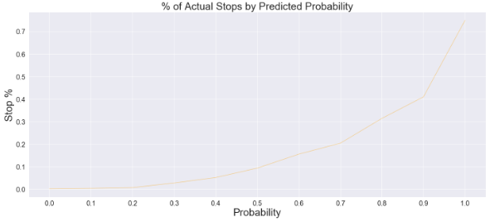
Machine learning (random forest analysis)
Since the Random Forest algorithm was the best performing, I chose the "Random Forest (Balanced, Max Features = 5, Max Depth = 22)" algorithm to dig into the details and see the individual probabilities.
The Actual Stop % is good at the higher predicted probabilities but there are fewer customers at the higher predicted probabilities.
You can see that if the company wanted to keep the accuracy of calling people who will actually stop over a threshold (ie. 30%), the company can choose to only call those people with more than an 80% chance of stopping.

Slide 24
conclusions
The Random Forest algorithm is the best model to use to calculate savings.
The higher the probability of stopping, the better chance that the customer will actually stop.
Possible Next Steps:
If time permitted, I would add additional algorithms (ex. xgboost).
The original dataset was reduced by only including certain cities. All cities should be included though.
The amount of data was resampled so that less customers would be analyzed. This was done to reduce training time. If I was doing this for the real thing and it was going to inform decisions then I would take the time to train on all Active SAs and still upsample the Stops. I would use a server to make the training run in a reasonable amount of time.
Most of the data manipulation was done in SQL against a Data Warehouse database. It would be ideal to be able to dynamically generate the SQL so that any date(s) can be used.
The effect of weather should be explored more. Then I can pick up relationships more on that margin. The current models are only using the average temperature on the day the customer started service.

