Slide 1
Customer churn
Springboard Capstone 2 Milestone report 1
By: brock nosbisch

Slide 2
Overview
The Problem
Dataset
Exploratory Data Analysis
…
…
…

Slide 3
The problem
My client is a natural gas company. Being able to predict when a customer will turn off is crucial to the natural gas business. By knowing when a customer will turn off you can:
Forecast future turn off work
Have sales reps to reach out to those customers to try to get them to stay on

Slide 4
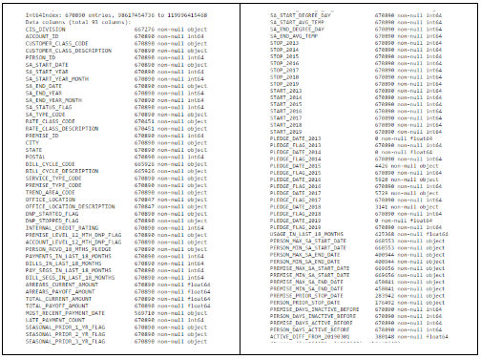
Dataset
This dataset comes from combining multiple internal applications and external data sources.
The dataset includes 93 fields and 670,000 records.

Slide 5
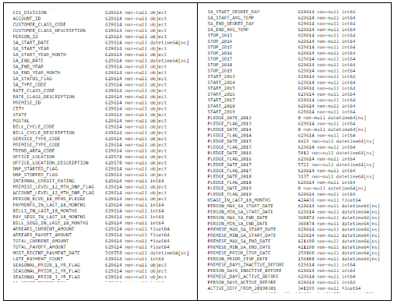
Dataset
Some data needed to be removed for certain SA Statuses.
The data also had some bad data for Rate Class, Company, and Bill Cycle values. The bad records were removed.

Slide 6
Dataset (field definitions)
CIS Division: Company
Account ID: An account is owned by 1 person but can have multiple Service Agreements.
Customer Class: Account level customer class.
Person ID: A person can have multiple accounts.
SA Start: The Service Agreement's Start Date (when gas started).
SA End: The Service Agreement's End Date (when gas stopped).
SA Status: The current SA status.
SA Type: The Service Agreement's type (example: Gas Residential).
Rate Class: Determines how the SA is billed.
Premise ID: Unique identifier for an address.
City: Premise's City
State: Premise's State
Postal: Premise's Zip Code
Bill Cycle: How we know when to bill an Account.
Service Type: Always Gas.
Premise Type: Premise Type (example: Commercial).
Office Location: Closest office to premise.

Slide 7
Dataset (field definitions)
DNP Started Flag: Was the previous stop a DNP.
DNP Stopped Flag: Did the current SA Stop because of DNP.
Internal Credit Rating: The internal credit rating for an Account.
Premise Level 12 Month DNP Flag: Has the Premise had a DNP in the last 12 months.
Account Level 12 Month DNP Flag: Has the Account had a DNP in the last 12 months.
Person Received 18 Months Pledge: Has the Person received a Pledge in the last 18 months.
Payments in Last 18 Months: How many payments have been made for the SA in the last 18 months.
Bills in Last 18 Months: How many bills were billed for the SA in the last 18 months.
Arrears Current/Payoff Amount: How much money is past due for the SA.
Total Current/Payoff Amount: How much money is owed for the SA.
Most Recent Payment Date: What was the most recent Payment Date.
Late Payment Count: How many late payments were charged to the SA in the past 18 months.
Seasonal Flags (1 year ago, 2 years ago, 3 years ago): Did the premise turn off between 3/1 and 6/30 and then turn on between 8/1 and 12/31.
SA Start/End Degree: What was the Degree Days on the SA Start and SA End dates.
Stop/Start Flags: Flags to show if the SA started/stopped in a given year.
Pledge Date/Flag: The Pledge Date and Flag for each year.
Usage in Last 18 Months: The Usage billed in the past 18 months.

Slide 8
Dataset (field definitions)
Person/Premise Min/Max SA Start/End Dates: What are the minimum and maximum start and end dates at a Person or Premise level.
Person/Premise Days Active/Inactive Before: How many days was the previous SA for the Person or Premise Active or Inactive for.
Stop Days from 20190301: Flags to use for training/testing. This should be dynamic but we are hardcoding the value for now.

Slide 9
Exploratory data analysis
Several observations of interest were found during EDA. Here are the high-level results.
The most frequent Start Date of the SAs that were stopped in March had started in October, November, and December of the previous year.
The Residential Customer Class had the most stops during all 3 of the time windows but less than 1% of all active Residential SAs were stopped. The biggest offenders of stops during the 3 windows were Landlords and Builder/Developers. 14% of Landlord SAs were stopped during the 21 day window and 9% of Builder/Developer SAs were stopped during the same window.
When looking at stops during the 7 day, 14 day, and 21 day windows by City, Webb City, Joplin, Cameron, and Aurora had the highest % of Active SAs that were stopped. Over 2% of all Active SAs in Aurora were stopped during the 21 day window.
The higher the arrears amount, the more likely you are to stop. For example, if you owe 100 or less then you have less than a 1% chance of stopping between 3/1/19 - 3/21/19. If you owe 700−799 then you have over a 6% chance of stopping in the same timeframe. Residential customers have almost a 10% chance of stopping in the same bucket/timeframe.
The shorter amount of time a customer has had gas service, the more likely the customer will stop gas.
The percentage of stopped SAs that were DNPs previously during the 7 day window was 11%, 14 day window was 15%, and 21 day window was also 15%.
The Bootstrap Estimate of SA Stops Mean shows the 95% confidence interval for SAs stopping between 3/1/2017 and 3/7/2019 is from .34% to .38%.. Similarly, 3/1/2017 to 3/14/2019 is from .67% to .72% and 3/1/2019 to 3/21/2019 is from .98% to 1.04%.

Slide 10
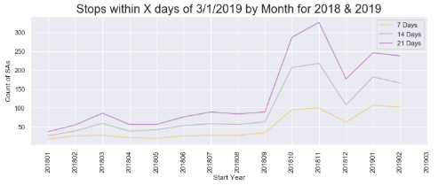
Exploratory data analysis (Start date of stops)

Slide 11
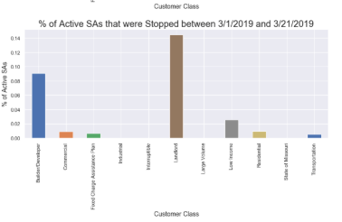
Exploratory data analysis (Stops by Customer class)

Slide 12
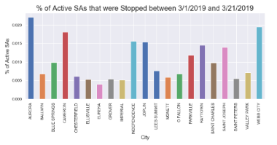
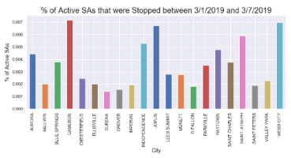
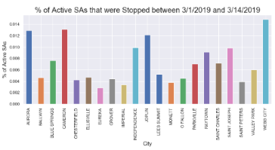
Exploratory data analysis (Stops by City)

Slide 13
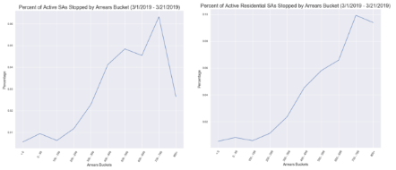
Exploratory data analysis (Arrearage)

Slide 14
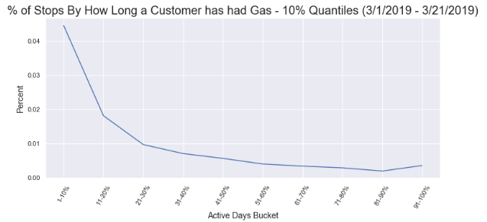
Exploratory data analysis (Active days)

Slide 15
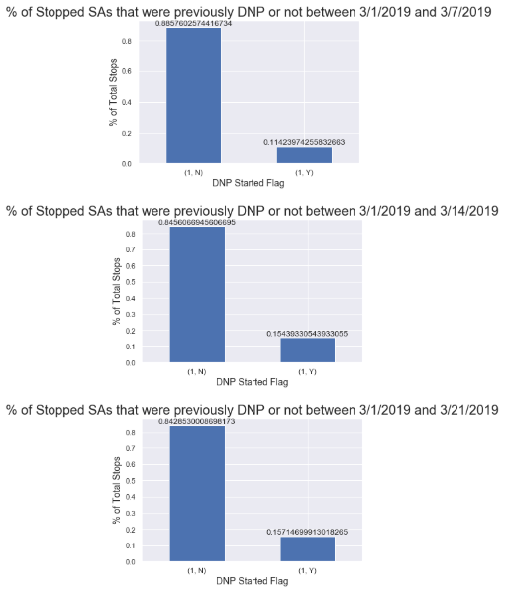
Exploratory data analysis (Stops for previous dnps)

Slide 16
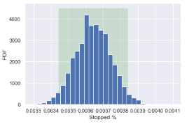
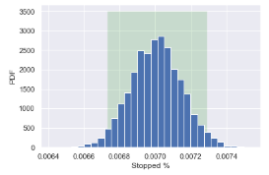
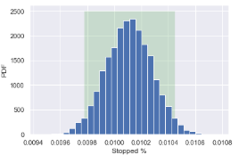
Exploratory data analysis (Bootstrap estimate)
7 Day Stops
14 Day Stops
21 Day Stops

