Slide 1
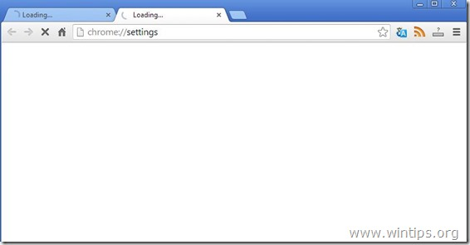
Weather.com
Navigation bar
copy copy copy copy copy copy copy copy copy copy copy copy copy copy copy copy copy copy copy copy copy copy copy copy copy copy copy copy copy copy copy copy copy copy copy copy copy copy copy
copy copy copy copy copy copy copy copy copy copy copy copy copy copy copy copy copy copy copy copy copy copy copy copy copy copy copy copy copy copy copy copy copy copy copy copy copy copy copy copy copy copy copy copy copy copy copy copy copy copy copy copy copy copy copy copy copy copy copy copy copy copy copy copy copy copy copy copy copy copy copy copy copy copy copy copy copy copy copy copy copy copy copy copy copy copy copy copy copy copy copy copy copy copy copy copy

Slide 2
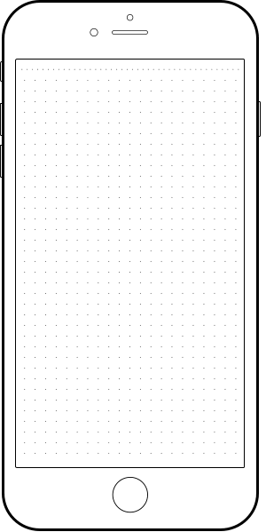

Weather.com
Weather.com
NAV
Navigation Bar
copy copy copy copy copy copy copy copy copy copy copy copy copy copy copy copy copy copy copy copy copy copy copy copy copy copy copy copy copy copy copy copy copy copy copy copy copy copy copy copy copy copy copy copy copy copy copy copy copy copy copy copy copy copy copy copy
copy copy copy copy copy copy copy copy copy copy copy copy copy copy
Description
Description

