Slide 1
Signatures of Gas Flows–II: Connecting the Kinematics of the Multiphase Circumgalactic Medium to Galaxy Rotation
Hasti Nateghi, Glenn G. Kacprzak, Nikole M. Nielsen, Sameer, Michael T. Murphy, Christopher W. Churchill, Jane C. Charlton

Slide 2
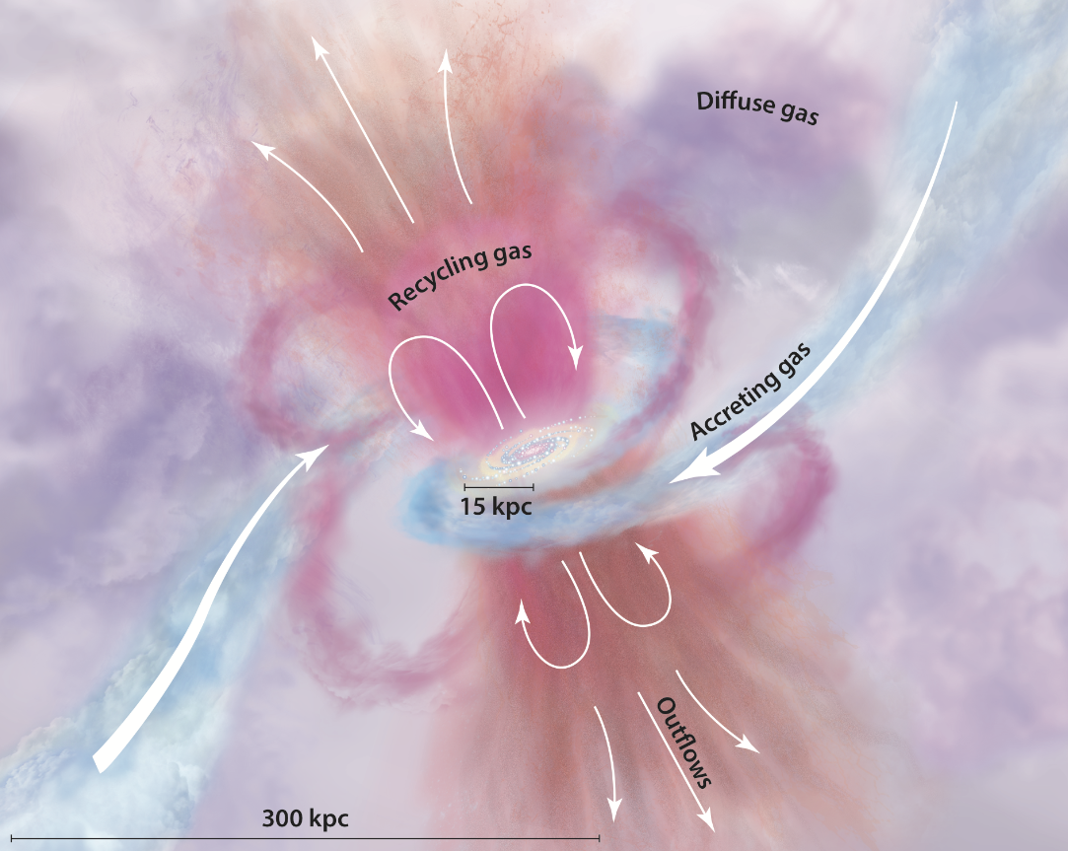
Goals
Constrain kinematic connection between multiphase CGM and host galaxy
CGM co-rotation across ionization states

Slide 3
Accretion Modes
Hot Mode
Accreted CGM gas virializes to the temperature of the halo
Cools and infalls isotropically
Cold Mode
Gas enters through dense filaments
Remains below virial temperature
Occurs within an extended co-rotating disk aligned with the galaxy plane
Notes:
Processed gas has to travel through the CGM

Slide 4
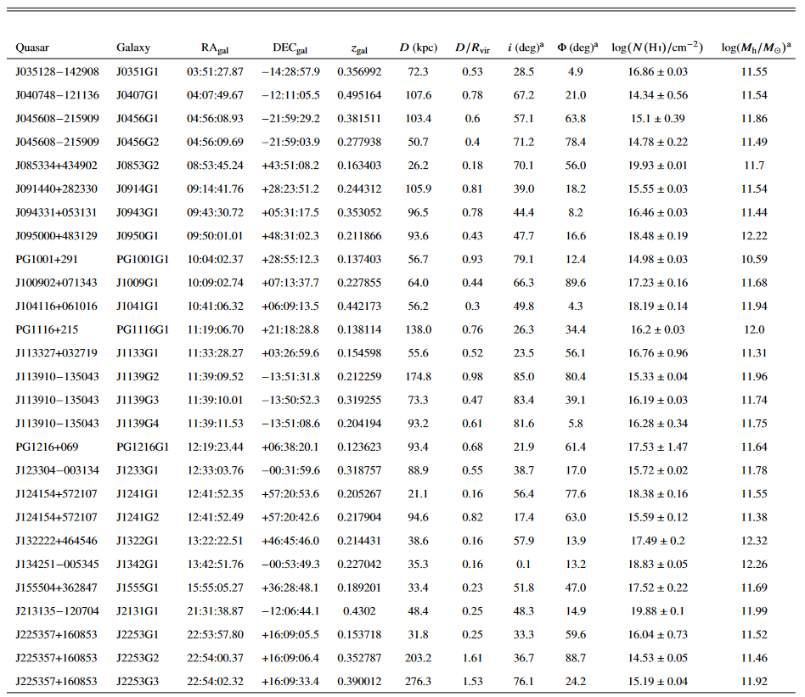
Sample/Data
Subset of 70 Paper I quasar-pairs
At least one detected metal line
Focused on isolated galaxies
27 galaxy-CGM metal absorption pairs
HST/COS spectra for all
Keck/HIRES or VLT/UVES for 10
Keck II/ESI rotation curves
Galaxy-selected and absorption-selected
OVI in 25
10.5-12.3 log(M☉) halo mass
CIII, CIV, SiII, SiIII, SiIV, NV, OVI

Slide 5
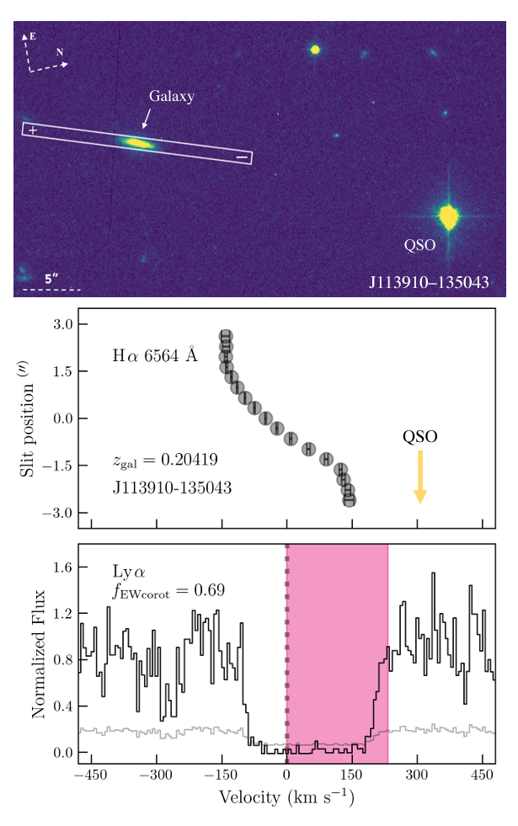
Equivalent Width Co-Rotation Fraction
We employ the method developed in GasFlows-I to measure the absorption equivalent width (EW) co-rotation fraction. This method allows us to quantify the fraction of the absorption EW caused by the CGM gas that has velocities consistent with the rotation direction of the host galaxies. The advantage of this approach is that it relies more on the data itself rather than user-dependant absorption decomposition.
For each galaxy, we define a velocity window for its absorption lines, which includes all of the gas starting from the galaxy’s systemic velocity to the edge of the absorption that resides in the direction of the rotation of the galaxy. We then calculate the equivalent width in that window, which represents the absorption that aligns with the galaxy’s spin direction along the quasar line of sight. We then divide that number by the total equivalent width of the absorption line and this quantity is referred to as the EW co-rotation fraction, 𝑓EWcorot. A value of 1 indicates that all of the gas is consistent with a co-rotation scenario, while a value of 0 suggests that none of the gas is consistent with such a scenario. Figure 2 in GasFlows-I describes this method.

Slide 6
Overview
Baryon cycle, driven by accretion and outflows
Process gas travels through the CGM
Background quasar absorption
MgII absorption reveal Doppler-shifted absorption with the same direction as galaxy rotation
Low ionization CGM most likely co-rotates with the galaxy disk at substantial distance (100 kpc) from the galaxy
Different kinematics and absorption profiles for higher ionization absorbers
OVI gas flows may obscure kinematic signatures

Slide 7
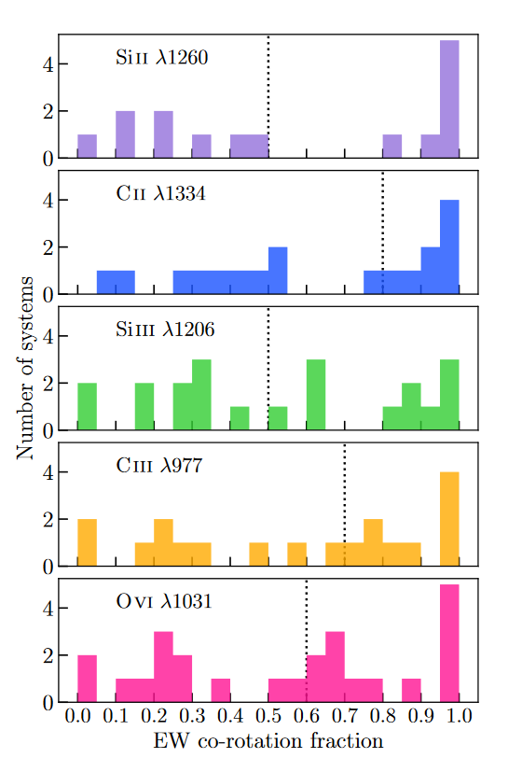
Co-Rotation Distribution
Notes:
Median greater than 0.5 indicates bulk absorption is consistent with rotation direction of the galaxy

Slide 8
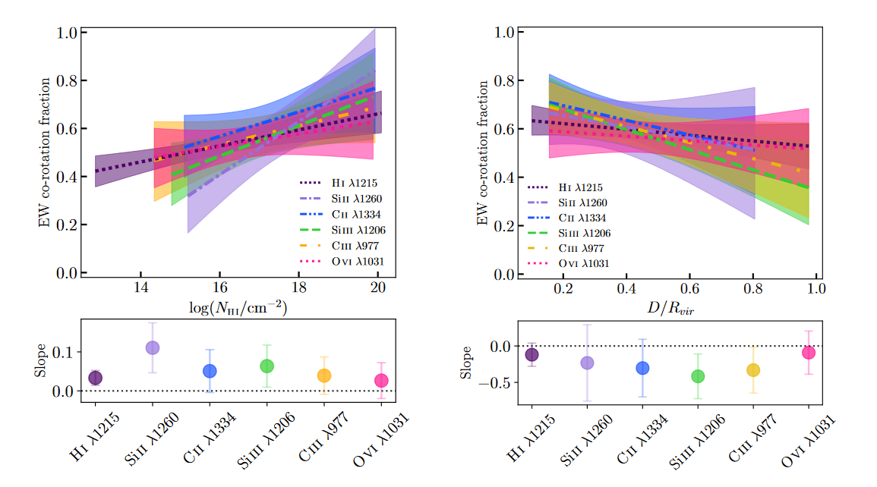

Slide 9
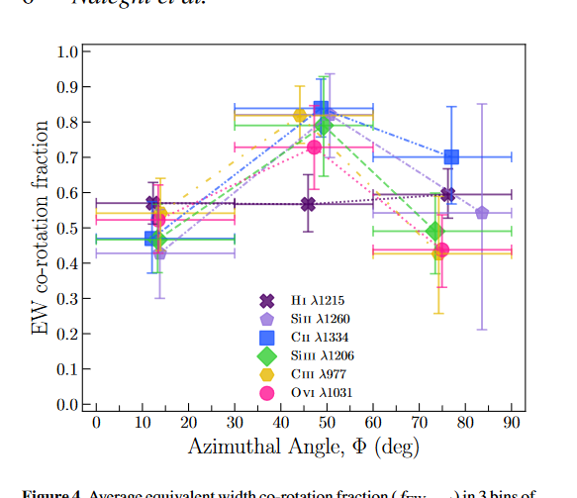

Slide 10
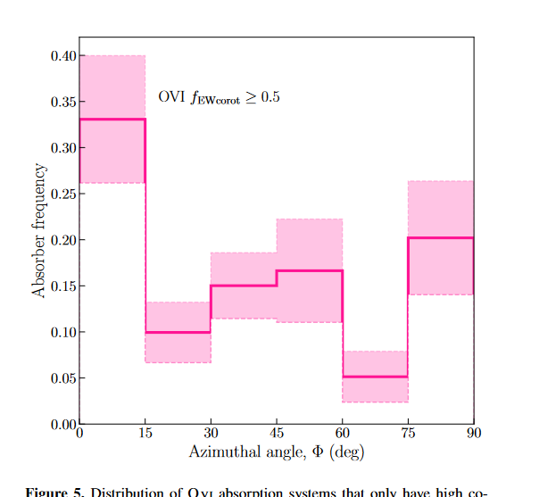

Slide 11
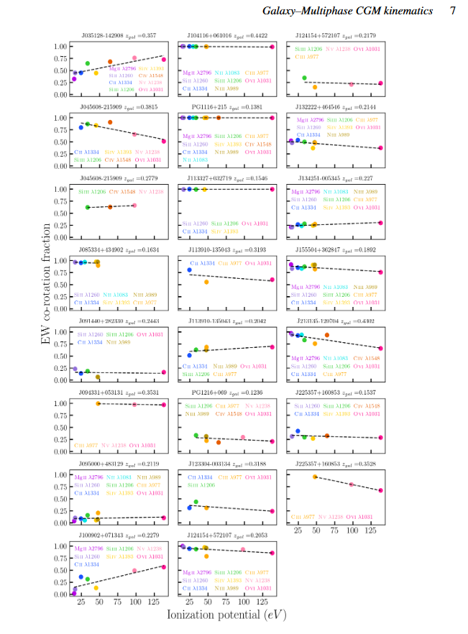
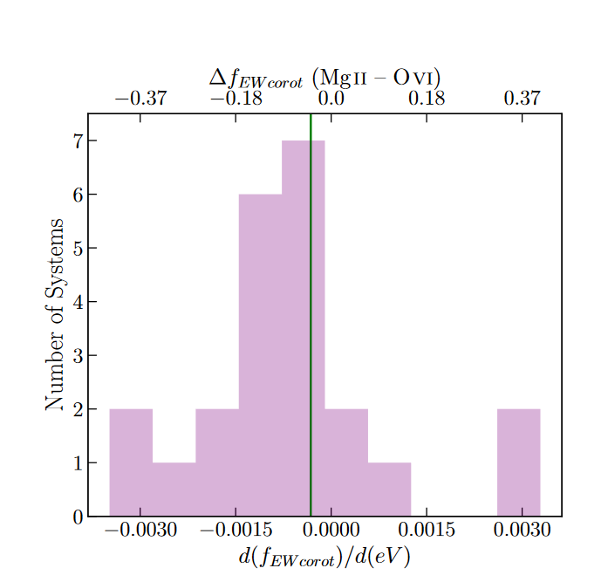

Slide 12
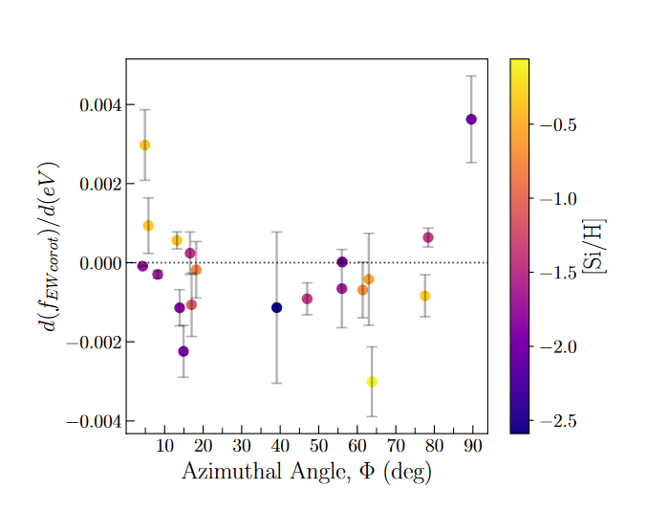

Slide 13
Metallicities
major axis absorption with lower ionization energy and higher co-rotation fraction is associated with lower metallicities
While absorption with higher ionization energy shows high co-rotation fractions at the highest metallicities. This could be suggestive of two forms of accretion: 1) low ionization gas that is co-rotating with the galaxy having the lowest metallicity, which is accreting along cosmic filaments 2) high ionization and higher metallicity gas being recycled material that is cooling and joining with the accretion along the major axis
Systems with higher metallicity and also higher co-rotation fractions (white to pink shades) could potentially indicate metal-rich outflows that are still kinematically connected to the disk where they are ejected from. The minor axis systems, with low co-rotation fractions could be interpreted as the recycled gas that may become kinematically coupled and eventually accrete onto the galaxy.

Slide 14
Conclusions
Median f for all ions is consistent
f increases with increasing hydrogen column density
f of lower ions decreases with distance from the galaxy center, but remains constant for higher ions
f varies minimally with azimuthal angle
Highly co-rotating OVI primarily resides along galaxy major axis
There is a stronger co-rotation signature for lower-ionization gas
Low ion gas with high f exhibits lower metallicity, may trace large-scale filamentary inflows
High ion gas with high f exhibits higher metallicity, may trace co-planar recycled gas accretion
Differentiate between various gas flow scenarios

