Slide 1
Upper Limits on the Mass of Cool Gas in the CGM of Dwarf Galaxies
Yakov Faerman, Yong Zheng (郑永), and Benjamin D. Oppenheimer

Slide 2
Observations
Galaxy-Quasar pair line-of-sight absorption measurements
Zheng et al. 2024
Complication of archival and new hydrogen and metal absorption line measurements
All done with HST-COS
Dwarf galaxies with stellar masses from 10^{6.5} – 10^{9.5} M⊙
25 Objects
Mishra et al. 2024
Similar H1 and metal absorption measurements
Part of the CUBS survey – HST Cycle 25 GO Program
Dwarf galaxies with stellar masses from 10⁷ – 10⁹ M⊙
15 Objects
Pick redshifts between 0-0.3
Bin by halo mass
Notes:
Cosmic ultraviolet baryon survey – HST cycle 25 GO Program
Use UNIVERSEMACHINE to get halo mass

Slide 3
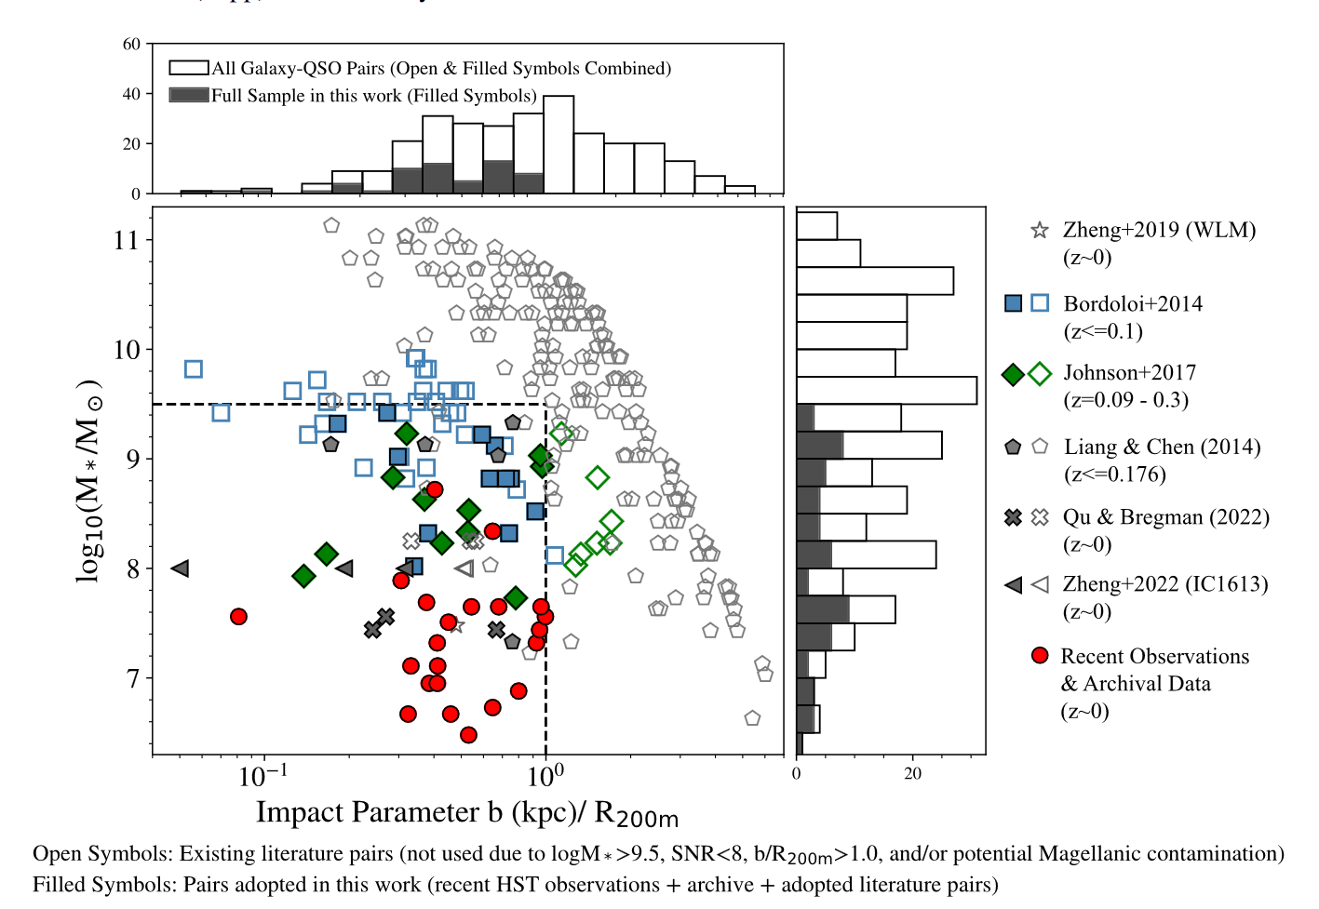
Z24

Slide 4
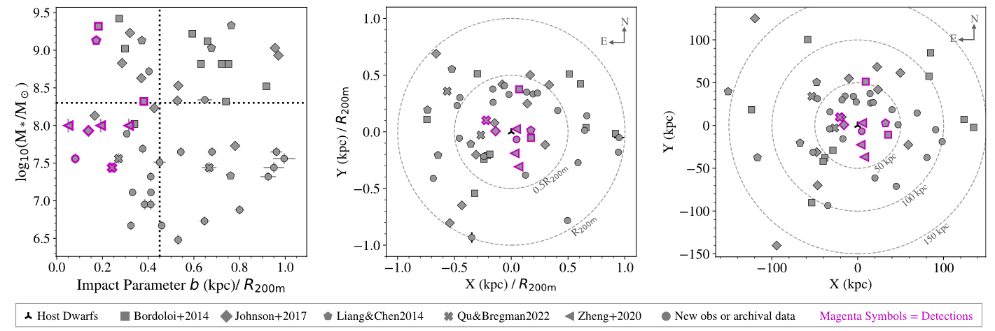
Z24

Slide 5
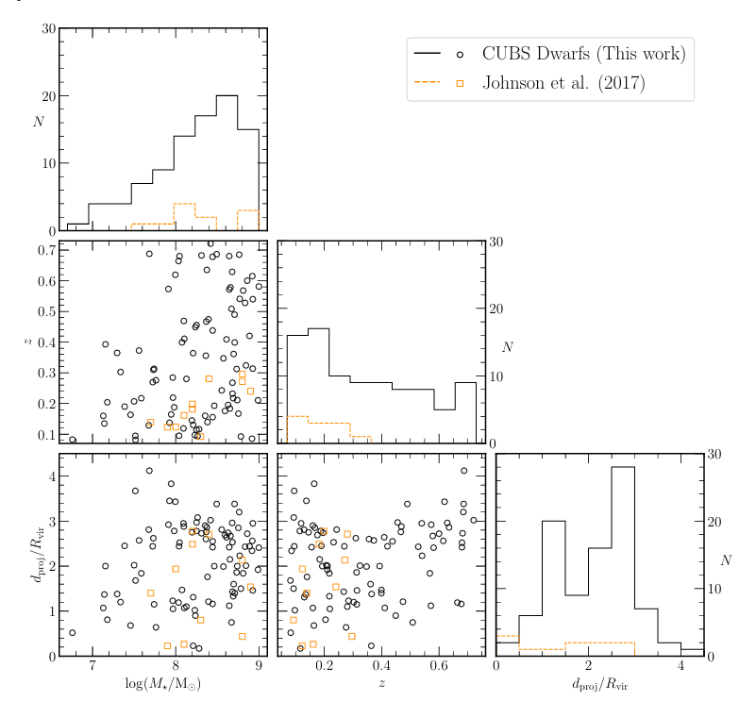
M24

Slide 6
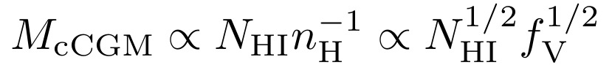
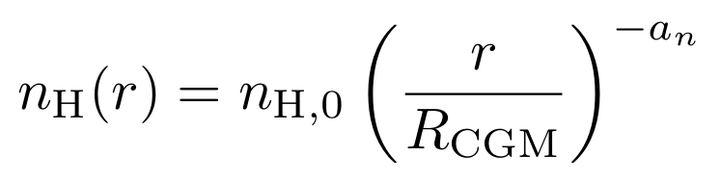
model
Detailed model
Assume power-law distribution of gas density as function of radial distance
Only use observations from 0.1 to 1 R_{200m}
Assume gas in in thermal equilibrium with UVB with non-constant temperature
Assume constant (Z = 0.3) metallicity
Assume constant volume filling fraction
Assume all H1 absorption originates in CGM
Use CLOUDY to calculate neutral H fraction and T_{eq}
Calculate H1 column density as a function of impact parameter
Notes:
Use CLOUDY to calculate Teq and neutral H fraction

Slide 7
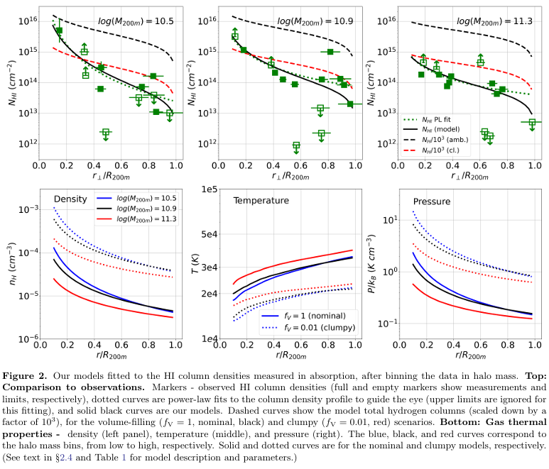
Fits
Fit by fixing filling factor
Clumpy gas reproduces column densities with ~11x lower masses
Higher density
Higher neutral fraction
Notes:
Reproduces H1 column densities with any filling factor

Slide 8
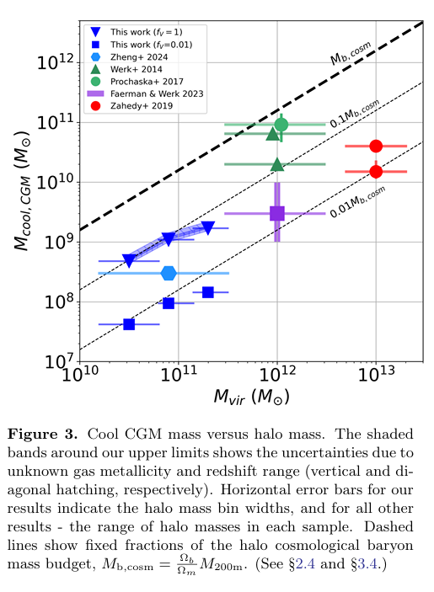
results
Find 5-10% of cosmological baryon budgets of the DM halos lies in cool CGM
Represents upper limits
Models with spatially varying filling factor and neutral fraction are consistent
Notes:
The black dashed contours show the masses that constitute fixed fractions of the halo cosmological baryon mass budget, given by Mb,cosm ≡ M200mΩb/Ωm = 0.158M200m (Planck Collaboration et al. 2016).
The thick line shows McCGM = Mb,cosm, and the thin lines are for 10% and 1% of Mb,cosm.

Slide 9
Comparison to massive halos
Studies
Results
Werk et al. 2014 and Prochaska et al. 2017
COS-Halos L* galaxies
Singh Bisht et al. 2024
Wide range of MW-like galaxies, MgII measurements
Zahedy et al. 2019
Luminous red galaxies with >10¹¹ M⊙
Upper limit (volume filling)
Cool gas baryon fraction constant across three order of halo mass
f~1-10%
Lower limits (clumpy model)
Significant cool gas baryon fraction variations
Different methods and samples make comparison highly uncertain

Slide 10
Comparison to massive halos
Studies
Results
Upper limit (volume filling)
Cool gas baryon fraction constant across three order of halo mass
f~1-10%
Lower limits (clumpy model)
Significant cool gas baryon fraction variations
Different methods and samples make comparison highly uncertain

Slide 11
Bigger picture
CGM thermal pressure equilibrium
Need cool CGM filling factor <1
Additional 85% of baryons
In warm/hot volume filling CGM?
Baryons escaped into IGM?
Dwarf galaxy SFR and accretion rates
Inferred accretion rates similar to SFR if f<1
Inefficient process, lots of play in upper limit
Continued SF for >1 Gyr
CGM Evolution
No change across small redshift sample
Redshift of 0.1 implies 30% larger mass
Cool CGM metallicity
No strong constraints (± 0.5 dex)
Less than 10% change in gas mass with 1 dex variation
Contributions outside CGM
Non-negligible contributions¹
Notes:
¹With specific criteria, columns of ∼ 1014 cm−2 may form in (i) extended IGM on a ∼ 1 Mpc scale, or (ii) in the warm/hot CGM at temperatures ≈ 3×105 K and densities of ∼ 10−4 cm−3.

Slide 12
Summary
Study H1 absorption of cool CGM around dwarf galaxies
Construct analytical model to fit H1 column density
Calculate empirical upper limits of cool CGM mass
Important implications for galaxy evolution
Find ~<10% of baryon budget in cool CGM + ~5% in stars
Remaining in warm/hot CGM or ejected
Cool CGM accretion rates support observed SF for > 1 Gyr
Comparison to massive halos
May be support for constant baryon fraction

Slide 14
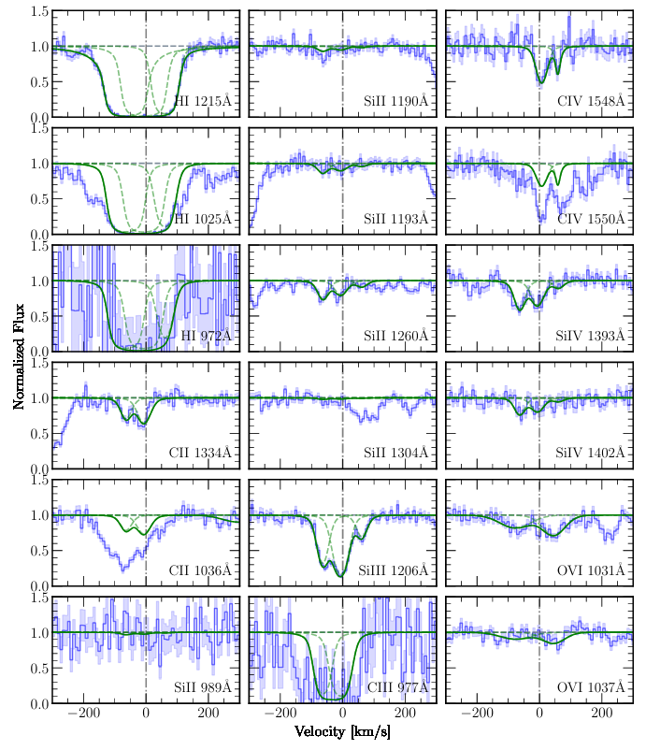
Absorption line studies

Slide 15
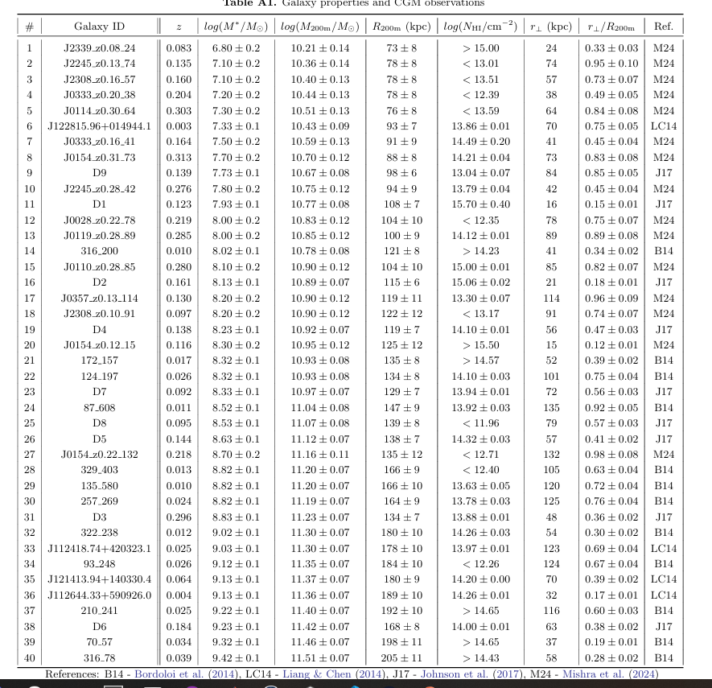
Data

Slide 16
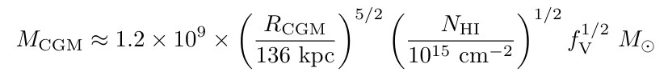
Detailed Model

Slide 17
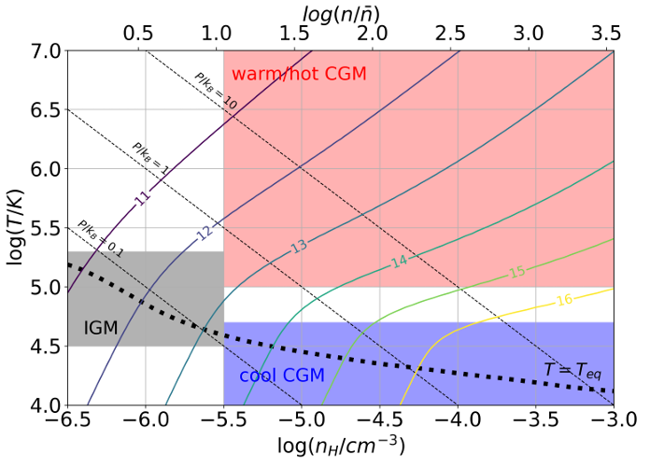
IGM contribution

