Slide 1
Signatures of Gas Flows–II: Connecting the Kinematics of the Multiphase Circumgalactic Medium to Galaxy Rotation
Hasti Nateghi, Glenn G. Kacprzak, Nikole M. Nielsen, Sameer, Michael T. Murphy, Christopher W. Churchill, Jane C. Charlton

Slide 2
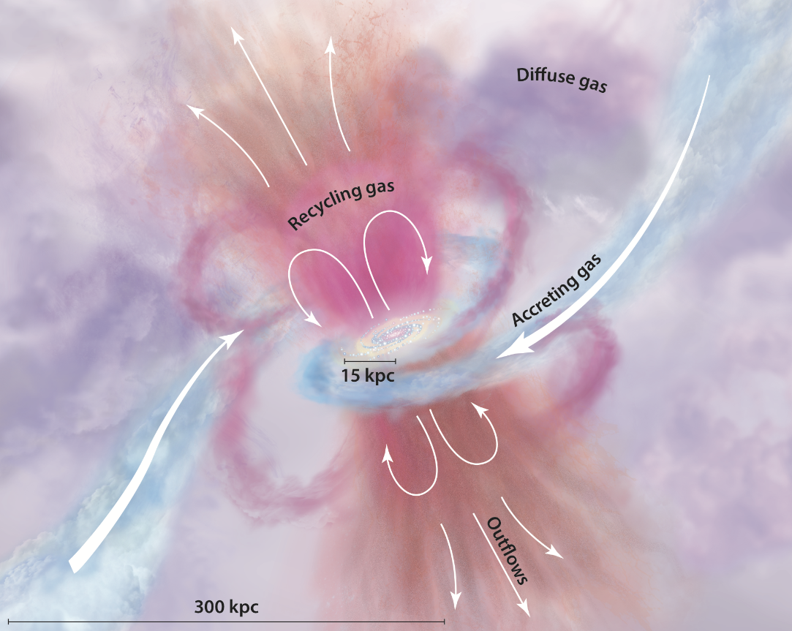
Goals
Constrain kinematic connection between multiphase CGM and host galaxy
CGM co-rotation across ionization states

Slide 3
Accretion Modes
Hot Mode
Accreted CGM gas virializes to the temperature of the halo
Cools and infalls isotropically
Cold Mode
Gas enters through dense filaments
Remains below virial temperature
Occurs within an extended co-rotating disk aligned with the galaxy plane
Notes:
Processed gas has to travel through the CGM

Slide 4
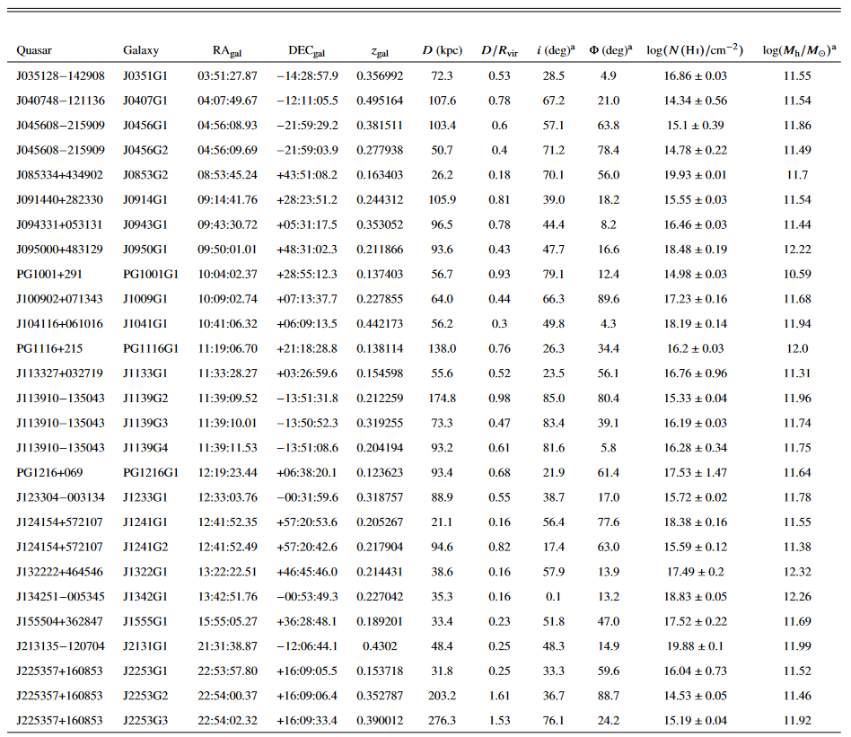
Sample/Data
Subset of 70 Paper I quasar-pairs
At least one detected metal line
Focused on isolated galaxies
27 galaxy-CGM metal absorption pairs
HST/COS spectra for all
Keck/HIRES or VLT/UVES for 10
Keck II/ESI rotation curves
Galaxy-selected and absorption-selected
OVI in 25
10.5-12.3 log(M☉) halo mass
CIII, CIV, SiII, SiIII, SiIV, NV, OVI

Slide 5
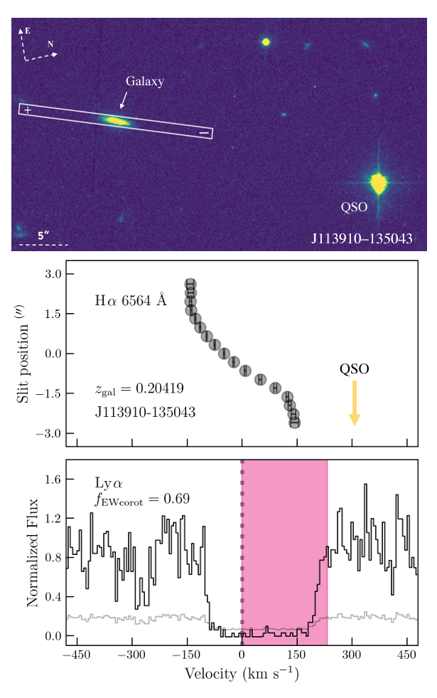
Absorption Equivalent Width Co-Rotation Fraction
Fraction of absorption caused by CGM gas with velocities consistent with rotation direction of host galaxies
Measure rotation curve
Measure/calculate absorption line velocities
Calculate fraction of absorption line equivalent width from galaxy systemic velocity in the direction of rotation
Value of 1 indicates all of the gas is consistent with co-rotation
Value of 0 indicates none of the gas is consistent with co-rotation

Slide 6
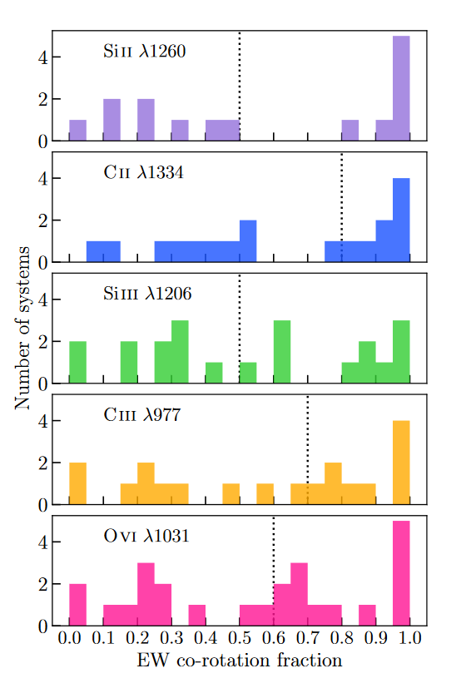
Co-Rotation Distribution
Notes:
Median greater than 0.5 indicates bulk absorption is consistent with rotation direction of the galaxy

Slide 7
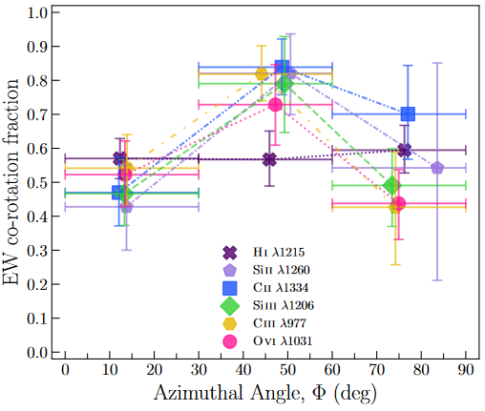
Aziumthal Angle
Co-rotation versus galaxy orientation
Ions consistent with each other
Peak at intermediate values
Indication of cold mode?
No real takeaways

Slide 8
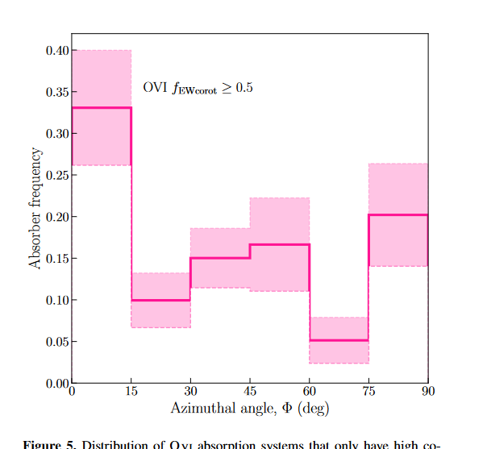
Azimuthal Angle
Where in the galaxy co-rotation is occurring
Plot where bulk of absorption is consistent with co-rotation model
Significant peak within 15 degrees of major axis
Where accretion is expected to occur

Slide 9
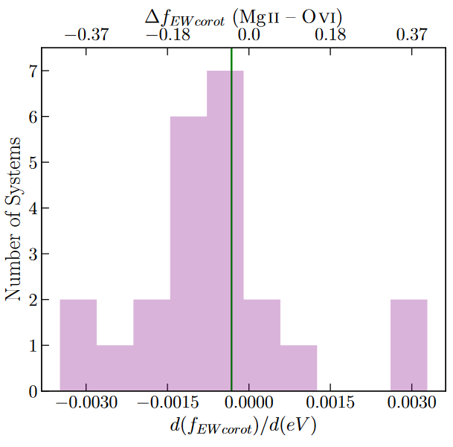
Ionization Dependence
Results imply difference between corotating fractions in different ionization states
Corotation also varies with ionization in individual systems
Most systems have higher fractions in lower-ionization CGM
Still significant kinematic consistency between ions

Slide 10
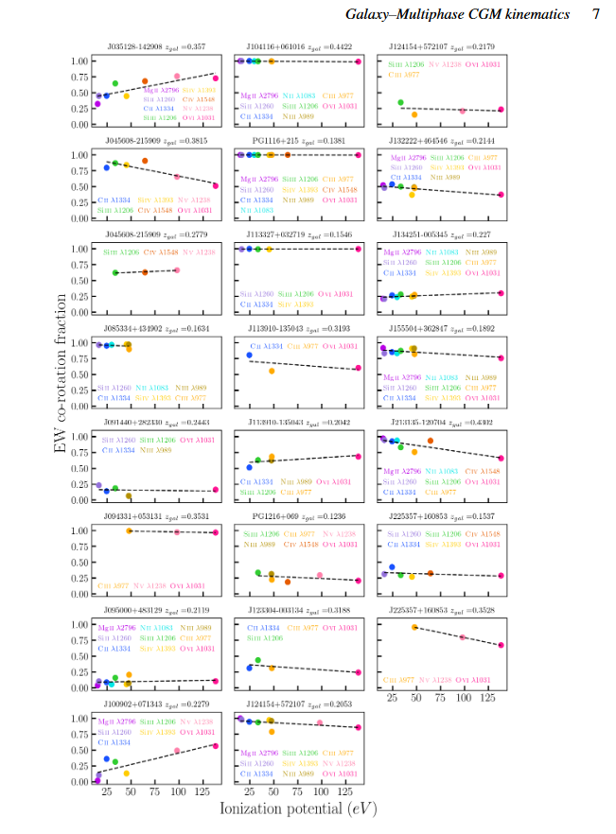
Ionization Dependence

Slide 11
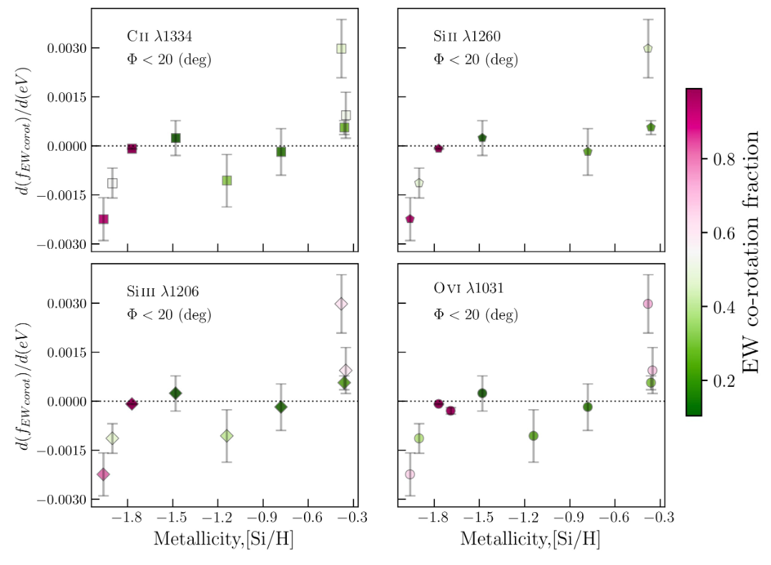
Metallicity
Absorption along major axis
Low ion and high corotation associated with lower metallicities
High ion and high corotation associated with higher metallicities
Suggests two forms of accretion
Low ion gas corotating with galaxy accreting along cosmic filaments – low metallicity
High ion gas recycled joining accretion along major axis

Slide 12
Conclusions
All ions have similar amounts of co-rotation
Co-rotation fraction increases with increasing hydrogen column density
Co-rotation of lower ions decreases with distance from the galaxy center, but remains constant for higher ions
Co-rotation fraction varies minimally with azimuthal angle
Highly co-rotating OVI primarily resides along galaxy major axis
There is a stronger co-rotation signature for lower-ionization gas
Low ion gas with high f exhibits lower metallicity, may trace large-scale filamentary inflows
High ion gas with high f exhibits higher metallicity, may trace co-planar recycled gas accretion

