Slide 1
Upper Limits on the Mass of Cool Gas in the CGM of Dwarf Galaxies
Yakov Faerman, Yong Zheng (郑永), and Benjamin D. Oppenheimer

Slide 2
Abstract
We use HI absorption measurements to constrain the amount of cool (≈ 104 K), photoionized gas in the CGM of dwarf galaxies with M∗ = 106.5−9.5 M⊙ in the nearby Universe (z < 0.3). We show analytically that volume-filling gas gives an upper limit on the gas mass needed to reproduce a given HI column density profile. We introduce a power-law density profile for the gas distribution and fit our model to archival HI observations to infer the cool CGM gas mass, McCGM, as a function of halo mass. For volume-filling (fV = 1) models, we find McCGM = 5 × 108 − 2 × 109 M⊙, constituting ≲ 10% of the halo baryon budget. For clumpy gas, with fV = 0.01, the masses are a factor of ≈ 11 lower, in agreement with our analytic approximation. Our assumption that the measured HI forms entirely in the cool CGM provides a conservative upper limit on McCGM, and possible contributions from the IGM or warm/hot CGM will further strengthen our result. We estimate the mass uncertainties due to the range of redshifts in our sample and the unknown gas metallicity to be ≈ 15% and ≈ 10%, respectively. Our results show that dwarf galaxies have only ≲ 15% of their baryon budget in stars and the cool CGM, with the rest residing in the warm/hot CGM or ejected from the dark matter halos.

Slide 3
Observations
Z24
the following, we refer to our data sample as the full sample (see Table 1), which comprises 56 dwarf-QSO pairs that include: (i) 22 new pairs either from our recent HST programs (#HST-GO-15156, PI Zheng; #HST-GO-15227, PI Burchett; #HST-GO-16301, PI Putman)11,12,13 or a thorough search of the Barbara A. Mikulski Archive for Space Telescopes (MAST) for available QSOs (Section 2.1), and (ii) 34 additional pairs compiled from existing literature (Section 2.2). The full sample is highlighted as filled symbols in Figure 1 and tabulated in Tables 2–3. Overall in this work we probe a unique parameter space of low stellar mass (M* = 10 6.5–9.5) and small impact parameter (b/R200m = 0.05–1.0

Slide 4
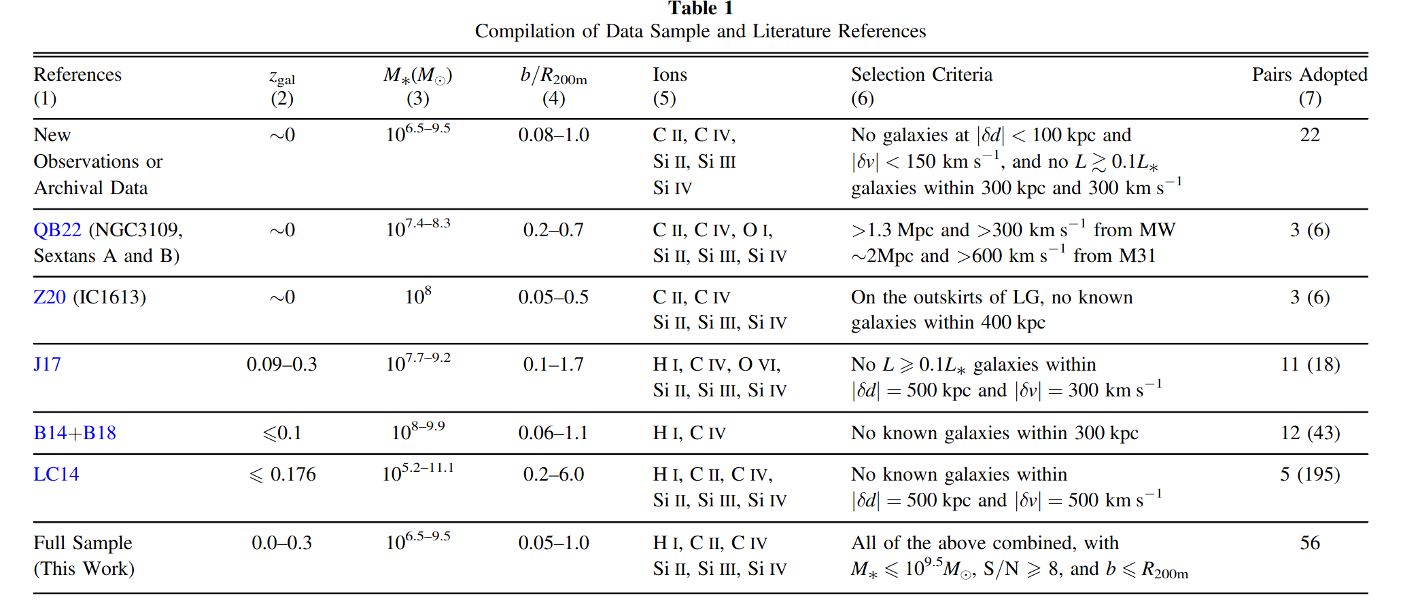
Observations
Z24

Slide 5
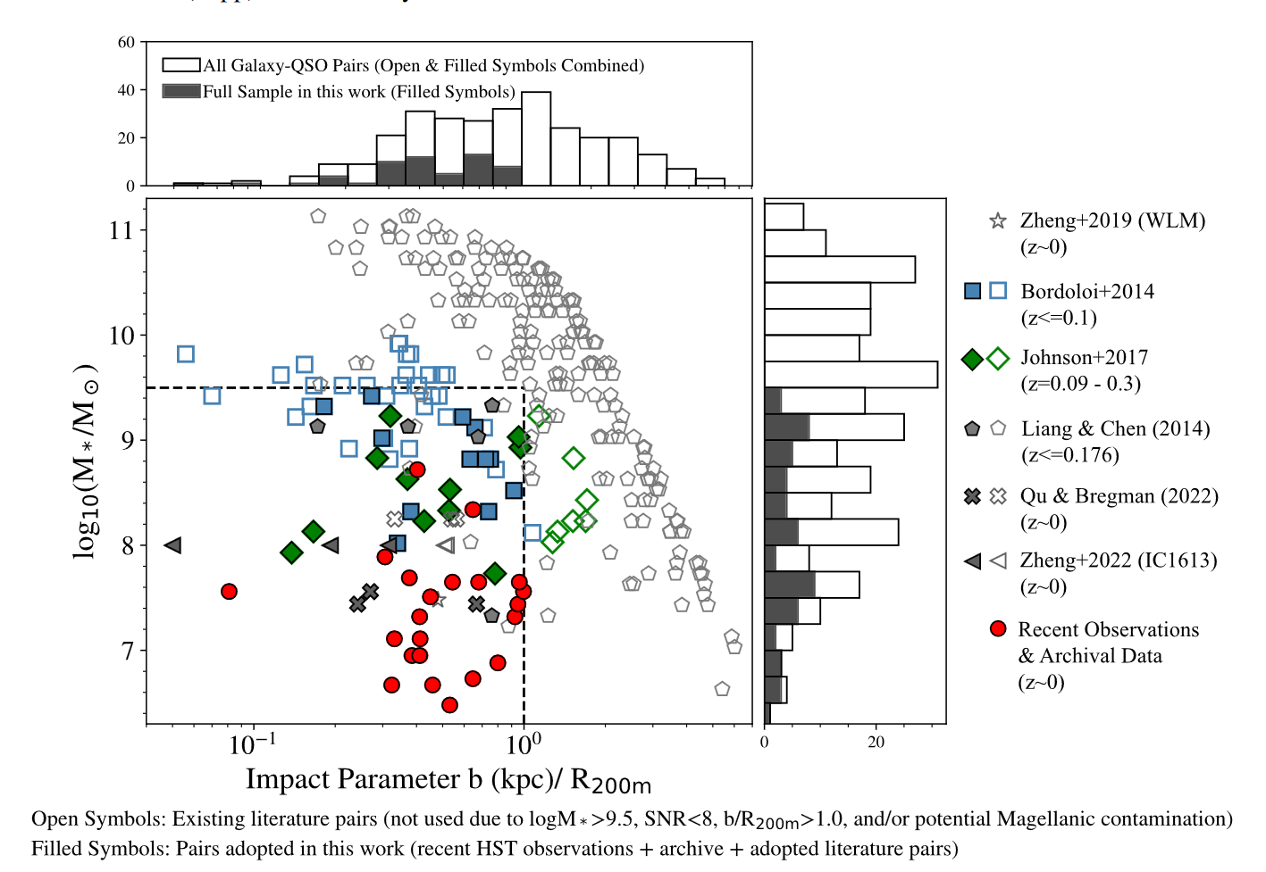
Observations
Z24

Slide 6
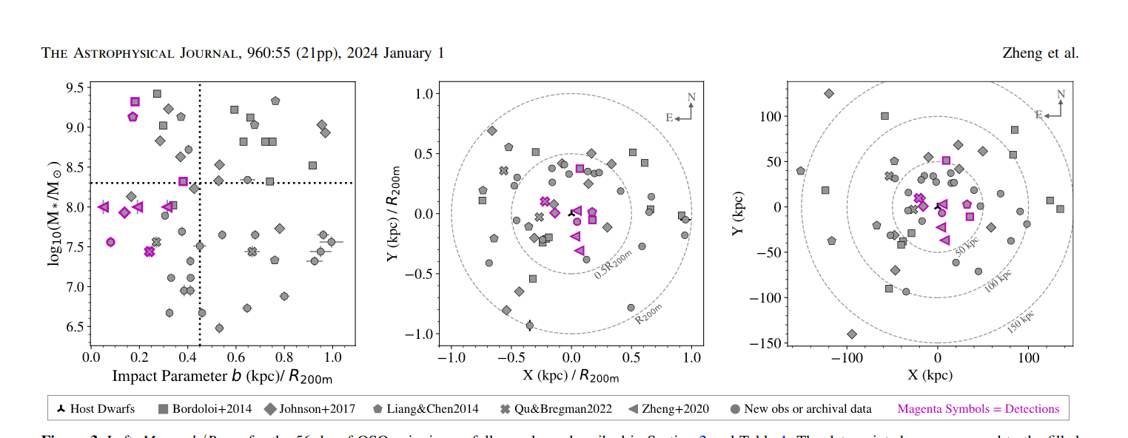
Observations
Z24

Slide 7
Observations
M24

Slide 9
Summary
In this work we study the cool, photoionized CGM of dwarf galaxies, by constructing a simple analytic model for the gas distribution and fitting it to HI column density observations from the literature. We report the first empirical limits on the amount of cool CGM in halos with masses in the range M200m ≈ 1010 − 3 × 1011 M⊙, significantly extending the range of previous works. For our model we adopt a power-law density profile, a constant volume filling factor (fV), and assume that the cool CGM phase is in heating/cooling and ionization equilibrium with the MGRF. We apply the model to the HI column densities measured in UV absorption and reported by Z24 and M24. Our best-fitting models reproduce the observed HI column density profiles (see Figure 2), and allow us to estimate the cool gas mass, McCGM up to the unknown value of fV. We show analytically that for a given HI column, McCGM ∝ f 1/2 V . Models with volume-filling cool gas (fV = 1), provide an upper limit on the mass (see Figure 1). For our sample we estimate McCGM ≲ 5 × 108 − 2 × 109M⊙, and that ≲ 10% of the total budget of baryons in these galaxies reside in the cool CGM (see Figure 3). We also construct clumpy gas models, with fV = 0.01, motivated by previous studies of more massive galaxies, and show that our analytic relation is a good approximation to the numerical results, giving masses a factor of ≈ 11 lower than models with fV = 1. We address two uncertainties in our results. First, the gas metallicity, affecting the gas equilibrium temperature and HI fraction, is not well constrained. We fit models with metallicities of Z′ = 0.1 and 1 and find these lead to ≈ 10% variation in the gas mass compared to a nominal value of Z′ = 0.3. Second, the galaxies in our sample have redshifts in the range 0 < z < 0.3, with ⟨z⟩med = 0.1. We model them at z = 0, and for z = 0.1 the inferred McCGM is 30% higher. The gas densities and pressures in our nominal models provide lower limits, with nH ∝ f −1/2 V . For cool gas that is volume-filling or close to it, the gas densities are ≈ 10−5 cm−3, barely above those of the IGM. The gas pressures are lower than expected for the warm/hot CGM, which may suggest either pressure imbalance between the phases, or non-thermal support in the cool gas. For lower volume-filling fractions, the thermal pressures are higher and the cool phase may be in thermal pressure equilibrium with the warm/hot gas (Figure 2). Our results have important implications in the context of galaxy evolution. First, our upper limits show that the stellar and cool CGM mass constitute together less that 15% of the halo cosmological baryon budget. The remaining 85% can be either in warm/hot CGM or could have been lost to the IGM through stellar feedback processes. Second, assuming accretion of cool gas onto the galaxy on a dynamical time scale, the accretion rates may be enough to maintain SF at the present measured rates, depending on the actual gas morphology, kinematics, and pressure support. Limits on Cool CGM in Dwarfs 11 We then compare our results to cool gas masses from previous studies of more massive halos, and show that the data may suggest a constant fraction of the halo baryons in the cool CGM (Figure 3). However, given the differences in galaxy samples and analysis methods, inferring any trends of McCGM vs Mhalo is still highly uncertain and requires additional work. Finally, we show that the diffuse IGM outside these halos and the warm/hot CGM associated with the galaxies can both have contributions to the total measured columns densities (see Figure 4). Our limits on McCGM in this work are conservative in assuming that all the measured HI column originates in the cool CGM. This study allows for the first time to empirically examine the behavior of the cool CGM mass as a function of halo mass. It also highlights the many questions still open. Where are the rest of the baryons in low mass halos and how can we detect them? How many metals are in the CGM and how many were ejected from the halo into the IGM? What physical processes control the properties of the cool CGM, and how does it interact with the galaxy? Future work, combining observations, models, and numerical experiments, will enable us to answer these questions and obtain a better understanding of the CGM and its role in galaxy evolution.

