Slide 1
The Cosmic Ultraviolet Baryon Survey (CUBS) VII: on the warm-hot circumgalactic medium probed by O VI and NE VIII at 0.4 ≲ z ≲ 0.7
Zhijie Qu, Hsiao-Wen Chen, Sean D. Johnson, Gwen C. Rudie, Fakhri S. Zahedy, David DePalma, Joop Schaye, Erin T. Boettcher, Sebastiano Cantalupo, Mandy C. Chen, Claude-Andre Faucher-Giguere, Jennifer I-Hsiu Li, John S. Mulchaey, Patrick Petitjean, and March Rafelski

Slide 2
CUBS
CUBS
Track CGM evolution over broad redshift range
z = 0-1
QSO absorption spectra
Deep galaxy survey data
11593 spectroscopically-identified foreground galaxies
Available g, r, and i magnitudes
LOS velocity > 5000 km/s
Within 5 Mpc around QSO sight lines

Slide 3
CUBS-midz
103 unique galaxies/galaxy groups
Redshift 0.43 to 0.72
Log M = 8-11.5
Isolated field galaxies and galaxy groups
All at < 1 Mpc from the sightlines
15 CUBS QSOs at z > 0.8
HST/COS Spectra
1100 Å to 1800 Å
Simultaneous coverage of O VI and Ne VIII doublets

Slide 4
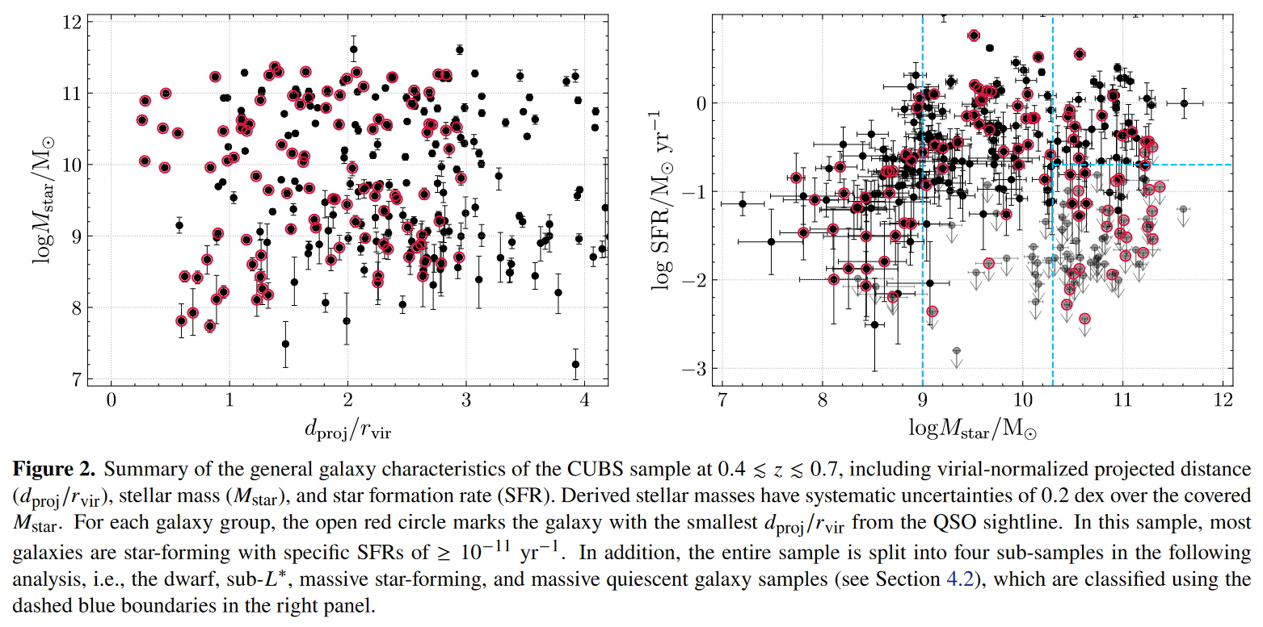
Sample Demographics

Slide 5
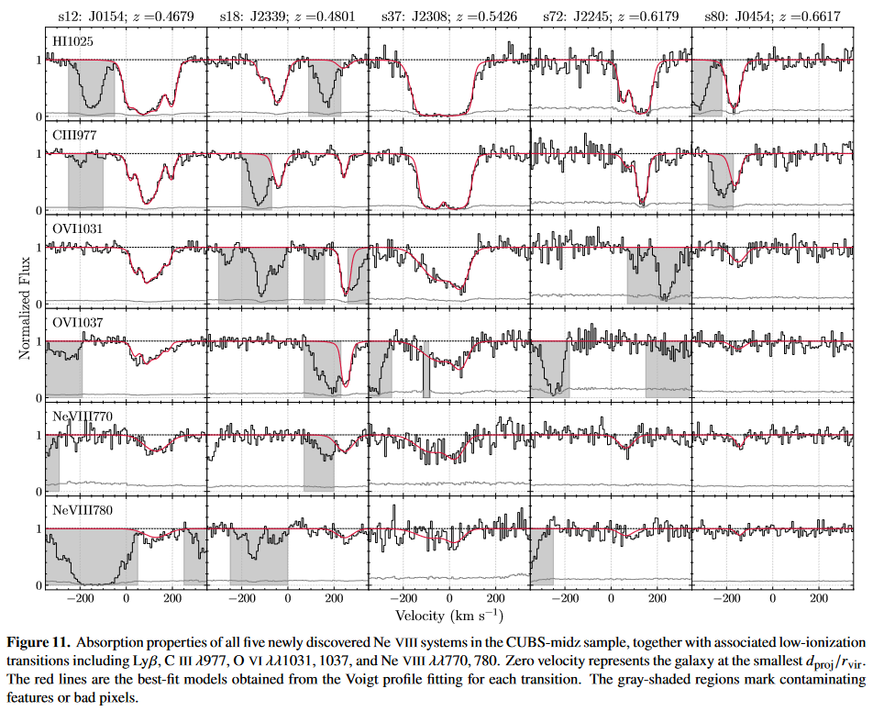
Line Fitting

Slide 6
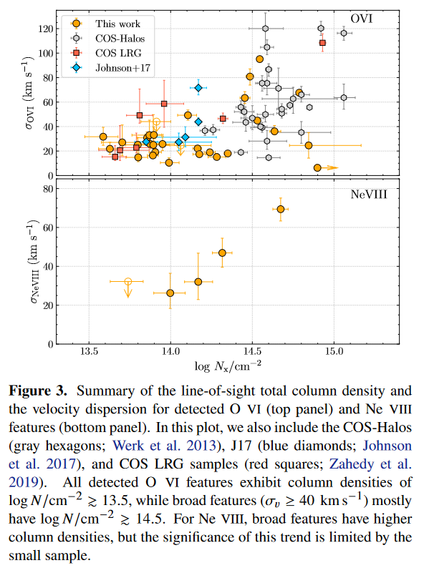
Column Densities

Slide 7
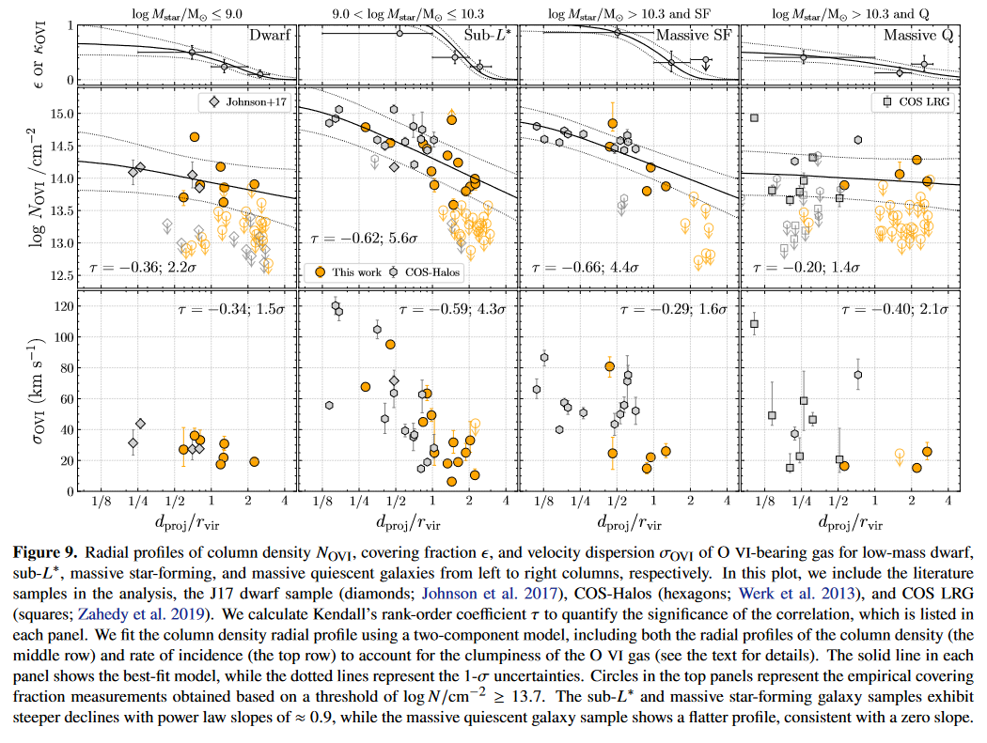
Radial Dependence OVI

Slide 8
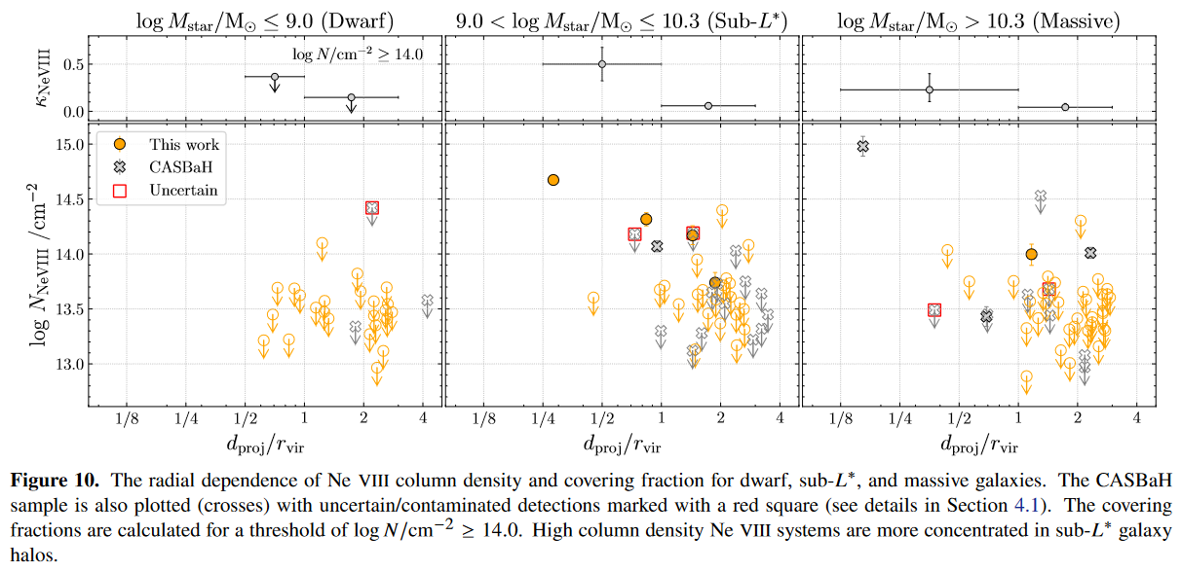
Radial Dependence NeVIII

Slide 9
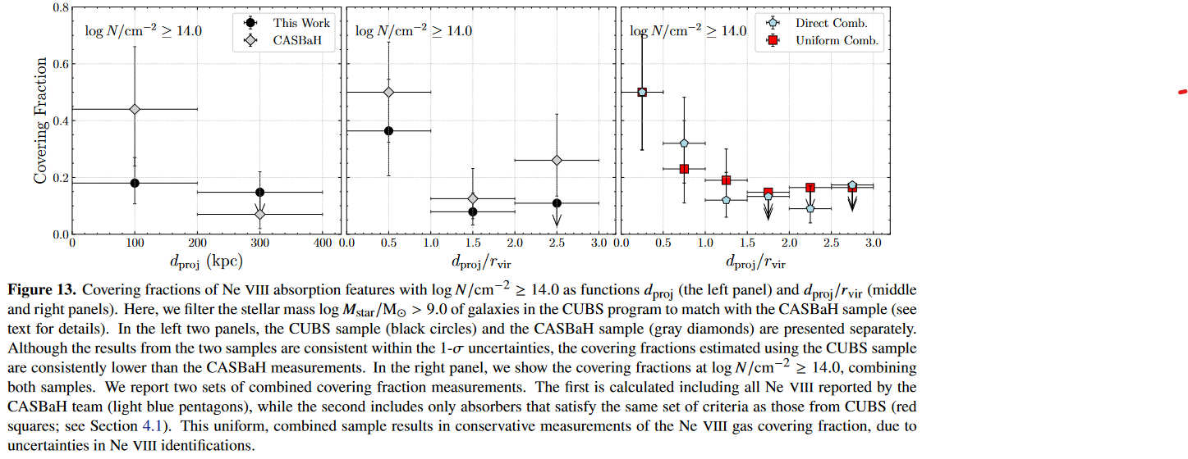
Radial Dependence NeVIII

Slide 10
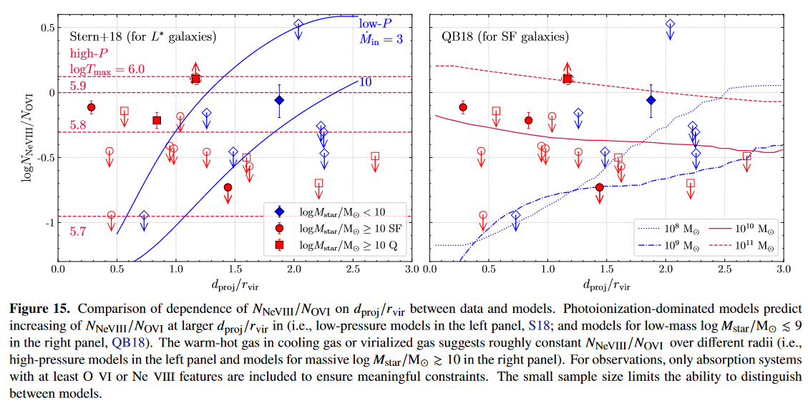
O VI/Ne VIII Ratio

Slide 11
Galaxy Dependencies
Star forming galaxies with Log M = 9-11
Concentration of metal-enriched warm-hot CGM within virial radius
Massive quiescent galaxies
Flatter radial profiles of both column densities and covering fractions
Velocity dispersion of O VI is broad for Log M > 9 within virial
Dynamic warm-hot halo around

Slide 12
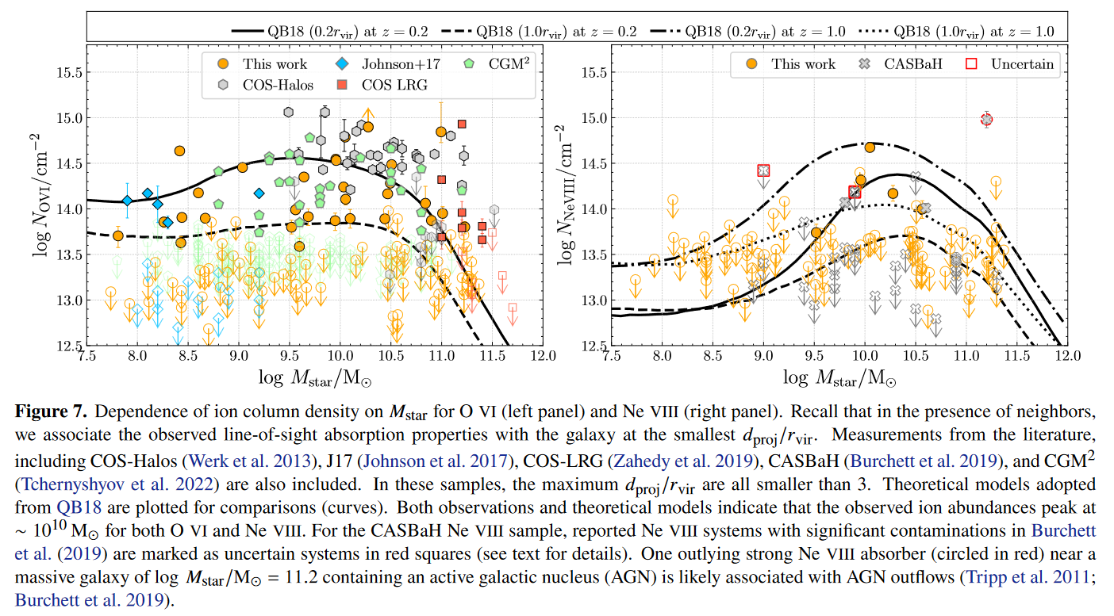
Stellar Mass Dependence

Slide 13
Summary
30 O VI and 5 Ne VIII absorbers detected
Column densities of logN/cm2 = 13.5-15.0
Velocity dispersion from 5 km/s to 120 km/s
Broad features trace the kinematics in the halo
O VI column density most correlated with galaxy with smallest dproj/rvir
Taken as host galaxy of absorption features
O VI and Ne VIII absorption exhibit bulk velocities within 200 km/s
Highest column density and broadest absorption around galaxies with log M = 10

Slide 14
Summary
Sub L* and massive star-forming galaxies show substantial radial declines of column densities
Massive quiescent galaxy sample exhibits flatter profiles
O VI covering fraction high for sub L* and massive star-forming galaxies within virial radius
Sharp decline at 1-2 rvir
Massive quiescent have roughly constant O VI covering fraction to 3 rvir
Less concentrated O VI gas in quiescent galaxies
Sub L* galaxies exhibit higher Ne VIII covering fractions within rvir

Slide 15
Summary
CUBS sample has lower covering fractions for all Ne VIII absorbers compared to CASBaH for log M = 9-11.5
Warm-hot CGM dominates the CGM of sub L* galaxies
Highest area weighted mean column density within rvir
Ionization fractions of O VI and Ne VIII comparable with peak ionization in CIE or PIE models

