Slide 1

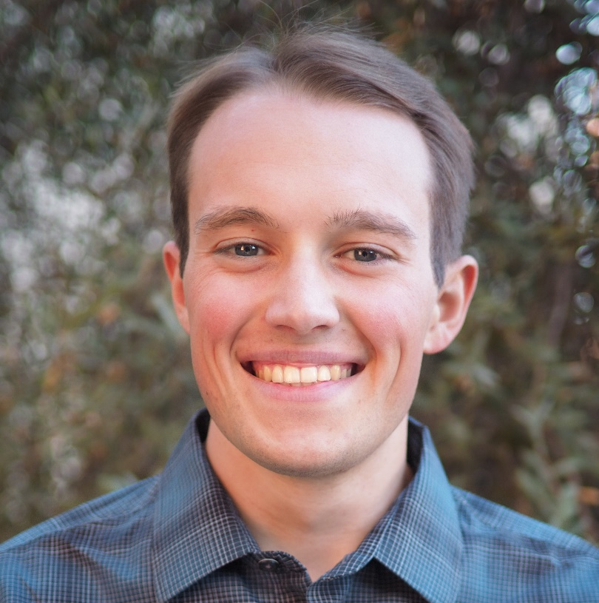
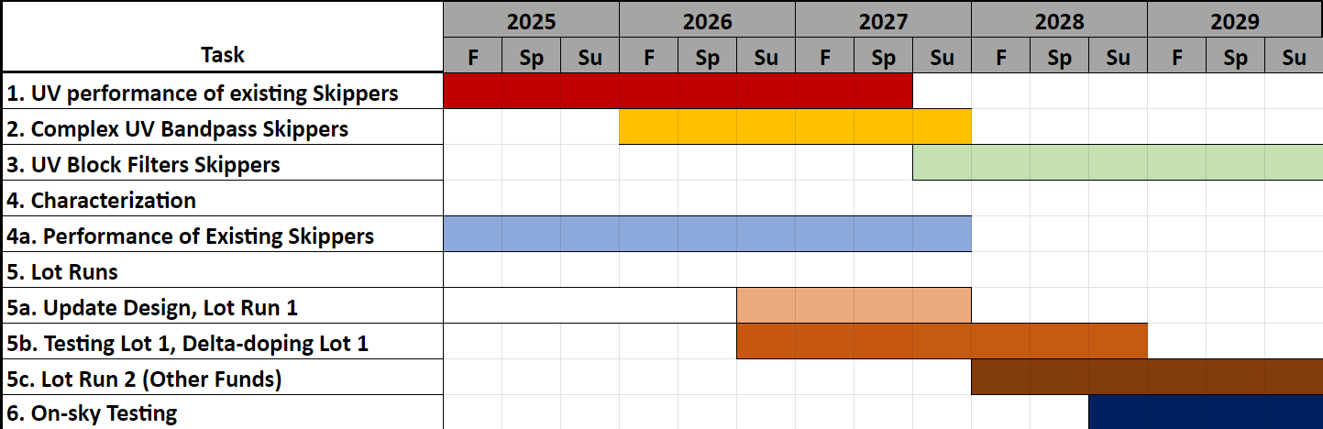
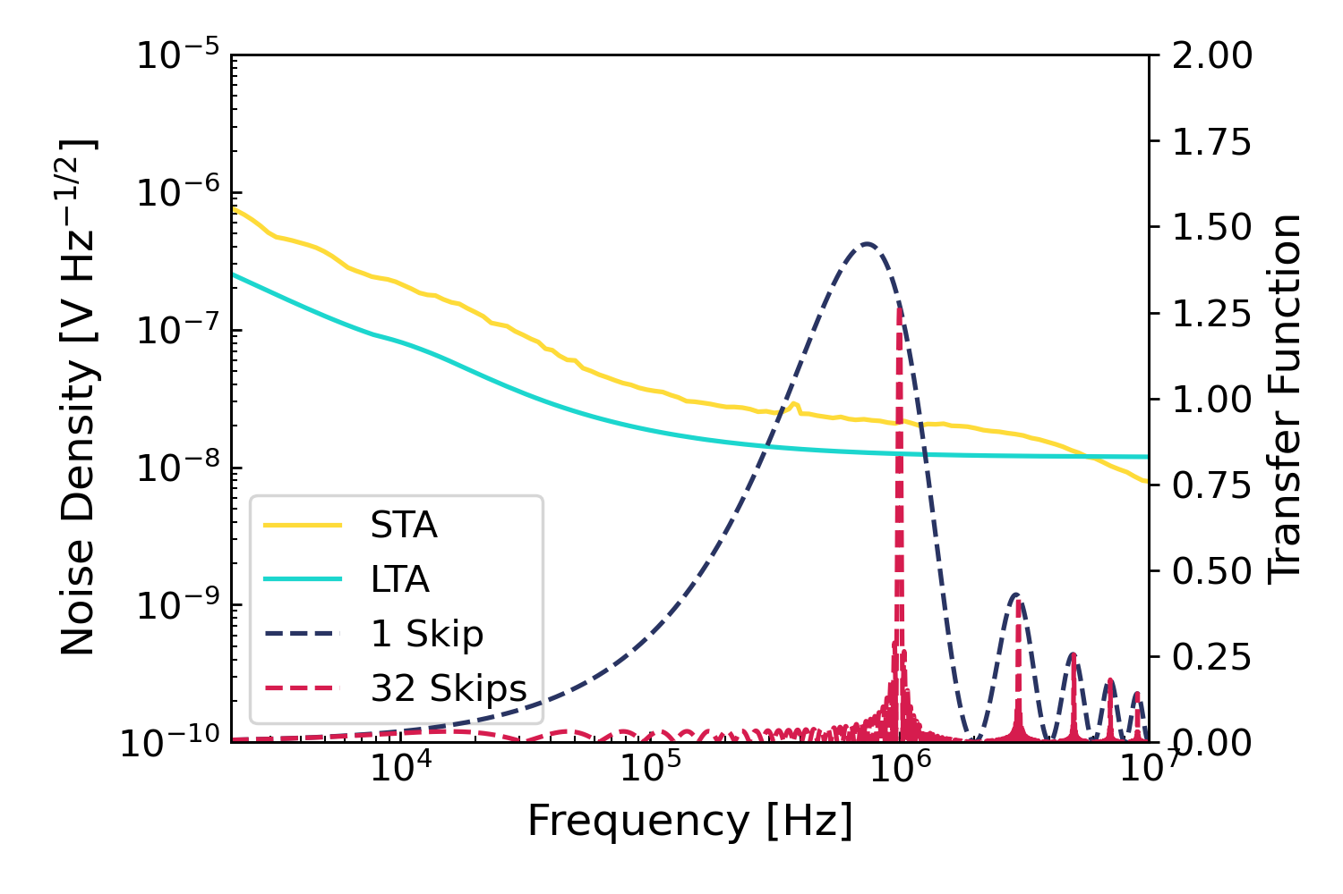
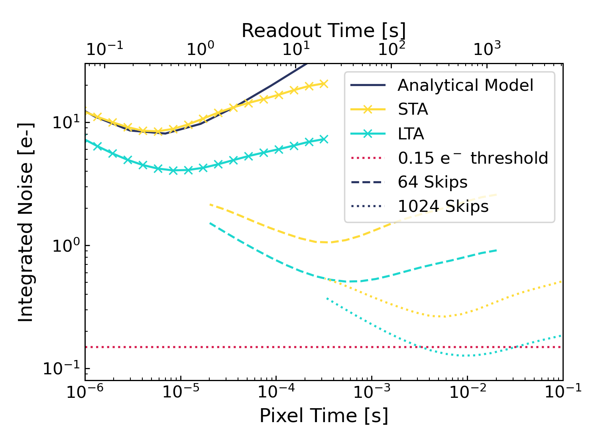
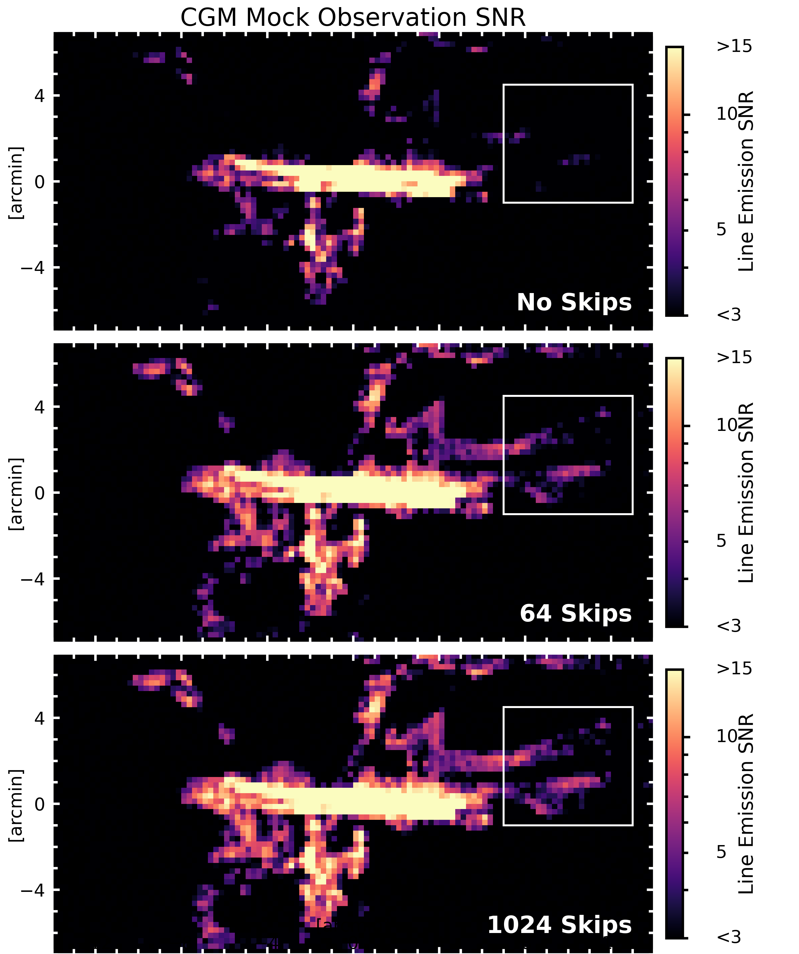
Theoretical Performance and Applications of a Novel 128-amplifier Delta-Doped UV Enhanced Skipper CCD
Brock A. Parker¹, Erika Hamden¹, Steve Kaye¹, Aafaque Khan¹
University of Arizona
Abstract
Project Timeline
Efforts are being made to develop detectors that can be used for applications in astronomy. Skipper CCDs are an inventive detector architecture with photon-counting ability utilizing multiple non-destructive readouts of pixel charge [6]. Our group is working on developing Skipper CCDs with enhanced UV QE. In this paper we present the design and readout electronics for a 128-amplifier Skipper CCD. We calculate theoretical Skipper noise models and optimize readout times for a selection of scenarios. Using this architecture, we demonstrate hypothetical signal-to-noise ratio improvements in two different applications: ultra-diffuse spatially resolved spectroscopic mapping, and high-resolution spectroscopy with pixel binning and automatic sky line removal. We provide the status of our on-going effort for extensive characterization of the noise performance of delta-doped enhanced Skipper CCDs, including our characterization setup and absolute quantum efficiency measurements. We propose a tentative project timeline, including planned lot runs, characterization tests, and on-sky testing. Low-noise Skipper CCDs have the potential to revolutionize ultra-faint imaging, due to their greatly increased signal-to-noise ratio at low incident fluxes.
We are currently undergoing construction of our Skipper CCD testing setup, including an existing UV monochromator, absolute QE measurement setup, and dark current measurement setup. In the proceeding years, we plan to perform UV characterization of existing Skipper CCDs, including 4k x 2k 15 μm detector designed at FermiLab. These devices will undergo UV optimization at JPL, including backside thinning, delta-doping, and AR coating. Concurrent to these characterization efforts, we are designing and planning a lot run of a 128-amplifier Skipper CCD, which we will characterize with our existing setup. Following design and testing of these devices, design optimizations will be completed and a new lot run will be performed, with the ultimate goal of deep-sub electron Skipper CCDs with a readout time of less than two minutes. After final testing and verification of the final device, we are planning on-sky testing of CGM observations with CHαS, the Circumgalactic Hα Spectrograph.
Figure 1: Proposed project timeline, including detector characterization, multiple lot runs, and on-sky testing.
Readout Simulation
Typical CCD readout noise is well characterized and can be modeled analytically fairly accurately [5, 12], as can be seen in black in Figure 3. Following this same methodology, and slightly modifying the transfer function, we can similarly model the integrated noise performance of hypothetical Skipper CCDS. We obtained readout electronics noise spectra from both the STA Archon controller and the newly developed Low Threshold Acquisition controller from FermiLab [5]. Because of the need for non-destructive readout-electronics, baseline Skipper read noise is higher than usual CCDs at around 2.5 e⁻ RMS [3, 6, 8]. However, new detector readout electronics promise to push intrinsic noise to sub-electron levels, reducing total readout times by a factor of ~10.
From our simulations, we find an optimal readout frequency of around 100-200 kHz, corresponding to a minimum readout time of approximately 1 second. In order to push into the photon counting regime, we require ~1000 skips with the LTA board, and more than 2000 skips with the STA controller. For the LTA electronics, this gives a final readout-time of ~700 seconds, or ~11 minutes. While this readout time is still prohibitive to many astronomical applications, future developments will continue to decrease this time, including additional amplifiers, a novel differential amplifier design, and decreasing electronics noise. With missions such as Aspera and the HWO, Skipper CCDs are in a prime field to become ubiquitous within low signal observations.
Simulated Observations
Using high resolution OVI CGM simulations, we calculate theoretical performance of the low-read noise Skipper CCDs with Aspera. Aspera currently implements a MCP with performance near the 1-skip Skipper noise background. From the simulations, we clearly see a large increase in the diffuse OVI line emission SNR with increasing skips, approaching the UV background limited regime. Assuming the optimal readout speed from the readout simulations with a readout time of approximately ~1000s, a Skipper CCD with 1024 skips and 128 amplifiers adds approximately 2-3 hours to the total Aspera exposure time of ~30 days, only a ~0.5% down time. The long exposure times and low-signal of the Aspera observations provide an optimal environment for Skipper CCDs.
Figure 4: Simulated OVI line emission signal to noise ratios for the Aspera SmallSat mission. Notable improvements in the diffuse outer edges can be seen for increasing numbers of skips.
Figure 2: Skipper CDS transfer function and readout electronics intrinsic noise spectrum. The transfer function is convolved with the noise spectrum to produce the integrated noise. The transfer function peaks near the pixel clock frequency, with additional skips narrowing the width of the transfer function.
Figure 3: Total integrated read noise for a 128- channel Skipper CCD as a function of pixel frequency and readout time. An optimal readout speed of 100 kHz is found, corresponding to a ~700 second readout time at deep 0.10 e⁻ read noise.
Body text for simulated observations
Other Applications
Numerous other areas of astrophysics stand to benefit greatly from low-to-zero read noise detectors, including:
Extremely high resolution spectrographs with automatic sky line removal
Exoplanet direct imaging/spectroscopy [10]
Flagship missions, such as the Habitable Worlds Observatory and upcoming 30-m class telescopes [4, 10]
Dark matter detectors with long exposure times and expected signals of 1-2 e⁻
Will these detectors work for you? Contact us!
baparker@arizona.edu
References
[1] E. T. Hamden et al., “Charge-coupled devices detectors with high quantum efficiency at UV wavelengths,” J. Astron. Telesc. Instrum. Syst, vol. 2, no. 3, p. 036003, Sep. 2016, doi: 10.1117/1.JATIS.2.3.036003.
[2] G. Kyne et al., “Delta-doped electron-multiplying CCDs for FIREBall-2,” J. Astron. Telesc. Instrum. Syst., vol. 6, no. 01, p. 1, Mar. 2020, doi: 10.1117/1.JATIS.6.1.011007.
[3] A. Lapi et al., “Fast readout of the Skipper CCD for astronomy and quantum imaging,” in X-Ray, Optical, and Infrared Detectors for Astronomy X, A. D. Holland and J. Beletic, Eds., Montréal, Canada: SPIE, Aug. 2022, p. 30. doi: 10.1117/12.2631791.
[4] S. Nikzad et al., “High-efficiency UV/optical/NIR detectors for large aperture telescopes and UV explorer missions: development of and field observations with delta-doped arrays,” J. Astron. Telesc. Instrum. Syst, vol. 3, no. 03, p. 1, Sep. 2017, doi: 10.1117/1.JATIS.3.3.036002.
[5] G. F. Moroni et al., “Low Threshold Acquisition Controller for Skipper Charge Coupled Devices,” in 2019 Argentine Conference on Electronics (CAE), Mar del Plata, Argentina: IEEE, Mar. 2019, pp. 86–91. doi: 10.1109/CAE.2019.8709274.
[6] J. Tiffenberg et al., “Single-Electron and Single-Photon Sensitivity with a Silicon Skipper CCD,” Phys. Rev. Lett., vol. 119, no. 13, p. 131802, Sep. 2017, doi: 10.1103/PhysRevLett.119.131802.
[7] F. Chierchie et al., “Smart-readout of the Skipper-CCD: Achieving Sub-electron Noise Levels in Regions of Interest,” 2020, doi: 10.48550/ARXIV.2012.10414.
[8] G. Fernández Moroni, J. Estrada, G. Cancelo, S. E. Holland, E. E. Paolini, and H. T. Diehl, “Sub-electron readout noise in a Skipper CCD fabricated on high resistivity silicon,” Exp Astron, vol. 34, no. 1, pp. 43–64, Jul. 2012, doi: 10.1007/s10686-012-9298-x.
[9] J. Tumlinson, M. S. Peeples, and J. K. Werk, “The Circumgalactic Medium,” Annu. Rev. Astron. Astrophys., vol. 55, no. 1, pp. 389–432, Aug. 2017, doi: 10.1146/annurev-astro-091916-055240.
[10] A. R. Howe, C. C. Stark, and J. E. Sadleir, “The Scientific Impact of a Noiseless Energy-Resolving Detector for a Future Exoplanet-Imaging Mission.” arXiv, May 14, 2024. Accessed: May 21, 2024. [Online]. Available: http://arxiv.org/abs/2405.08883
[11] H. Chung et al., “Aspera: the UV SmallSat telescope to detect and map the warm-hot gas phase in nearby galaxy halos,” Proc. SPIE 11819, Aug 2021. doi:https://doi.org/10.1117/12.2593001
[12] J. R. Janesick, Scientific charge-coupled devices. 2001. Accessed: Jun. 17, 2024. [Online]. Available: https://ui.adsabs.harvard.edu/abs/2001sccd.book.....J

