Slide 1
Assignment 06: Photobooth
Brock Dvais

Slide 2
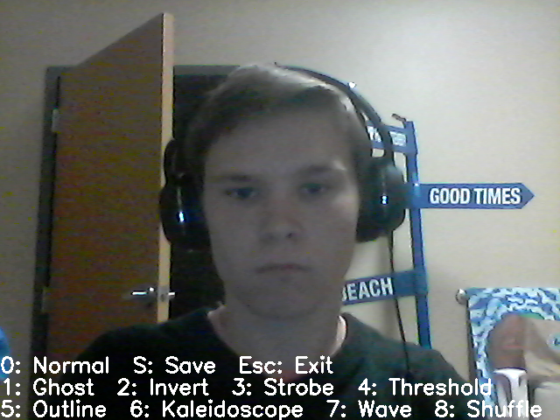
0: Normal

Slide 3
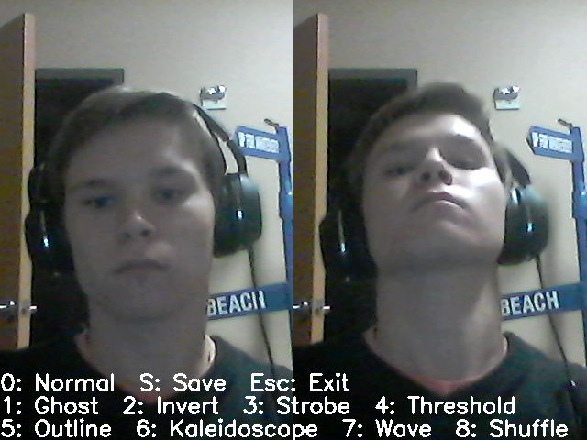
1: Ghost
Shows the unedited picture from 30 frames ago

Slide 4
1: Ghost
last30.append(frame)
if len(last30)>30:
last30.pop(0)
elif key==ord("1"):
current=frame[:,w/4:3*w/4,:]
ghost=last30[0][:,w/4:3*w/4,:]
out=np.hstack((current,ghost))

Slide 5
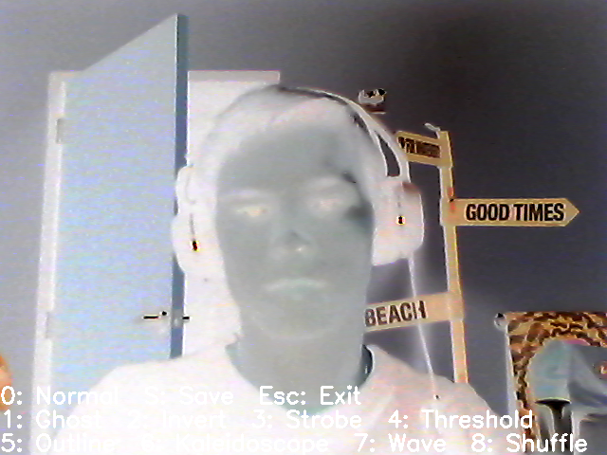
2: Invert
Takes the inverse image of the read image
out=255-frame

Slide 6
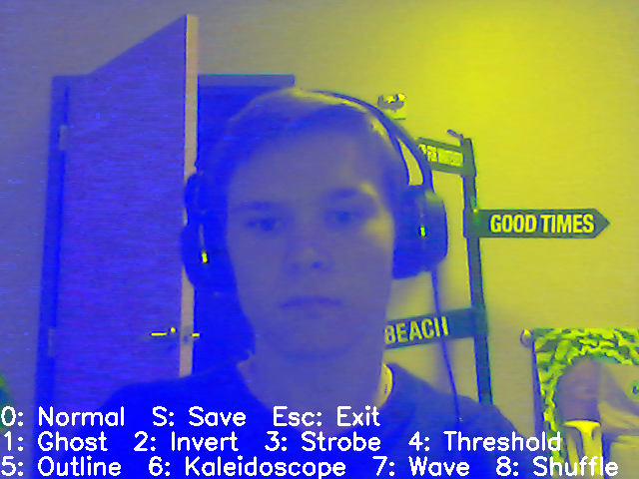
3: Strobe
Makes the screen strobe red, green, and blue

Slide 7
3: Strobe
if (i%6)/2==0:
out=np.dstack((255-frame[:,:,0],
frame[:,:,1],
frame[:,:,2]))
elif (i%6)/2==1:
out=np.dstack((frame[:,:,0],
255-frame[:,:,1],
frame[:,:,2]))
else:
out=np.dstack((frame[:,:,0],
frame[:,:,1],
255-frame[:,:,2]))

Slide 8
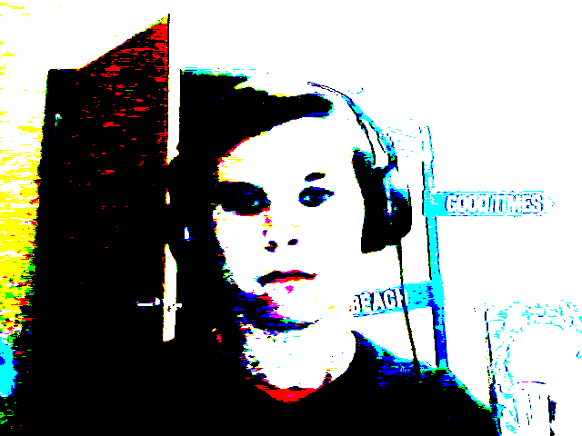
4: Threshold
Thresholds each color of the image. The threshold value varies back and forth based on the frame

Slide 9
4: Threshold
threshold=abs(256-(i%511))
out=frame.copy()
out[out<=threshold]=0
out[out>threshold]=255

Slide 10
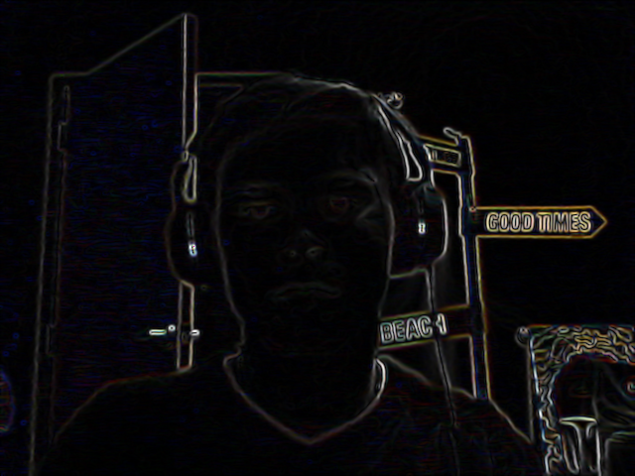
5: Outline
Shows the colored energy map of the image

Slide 11
5: Outline
frame=np.float32(cv2.GaussianBlur(frame,(5,5),0))
derivative_kernel=np.float32([[-1,0,1],[-2,0,2],[-1,0,1]])
Ix=cv2.filter2D(frame,-1,derivative_kernel)
Iy=cv2.filter2D(frame,-1,derivative_kernel.T)
out=(Ix**2+Iy**2)**.5
out-=np.min(out)
out/=np.max(out)
out*=255.999999
out=np.uint8(out)

Slide 12
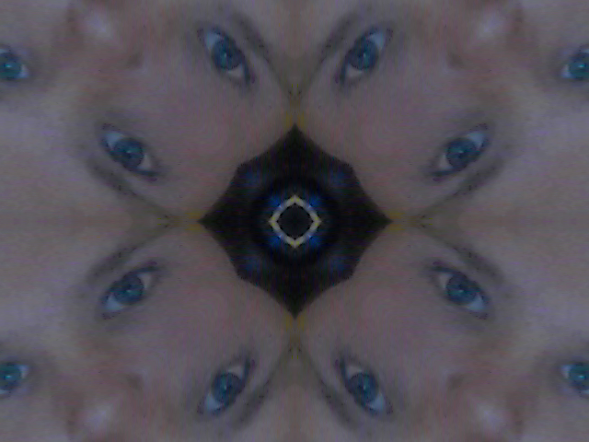
6: Kaleidoscope
This is an 8 way kaleidoscope based on the top left corner of the image

Slide 13
6: Kaleidoscope
polar=np.zeros((h,w,2),dtype=np.float32)
This creates an array the same size of the frame that saves the equivalent polar coordinates with the origin as the center of the array
x_dist=np.abs(x-np.ones((h,w))*w/2)
y_dist=np.abs(y-np.ones((h,w))*h/2)
polar[:,:,0]=(x_dist**2+y_dist**2)**.5
This gives the distance from the origin

Slide 14
6: Kaleidoscope
polar[:,:,1]=np.minimum(np.arctan2(y_dist,x_dist), np.arctan2(x_dist,y_dist))
This gives the angle of the point in polar coordinates, but only in the first 45 degree range, because x_dist and y_dist are all positive values, and it takes the minimum of two supplementary angles.
new_rect=np.ones((h,w))
x_coord=polar[:,:,0]*np.cos(polar[:,:,1])
y_coord=polar[:,:,0]*np.sin(polar[:,:,1])
This turns the polar coordinates back into Cartesian coordinates to use for the remap function

Slide 15
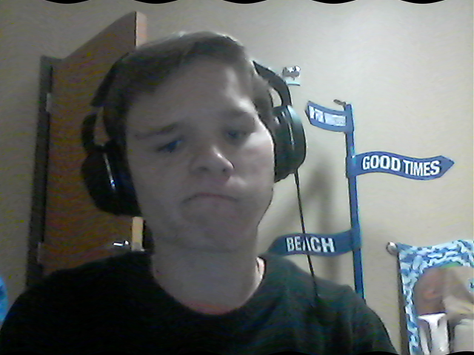
7: Wave
This creates a sine wave with the coordinates of the picture

Slide 16
7: Wave
x_wave=(x+3*np.sin(2*np.pi*(x)/(w/8)))
y_wave=(y+5*np.sin(2*np.pi*(x)/(h/4)))

Slide 17
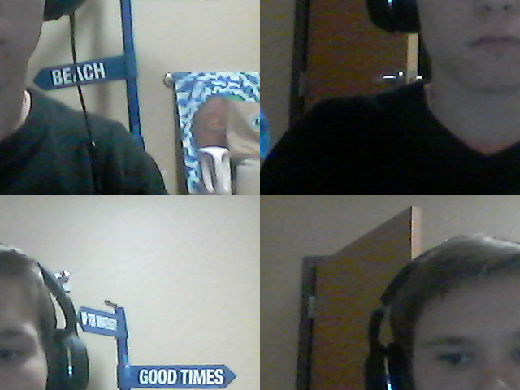
8: Shuffle
This shuffles the four quadrants of the picture
A
B
D
C
C
D
B
A

Slide 18
8: Shuffle
x_shuff[:h/2,:]=(x_shuff[:h/2,:]+(w/2))%w
y_shuff[:,:w/2]=(y_shuff[:,:w/2]+(h/2))%h
x_shuff[h/2:,:]=(x_shuff[h/2:,:]-(w/2))%w
y_shuff[:,w/2:]=(y_shuff[:,w/2:]-(h/2))%h

