Slide 1
Assignment 03: Self Balancing Tree
Brock Davis

Slide 2
Goal
Make a generic self-balancing tree
Generic: Can be used with any Comparable data type
Self-Balancing: Rotates node connections so search takes O(n*log(n))

Slide 3
Approach Overview
AVL Tree
Create a Node class
Has generic type
Keeps trach of left, right, and parent Node
Recursive functions for add, remove, etc.
Self-balances up through call stack

Slide 4
Add
if newVal < thisVal:
if left is null:
left = newVal
left.parent = this
else:
left.add(newVal)
//Same with right//
updateDepth
rebalance

Slide 5
Remove
if removeVal == this.value:
if left isNull && right isNull:
parent.remove(this)
else if right not isNull
this.value = right.min
right.remove(this)
else if left not isNull
this.value = left.min
left.remove(this)
else if removeVal < this.value
left.remove(removeVal)
//Same with right//
updateDepth()
parent.balance(this)

Slide 6
Rebalance
if left.depth – right.depth > 1:
if left.right.depth > left.left.depth:
left.rotateLeft()
this.rotateRight()
if left.depth – right.depth < -1:
if right.left.depth > right.right.depth:
right.rotateRight()
this.rotateLeft()

Slide 7
Rotation
Right Rotation
Left Rotation
A
A
B
B
C
C
B
B
A
C
A
C

Slide 8
Results
The Implemented AVL Tree was compared to the Java TreeSet for time of addition and removal of consecutive integers
Depth of tree was always log₂(n) where n is # of elements

Slide 9
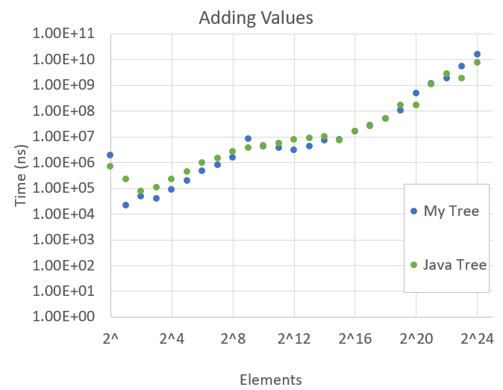
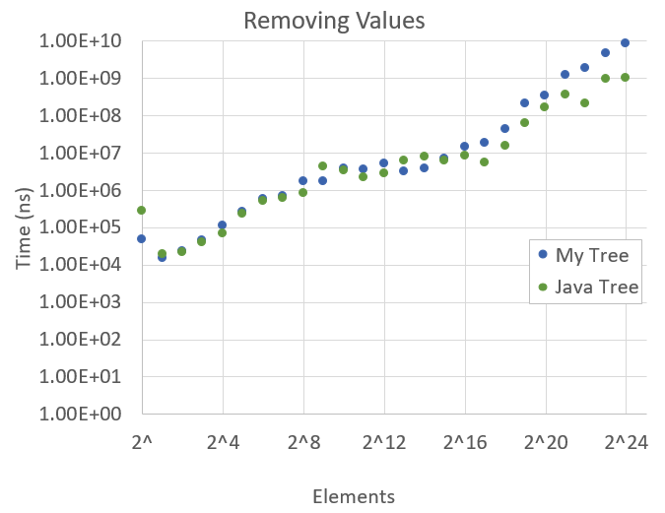
Results

