Slide 1
Assignment 04: Hashing
Brock Davis
Computer Programming III
April 2017

Slide 2
Goal
Make a generic HashTable
It will model the Java HashMap
Use unique Keys that are hashed
Stores values in parallel table
Testing
A book is read, storing each word’s frequency

Slide 3
Approach Overview
Two parallel arrays, storing pairs of keys and values
Index is determined by hash function modulus array size
Automatically upsizes table after a certain load factor is reached

Slide 4
Hashing Keys
Utilizes Java’s built-in hashCode() function that every Object has
Scrambles that hash integer to obtain an even distribution
Returns absolute value to be able to use as an index
hashCode = key.hashCode();
hashCode ^= (hashCode >>> 20) ^ (hashCode >>> 12);
return abs(hashCode ^ (hashCode >>> 7) ^ (hashCode >>> 4));

Slide 5
Putting Key/Value pairs
i = hash(key)
coll = 0
while (keys[i + coll] != null)
if (keys[i + coll].equals(key))
return -1 //Doesn’t allow duplicate keys
coll ++
keys[i + coll] = key
values[i + coll] = value
size ++
updateTable() //Upsizes table if needed
return coll

Slide 6
Removing Key/Value pair from Key
Finds the selected key in the chain, if it is present
For each key/value pair that doesn’t match the hash code for the index, remove it and re-add it

Slide 7
Removing Key, Value pair from Key
val = null
i = hash(k)
toAddK = {}
toAddV = {}
while (keys[i] != null)
if (keys[i].equals(k)) //Found key
size --;
val = values[i];
keys[i] = null; //Remove from array
values[i] = null;
K next = keys[i + 1];
while (next != null) //Search for pairs to remove and re-add
if (hash(next) % (i + 1) == 0)
toAddK.add(next);
toAddV.add(values[i + 1]);
keys[i + 1] = null;
values[i + 1] = null;
size--;
break;
i++;
next = keys[i + 1];
break;
i++;
for (int ind = 0; ind < toAddK.size(); ind++)
this.put(toAddK.get(ind), toAddV.get(ind));
return val;

Slide 8
Other Notable Implemented Functions
containsKey
Checks key table in O(1) with hashing
containsValue
Linear search through value table
Get
Checks key table and returns associated value in O(1)
keyset
Adds all elements in key table to a set

Slide 9
Results
The HashTable was able to be implemented comparable to the Java HashMap implementation
The functionality was tested by mapping a word as a key and its frequency in a book as the value into a HashTable and Java HashMap and recording various statistics
The put(K key, V val), containsKey(K key), remove(K key), and keySet() functions were tested in this method

Slide 10
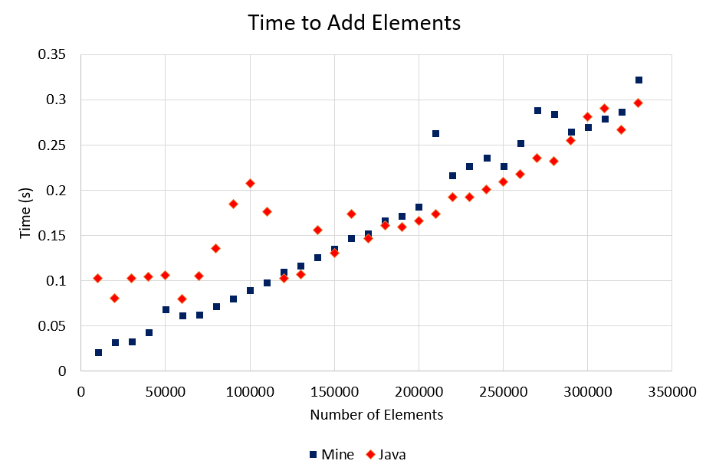
Results

Slide 11
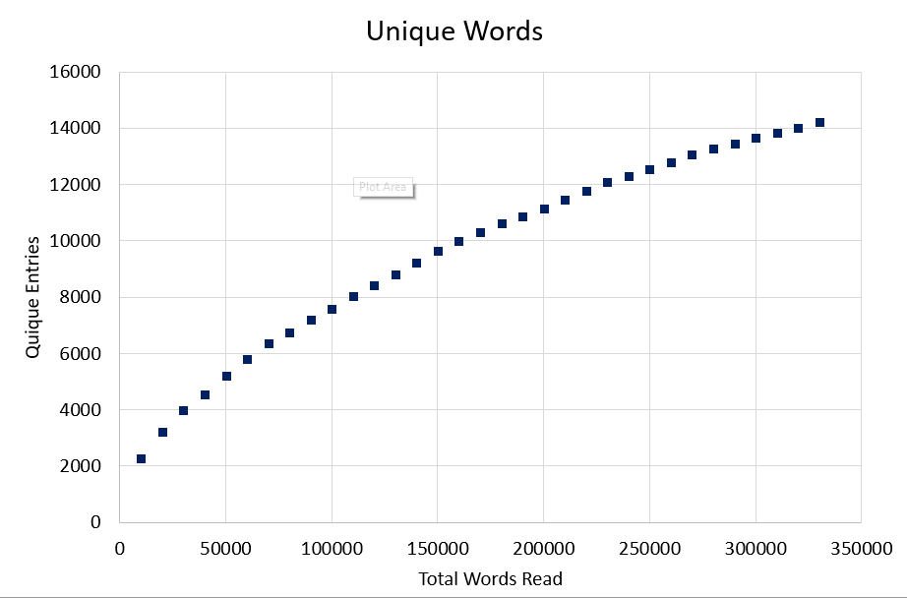
Results

Slide 12
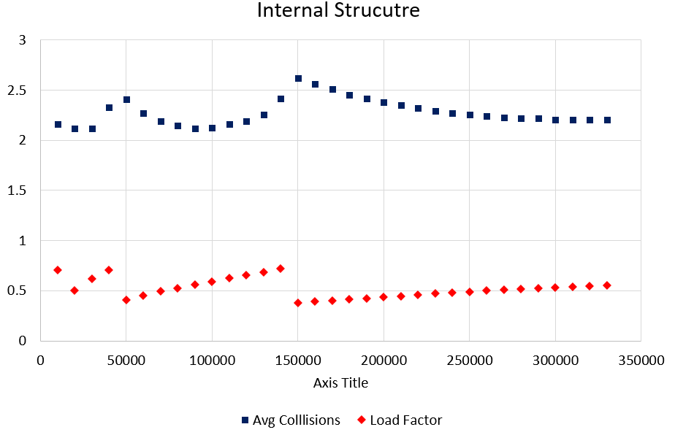
Results

Slide 13
Conclusion / Further Research
A generic Hash Table was successfully implemented with access and removal times comparable to the Java implementation
Additional Functions could include:
Dynamic resizing
Better hash function
Hop scotch hatching
Additional testing could include:
Testing for limits of space
Testing for collisions in hash function

