Slide 1
Assignment 00: Martian Squirrel City Simulator
Brock Davis

Slide 2
Approach
Step1: Input images to short[][]
Step2: Run loop to obtain x, y of best city
Generate random coordinates
Put city and level terrain
Check cost
If cost < bestCost, save new best x, y
Output new terrain image

Slide 3
City Placing
double total=0;
for (int i=0;i<500;i++)
for (int j=0;j<500;j++)
total+=terrain[x+i][y+j];
cityLevel=(short)(Math.round(total/(500*500)));
for (int i=0;i<500;i++)
for (int j=0;j<500;j++)
{
terrain[cityX+i][cityY+j]=cityLevel;
touched[cityX+i][cityY+j]=true;
}
for (int i=0;i<255;i++)
levelPerim(i);

Slide 4
Results
The program was run and the optimal city was searched for for 45 seconds.
Iterations of placing cities: 173
Cost: 1,156,682 acorns
Times a new solution was found: 4

Slide 5
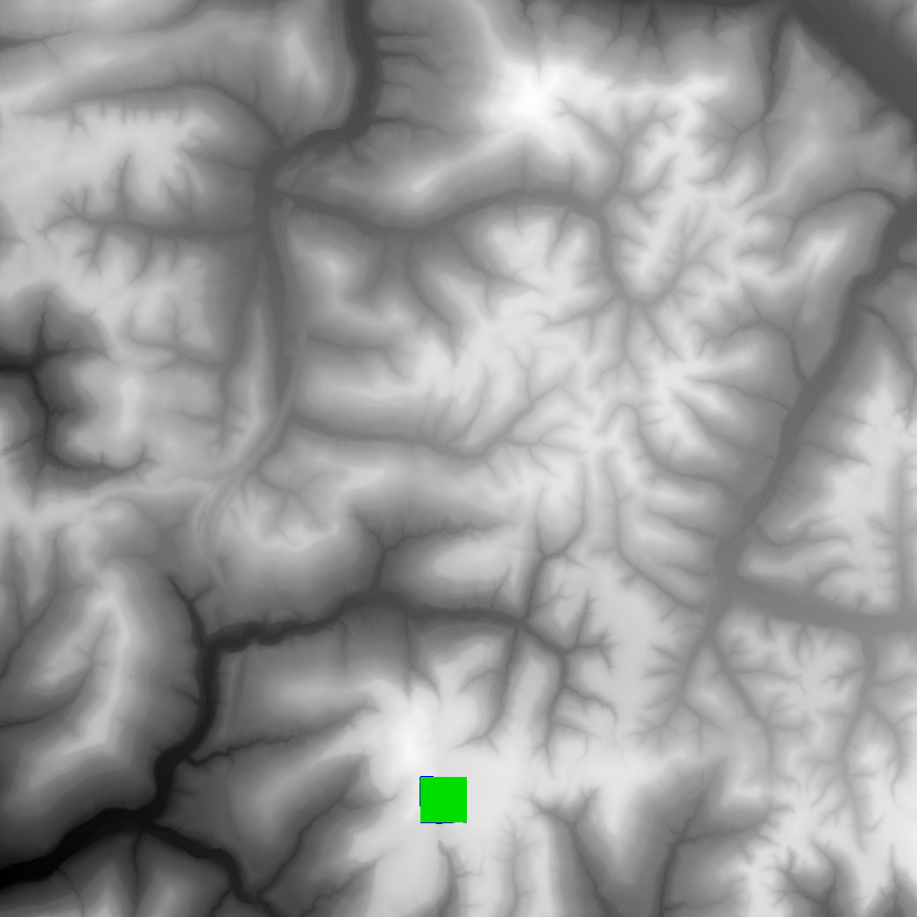
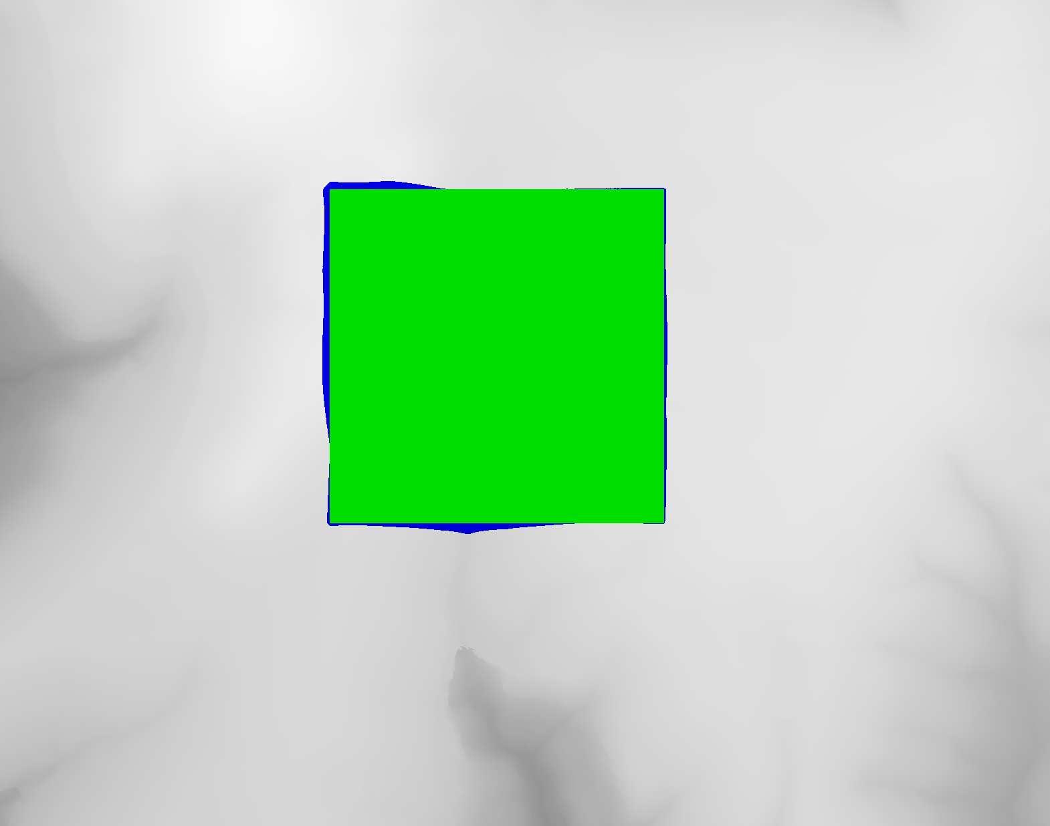
Images
output.png
Zoomed view of output.png

Slide 6
Future Ideas
Implement a better optimization algorithm
Hill climbing
Exhaustive search in smaller resolution
Bugfix level terrain function
Check surrounding pixels after changing it
Recursive + iterative solution

