Slide 1
Assignment 01: Maze Generation & Solving
Brock Davis

Slide 2
Goal & Approach
Maze Generation
Size up to about 20000px x 30000px
Recursive Backtracking (Stack) in Java
Maze Solving
Size up to about 13000px x 20000px
Right Hand Following in Java
Stack to keep track of path
Custom Point class was made

Slide 3
Maze Generation
while points not empty:
int[] possibles = getPossibles()
if possibles.length > 0:
int choice = random_choice(possibles)
makeMove(choice);
points.push(current.copy())
else:
current=points.pop()

Slide 4
Maze Solving
while current != final_point:
boolean[] possibles = getPossibles();
if (possibles[right of direction])
direction = right of direction;
else if (possibles[direction]);
else if (possibles[left of direction])
direction = left of direction;
else if (possibles[backward])
direction = backward;
makeMove(direction);

Slide 5
Maze Solving (cont.)
void makeMove(int direction):
change x, y based on direction
if current in points:
remove last point from points
else:
add current to points

Slide 6
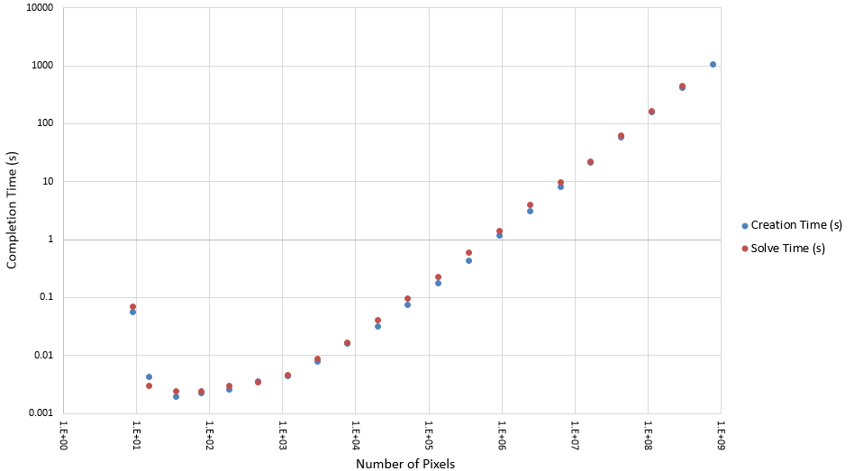
Program Statistics

Slide 7
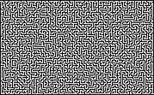

Slide 8
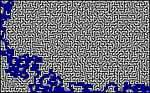

Slide 9
Results
The goal was accomplished
Mazes up to 20000px x 30000px were created
Mazes up to 13000px x 20000px were solved
Maze creation was faster than solving
Mazes took about 10% longer to make
Creation also took more memory
maze20 could not be solved because of insufficient memory
Much of time spent was i/o of images

Slide 10
Resources
Maze Creation
https://youtu.be/WDONIYY8ljY
Maze Solving
https://youtu.be/9LDbFS1Qh1I

