Slide 1
Assignment 02: Pathfinding
Brock Davis

Slide 2
Goal
Given an array with defined costs between each cardinally adjacent element, return and highlight the lowest cost path between any two points

Slide 3
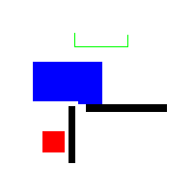
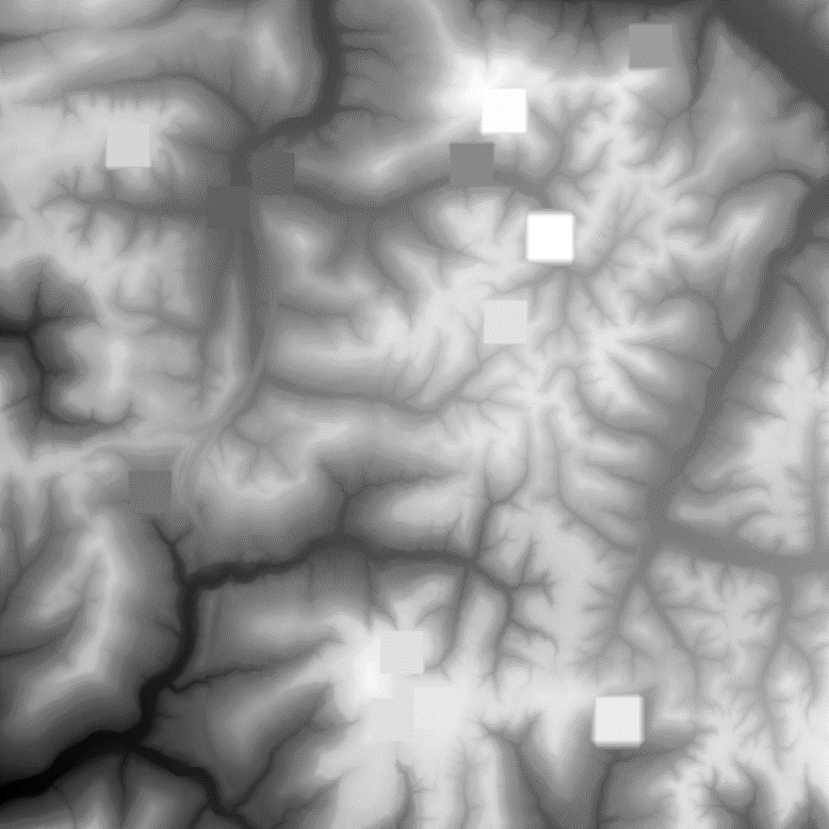
Input
Input 1:
H: 200 px
W: 200 px
Cost to move:
1 on white
2 on blue
infinite on black
Input 2:
H: 10024 px
W: 10024 px
Cost to move:
1 + (diff in value)^2

Slide 4
Approach
A more optimized version of Dijkstra’s Algorithm was implemented
A set of points w/ adj. points to be evaluated were kept in fringe
The points in the fringe with the lowest values had adj. points evaluated and added to fringe
The need to linearly search through the fringe for every point was eliminated with a counter with the lowest cost
c=0
while fringe not empty:
for point in fringe with cost c:
evaluate cost of adj points
add adj to fringe
remove point

Slide 5
Pseudocode
c=0
while fringe not empty:
for point in fringe with cost c:
evaluate(adj(point))
fringe.add(adj(point))
fringe.remove(point)
c++

Slide 6
Also Implemented
When the adjacent points were evaluated, they should not be added to the list of points right away because the array is being iterated through while the adjacent points are being evaluated
After all points have been evaluated, the goal is traced back to 0, starting with the lowest cost in the goal and moving to the lowest cost adjacent cell until 0 is reached

Slide 7

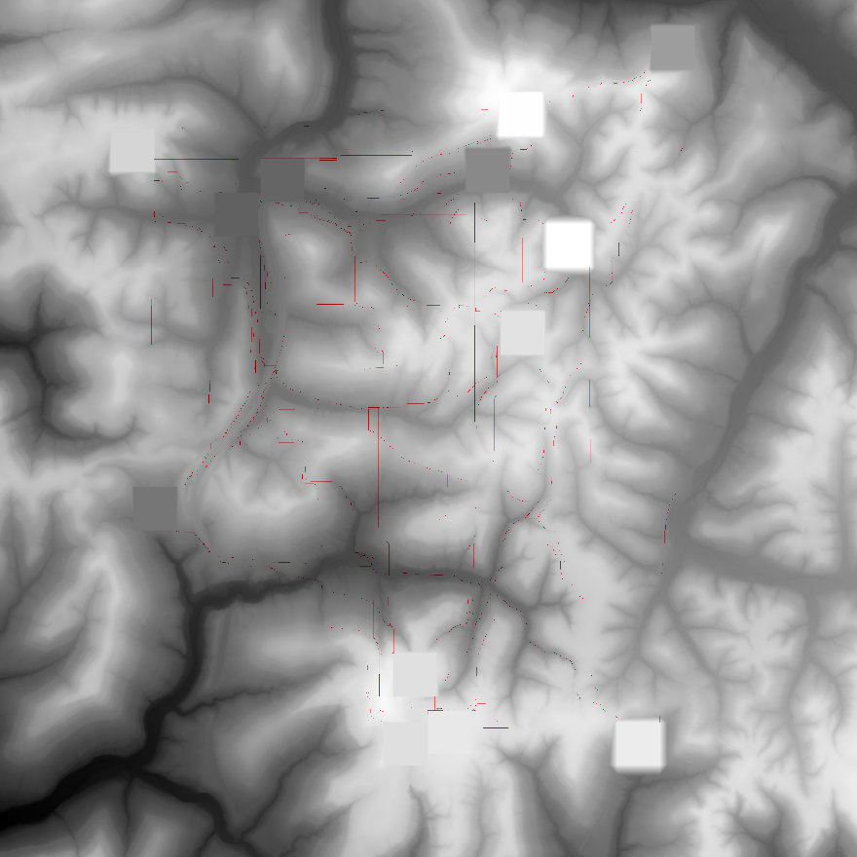
Results
Output 1:
Lowest cost: 140
Path highlighted in orange
Approx time: 1 sec on lab computer
Output 2:
Costs vary between cities
Path highlighted in redscale
Approx time: 40 min on lab computer

Slide 8

Results (cont.)
Output 2 (Zoomed)

Slide 9
Conclusion
The path costs were verified to be correct, so the program was successful
However, the program took ~40 min to complete on a desktop computer, so optimization would be needed to scale up to more connections between nodes or a larger map
This could be done by calculating all costs between nodes and then using a preexisting pathfinding algorithm
Also adding a heuristic could greatly improve time of pathfinding to a certain point

