Slide 1
Assignment 05: Socketing
Brock Davis
Computer Programming III
May 2017

Slide 2
Goal
Use socketing to perform computationally heavy tasks
Build a Server class and Client class
Single Server to relegate tasks to multiple Clients
Task: Factoring Semiprimes
Product of 2 primes

Slide 3
Approach Overview
Server gives prime and range of indexes to test
Server command
SOLVE [NUM] [STARTN] [STOPN]
Client responses
CRACKED [FACTOR1] [FACTOR2]
FAILED
Iterating quadratic equations to factor semiprimes

Slide 4
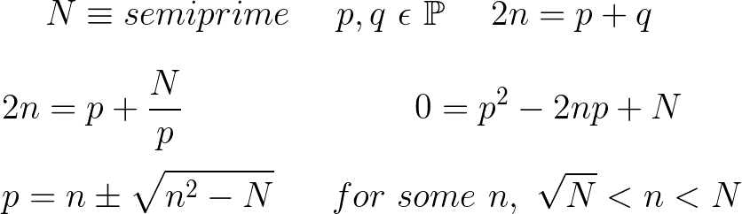

Factoring Approach
$n+ \sqrt{n^{2}−N}$ is a whole number for only one n, and that whole number is p.
n is iterated from sqrt(N) to N until a whole number is found

Slide 5
Server Overview
Reads in semiprimes, calculates sqrt(N), (starting point) stores them for solving
Assigns each Client the current N to factor, and a range of 10 million n’s to check
Continues assigning consecutive n’s until factorization is found
Logs time and events:
Connect/disconnect
Task assigned
Cracked number
Progress made

Slide 6
Results
After 12 hours, a total of 14 semiprimes were cracked.
2 digits up to 25 digits
The time to crack each semiprime increased exponentiallly

Slide 7
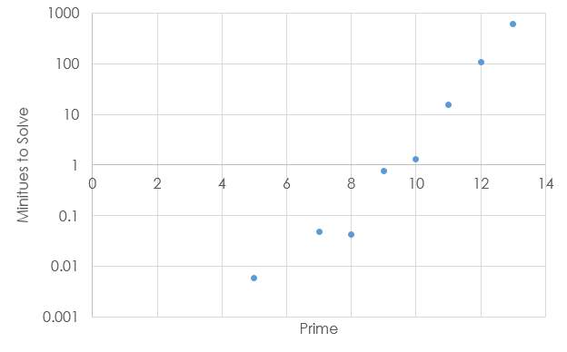
Time To Factor

Slide 8
Future Improvements
Faster semiprime factoring algorithm
Quadratic Sieve method
More sockets
Utilize more computers

