Slide 1



Notes:
We are all lucky to live in a nation with a stable government that generally works for its people.
But based recent news headlines in Venezuela, Egypt, or Turkey, it is clear that others aren’t so lucky.
Such circumstances can lead to extreme, often violent action to overthrow the government.
What if we could prevent these catastrophic events from even occurring? Imagine if we could identify countries at risk, then intervene.

Slide 2
To Coup Or Not to Coup?
A Classification of Coup Attempts
Brooke Ann Coco
Notes:
Name
My aim is to utilize supervised learning techniques to classify whether a sovereign nation will experience a coup attempt within the next year

Slide 3

Theory
Notes:
Theory based off of a 2011 book, The Dictators Handbook: Why Bad Behavior Is Almost Always Good Politics
Regardless of benevolent intentions, the underlying motivation of any ruler is to remain in power
Thus, all rulers are bound by the same sets of political rules

Slide 4


Autocracy – Democracy Spectrum
Small Winning Coalition Governments
Large Winning Coalition Governments
Autocracy
Oppression, corruption, and investment in private goods
Democracy
Less corruption and investment in public goods
Notes:
Leaders are beholden to those who put them in power
Governments who rely on many must please the masses through social benefits and civil works
Less corruption
Governments who rely on few need only please those few, often in the form of direct payment
More corruption

Slide 5
Data
REIGN
(Rulers, Elections, and Irregular Governance)
Regime length
Election timing
Penn World Table
Human capital Index
Government finances
Access to basic resources
GDP
Coup attempts
World Development Indicators
Notes:
This is a hard theory to test and a complex problem to solve. I attempted to find proxies for corruption.
World Bank
Economic figures
Development indicators
OEF Research’s REIGN (Rulers, Elections, and Irregular Governance)
Political conditions from over 200 countries
Penn World Table
More Economics

Slide 6
Methodology
Missing Data
Class Imbalance
GridSearch
Logistic Regression
Decision Tree
Gradient Boosting
Bagging
Impute with mean
Resampling
SMOTE
ADASYN
K-Nearest Neighbors
Notes:
Missing Data
Biggest hurdle
Tossed around ideas, but went with mean
Class Imbalance
Resampling
SMOTE – Synthetic Minority Over-sampling Technique
ADASYN – ADAptive Synthetic
Input data into grid search to find the best parameters

Slide 7
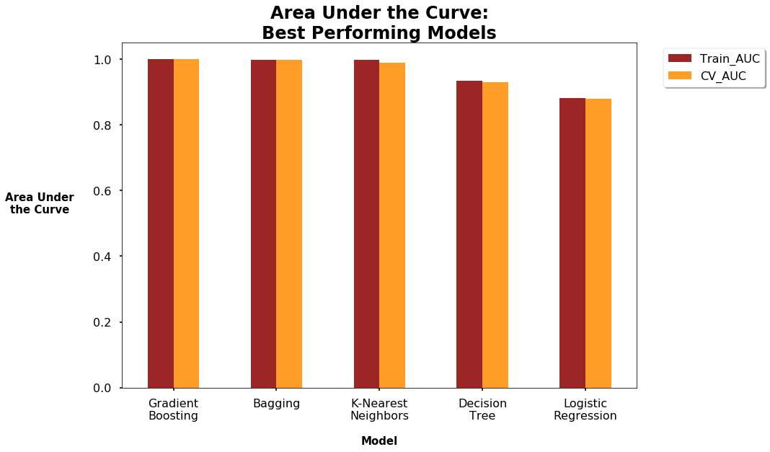
Results
Notes:
- Wow, these are some great scores
But, wait, it seems too good to be true
Indicates an error, but let's take the best performing model – Gradient Boosting – and see how it performs on the testing data

Slide 8
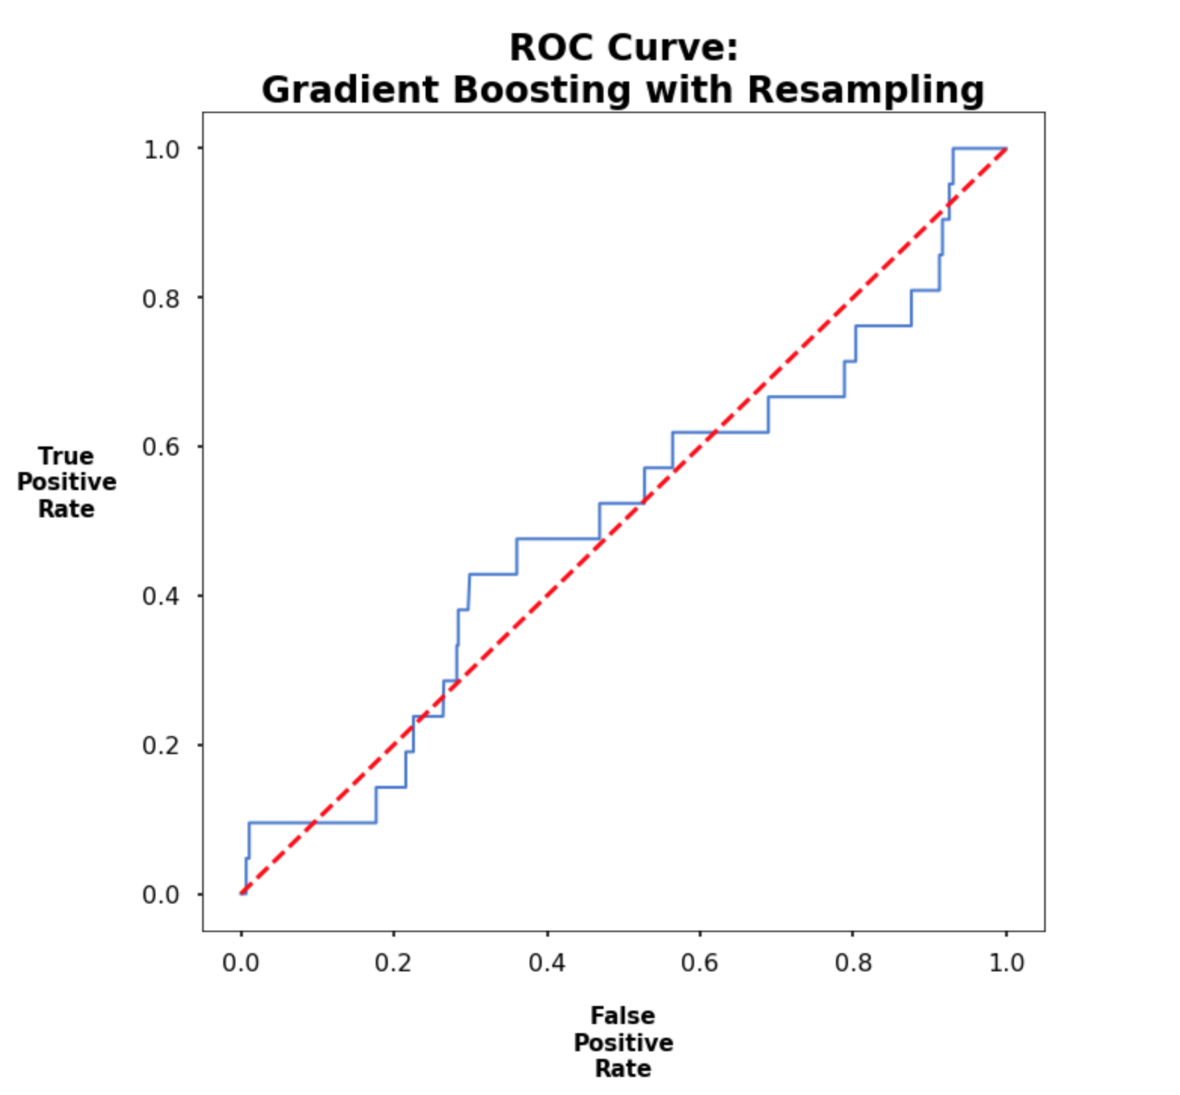
Results
Notes:
Oh no! What happened to that killer auc score?
The model performs no better than always predicting that a coup will not occur.

Slide 9
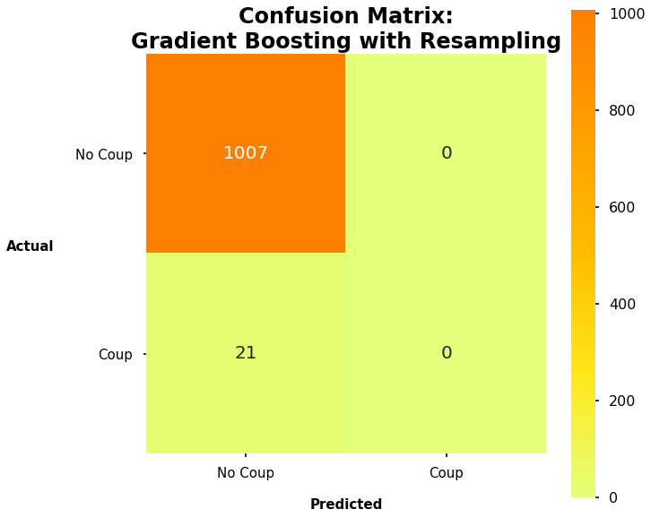
Results
Notes:
What do you know, that’s exactly what it’s doing. But why?
After a little digging, it turns out that while tuning parameters with gridsearch, I input my oversampled training data. If we remember, resampling replicates existing points in the minority class, meaning that my cross validation had access to leaky variables.
LEAKY VARIABLES will awlays come back to haunt you!

Slide 10
Future Work
Be more cognizant of leaky variables
Calculate more sophisticated imputation of nulls
Add more features
Test other models
Notes:
So my model was not predictive. But some preliminary analysis after accounting for the leaky variables reveals that the data may still hold predictive power. Yielding plenty of opportunity for future work.
Add government type
Imputing more sophisticated values for nulls
Group by country
Regression
KNN
Combining similar features
Play with SVM or Naïve Bayes

Slide 11

Thank you

