Slide 1
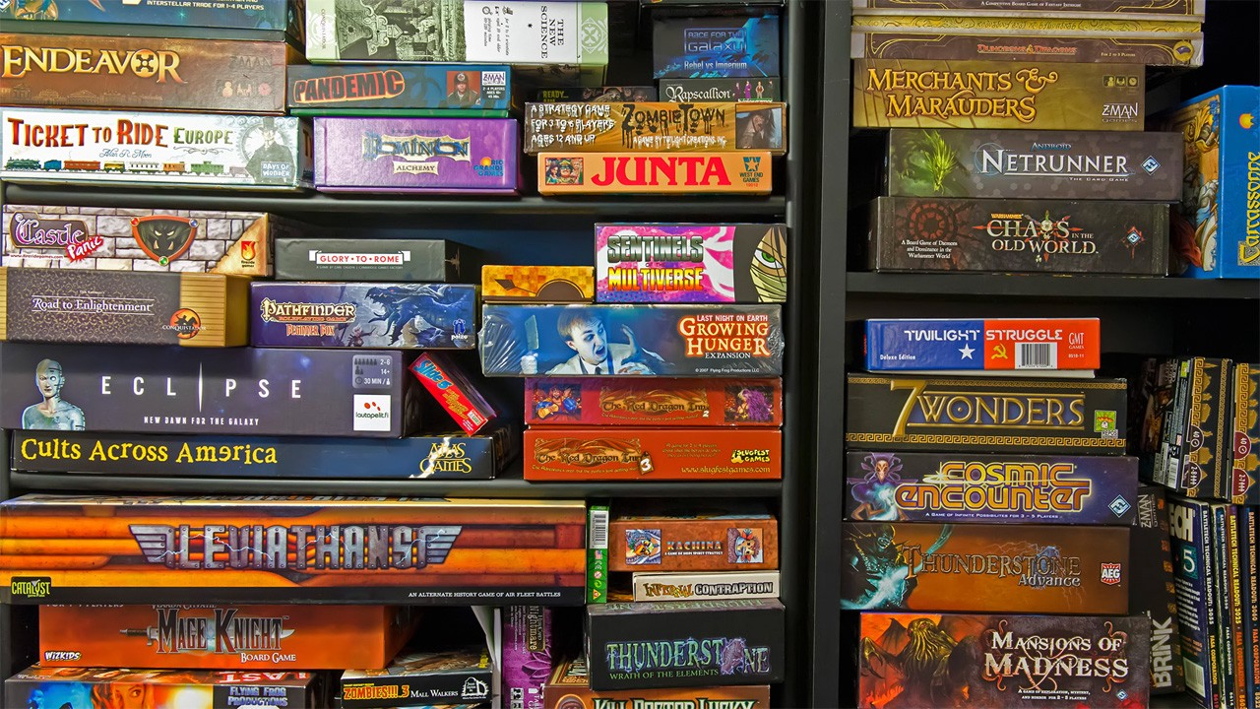
Predicting Tabletop Game Success
Brooke Ann Coco
Notes:
In spite of our steady march towards a digital singularity, tabletop games are thriving.
In 2017 alone, more than 5,000 board games were introduced into the U.S. market.
Given the growing success of tabletop games within recent years, my goal is to use a linear regression model to predict the success of tabletop games as measured by rating.
This project would be of particular interest to tabletop game designers and publishers alike, who can use this information to produce games that are optimized towards consumer desires.

Slide 2
Methodology
Scraping
BeautifulSoup4
Selenium
Cleaning/
Engineering
Pandas
Modeling
Staysmodels
Scikit-learn
Visualizations
Seaborn
Matplotlib
Numpy

Slide 3

Data
boardgamegeek.com
> 8,000 observations scraped
Notes:
Data scraped from boardgamegeek.com
Comprehensive games database as well as a popular online forum for tabletop game enthusiasts
Database contains information on over 81,000 tabletop games
Videos, images, playtime, number of players, list price, community reviews, ratings
Scraped 8,000

Slide 4
Metrics
Target
Ratings
Features
Years Since Release
Minimum Players Needed
Maximum Players Needed
Minimum Playtime
Maximum Playtime
Complexity
Genre
Price
Number of Awards Received
Notes:
Average rating of game as scored from 0.0 (awful) – 10.0 (outstanding)
(based on BGG community ratings of difficulty)
Subjective measure that may vary from source to source
Best option in an industry that does not publish sales data

Slide 5
Metrics
Target
Ratings
Features
Years Since Release
Minimum Players Needed
Maximum Players Needed
Minimum Playtime
Maximum Playtime
Complexity
Genre
Price
Number of Awards Received
Notes:
Scrape year of release to obtain years since the game has been released

Slide 6
Metrics
Target
Ratings
Features
Years Since Release
Minimum Players Needed
Maximum Players Needed
Minimum Playtime
Maximum Playtime
Complexity
Genre
Price
Number of Awards Received
Notes:
Scrape the minimum number and maximum number of people required to play
Difference between maximum number of players and minimum number of players ?

Slide 7
Metrics
Target
Ratings
Features
Years Since Release
Minimum Players Needed
Maximum Players Needed
Minimum Playtime
Maximum Playtime
Complexity
Genre
Price
Number of Awards Received
Notes:
Minimum and maximum length of time to complete game
Difference between maximum number of players and minimum number of players
Difference between maximum playtime and minimum playtime

Slide 8
Metrics
Target
Ratings
Features
Years Since Release
Minimum Players Needed
Maximum Players Needed
Minimum Playtime
Maximum Playtime
Complexity
Genre
Price
Number of Awards Received
Notes:
Difficulty of game as scored from 0.00 (easiest) – 5.00 (most difficult)
Metrics based on BGG community ratings of difficulty

Slide 9
Metrics
Target
Ratings
Features
Years Since Release
Minimum Players Needed
Maximum Players Needed
Minimum Playtime
Maximum Playtime
Complexity
Genre
Price
Number of Awards Received
Notes:
Subdomains:
Strategy
Children’s
Family
War
Abstract
Party
Thematic
Customizable

Slide 10
Methodology
Scraping
BeautifulSoup4
Selenium
Cleaning
Pandas
Modeling
Statsmodels
Scikit-learn
Visualizations
Seaborn
Matplotlib
Numpy
Notes:
Iterative Process:
Look at data
Filter relevant data
Filtered number of ratings
Chose not to include list price as
Account for outliers

Slide 11
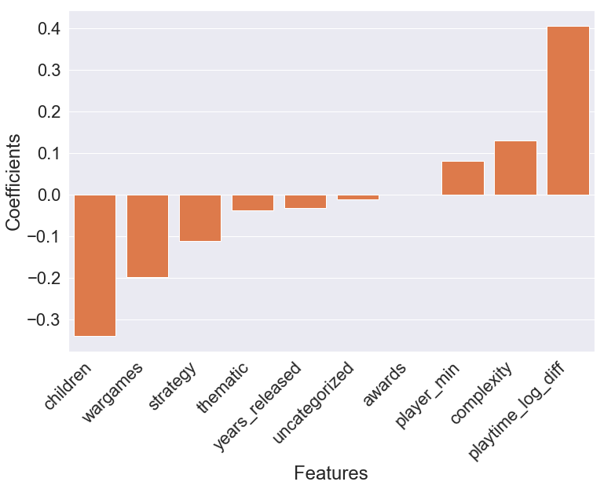
Results
R² = 0.5660
Notes:
MVP r-squared was 0.412, but got it up an R-squared value of _______.
Not bad given proxy for success and complexity

Slide 12
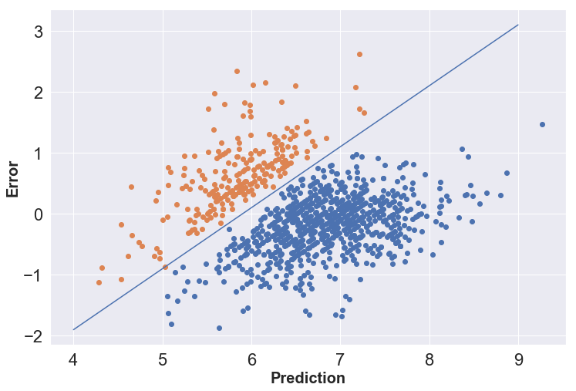
Analysis
Notes:
Residual plot

Slide 13



Future Work
Scrape
Scrape more data
Add
Add new features
Explore
Further explore data transformations
Notes:
Scrape more data
Country of origin
Order of release
Type of game
List price
Add new features
Explore further transformations

