Slide 1


Divide and Conquer
Slides by Dr. Steinberg

Slide 2
Introduction
In CS1, you have learned a variety of techniques of solving problems
Brute Force (simple, but poor approach in terms of running time complexity)
Divide and Conquer
In CS1, you got a simple background of divide and conquer
Mergesort
Quicksort
Binary Search
All of these problems all involve of some data structure that stores a value and the idea is to break that data structure into smaller subproblems
Our goal in this lesson is to observe other divide and conquer problems that may not be as intuitive in sort/search problems.

Slide 3
Divide & Conquer
A popular technique that used for general algorithm design
Divide & Conquer Plan
A problem is divided into several subproblems of the same type, ideally about size.
The subproblems are solved (typically recursively, through sometimes a different algorithm is employed, especially when subproblems become small enough)
If necessary, the solutions to the subproblems are combined to get a solution to the original problem.
Base Case: When the size of the problem is small enough, solve using Brute Force

Slide 4
Problem of size n
subproblem 1 of size n/2
subproblem 2 of size n/2
solution to subproblem 1
solution to subproblem 2
solution to the original problem

Slide 5
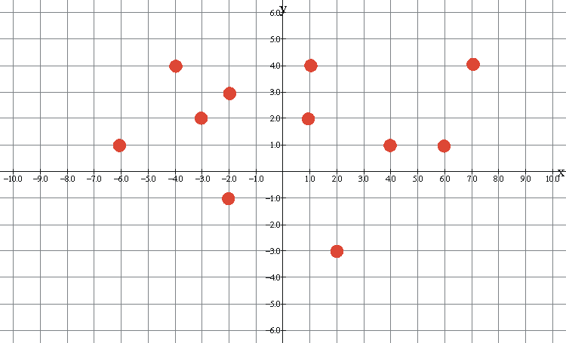

Closest Pair of Points
Problem Definition: Given $n$ points in the 2D plane, find the pair that is closest together.
Notes:
In the case of simplicity lets assume the coordinates integers
We also going to go with the assumption that my points are unique – no duplicate

Slide 6
Closest Pair of Points
IMMEDIATELY IN YOUR HEAD, YOU PROBABLY HAVE A SOLUTION THAT IS CONSIDERED A BRUTE FORCE APPROACH!!!
Problem Definition: Given $n$ points in the 2D plane, find the pair that is closest together.

Slide 7
Closest Pair of Points
COMPUTE EACH PAIR OF POINTS AND GRAB THE MINIMUM! WHAT IS THE RUNNING TIME?
Problem Definition: Given $n$ points in the 2D plane, find the pair that is closest together.
Notes:
Quadratic O(n^2)

Slide 8
Basic History of the Problem
M.I. Shamos and D. Hoey in the early 1970s considered this problem as part of a project to work on efficient algorithms for basic geometry problems.
Computational Geometry
They both wondered if an algorithm of such exists and its asymptotic notation is faster than the quadratic version.

Slide 9
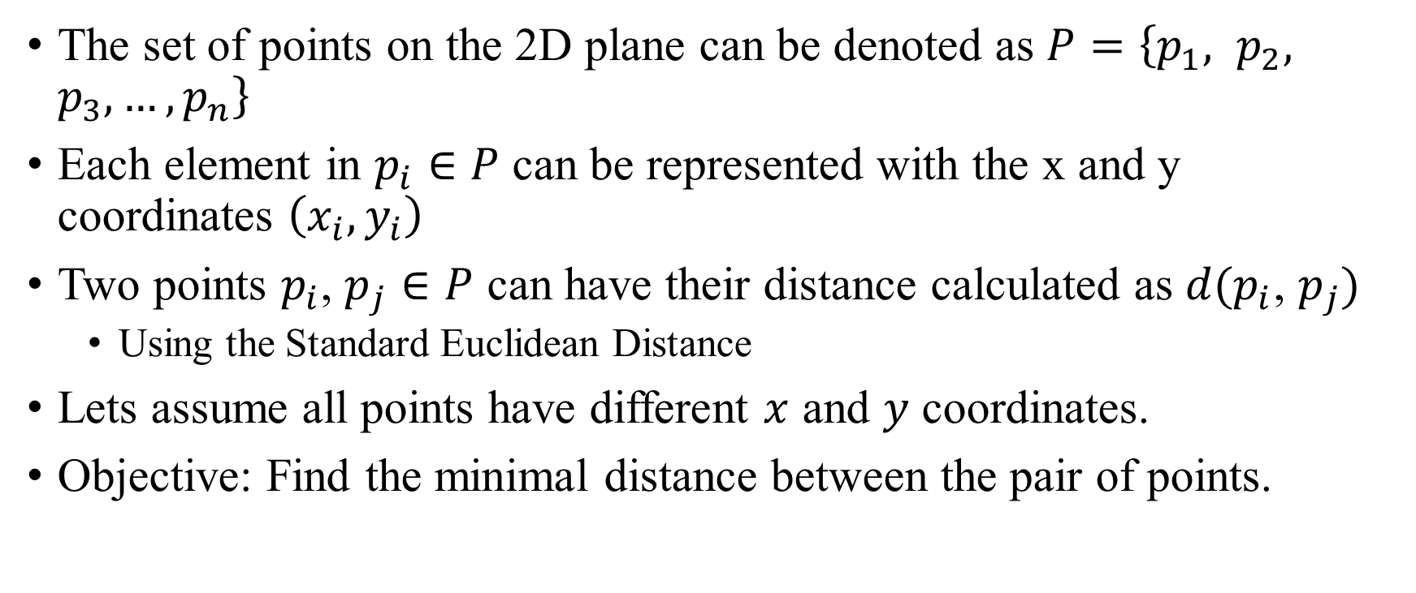
Notations of the Problem
The set of points on the 2D plane can be denoted as $P=\left\{p_{1}, p_{2}, p_{3},…,p_{n}\right\}$
Each element in $p_{i}∈P$ can be represented with the x and y coordinates $\left(x_{i}, y_{i}\right)$
Two points $p_{i}$, $p_{j}∈P$ can have their distance calculated as $d(p_{i}\text{, }p_{j})$
Using the Standard Euclidean Distance
Lets assume all points have different $x$ and $y$ coordinates.
Objective: Find the minimal distance between the pair of points.

Slide 10
Closest Pair of Points
We are given a bunch points on a 2D plane with different x and y coordinates.

Slide 11

Closest Pair of Points
We are given a bunch points on a 2D plane with different x and y coordinates.
We can sort all the points by one of the coordinates (x or y) and see if any of the coordinates are close to each other.
We can use a $O(nlogn)$sorting algorithm!!

Slide 12
Closest Pair of Points
We are given a bunch points on a 2D plane with different x and y coordinates.
We can sort all the points by one of the coordinates (x or y) and see if any of the coordinates are close to each other.
We can use a $O(nlogn)$sorting algorithm!!

Slide 13
Closest Pair of Points
Instead we could use a divide and conquer approach like in Mergesort.
Find the closest pair on the left side and closest pair on the right side.

Slide 14
Closest Pair of Points
Instead we could use a divide and conquer approach like in Mergesort.
Find the closest pair on the left side and closest pair on the right side.

Slide 15


Closest Pair of Points
Instead we could use a divide and conquer approach like in Mergesort.
Find the closest pair on the left side and closest pair on the right side.
$$Q$$
Line L
$$R$$
Notes:
Divide the problem in half
DIVIDE STEP!
We pick the median of the points and divide by halves
NOTE: If we don’t sort, we can get overlapping planes!

Slide 16

Closest Pair of Points
Instead we could use a divide and conquer approach like in Mergesort.
Find the closest pair on the left side and closest pair on the right side.
$$Q$$
Line L
$$R$$
$$δ$$
Notes:
After dividing the problem, we can CONQUER now by computing the distance on the left side and right side of line L.

Slide 17
Let’s go to the board

Slide 18
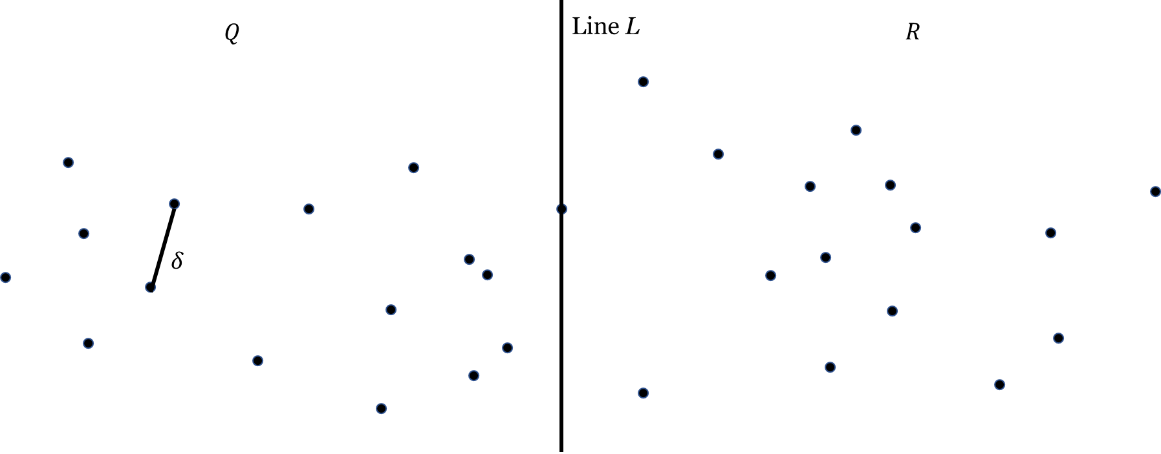
Setting Up The Recursion

Slide 19

Setting Up The Recursion
Let’s have two list
$P_{x}$ can be all points sorted by the x-coordinate
$P_{y}$ can be all points sorted by the y-coordinate

Slide 20
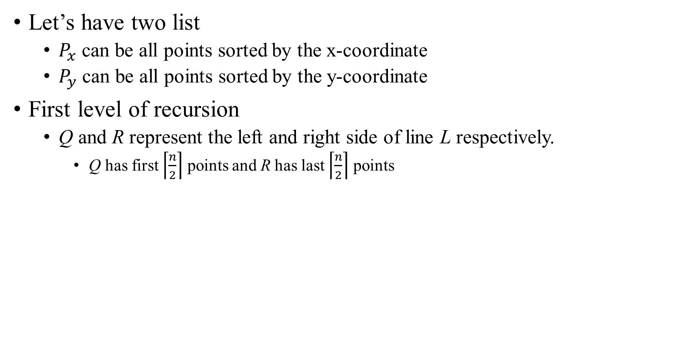
Setting Up The Recursion
Let’s have two list
$P_{x}$ can be all points sorted by the x-coordinate
$P_{y}$ can be all points sorted by the y-coordinate
First level of recursion
Q and R represent the left and right side of line L respectively.
Q has first $\left\lceil \frac{n}{2}\right\rceil$ points and R has last $\left\lceil \frac{n}{2}\right\rceil$ points

Slide 21
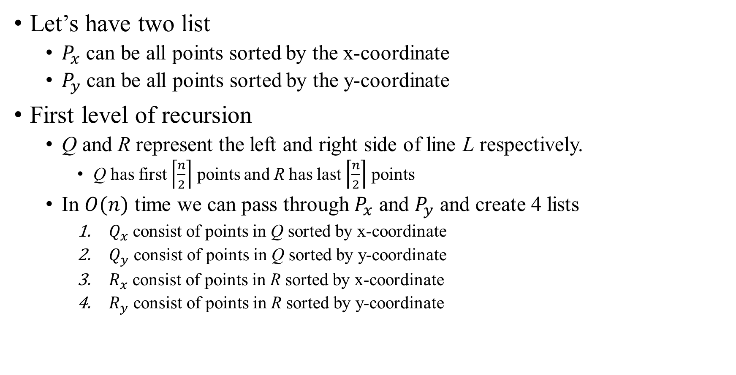
Setting Up The Recursion
Let’s have two list
$P_{x}$ can be all points sorted by the x-coordinate
$P_{y}$ can be all points sorted by the y-coordinate
First level of recursion
Q and R represent the left and right side of line L respectively.
Q has first $\left\lceil \frac{n}{2}\right\rceil$ points and R has last $\left\lceil \frac{n}{2}\right\rceil$ points
In $O(n)$ time we can pass through $P_{x}$ and $P_{y}$ and create 4 lists
$Q_{x}$ consist of points in Q sorted by x-coordinate
$Q_{y}$ consist of points in Q sorted by y-coordinate
$R_{x}$ consist of points in R sorted by x-coordinate
$R_{y}$ consist of points in R sorted by y-coordinate

Slide 22
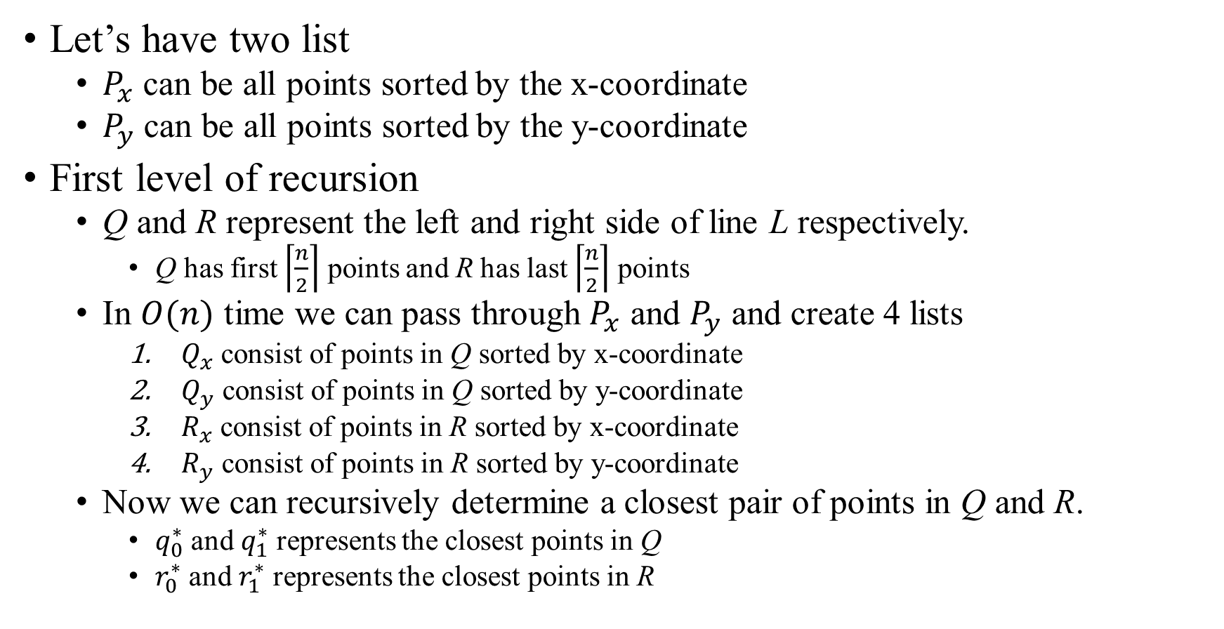
Setting Up The Recursion
Let’s have two list
$P_{x}$ can be all points sorted by the x-coordinate
$P_{y}$ can be all points sorted by the y-coordinate
First level of recursion
Q and R represent the left and right side of line L respectively.
Q has first $\left\lceil \frac{n}{2}\right\rceil$ points and R has last $\left\lceil \frac{n}{2}\right\rceil$ points
In $O(n)$ time we can pass through $P_{x}$ and $P_{y}$ and create 4 lists
$Q_{x}$ consist of points in Q sorted by x-coordinate
$Q_{y}$ consist of points in Q sorted by y-coordinate
$R_{x}$ consist of points in R sorted by x-coordinate
$R_{y}$ consist of points in R sorted by y-coordinate
Now we can recursively determine a closest pair of points in Q and R.
$q_{0}^{∗}$ and $q_{1}^{∗}$ represents the closest points in Q
$r_{0}^{∗}$ and $r_{1}^{∗}$ represents the closest points in R

Slide 23
Setting Up The Recursion
How many subproblems did our divide step create?
Let’s have two list
$P_{x}$ can be all points sorted by the x-coordinate
$P_{y}$ can be all points sorted by the y-coordinate
First level of recursion
Q and R represent the left and right side of line L respectively.
Q has first $\left\lceil \frac{n}{2}\right\rceil$ points and R has last $\left\lceil \frac{n}{2}\right\rceil$ points
In $O(n)$ time we can pass through $P_{x}$ and $P_{y}$ and create 4 lists
$Q_{x}$ consist of points in Q sorted by x-coordinate
$Q_{y}$ consist of points in Q sorted by y-coordinate
$R_{x}$ consist of points in R sorted by x-coordinate
$R_{y}$ consist of points in R sorted by y-coordinate
Now we can recursively determine a closest pair of points in Q and R.
$q_{0}^{∗}$ and $q_{1}^{∗}$ represents the closest points in Q
$r_{0}^{∗}$ and $r_{1}^{∗}$ represents the closest points in R
Notes:
2 (Q and R)

Slide 24
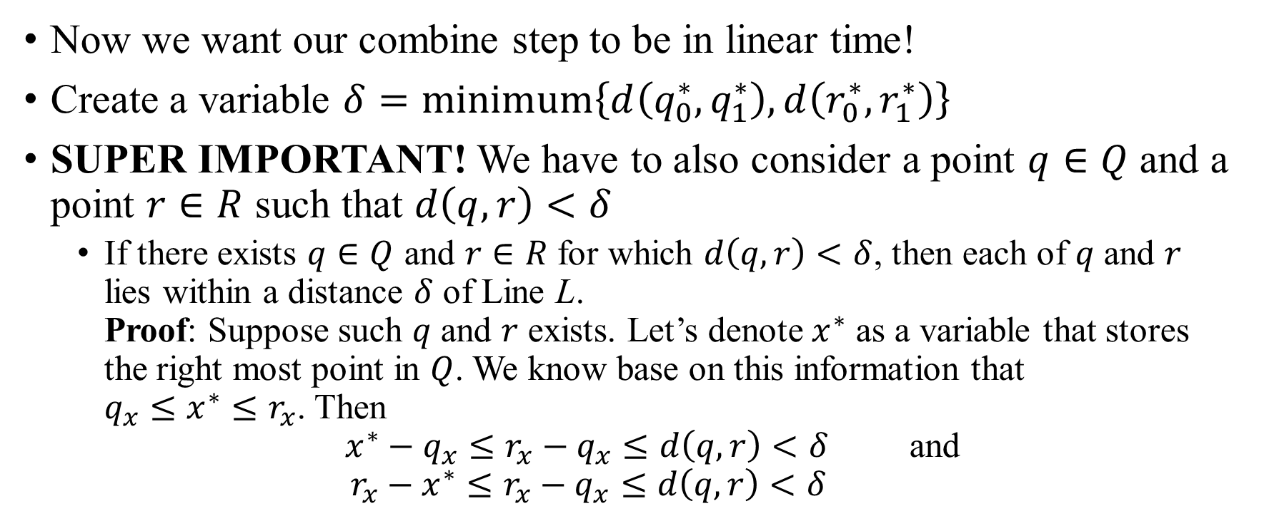
Combining the Solutions
Now we want our combine step to be in linear time!
Create a variable $δ=minimum\left\{d\left(q_{0}^{∗},q_{1}^{∗}\right), d\left(r_{0}^{∗},r_{1}^{∗}\right)\right\}$
SUPER IMPORTANT! We have to also consider a point $q∈Q$ and a point $r∈R$ such that $d\left(q,r\right)<δ$
If there exists $q∈Q$ and $r∈R$ for which $d\left(q,r\right)<δ$, then each of $q$ and $r$ lies within a distance $δ$ of Line L. Proof: Suppose such $q$ and $r$ exists. Let’s denote $x^{∗}$ as a variable that stores the right most point in $Q$. We know base on this information that $q_{x}≤x^{∗}≤r_{x}$. Then $x^{∗}−q_{x}≤r_{x}−q_{x}≤d\left(q,r\right)<δ$ and $r_{x}−x^{∗}≤r_{x}−q_{x}≤d\left(q,r\right)<δ$

Slide 25
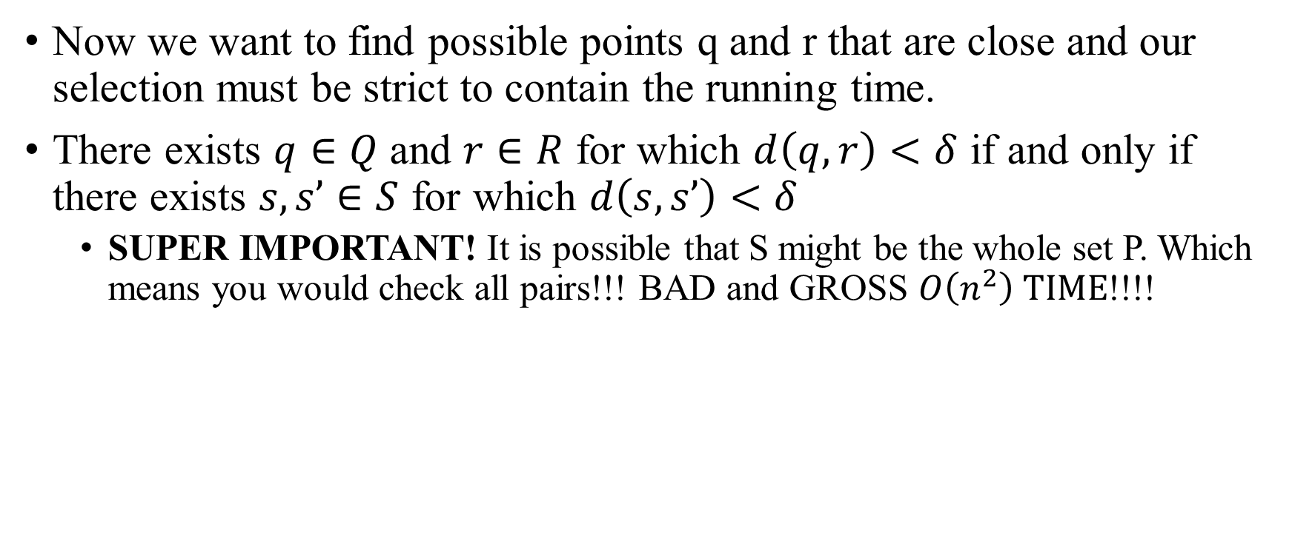
Combining the Solutions
Now we want to find possible points q and r that are close and our selection must be strict to contain the running time.
There exists $q∈Q$ and $r∈R$ for which $d\left(q,r\right)<δ$ if and only if there exists $s, s’∈S$ for which $d\left(s, s’\right)<δ$
SUPER IMPORTANT! It is possible that S might be the whole set P. Which means you would check all pairs!!! BAD and GROSS $O\left(n^{2}\right) TIME$!!!!

Slide 26
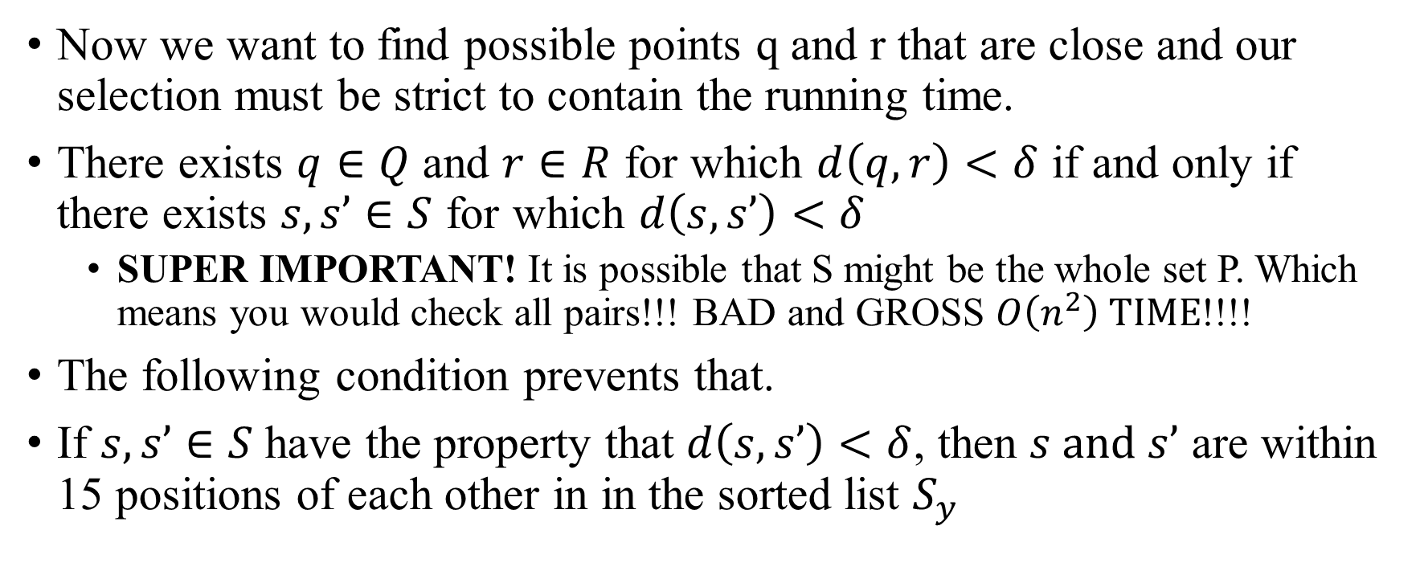
Combining the Solutions
Now we want to find possible points q and r that are close and our selection must be strict to contain the running time.
There exists $q∈Q$ and $r∈R$ for which $d\left(q,r\right)<δ$ if and only if there exists $s, s’∈S$ for which $d\left(s, s’\right)<δ$
SUPER IMPORTANT! It is possible that S might be the whole set P. Which means you would check all pairs!!! BAD and GROSS $O\left(n^{2}\right) TIME$!!!!
The following condition prevents that.
If $s, s’∈S$ have the property that $d\left(s, s’\right)<δ$, then $s and s’$ are within 15 positions of each other in in the sorted list $S_{y}$

Slide 27

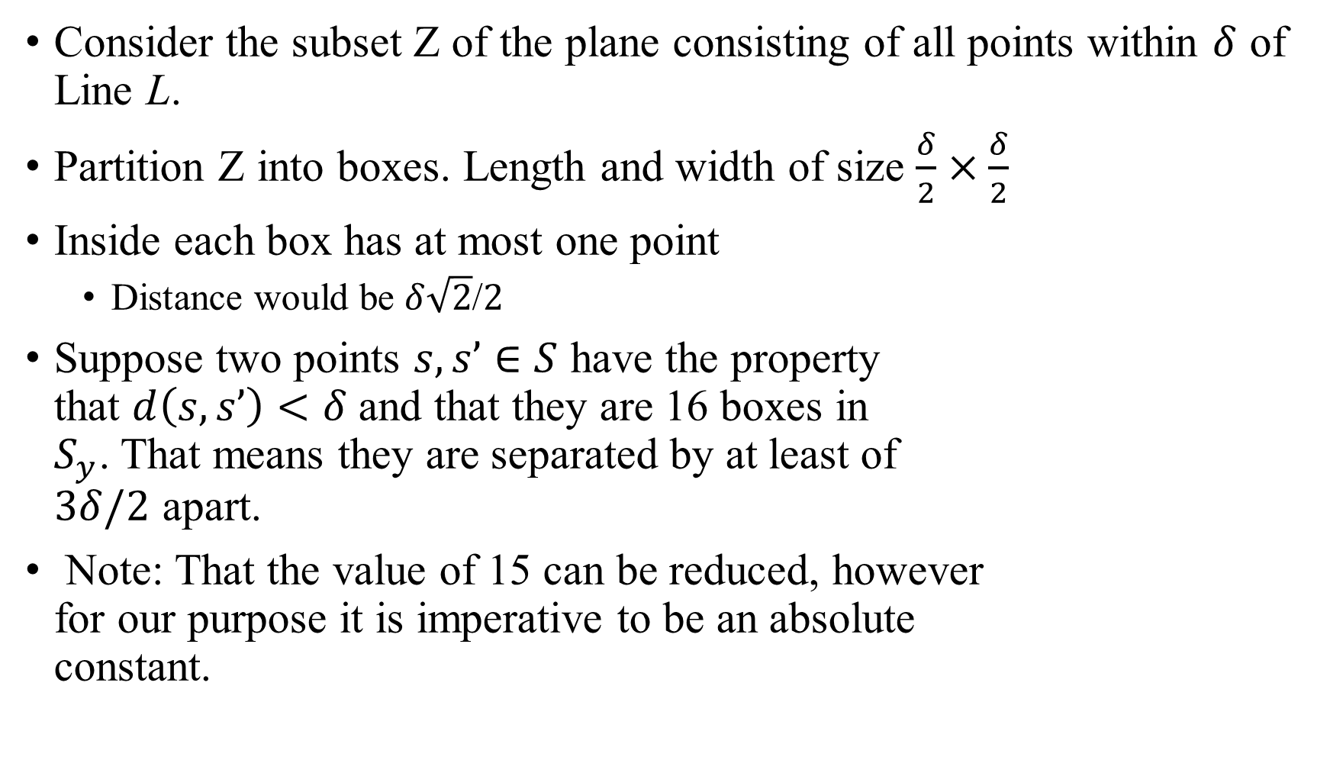



Proof of Last Statement
Consider the subset Z of the plane consisting of all points within $δ$ of Line L.
Partition Z into boxes. Length and width of size $\frac{δ}{2}×\frac{δ}{2}$
Inside each box has at most one point
Distance would be $δ\sqrt{2}$/$2$
Suppose two points $s, s’∈S$ have the property that $d\left(s, s’\right)<δ$ and that they are 16 boxes in $S_{y}$. That means they are separated by at least of $3δ/2$ apart.
Note: That the value of 15 can be reduced, however for our purpose it is imperative to be an absolute constant.
$δ$/$2$
Line L
$δ$/$2$
$δ\sqrt{2}$/$2$
$$δ$$

Slide 28
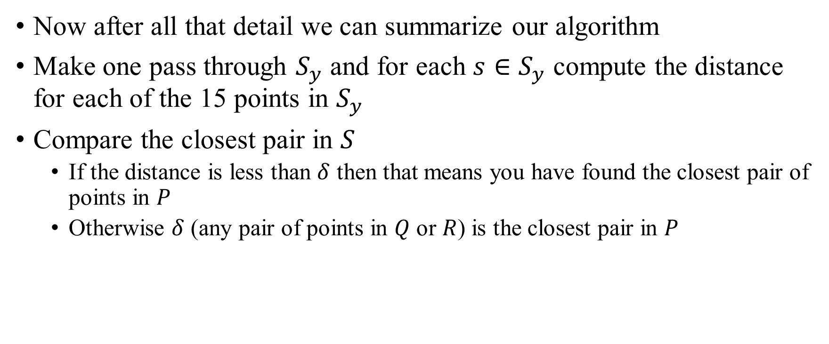
Combining the Solutions
Now after all that detail we can summarize our algorithm
Make one pass through $S_{y}$ and for each $s∈S_{y}$ compute the distance for each of the 15 points in $S_{y}$
Compare the closest pair in $S$
If the distance is less than $δ$ then that means you have found the closest pair of points in $P$
Otherwise $δ$ (any pair of points in $Q$ or $R$) is the closest pair in $P$

Slide 29
Combining the Solutions
This whole combine step takes O(n) time!!!
Now after all that detail we can summarize our algorithm
Make one pass through $S_{y}$ and for each $s∈S_{y}$ compute the distance for each of the 15 points in $S_{y}$
Compare the closest pair in $S$
If the distance is less than $δ$ then that means you have found the closest pair of points in $P$
Otherwise $δ$ (any pair of points in $Q$ or $R$) is the closest pair in $P$

Slide 30
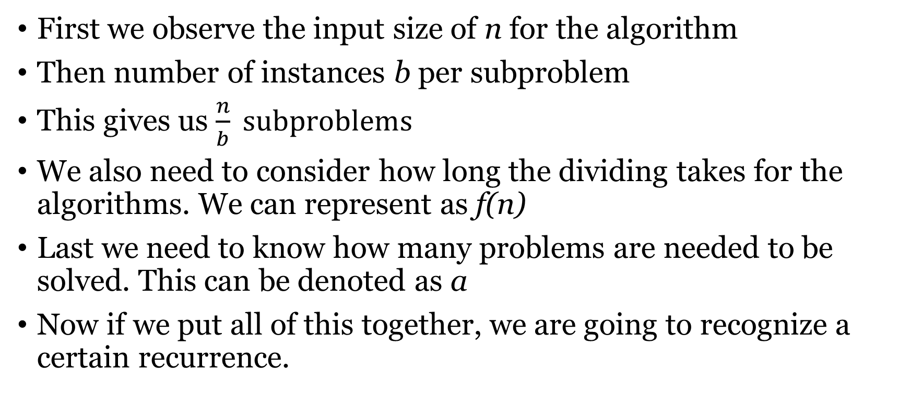
How could we represent a divide and conquer using a recurrence?
First we observe the input size of n for the algorithm
Then number of instances b per subproblem
This gives us $\frac{n}{b} subproblems$
We also need to consider how long the dividing takes for the algorithms. We can represent as f(n)
Last we need to know how many problems are needed to be solved. This can be denoted as a
Now if we put all of this together, we are going to recognize a certain recurrence.

Slide 31

The General Divide-and-Conquer
$$T\left(n\right)=aT\left(\frac{n}{b}\right)+f\left(n\right)$$

Slide 32
Running Time Analysis of The Problem
How many subproblems are being created?

Slide 33
Running Time Analysis of The Problem
How many subproblems are being created?
2

Slide 34
Running Time Analysis of The Problem
How many subproblems are being created?
2
How are the inputs size being divided?

Slide 35
Running Time Analysis of The Problem
How many subproblems are being created?
2
How are the inputs size being divided?
n/2

Slide 36
Running Time Analysis of The Problem
How many subproblems are being created?
2
How are the inputs size being divided?
n/2
How long is the combine step?

Slide 37
Running Time Analysis of The Problem
How many subproblems are being created?
2
How are the inputs size being divided?
n/2
How long is the combine step?
n

Slide 38
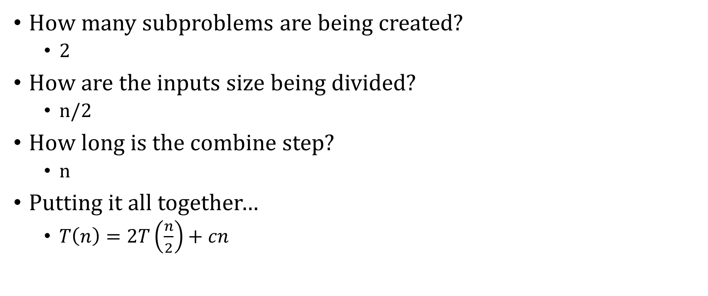
Running Time Analysis of The Problem
How many subproblems are being created?
2
How are the inputs size being divided?
n/2
How long is the combine step?
n
Putting it all together…
$T\left(n\right)=2T\left(\frac{n}{2}\right)+cn$

Slide 39
Running Time Analysis of The Problem
OMG! THAT RECURRENCE CAN BE SOLVED WITH THE AWESOME MASTER THEOREM!!
How many subproblems are being created?
2
How are the inputs size being divided?
n/2
How long is the combine step?
n
Putting it all together…
$T\left(n\right)=2T\left(\frac{n}{2}\right)+cn$

Slide 40

Running Time Analysis of The Problem
It is Case 2 of Master Theorem! Which means T(n)=$Θ(nlgn)$
How many subproblems are being created?
2
How are the inputs size being divided?
n/2
How long is the combine step?
n
Putting it all together…
$T\left(n\right)=2T\left(\frac{n}{2}\right)+cn$

