Slide 1

Case Study: Data Parallelization Using Pytorch
BY: Brian Rodriguez

Slide 2
Training Across multiple GPUs
Used data parallelization constructs in the Pytorch framework
Almost Seamless training with GPUs
Minor code modifications to enable GPU training

Slide 3
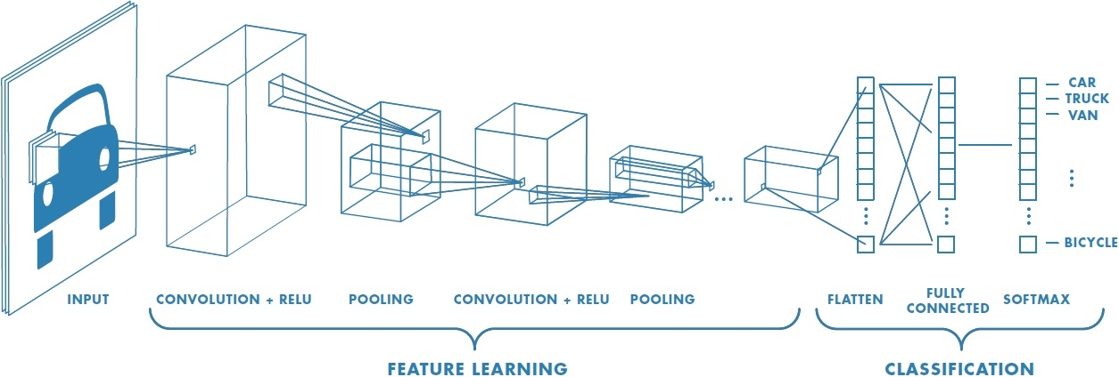
Neural Network
Implemented VGG19
VGG19 contains 19 Convolutional Layers composed with ReLU activation functions
Size of Network in memory about 18 GBs

Slide 4
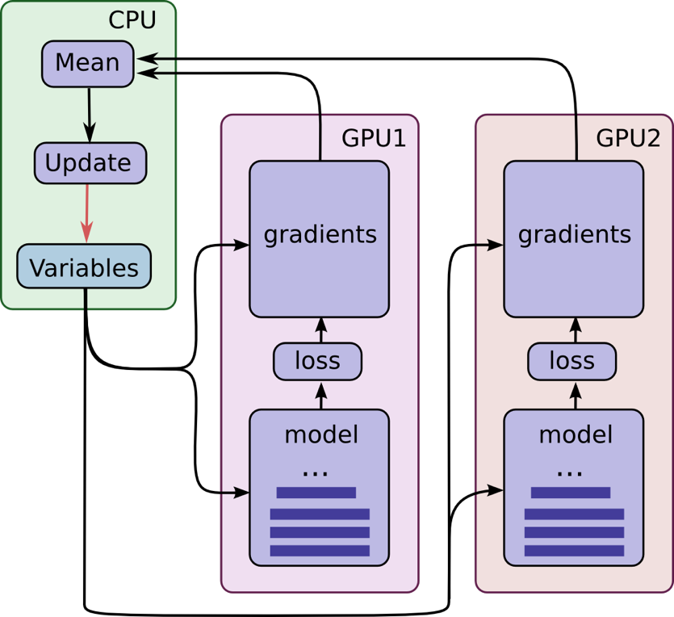
Set Backs During Development
Multi GPU training is cumbersome
Training across Two GPUs is slower than One
Training across Three GPUs is close to impossible without using a 3rd party wrapper
Data Imbalance when distributing across multiple GPUs

