Slide 1
Keyguardian
A cybersecurity tool using
C++ & Python

Slide 2

Raj Kumar Goel Institute of Technology Ghaziabad
5th KM. STONE, DELHI-MEERUT ROAD, GHAZIABAD (U.P)-201003.
Department of Computer Science Engineering & Engineering
Final Year Project Approval Presentation
on KeyGuardian
(A cybersecurity tool using C++ & Python)
Sr. No. | Student Name | Roll No. | Under the Guidance of
1 | Surya Pratap Singh Chauhan | 2000330100232 | 1. Mr. Sanjay Srivastav (Coordinator)
 |  |  | 2. Mr. Mandeep Singh
 |  |  | 3. Ms. Palak
 |  |  | 4. Mr. Lakshay

Slide 3
contents
Introduction
Objective
Methodology
Requirement Specification and Analysis
Data Flow Diagram
Software Features
Project Snapshots
Limitations
Future Scope
Conclusions
References

Slide 4
The Power of
Encryption

Slide 5

enhancing
Confidentiality
&
Integrity

Slide 6
confidentiality
Definition: Ensures that sensitive information is accessed only by authorized individuals, preventing unauthorized disclosure.
Techniques: Common methods include encryption, access control lists, and secure communication channels.
Importance: Protects personal data, trade secrets, and other sensitive information from cyber threats and unauthorized access.
Applications: Used in industries like healthcare, finance, and government to protect data such as medical records, financial information, and classified documents.

Slide 7
Integrity
Definition: Ensures that information remains accurate, complete, and unaltered during storage and transmission.
Techniques: Implemented using hashing algorithms, digital signatures, and checksums to detect and prevent unauthorized modifications.
Importance: Maintains the trustworthiness of data, ensuring that decisions are based on accurate and reliable information.
Applications: Critical in sectors such as banking, e-commerce, and data storage, where data accuracy and reliability are paramount.

Slide 8
Introduction
KeyGuardian is a cybersecurity tool designed to enhance data security through various encryption techniques and file management capabilities. Originally developed in C++, it has been transitioned to Python for enhanced community support, improved functionality and ease of use.

Slide 9
Objectives
To develop a one-stop tool for identifying type of hash.
To create hashes of the 20 most famous hashing algorithms.
To develop a reliable and efficient tool for encrypting files and folders.
To ensure data security through advanced encryption methods.
To provide a user-friendly command line interface for easy operation.
To support additional functionalities like steganography and API integration.

Slide 10
Methodology
Research on various encryption and security algorithms.
Design and implementation of the tool using Python.
Testing the tool for various use cases and security scenarios.
Iterative development based on user feedback and testing results.

Slide 11
Requirement Specification and Analysis
Hardware:
Standard computer with Python environment setup.
Software:
Python 3, Cryptography libraries, Command-line interface.
Functional Requirements:
File encryption, decryption, steganography, user authentication.
Non-functional Requirements:
Security, performance, usability, scalability.

Slide 12
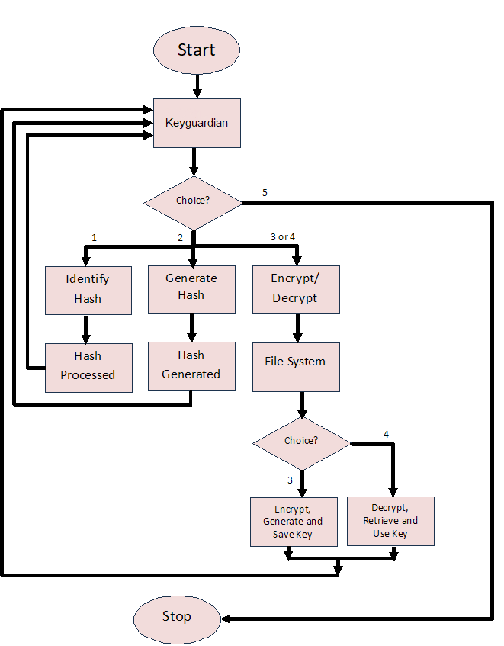
Data flow diagram

Slide 13
Software features
Key Management: Automatically manage cryptographic keys with a default key folder, simplifying the key handling process for users.
User-Friendly Command-Line Interface: Provide a comprehensive and intuitive command-line interface to facilitate easy interaction with KeyGuardian’s features.
Secure Storage Solutions: Offer options for secure, decentralized storage of encrypted data to protect against unauthorized access
Offline Functionality: Provide offline functionality to enable users to perform encryption and decryption tasks without an internet connection.
Community Integration: Facilitate a user community for sharing best practices, tips, and collaborative problem-solving.

Slide 14
Future scope
User Login and Authentication: Adding user login for multiple user control and authentication.
Enhanced Encryption Methods: Adding extra cryptographic methods to encrypt files and folders.
Steganography Support: Incorporating steganography for hiding information within files.
API Support: Adding API support for web linking and integration with other applications.

Slide 15
conclusions
KeyGuardian provides robust security solutions for file and data protection.
The transition to Python has enhanced the tool's functionality and usability.
Continuous development and user feedback will drive further improvements.
KeyGuardian has the potential to be a comprehensive tool for cybersecurity needs.

Slide 16
References
Dhruv Sharma, C. Fancy, (2022) "Cloud Storage Security using Firebase and Fernet Encryption," International Journal of Emerging Technologies (pp. 1-15).
El Gaabouri Ismail, Chahboun Asaad, and Raissouni Naoufal, (2020) "Fernet Symmetric Encryption method to gather MQTT E2E secure communications for IOT Devices,". ResearchGate (pp. 1-20).
Aryo P. Pinanditoa, Agi Putra Kharismab, Eriq Muhammad Adams Jonemarob, (2023) "Architectural Design of Representational State Transfer Application Programming Interface with Application-Level Base64-Encoding and Zlib Data Compression,". Journal of Information Technology and Computer Science (pp. 1-18).
Bharati A. Patil, Prajakta R. Toke, Sharyu S. Naiknavare, (2024) "Research on Various Cryptography Techniques," Computer Science & Engineering: An International Journal. (pp. 1-16).

Slide 17
THANK YOU
Surya Pratap Singh Chauhan
+91 9305738812
surya.pratap0038@gmail.com
https://brodante.github.io/portfolio/

